Slide 1
Chapter 10: Projectile and Satellite Motion

Slide 2
Topics
Projectile Motion
Fast-Moving Projectiles – Satellites
Circular Satellite Orbits
Elliptical Orbits
Kepler's Laws of Planetary Motion
Energy Conservation and Satellite Motion
Escape Speed

Slide 3
Projectile Motion
Without gravity, a tossed object follows a straight-line path.
With gravity, the same object tossed at an angle follows a curved path.
Projectile:
Any object that moves through the air or space under the influence of gravity, continuing in motion by its own inertia

Slide 4
Projectile Motion
Projectile motion is a combination of
a horizontal component …
… and a vertical component.

Slide 5
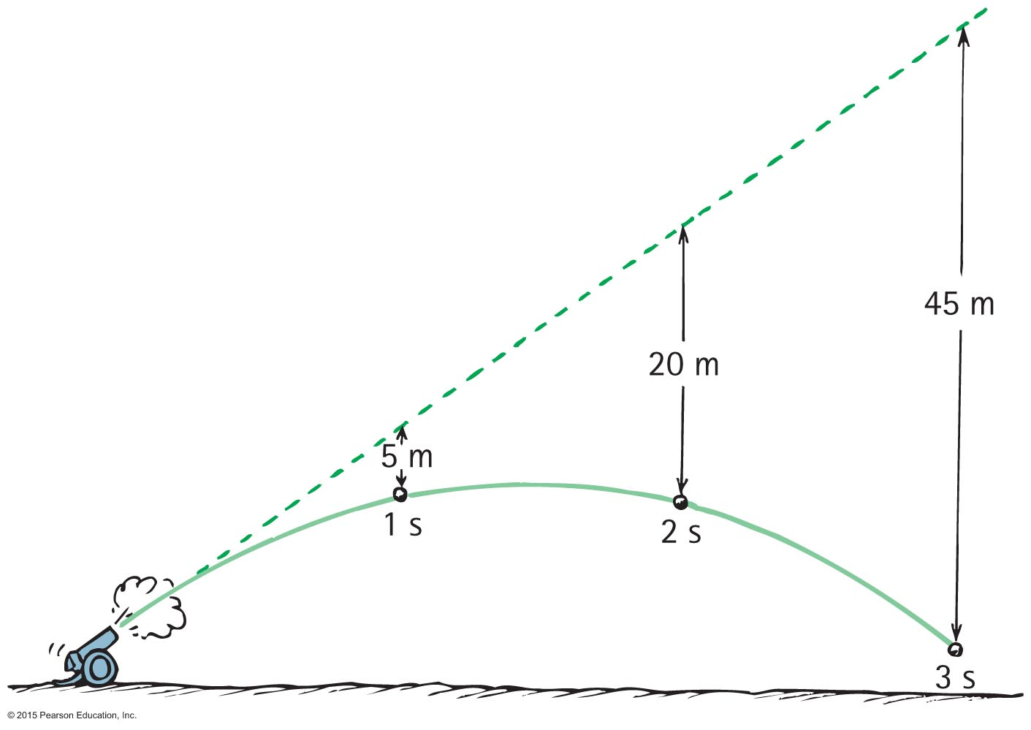
Projectile Motion
Projectiles launched horizontally
Important points:
Horizontal component of velocity doesn't change (when air drag is negligible).
travels the same horizontal distance in equal times (no horizontal force!).
1s
1s
1s

Slide 6
Projectile Motion
Vertical positions become farther apart with time.
Gravity acts downward, ball accelerates downward.
Vertical part same as for any falling object
Curvature of path is the combination of horizontal and vertical components of motion.

Slide 7
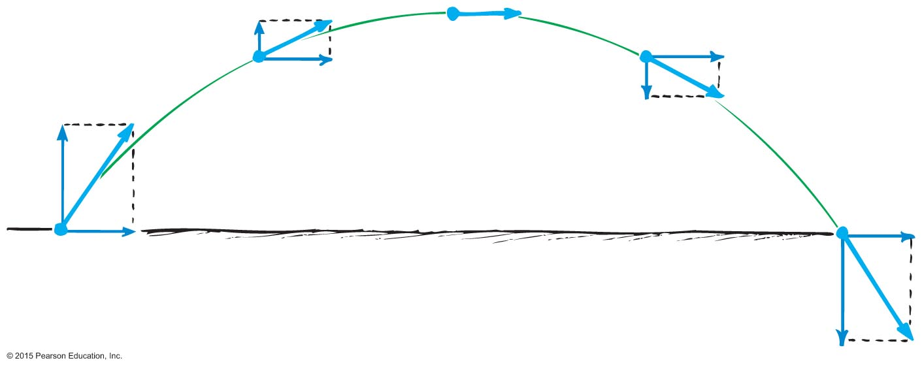
Projectile Motion
Parabola:
Path you get when acceleration is purely vertical
Horizontal speed is constant
Net velocity vector changes size & direction

Slide 8
Demos
https://www.wired.com/story/5-of-the-best-demos-of-projectile-motion-and-its-quirks/

Slide 9
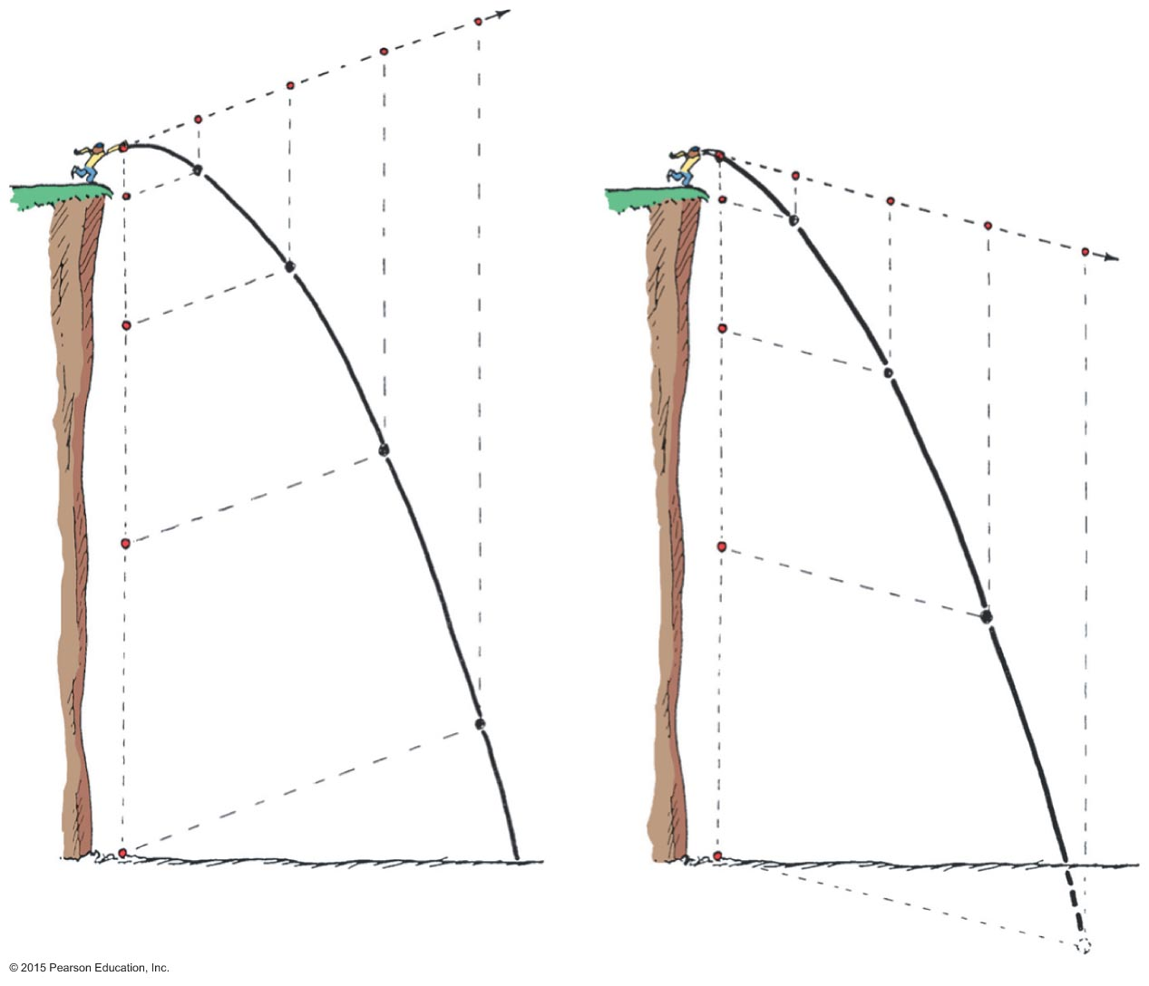
Projectile Motion
Projectiles launched at an angle:
Paths of stone thrown at an angle upward and downward
Vertical and horizontal components are independent of each other.
Horizontal speed same!

Slide 10
Projectile Motion
Paths of a cannonball shot at an upward angle
Vertical distance cannonball falls is the same vertical distance it would have fallen if it had been dropped from rest and been falling for the same amount of time (5t²).

Slide 11
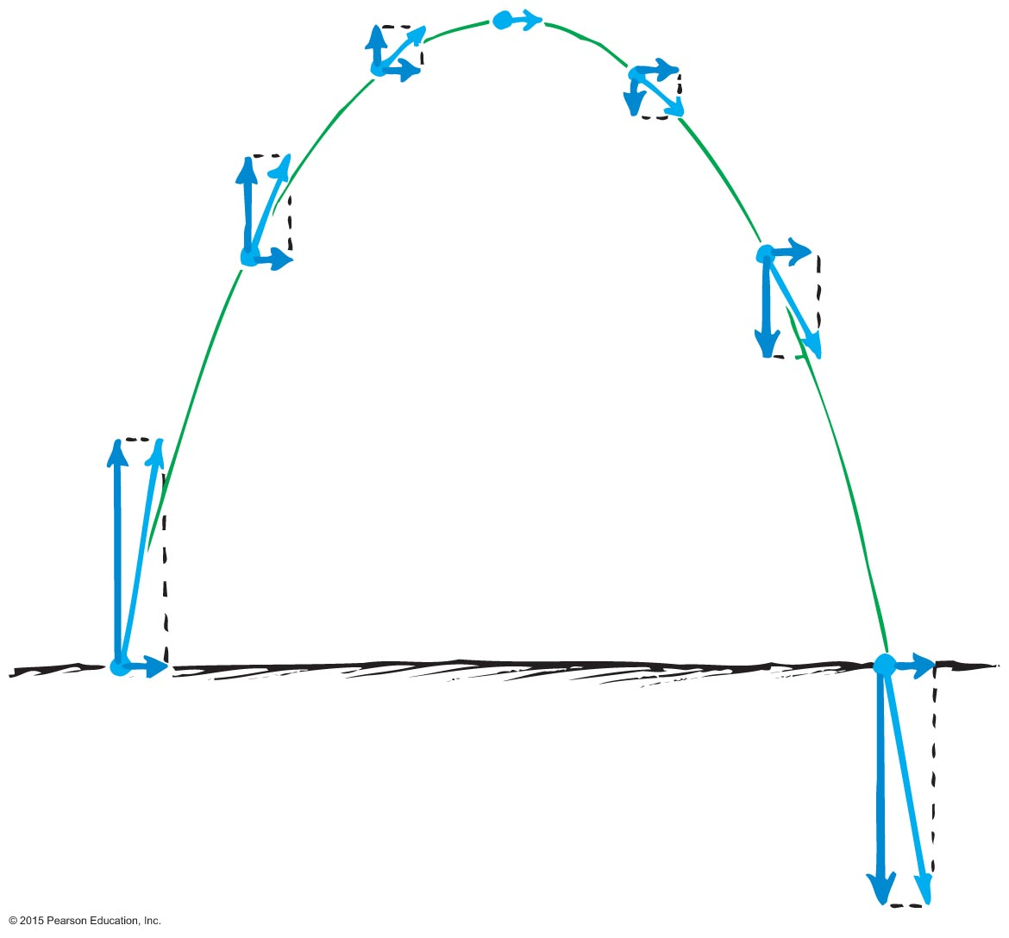
Projectile Motion
Paths of projectile following a parabolic trajectory
Horizontal component along trajectory remains unchanged.
Only vertical component changes.
Velocity at any point is computed with the Pythagorean theorem (diagonal of rectangle).
Angle of launch = angle as it hits ground

Slide 12
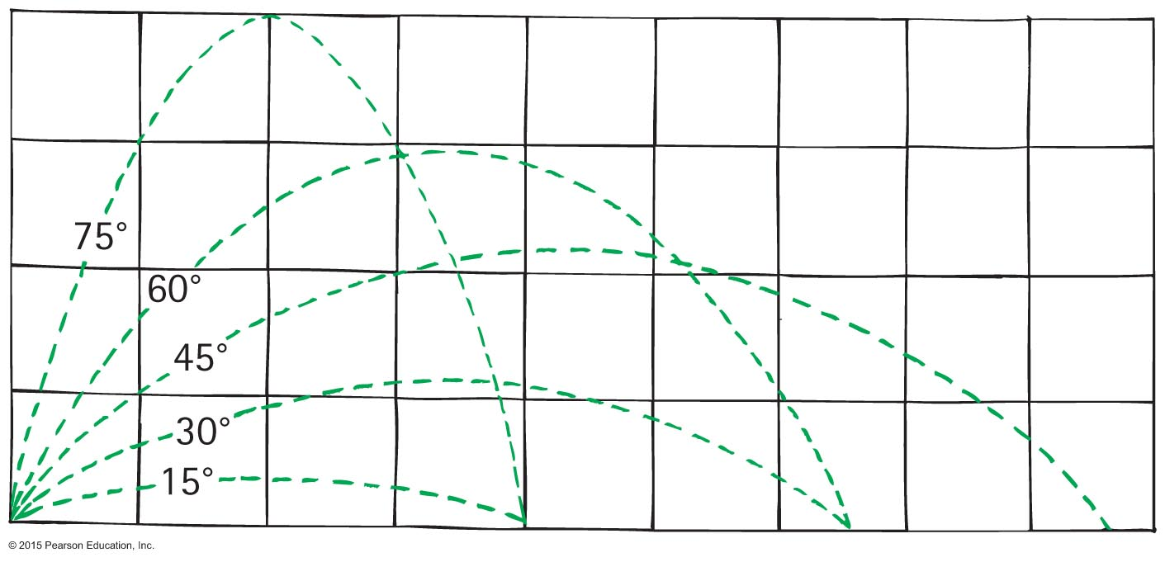
Projectile Motion
Different horizontal distances
Same range is obtained from two different launching angles when the angles add up to 90 °.
Object thrown at an angle of 60° has the same range as if it were thrown at an angle of 30 ° .
If you’ve played a sport with a ball you know this

Slide 13
Projectile Motion
Different horizontal distances
Maximum range occurs for ideal launch at 45 °
With air resistance, maximum range for a baseball is at a smaller angle, ~25 °−34 ° above horizontal
With air resistance, for a golf ball the optimal angle is less than 38 °

Slide 14
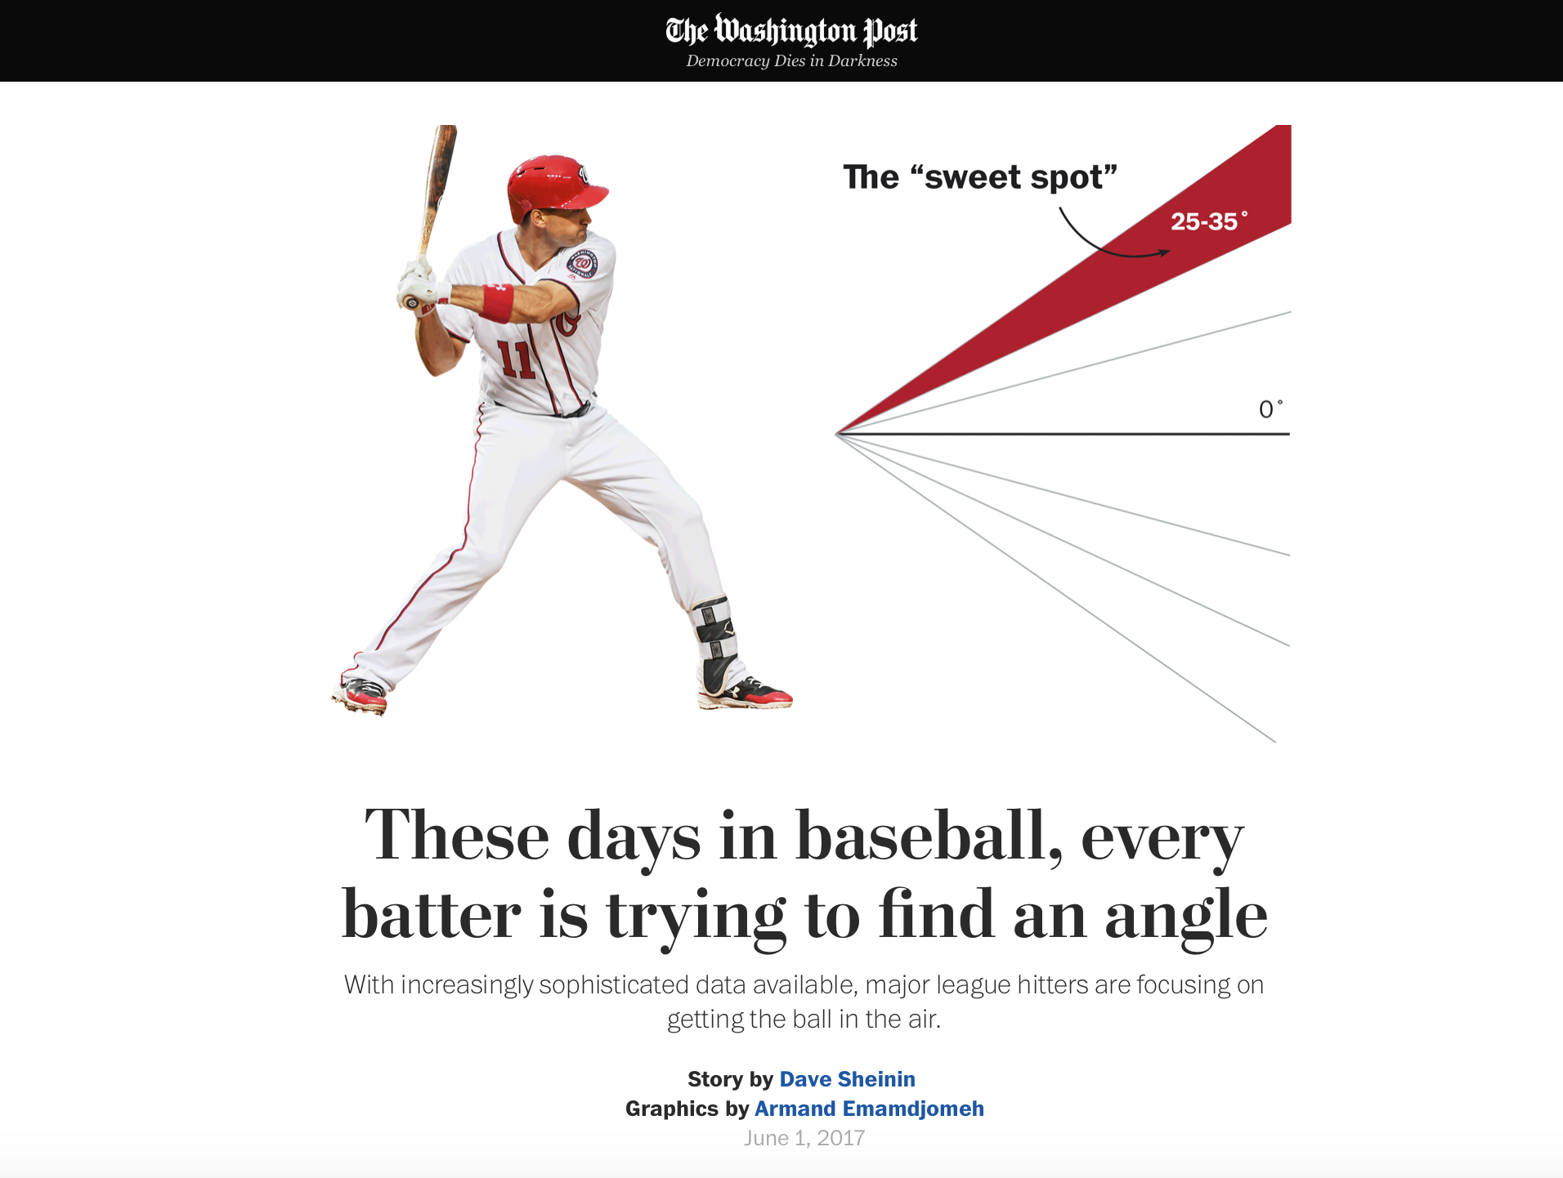
They should have asked us

Slide 15
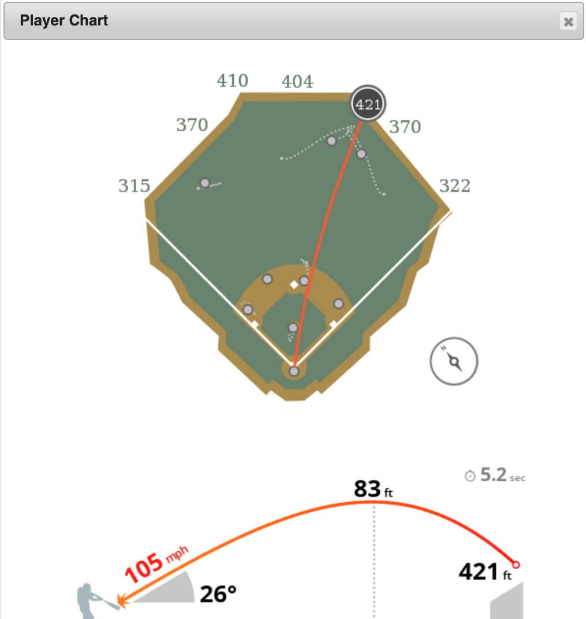
Astros-Rays ALDS gm4 8 Oct 2019
Three examples with good velocity & angle
There were faster hits, but not at good angles!
(park is asymmetric, location matters)
https://baseballsavant.mlb.com/
Baseball stats are extensive

Slide 16
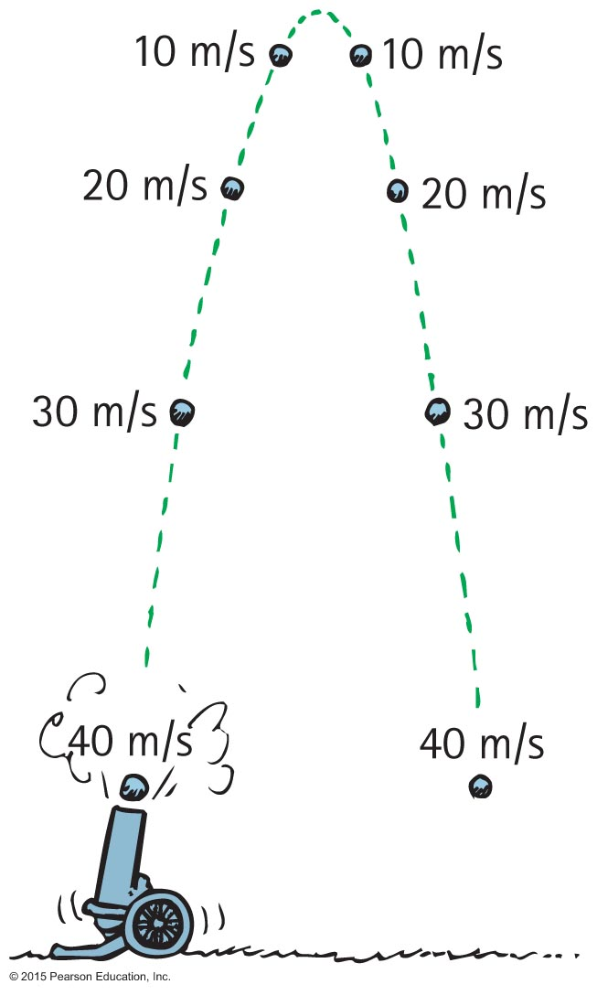
Projectile Motion
Without air resistance, the time for a projectile to reach maximum height is the same as the time for it to return to its initial level.
Hang time: just need to know max height

Slide 17
Projectile Motion CHECK YOUR NEIGHBOR
The velocity of a typical projectile can be represented by horizontal and vertical components. Assuming negligible air resistance, the horizontal component along the path of the projectile
increases.
decreases.
remains the same.
Not enough information.
Notes:
C. remains the same.

Slide 18
Projectile Motion CHECK YOUR ANSWER
The velocity of a typical projectile can be represented by horizontal and vertical components. Assuming negligible air resistance, the horizontal component along the path of the projectile
increases.
decreases.
remains the same.
Not enough information.
Explanation:
There is no force horizontally, thus no horizontal acceleration, so the horizontal component can’t change.
Notes:
C. remains the same.

Slide 19
Projectile Motion CHECK YOUR NEIGHBOR
When air resistance is negligible, a fast-moving baseball has acceleration that is
downward, g.
a combination of constant horizontal motion and accelerated downward motion.
opposite to the force of gravity.
centripetal.
Notes:
A. downward, g.

Slide 20
Projectile Motion CHECK YOUR ANSWER
When air resistance is negligible, a fast-moving baseball has acceleration that is
downward, g.
a combination of constant horizontal motion and accelerated downward motion.
opposite to the force of gravity.
centripetal.
Notes:
A. downward, g.

Slide 21
Projectile Motion CHECK YOUR NEIGHBOR
Neglecting air drag, a ball tossed at an angle of 30 ° with the horizontal will go as far downrange as one that is tossed at the same speed at an angle of
45 °.
60 °.
75 °.
None of the above.
Notes:
B. 60°.

Slide 22
Projectile Motion CHECK YOUR ANSWER
Neglecting air drag, a ball tossed at an angle of 30 ° with the horizontal will go as far downrange as one that is tossed at the same speed at an angle of
45°.
60 °.
75 °.
None of the above.
Explanation:
Same initial-speed projectiles have the same range when their launching angles add up to 90° . Why this is true involves a bit of trigonometry—which, in the interest of time, we'll not pursue here.
Notes:
B. 60°.

Slide 23
Fast-Moving Projectiles—Satellites
Satellite motion is an example of a high-speed projectile.
A satellite is simply a projectile that falls around Earth rather than into it.
Sufficient tangential velocity needed for orbit.
With no resistance to reduce speed, a satellite goes around Earth indefinitely.

Slide 24
Fast-Moving Projectiles—Satellites CHECK YOUR NEIGHBOR
As the ball leaves the girl's hand, 1 second later it will have fallen
10 meters.
5 meters below the dashed line.
less than 5 meters below the straight-line path.
None of the above.
Notes:
B. 5 meters below the dashed line.

Slide 25
Fast-Moving Projectiles—Satellites CHECK YOUR ANSWER
As the ball leaves the girl's hand, 1 second later it will have fallen
10 meters.
5 meters below the dashed line.
less than 5 meters below the straight-line path.
None of the above.
Comment:
Whatever the speed, the ball will fall a vertical distance of 5 meters below the dashed line: d = ½gt² = 5gt²
Notes:
B. 5 meters below the dashed line.

Slide 26
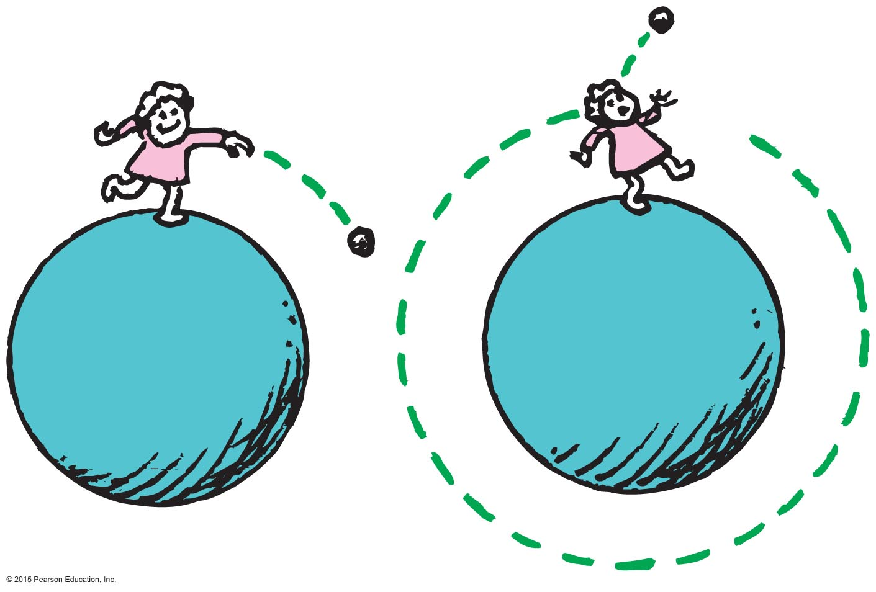
Circular Satellite Orbits
Satellite in circular orbit
Speed
must be great enough to ensure that its falling distance matches Earth's curvature.
is constant—only direction changes.
is unchanged by gravity.
“There is an art to flying, or rather a knack. The knack lies in learning how to throw yourself at the ground and miss. ... Clearly, it is this second part, the missing, that presents the difficulties.”
- Hitchhiker’s Guide to the Galaxy

Slide 27
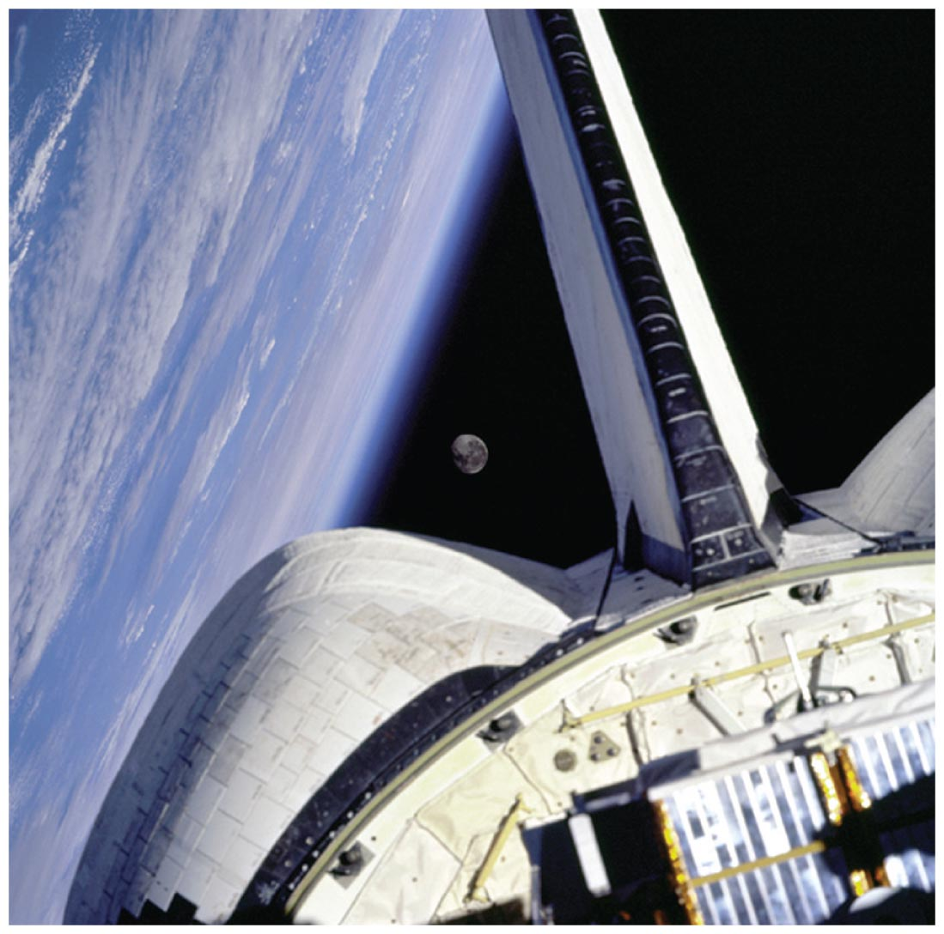
Circular Satellite Orbits
Positioning:
beyond Earth's atmosphere, where air resistance is almost totally absent
Example: Space shuttles were launched to altitudes of 150 kilometers or more, to be above air drag
Even the ISS experiences some air drag, which is compensated for with periodic upward boosts.

Slide 28
Circular Satellite Orbits
Motion
moves in a direction perpendicular to the force of gravity acting on it
Period for complete orbit about Earth
for satellites close to Earth—about 90 minutes
(Hubble telescope, 96 min)
for satellites at higher altitudes—longer periods
GPS / geosynchronous – 24 hours to match earth rotation

Slide 29
Circular Satellite Orbits
Curvature of Earth
Earth surface drops a vertical distance of 5 meters for every 8000 meters tangent to the surface
So you need to go 8000 meters in the time it takes to fall 5m!

Slide 30
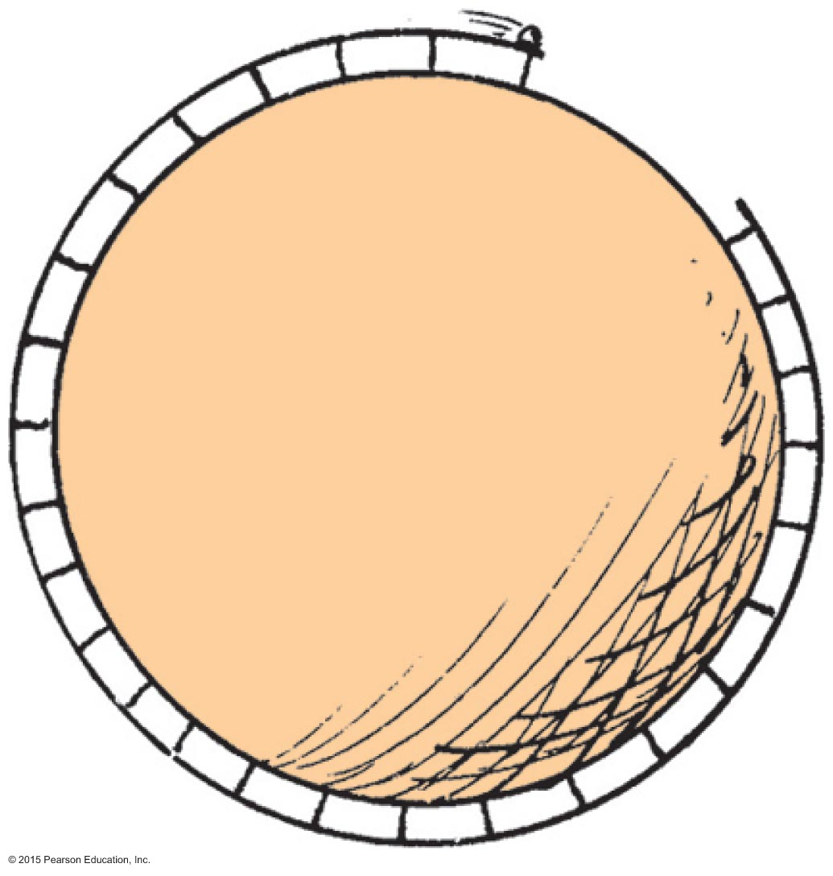
Circular Satellite Orbits
What speed will allow the ball to clear the gap?

Slide 31
Circular Satellite Orbits CHECK YOUR NEIGHBOR
When you toss a projectile sideways, it curves as it falls. It will be an Earth satellite if the curve it makes
matches the curved surface of Earth.
results in a straight line.
spirals out indefinitely.
None of the above.
Notes:
A. matches the curved surface of Planet Earth.

Slide 32
Circular Satellite Orbits CHECK YOUR ANSWER
When you toss a projectile sideways, it curves as it falls. It will be an Earth satellite if the curve it makes
matches the curved surface of Earth.
results in a straight line.
spirals out indefinitely.
None of the above.
Explanation:
For an 8-km tangent, Earth curves downward 5 m.
It takes 1sec to fall 5m (Δx = ½gt²=5t²)
Therefore, a projectile traveling horizontally at 8 km/s will fall 5 m in that time, and follow the curve of Earth.
Notes:
A. matches the curved surface of Planet Earth.

Slide 33
Circular Satellite Orbits CHECK YOUR NEIGHBOR
When a satellite travels at a constant speed, the shape of its path is
a circle.
an ellipse.
an oval that is almost elliptical.
a circle with a square corner, as seen throughout your book.
Notes:
A. a circle.

Slide 34
Circular Satellite Orbits CHECK YOUR ANSWER
When a satellite travels at a constant speed, the shape of its path is
a circle.
an ellipse.
an oval that is almost elliptical.
a circle with a square corner, as seen throughout your book.
Explanation:
Circular motion: constant speed, only direction changes
Changing curvature or radius requires changing speed
Notes:
A. a circle.

Slide 35
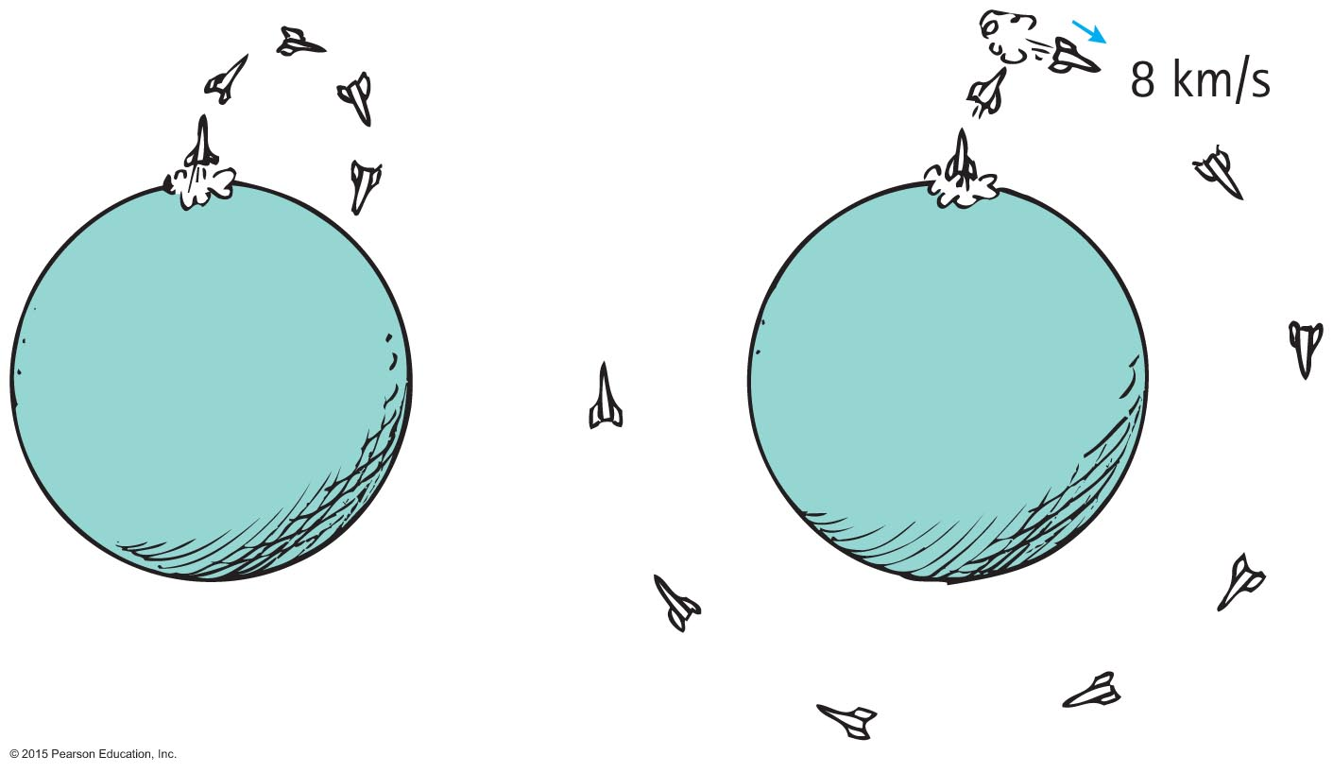
Circular Satellite Orbits
For satellites at relatively low altitude (ISS, Hubble)
A payload into orbit requires control over direction
Initially, rocket is fired vertically, then tipped.
(Variety of reasons, including who’s land you’re over.)
Once above the atmosphere, the rocket is aimed horizontally.
speed of rocket
Payload is given a final thrust to orbital speed of 8 km/s to fall around Earth and become an Earth satellite.

Slide 36
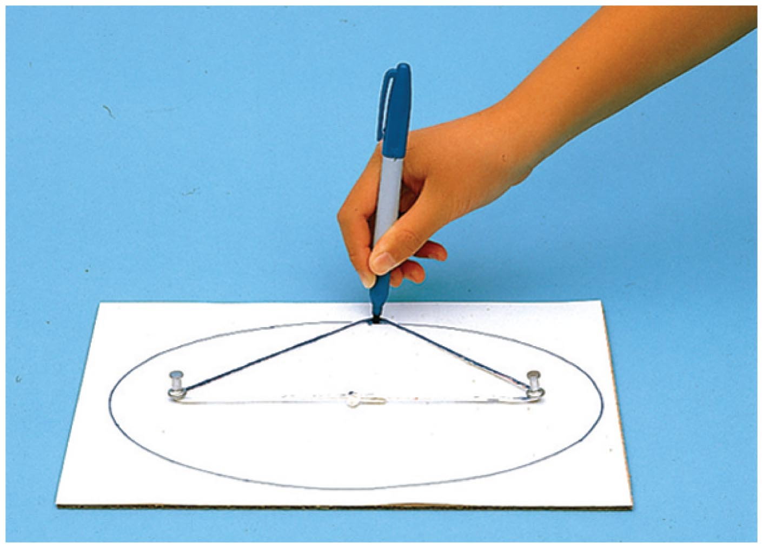
Elliptical Orbits
A projectile just above the atmosphere will follow an elliptical path if given a horizontal speed greater than 8 km/s.
Ellipse
specific curve, an oval path
Example: A circle is a special case of an ellipse when its two foci coincide.
All that stuff about conic sections

Slide 37
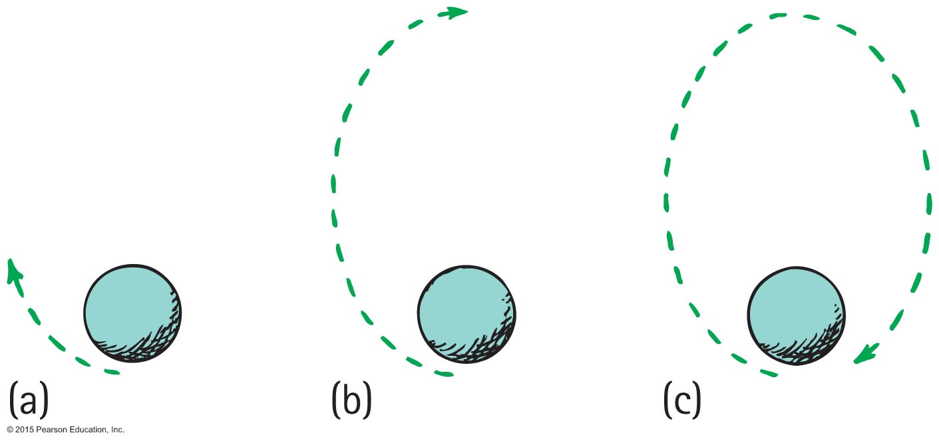
Elliptical Orbits
Speed of satellite varies during orbit.
Initially, if speed is greater than needed for circular orbit, satellite overshoots a circular path and moves away from Earth.
Satellite loses speed and then regains it as it falls back toward Earth.
It rejoins its original path with the same speed it had initially.
Procedure is repeated.
Too fast? Hyperbola
(satellite escapes)

Slide 38
Kepler's Laws of Planetary Motion
Kepler was assistant to the famous astronomer Brahe, who directed the world's first observatory.
He used data his mentor Brahe had collected on planetary motion to figure out the motion of planets.
He found that the motion of planets was not circular; rather, it was elliptical.

Slide 39
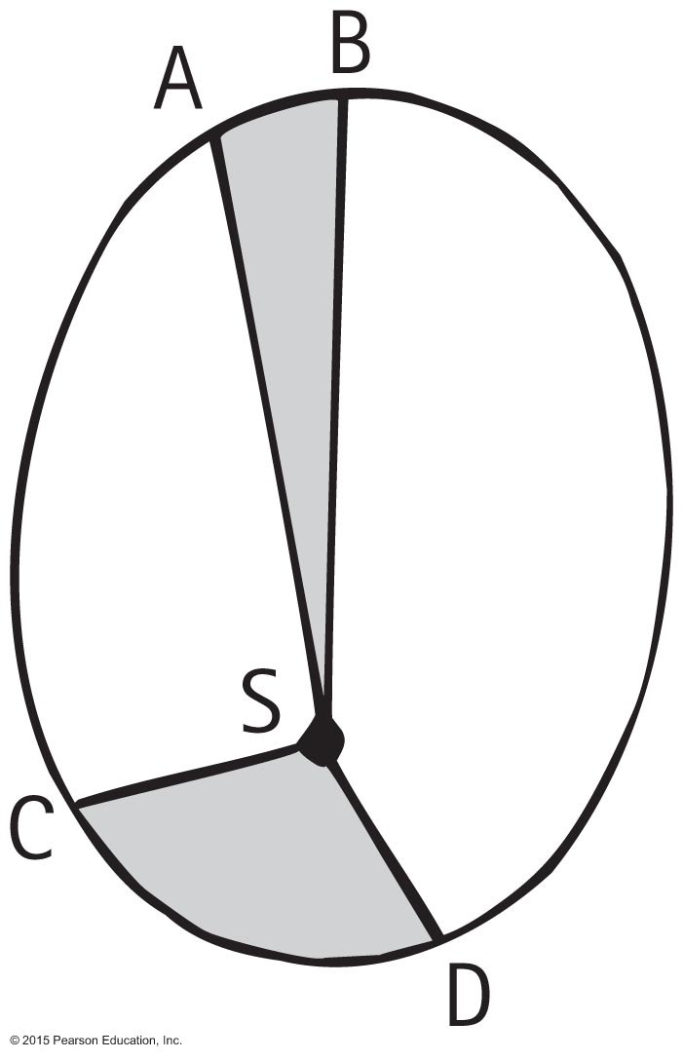
Kepler's Laws of Planetary Motion
1st Law: The path of each planet around the Sun is an ellipse with the Sun at one focus.
2nd Law: The line from the Sun to any planet sweeps out equal areas of space in equal time intervals.
3rd Law: The square of the orbital period (T) of a planet is proportional to the cube of the average distance of the planet from the Sun (r) for all planets. T²~r³

Slide 40
Kepler’s Laws of Planetary motion (1st)
Via oneminuteastronomer.com
Ellipse has 2 focal points
When they coincide, you have a circle

Slide 41
Kepler’s Laws of Planetary motion (2nd)
Via wicktionary.com
shaded areas all equal
Implies velocity is higher on right side – covers longer arc length in same time!
Planet’s orbits are very very nearly circular

Slide 42
Kepler’s Laws of Planetary Motion (3rd)
Via https://www.learnodo-newtonic.com: it works
(as it must, since it is derived from empirical data – but theory backs it up)

Slide 43
Energy Conservation and Satellite Motion
Recall the following:
Object in motion possesses KE due to its motion.
Object above Earth's surface possesses PE by virtue of its position.
Satellite in orbit possesses KE and PE.
Sum of KE and PE is constant at all points in the orbit.

Slide 44
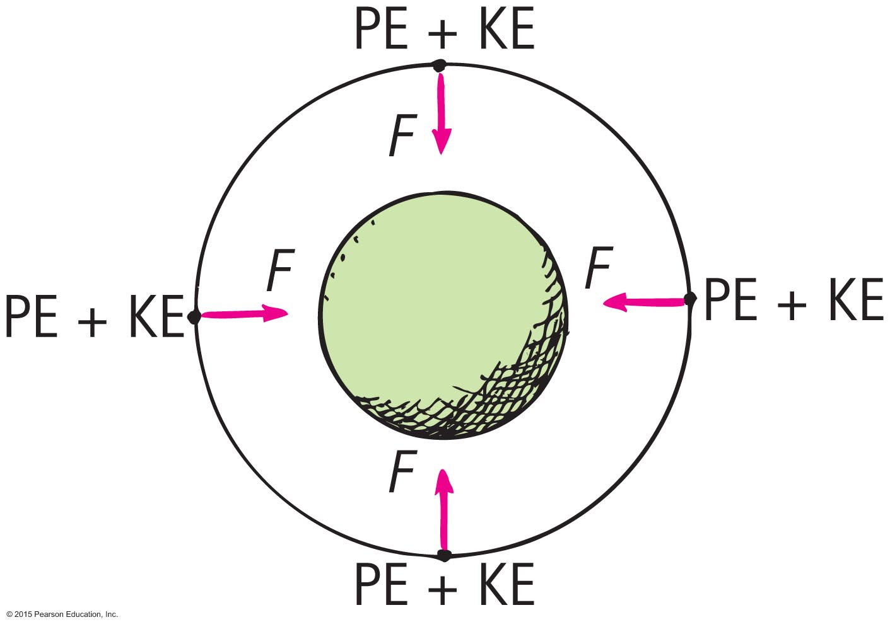
Energy Conservation and Satellite Motion
PE, KE, and speed in circular orbit:
Unchanged.
distance between the satellite and center of the attracting body does not change, so PE is the same everywhere.
no component of force acts along the direction of motion, so no change in speed and KE.

Slide 45
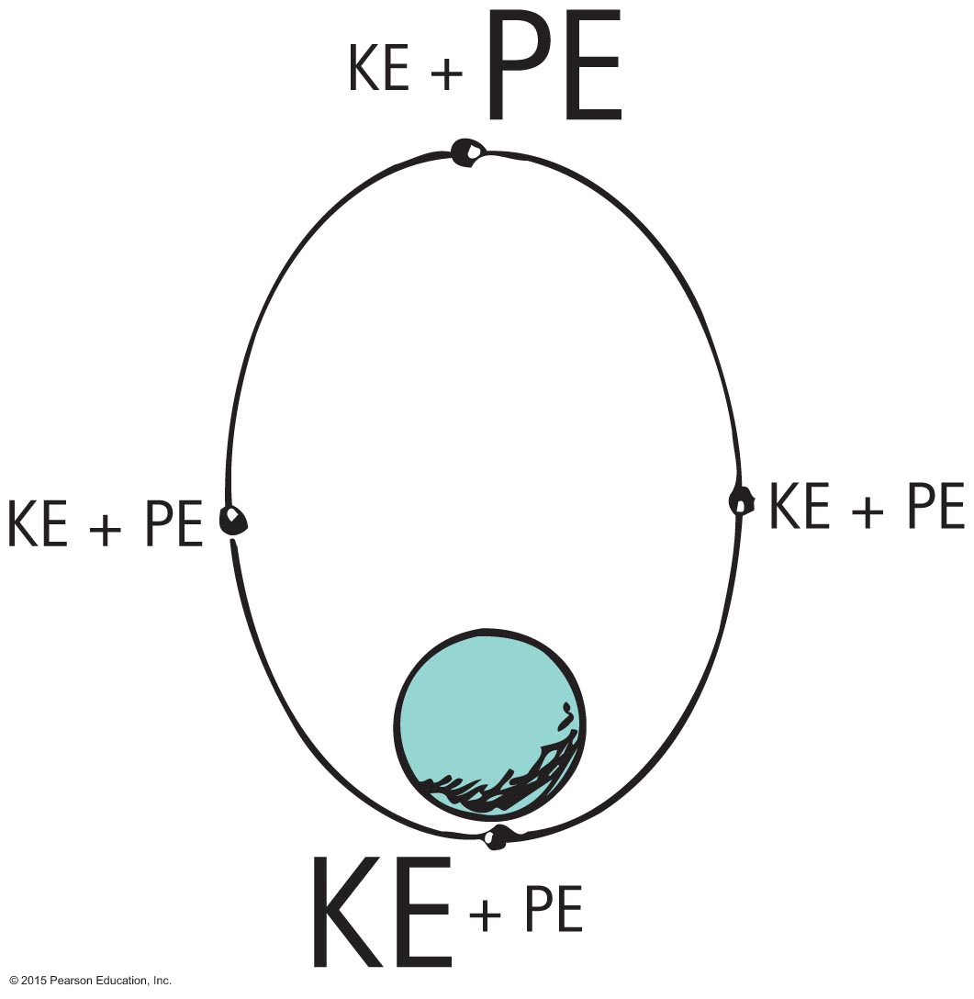
Energy Conservation and Satellite Motion
Elliptical Orbit: energy balance varies.
PE is greatest when the satellite is farthest away (apogee).
PE is least when the satellite is closest (perigee).
KE is least when PE is the most and vice versa.
At every point in the orbit, sum of KE and PE is the same.

Slide 46
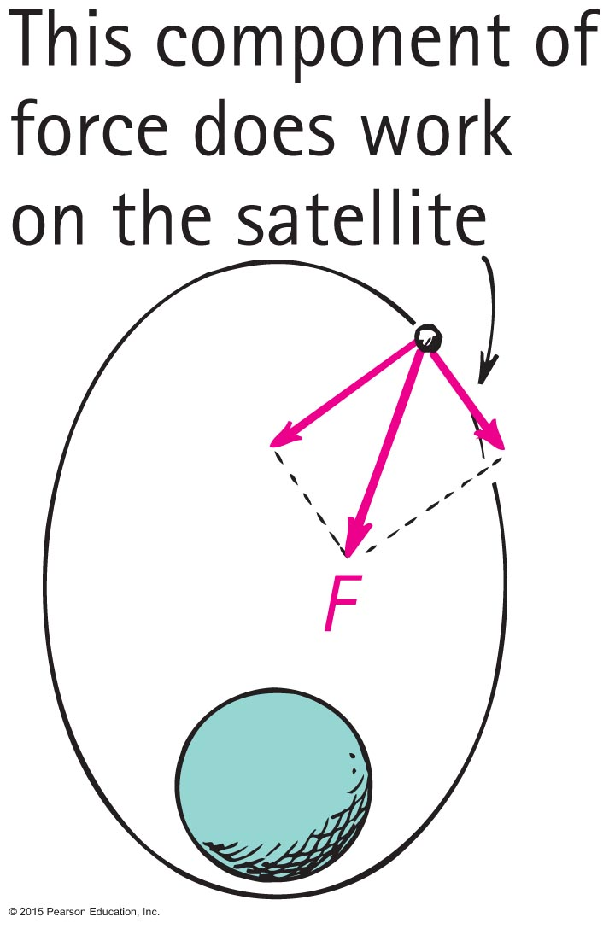
Energy Conservation and Satellite Motion
When satellite gains altitude and moves against gravitational force, its speed and KE decrease and decrease continues to the apogee.
Past the apogee, satellite moves in the same direction as the force component and speed and KE increase.
Increase continues until past the perigee and cycle repeats.

Slide 47
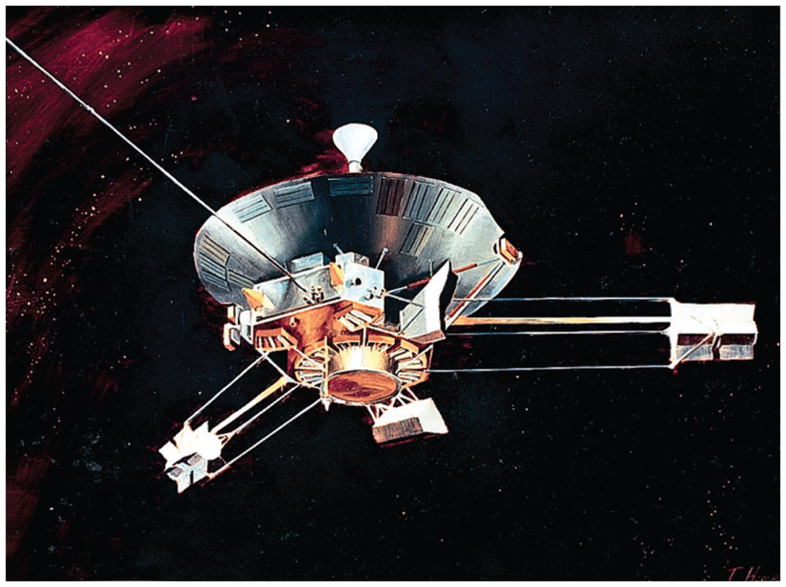
Escape Speed
First probe to escape the solar system was Pioneer 10, launched from Earth in 1972.
Accomplished by directing the probe into the path of oncoming Jupiter

Slide 48
Escape Speed CHECK YOUR NEIGHBOR
When a projectile achieves escape speed from Earth, it
forever leaves Earth's gravitational field.
outruns the influence of Earth's gravity, but is never beyond it.
comes to an eventual stop, returning to Earth at some future time.
All of the above.
Notes:
B. outruns the influence of Earth's gravity, but is never beyond it.

Slide 49
Escape Speed CHECK YOUR ANSWER
When a projectile achieves escape speed from Earth, it
forever leaves Earth's gravitational field.
outruns the influence of Earth's gravity, but is never beyond it.
comes to an eventual stop, returning to Earth at some future time.
All of the above.
Notes:
B. outruns the influence of Earth's gravity, but is never beyond it.

Slide 50
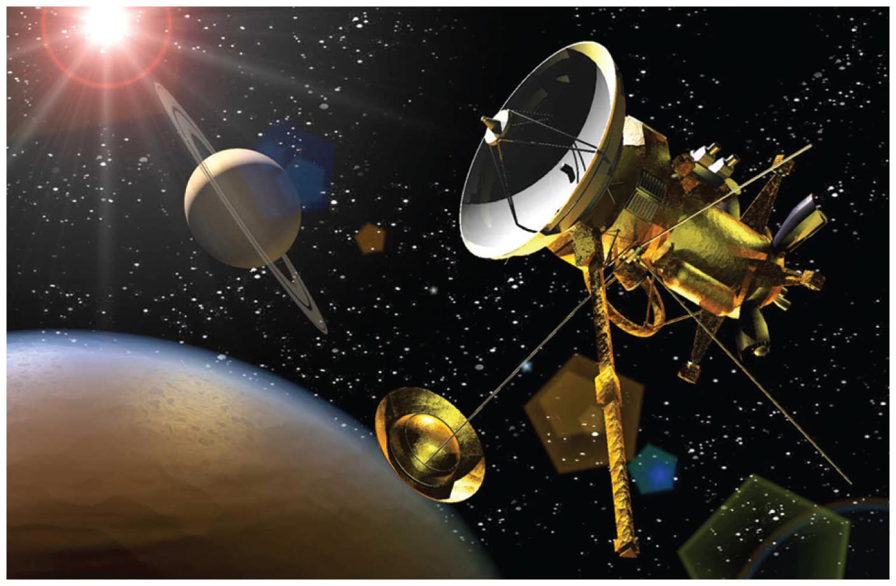
Escape Speed
Voyages to the Moon, Mars, and beyond begin with launches that exceed escape speed from Earth.

