Slide 1
Chapter 15: Temperature, Heat, and Expansion

Slide 2
This lecture will help you understand:
Temperature
Heat
Specific Heat Capacity
Thermal Expansion

Slide 3
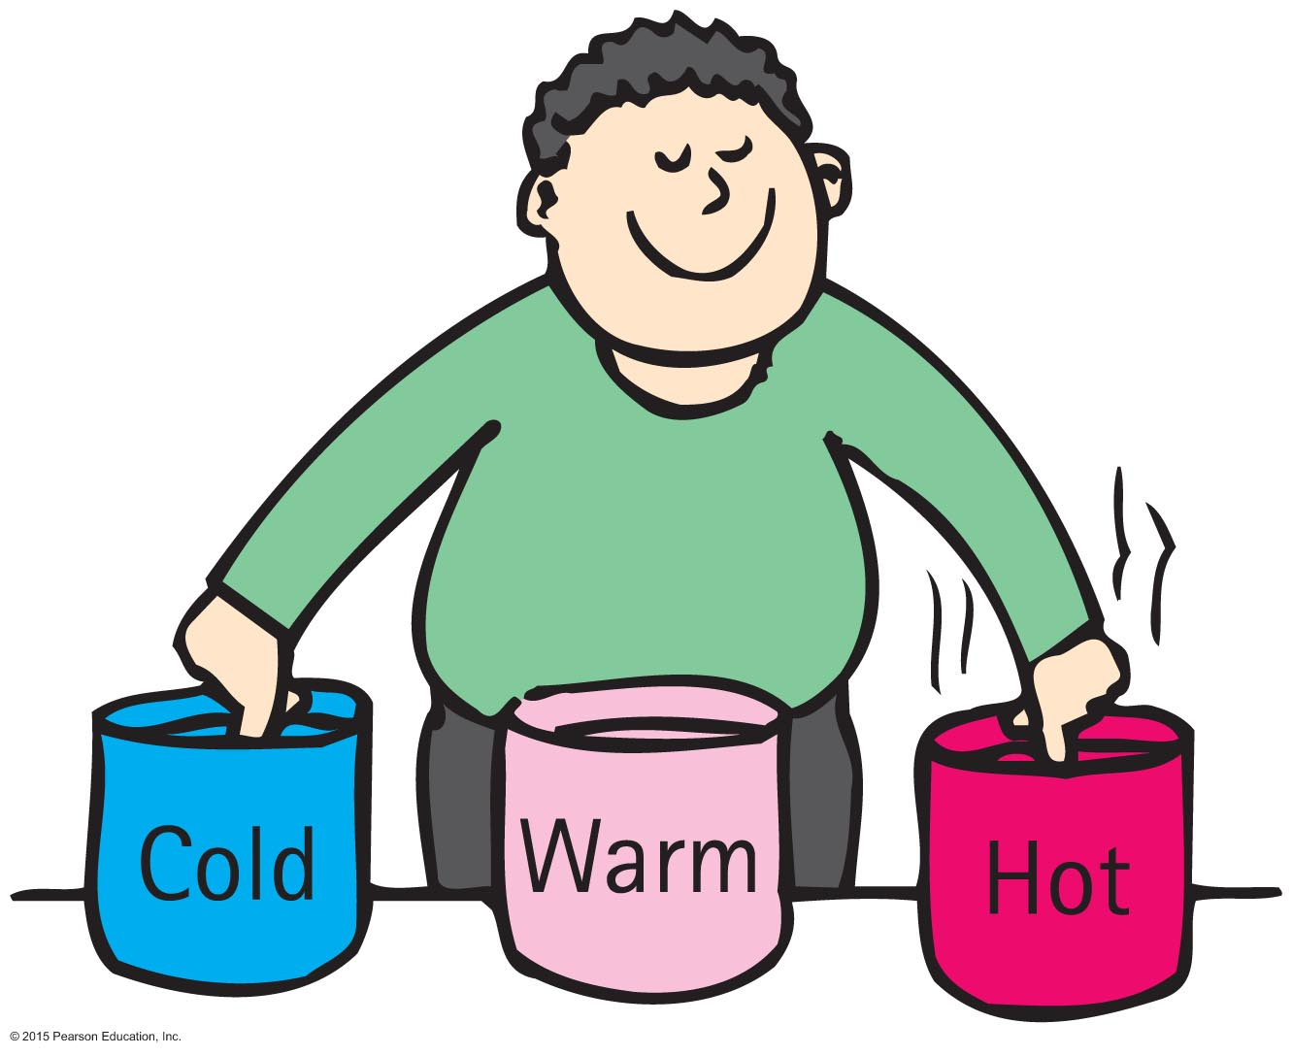
Temperature
Temperature
A number that corresponds to the warmth or coldness of an object
Measured by a thermometer
Is a per-particle property
No upper limit
Definite limit on lower end

Slide 4
Temperature
Temperature is proportional to the average translational kinetic energy per particle in a substance.
Gas—how fast the gas particles are bouncing to and fro
Liquid—how fast particles slide and jiggle past one another
Solid—how fast particles move as they vibrate and jiggle in place

Slide 5
Temperature
Thermometer
Measures temperature by expansion or contraction of a liquid (mercury or colored alcohol)
Reading occurs when the thermometer and the object reach thermal equilibrium (having the same average kinetic energy per particle)
Infrared thermometers operate by sensing IR radiation

Slide 6
Temperature
Temperature scale
Celsius scale named after Anders Celsius (1701–1744).
0ºC for freezing point of water to 100ºC for boiling point of water
Fahrenheit scale named after G. D. Fahrenheit (1686–1736).
32ºF for freezing point of water to 212ºF for boiling point of water
Kelvin scale named after Lord Kelvin (1824–1907).
0 K for freezing point of water to 373 K for boiling point of water
0 at absolute zero; same size degrees as Celsius scale
kelvins, rather than degrees, are used

Slide 7
Temperature CHECK YOUR NEIGHBOR
There is twice as much molecular kinetic energy in 2 liters of boiling water as in 1 liter of boiling water. Which will be the same for both?
Temperature
Thermal energy
Both A and B.
Neither A nor B.
Notes:
A. Temperature

Slide 8
Temperature CHECK YOUR ANSWER
There is twice as much molecular kinetic energy in 2 liters of boiling water as in 1 liter of boiling water. Which will be the same for both?
Temperature
Thermal energy
Both A and B.
Neither A nor B.
Explanation:
Average kinetic energy of molecules is the same, which means temperature is the same for both.
Notes:
A. Temperature

Slide 9
Temperature CHECK YOUR NEIGHBOR
To say that body A has a higher temperature than body B is to say that body A has more
internal energy.
mass.
kinetic energy per particle.
potential energy.
Notes:
C. kinetic energy per particle.

Slide 10
Temperature CHECK YOUR ANSWER
To say that body A has a higher temperature than body B is to say that body A has more
internal energy.
mass.
kinetic energy per particle.
potential energy.
Notes:
C. kinetic energy per particle.

Slide 11
Heat
Heat
Internal energy transferred from one thing to another due to a temperature difference
Internal energy in transit
Flow of internal energy
From a high-temperature substance to a low-temperature substance until thermal equilibrium is reached
Internal energy never flows unassisted from a low-temperature to a high-temperature substance

Slide 12
Heat CHECK YOUR NEIGHBOR
If a red-hot thumbtack is immersed in warm water, the direction of heat flow will be from the
warm water to the red-hot thumbtack.
red-hot thumbtack to the warm water.
There will be no heat flow.
Not enough information.
Notes:
B. red-hot thumbtack to the warm water.

Slide 13
Heat CHECK YOUR ANSWER
If a red-hot thumbtack is immersed in warm water, the direction of heat flow will be from the
warm water to the red-hot thumbtack.
red-hot thumbtack to the warm water.
There will be no heat flow.
Not enough information.
Notes:
B. red-hot thumbtack to the warm water.

Slide 14
Quantity of Heat
Quantity of heat
Measured in joules or calories
4.18 joules of heat are required to change the temperature of 1 gram of water by 1 Celsius degree
4.18 joules = 1 calorie

Slide 15
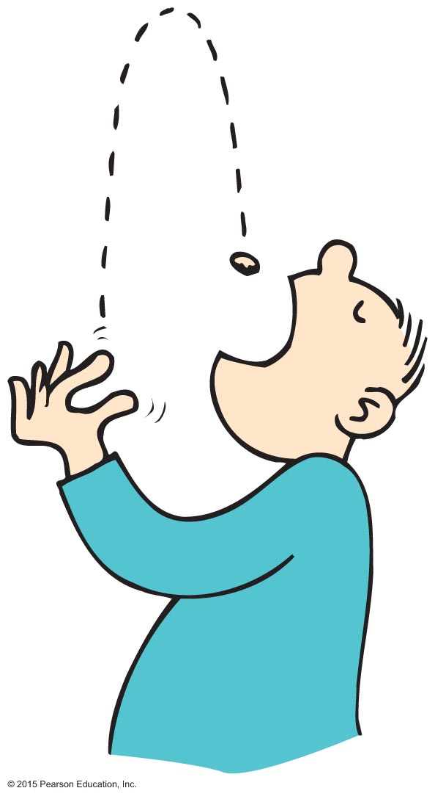
Quantity of Heat
Energy ratings of foods and fuels are determined from energy released when they are burned.
Unit of energy, the Calorie, is common for foods.
Heat unit for labeling food
kilocalorie or 1000 calories called a Calorie
heat needed to change the temperature of 1 kg of water by 1ºC

Slide 16
Quantity of Heat CHECK YOUR NEIGHBOR
The same quantity of heat is added to different amounts of water in two equal-size containers. The temperature of the smaller amount of water
decreases more.
increases more.
does not change.
Not enough information.
Notes:
B. increases more.

Slide 17
Quantity of Heat CHECK YOUR ANSWER
The same quantity of heat is added to different amounts of water in two equal-size containers. The temperature of the smaller amount of water
decreases more.
increases more.
does not change.
Not enough information.
Notes:
B. increases more.

Slide 18
Quantity of Heat CHECK YOUR NEIGHBOR
You heat a half-cup of tea and its temperature rises by 4ºC. How much will the temperature rise if you add the same amount of heat to a full cup of tea?
0ºC
2ºC
4ºC
8ºC
Notes:
B. 2ºC.

Slide 19
Quantity of Heat CHECK YOUR ANSWER
You heat a half-cup of tea and its temperature rises by 4ºC. How much will the temperature rise if you add the same amount of heat to a full cup of tea?
0ºC
2ºC
4ºC
8ºC
Notes:
B. 2ºC.

Slide 20
Specific Heat Capacity
Specific heat capacity
Defined as the quantity of heat required to change the temperature of a unit mass of the substance by 1 degree Celsius
Like thermal inertia—resistance of a substance to a change in temperature

Slide 21
Specific Heat Capacity
Different substances have different thermal capacities for storing energy.
Example:
Takes about 2 minutes to raise the temperature of an iron pot of water to boiling temperature
Takes less than 1 minute to raise the temperature of the same quantity of water in a silver pot to boiling temperature

Slide 22
Specific Heat Capacity
Equal masses of different materials required different quantities of heat to change their temperatures by a specified number of degrees.
1 gram of water requires 1 calorie of energy to raise the temperature 1 degree Celsius.
1 gram of iron requires 1/8 as much energy for the same temperature increase. Therefore, water absorbs more heat than iron for the same change in temperature. Water has a higher specific heat.

Slide 23
Specific Heat Capacity
The high specific heat capacity of water
has higher capacity for storing energy than almost any other substance.
involves various ways that energy can be absorbed.
increases the jiggling motion of molecules, which raises the temperature
increases the amount of internal vibration or rotation within the molecules, which becomes potential energy and doesn't raise temperature
water molecules can absorb energy without increasing translational kinetic energy

Slide 24
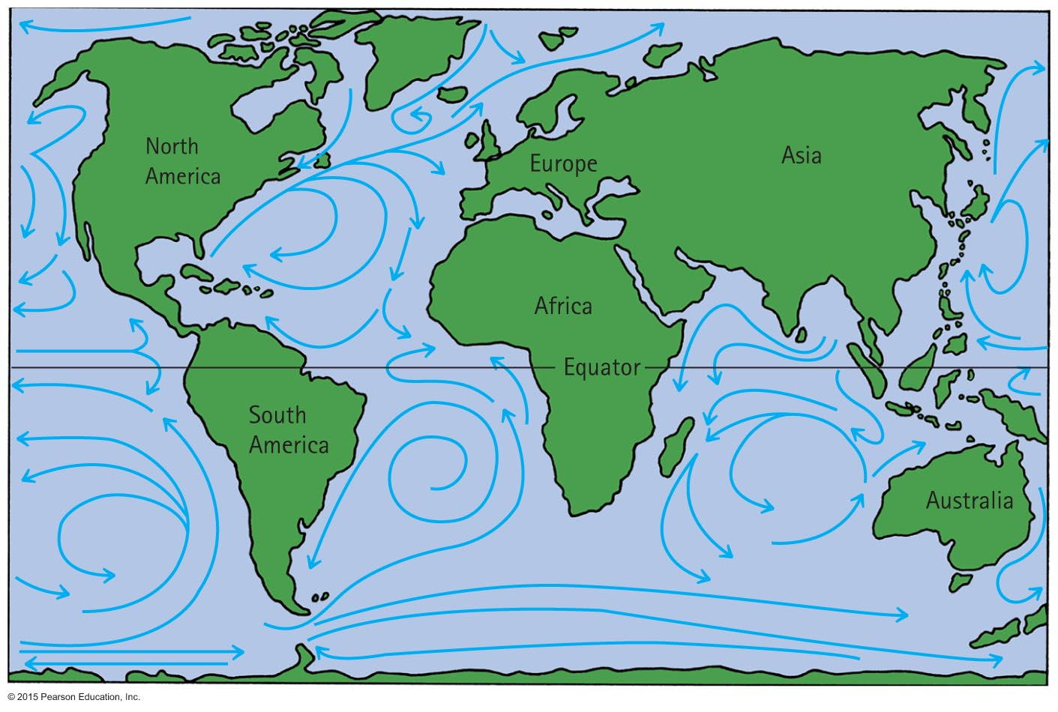
Specific Heat Capacity
Specific heat affects climate
For Europeans, the Atlantic Ocean current carries warm water northeast from the Caribbean regions and retains much of its internal energy long enough to reach the North Atlantic Ocean. Energy released is carried by westerly winds over the European continent.

Slide 25
Specific Heat Capacity
Specific heat affects climate (continued)
In the United States, winds in North America are mostly westerly. On the West Coast, air moves from the Pacific Ocean to the land. In winter months, the ocean water is warmer than the air. Air blows over the warm water and then moves over the coastal regions. This produces a warm climate.
On the East Coast, air moves from the land to the Atlantic Ocean. Land with lower specific heat capacity gets hot in the summer and cool in the winter.

Slide 26
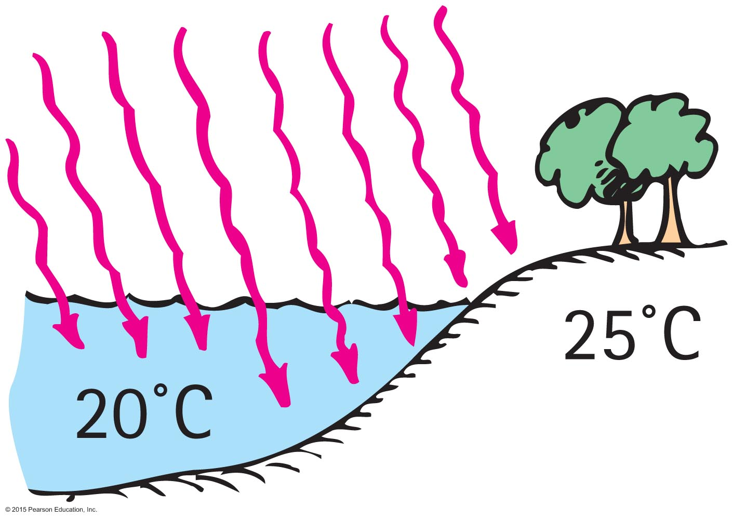
Specific Heat Capacity CHECK YOUR NEIGHBOR
Which has the higher specific heat capacity, water or land?
Water
Land
Both of the above are the same.
None of the above.
Notes:
A. Water

Slide 27
Specific Heat Capacity CHECK YOUR ANSWER
Which has the higher specific heat capacity, water or land?
Water
Land
Both of the above are the same.
None of the above.
Explanation:
A substance with small temperature changes for large heat changes has a high specific heat capacity. Water takes much longer to heat up in the sunshine than does land. This difference is a major influence on climate.
Notes:
A. Water

Slide 28
Thermal Expansion
Thermal expansion
Due to rise in temperature of a substance, molecules jiggle faster and move farther apart.
Most substances expand when heated and contract when cooled.
Railroad tracks laid on winter days expand and can buckle in hot summer.
Warming metal lids on glass jars under hot water loosens the lid by more expansion of the lid than the jar.

Slide 29
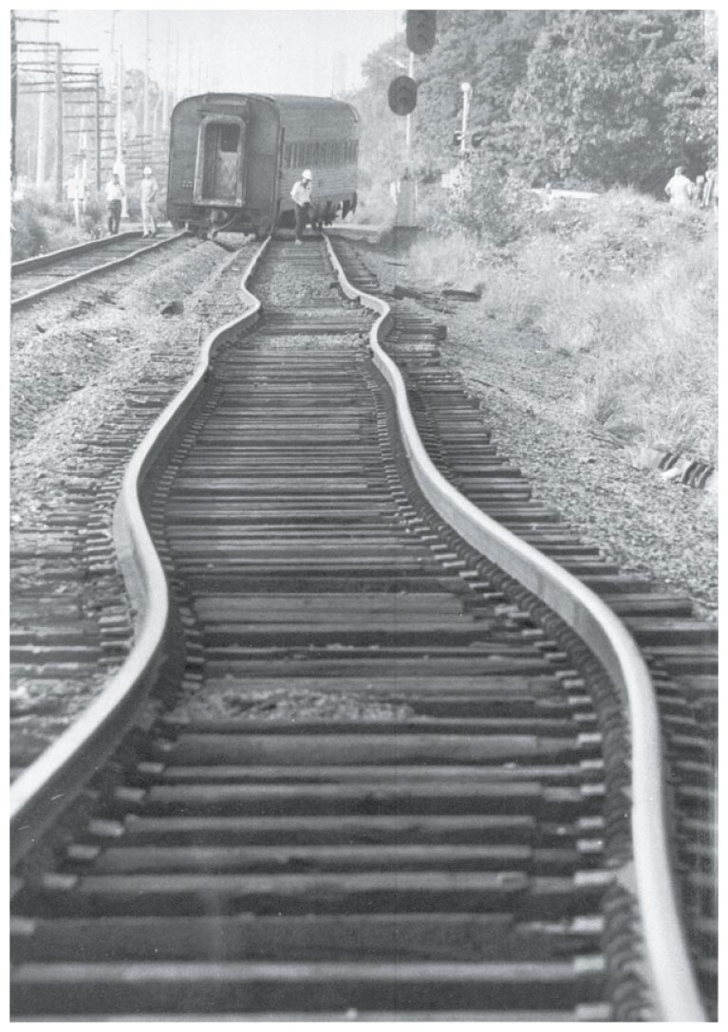
Thermal Expansion
Thermal expansion (continued)
Plays a role in construction and devices.
Example:
Use of reinforcing steel with the same rate of expansion as concrete—expansion joints on bridges.
Gaps on concrete roadways and sidewalks allow for concrete expansion in the summer and contraction in the winter.

Slide 30
Thermal Expansion
Thermal expansion (continued)
Different substances expand at different rates.
Example:
When the temperature of a bimetallic strip of brass and iron is increased, greater expansion occurs for the brass strip, which bends to turn a pointer, to regulate a valve, or to close a switch.
Bimetallic strips are used in heaters, oven thermometers, refrigerators, and electric toasters.

Slide 31
Thermal Expansion CHECK YOUR NEIGHBOR
When stringing telephone lines between poles in the summer, it is advisable to allow the lines to
sag.
be taut.
be close to the ground.
allow ample space for birds.
Notes:
A. sag.

Slide 32
Thermal Expansion CHECK YOUR ANSWER
When stringing telephone lines between poles in the summer, it is advisable to allow the lines to
sag.
be taut.
be close to the ground.
allow ample space for birds.
Explanation:
Telephone lines are longer in a warmer summer and shorter in a cold winter. Hence, they sag more on hot summer days than in winter. If the lines are not strung with enough sag in summer, they might contract too much and snap during the winter—especially when carrying ice.
Notes:
A. sag.

Slide 33
Thermal Expansion
Increases in expansion are greater in liquids than in solids.
Example:
Reason:
Overflow of gasoline from a car’s tank on a hot day
Gasoline underground is cool, but when placed in the car's tank, it warms and expands.

Slide 34
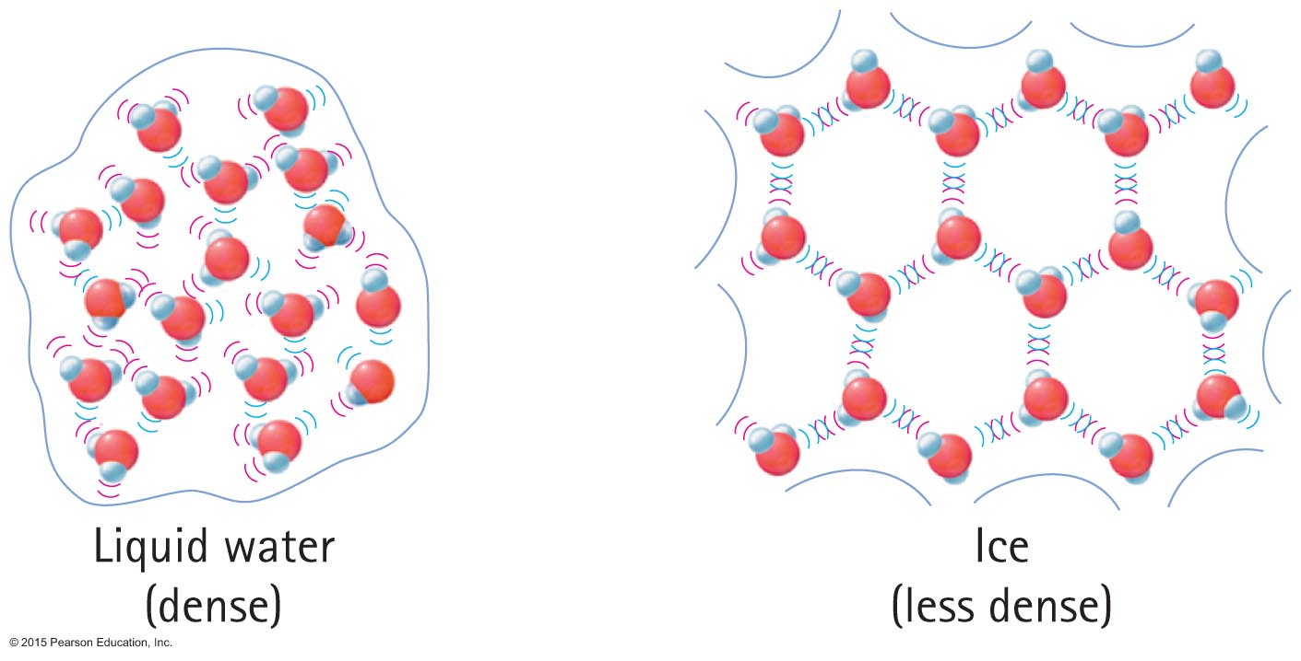
Thermal Expansion
Expansion of water
When water becomes ice, it expands. Ice has open-structured crystals resulting from strong bonds at certain angles that increase its volume. This make ice less dense than water.

Slide 35
Thermal Expansion
Thermal expansion of water
As temperature of water at 0ºC increases, more of the remaining ice crystals collapse. The melting of these ice crystals further decrease the volume of the water. Two opposite processes occur at the same time—contraction and expansion. Volume decreases as ice crystals collapse, while volume increases due to greater molecular motion. The collapsing effect dominates until the temperature reaches 4ºC. After that, expansion overrides contraction because most of the ice crystals have melted.

Slide 36
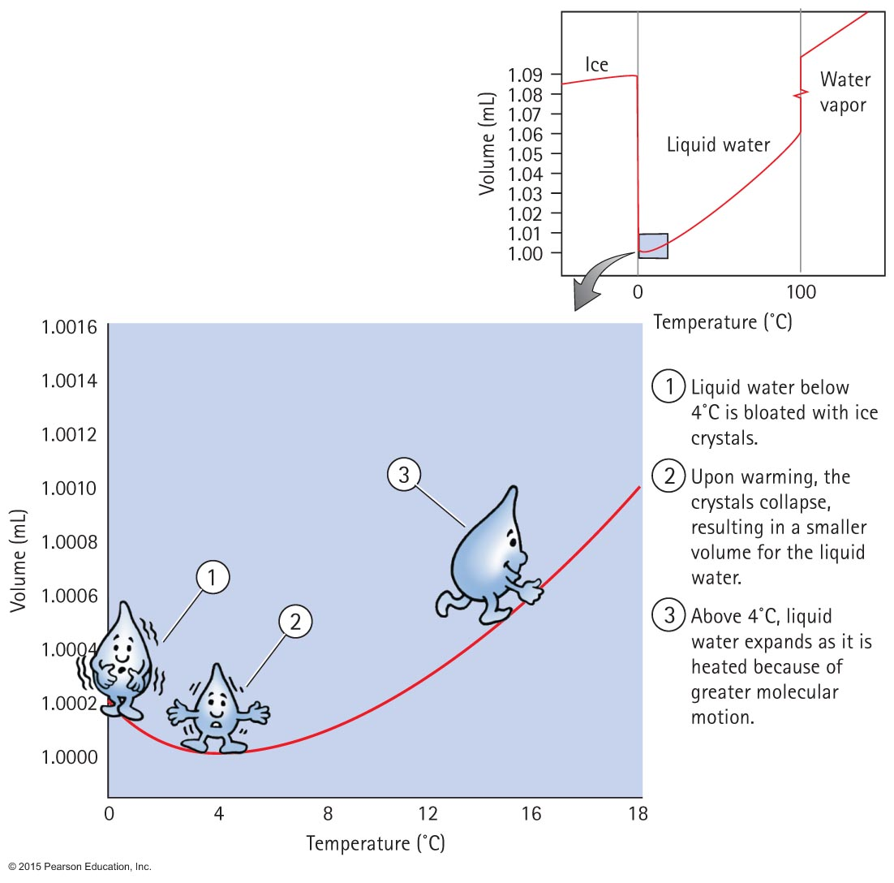
Thermal Expansion
Volume changes for a 1-gram sample of water.

Slide 37
Thermal Expansion
Thermal expansion of water
When ice freezes to become solid ice, its volume increases tremendously. As solid ice cools further, it contracts. Density of ice at any temperature is much lower than the density of water, which is why ice floats on water.

Slide 38
Thermal Expansion CHECK YOUR NEIGHBOR
When a sample of 0ºC water is heated, it first
expands.
contracts.
remains unchanged.
Not enough information.
Notes:
B. contracts.

Slide 39
Thermal Expansion CHECK YOUR ANSWER
When a sample of 0ºC water is heated, it first
expands.
contracts.
remains unchanged.
Not enough information.
Explanation:
Water continues to contract until it reaches a temperature of 4ºC. With further increase in temperature beyond 4ºC, water then expands.
Notes:
B. contracts.

Slide 40
Thermal Expansion CHECK YOUR NEIGHBOR
When a sample of 4ºC water is cooled, it
expands.
contracts.
remains unchanged.
Not enough information.
Notes:
A. expands.

Slide 41
Thermal Expansion CHECK YOUR ANSWER
When a sample of 4ºC water is cooled, it
expands.
contracts.
remains unchanged.
Not enough information.
Explanation:
Parts of the water will crystallize and occupy more space.
Notes:
A. expands.

