Slide 1
Chapter 16: Heat Transfer

Slide 2
This lecture will help you understand:
Conduction
Convection
Radiation
Newton's Law of Cooling
Global Warming and Greenhouse Effect

Slide 3
Heat Transfer and Change of Phase
Objects in thermal contact at different temperatures tend to reach a common temperature in three ways:
Conduction
Convection
Radiation

Slide 4
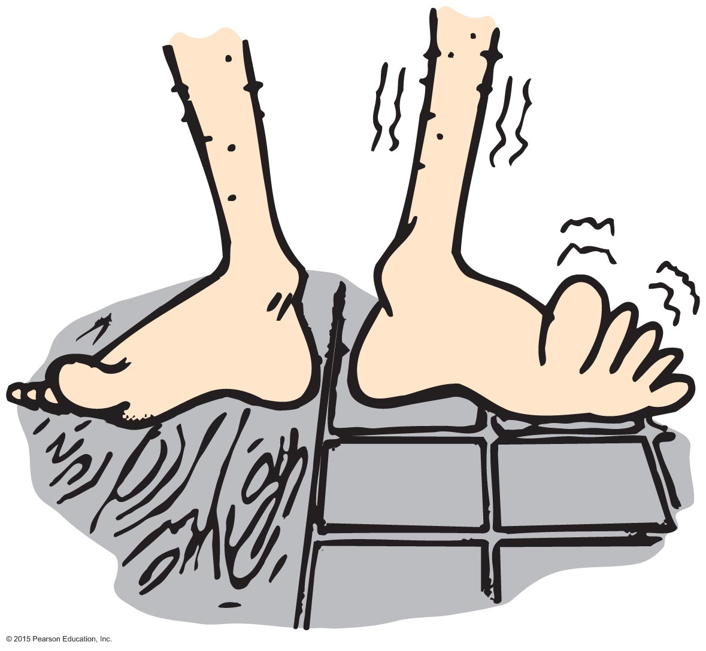
Conduction
Conduction
Transfer of internal energy by electron and molecular collisions within a substance, especially a solid

Slide 5
Conduction
Conductors (thermal conduction vs electrical conduction)
Good conductors conduct heat quickly.
Substances with loosely held electrons transfer energy quickly to other electrons throughout the solid.
Example: Silver, copper, and other solid metals
For the same reason, tend to conduct electricity well

Slide 6
Conduction
Conductors (continued)
Poor conductors are insulators.
molecules with tightly held electrons in a substance vibrate in place and transfer energy slowly—these are good insulators (and poor conductors).
Example: Glass, wool, wood, paper, cork, plastic foam, air
Substances that trap air are good insulators.
Example: Wool, fur, feathers, and snow
This is why one layers
Notes:
are insulators.
molecules with tightly held electrons in a substance vibrate in place and transfer energy slowly—these are good insulators (and poor conductors).
Example: Glass, wool, wood, paper, cork, plastic foam, air
Substances that trap air are good insulators.
Example: Wool, fur, feathers, and snow

Slide 7
Conduction CHECK
If you hold one end of a metal bar against a piece of ice, the end in your hand will soon become cold. Does cold flow from the ice to your hand?
Yes
In some cases, yes
No
In some cases, no
Notes:
C. No

Slide 8
Conduction CHECK YOUR ANSWER
If you hold one end of a metal bar against a piece of ice, the end in your hand will soon become cold. Does cold flow from the ice to your hand?
Yes
In some cases, yes
No
In some cases, no
Explanation:
Cold does not flow from the ice to your hand. Heat flows from your hand to the ice. The metal is cold to your touch because you are transferring heat to the metal.
Notes:
C. No

Slide 9
Conduction
Insulation
Doesn't prevent the flow of internal energy
Slows the rate at which internal energy flows
Example: Rock wool or fiberglass between walls slows the transfer of internal energy from a warm house to a cool exterior in winter, and the reverse in summer.

Slide 10
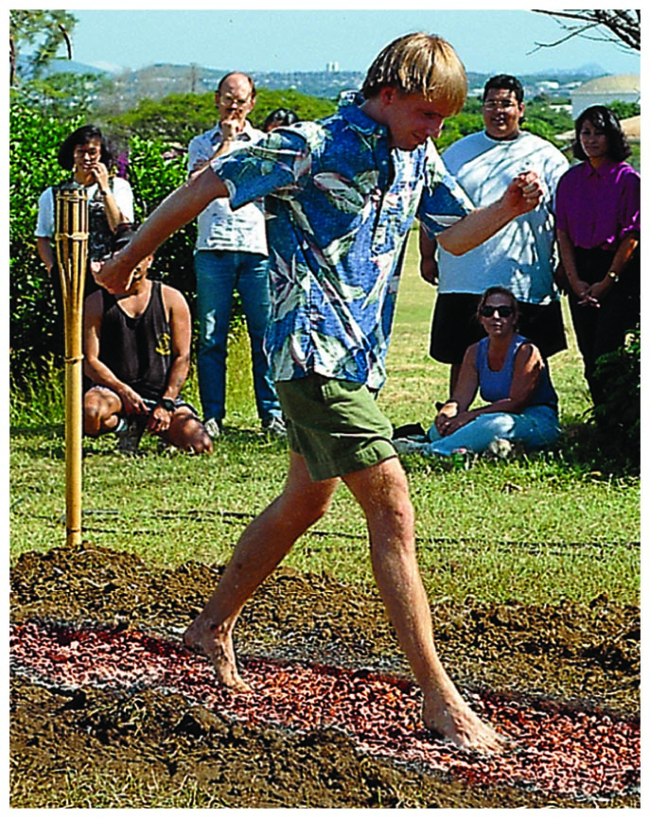
Conduction
Insulation (continued)
Dramatic example:
Walking barefoot without burning feet on red-hot coals is due to poor conduction between coals and feet.

Slide 11
Conduction
Insulation (continued)
Leidenfrost effect – water drops on a hot pan
Liquid surrounded by pocket of gas, isolating it

Slide 12
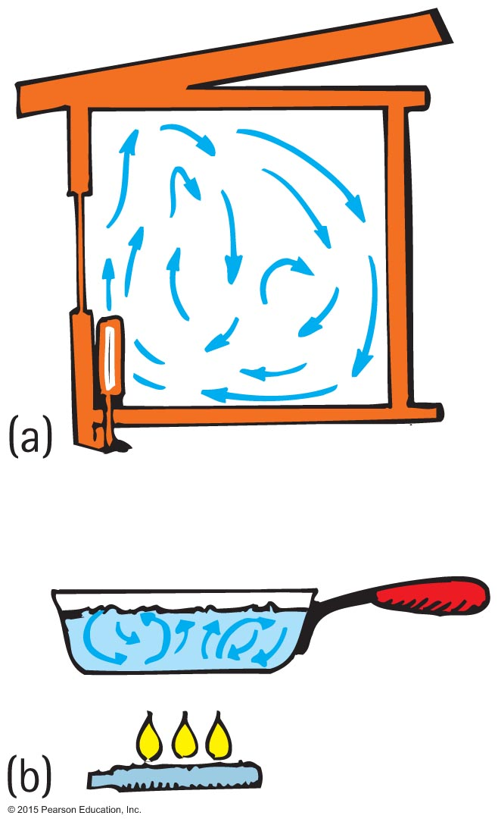
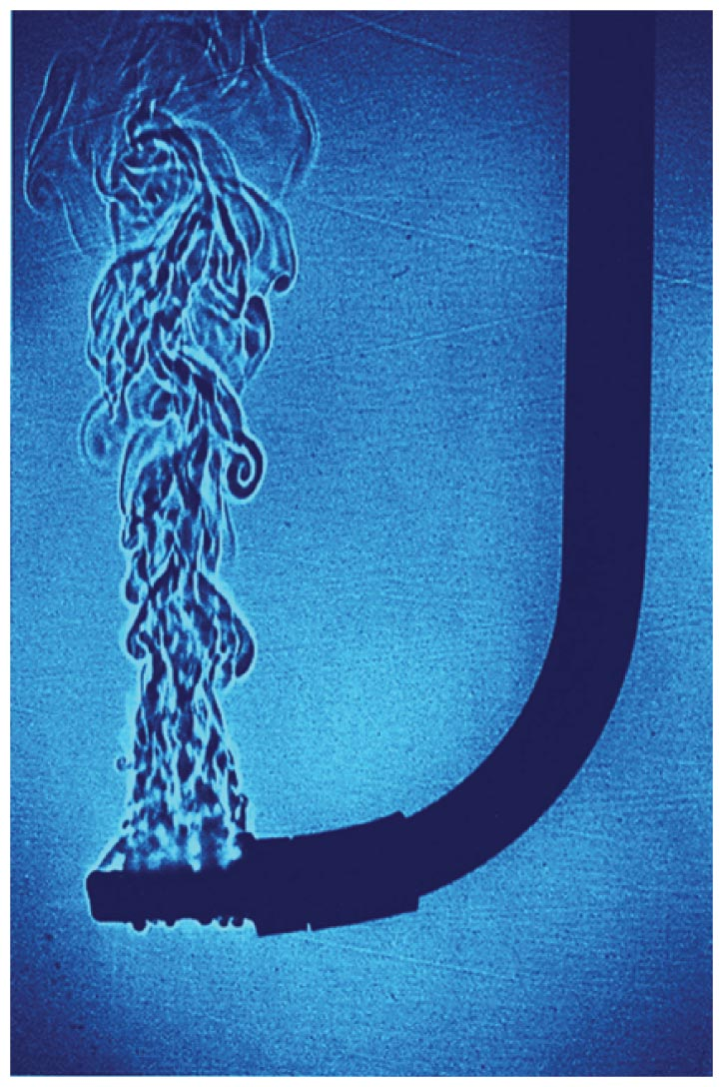
Convection
Convection
Transfer of heat involving only bulk motion of fluids
Familiar from cooking
Example:
Visible shimmer of air above a hot stove or above asphalt on a hot day
Visible shimmers in water due to temperature difference

Slide 13
Convection
Reason warm air rises
Warm air expands, becomes less dense, and is buoyed upward.
It rises until its density equals that of the surrounding air.
Example: Smoke from a fire rises and blends with the surrounding cool air.

Slide 14
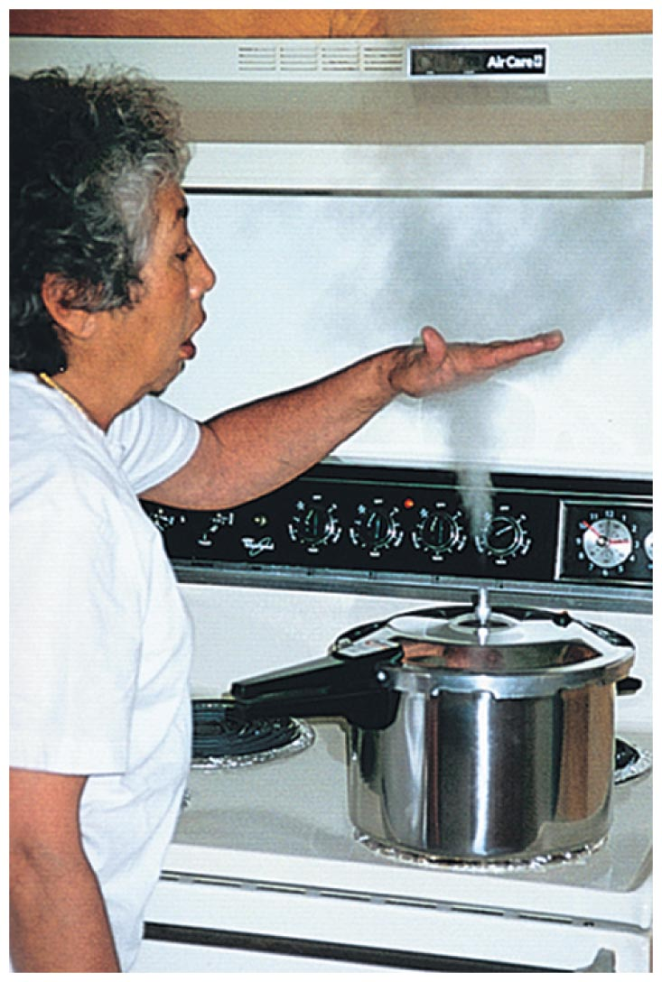
Convection
Cooling by expansion
Opposite to the warming that occurs when air is compressed
Example: The "cloudy" region above hot steam issuing from the nozzle of a pressure cooker is cool to the touch (a combination of air expansion and mixing with cooler surrounding air). Careful, the part at the nozzle that you can't see is steam—ouch!

Slide 15
Convection CHECK
Although warm air rises, why are mountaintops cold and snow covered, while the valleys below are relatively warm and green?
Warm air cools when rising.
There is a thick insulating blanket of air above valleys.
Both A and B.
None of the above.
Notes:
C. Both A and B.

Slide 16
Convection CHECK YOUR ANSWER
Although warm air rises, why are mountaintops cold and snow covered, while the valleys below are relatively warm and green?
Warm air cools when rising.
There is a thick insulating blanket of air above valleys.
Both A and B.
None of the above.
Explanation:
Earth's atmosphere acts as a blanket, which keeps the valleys from freezing at nighttime.
Notes:
C. Both A and B.

Slide 17
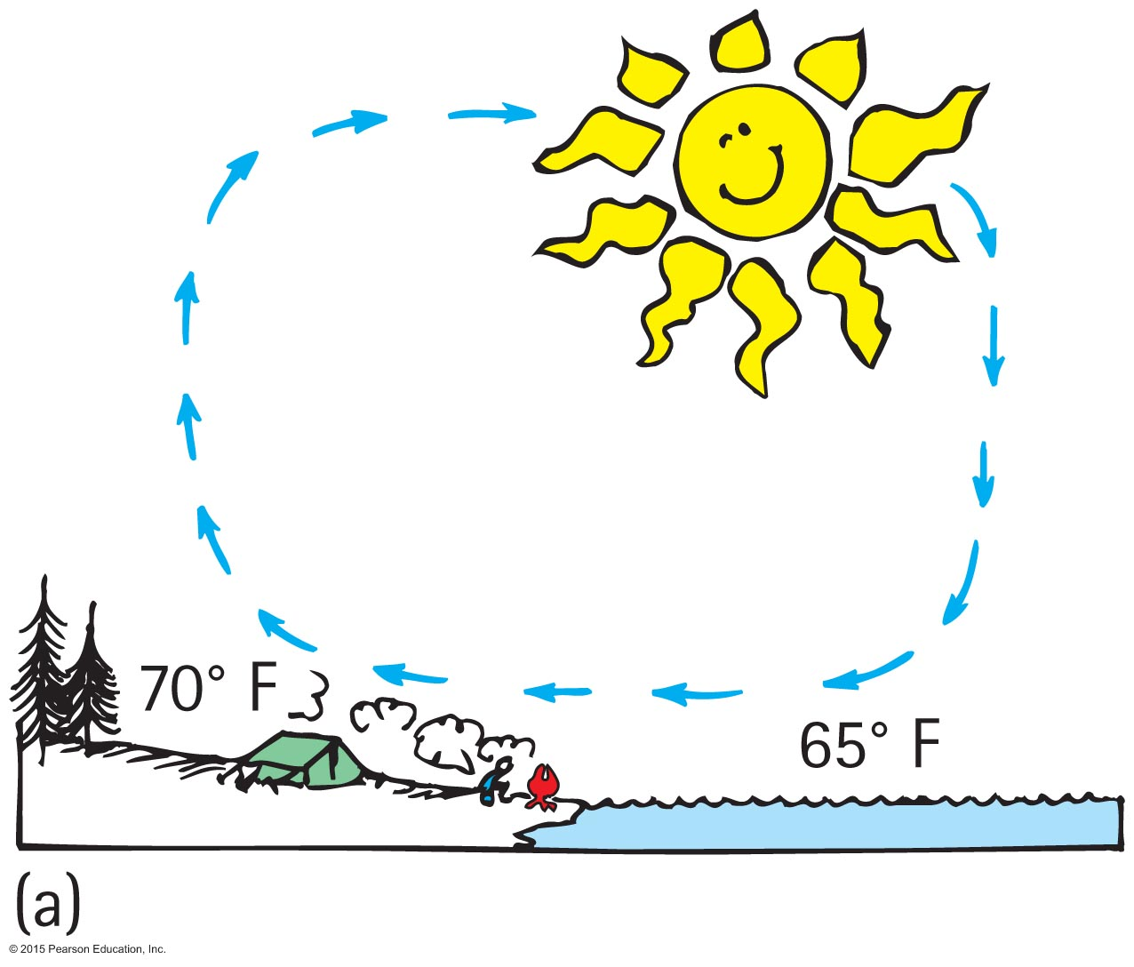
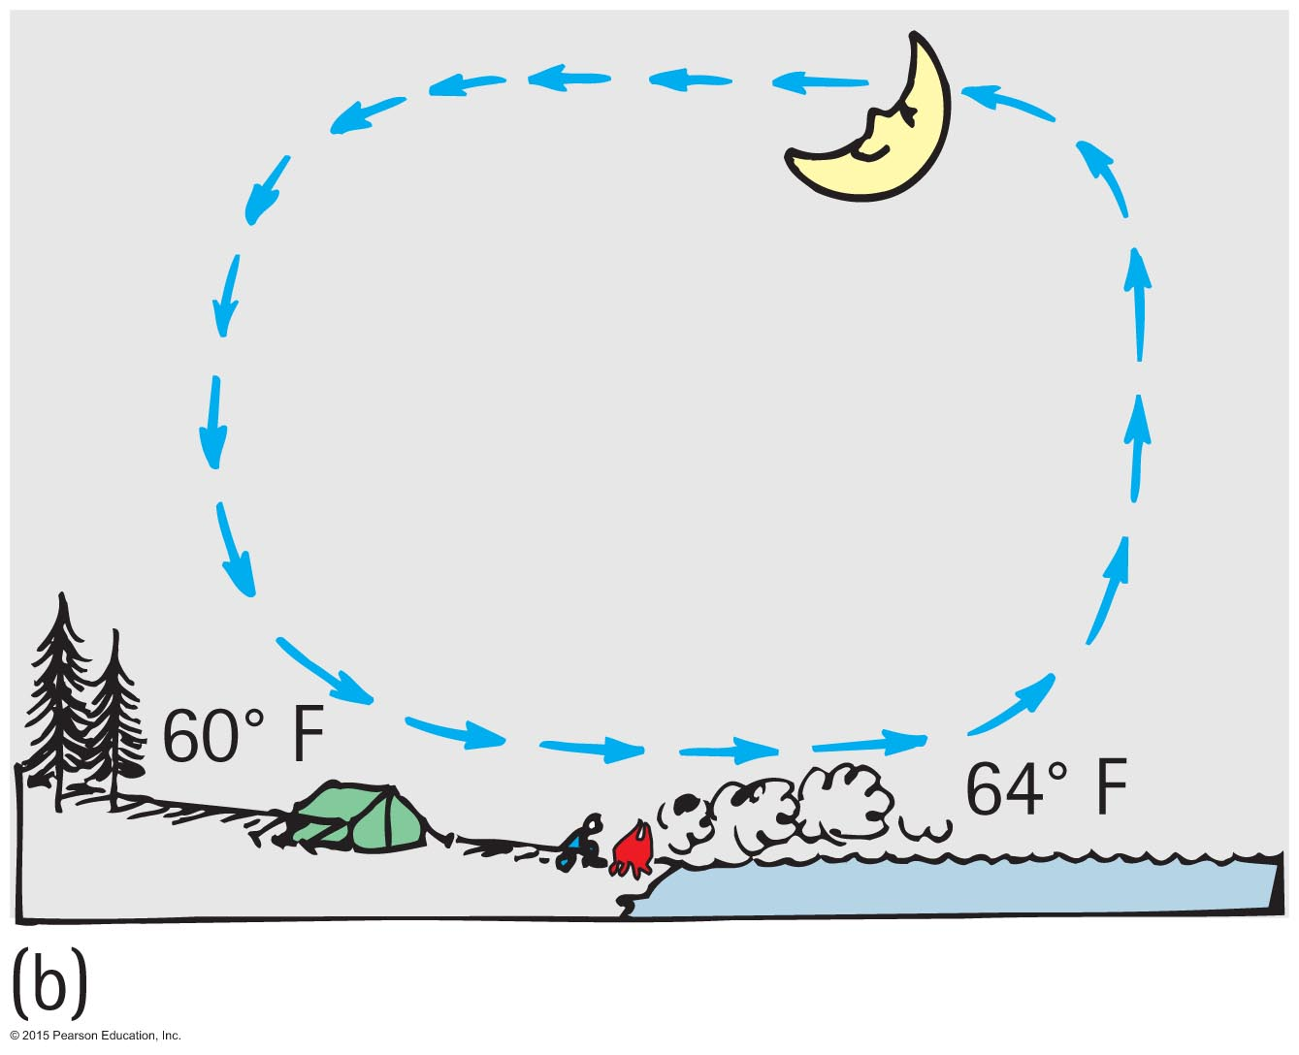
Convection
Winds
Result of uneven heating of the air near the ground
Absorption of Sun's energy occurs more readily on different parts of Earth's surface.
Sea breeze
The ground warms more than water in the daytime.
Warm air close to the ground rises and is replaced by cooler air from above the water.

Slide 18
Radiation
Radiation
Transfer of energy from the Sun through empty space

Slide 19
Radiation CHECK
The surface of Earth loses energy to outer space due mostly to
conduction.
convection.
radiation.
radioactivity.
Notes:
C. radiation.

Slide 20
Radiation CHECK YOUR ANSWER
The surface of Earth loses energy to outer space due mostly to
conduction.
convection.
radiation.
radioactivity.
Explanation:
Radiation is the only choice, given the vacuum of outer space.
Notes:
C. radiation.

Slide 21
Radiation CHECK
Which body glows with electromagnetic waves?
Sun
Earth
Both A and B.
None of the above.
Notes:
C. Both A and B.

Slide 22
Radiation CHECK YOUR ANSWER
Which body glows with electromagnetic waves?
Sun
Earth
Both A and B.
None of the above.
Explanation:
Earth glows in long-wavelength radiation, while the Sun glows in shorter waves.
Notes:
C. Both A and B.

Slide 23
Radiation
Radiant energy
Transferred energy
Exists as electromagnetic waves ranging from long (radio waves) to short wavelengths (X-rays)
In visible region, ranges from long waves (red) to short waves (violet)

Slide 24
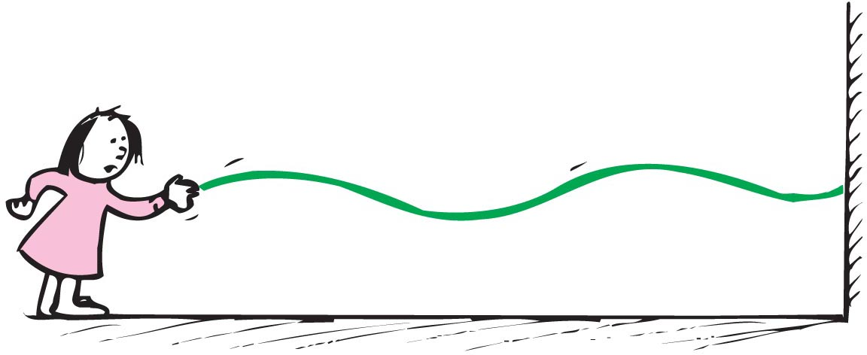
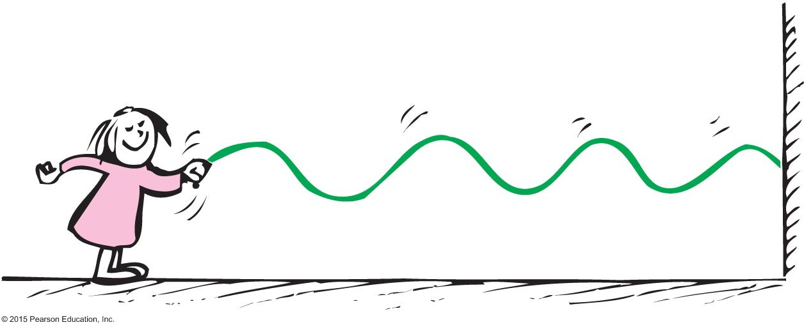
Radiation
Wavelength of radiation
Related to frequency of vibration (rate of vibration of a wave source)
Low-frequency vibration produces long-wavelength waves.
High-frequency vibration produces short-wavelength waves.

Slide 25
Radiation
Emission of radiant energy
Every object above absolute zero radiates.
From the Sun's surface comes light, called electromagnetic radiation, or solar radiation.
From the Earth's surface comes terrestrial radiation in the form of infrared waves below our threshold of sight.

Slide 26
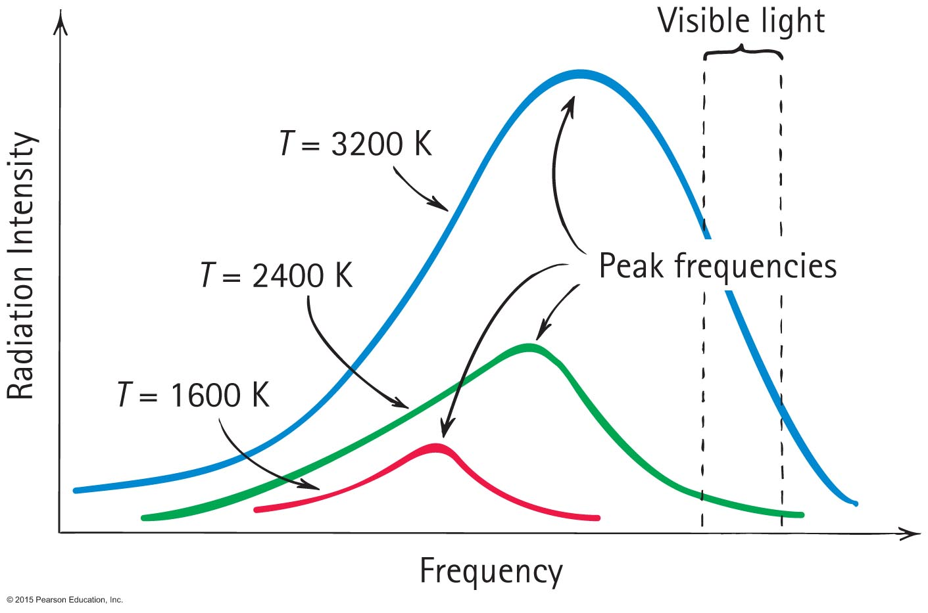
Radiation
Emission of radiant energy (continued)
Frequency (and energy) of radiation is proportional to the absolute temperature of the source ( ).

Slide 27
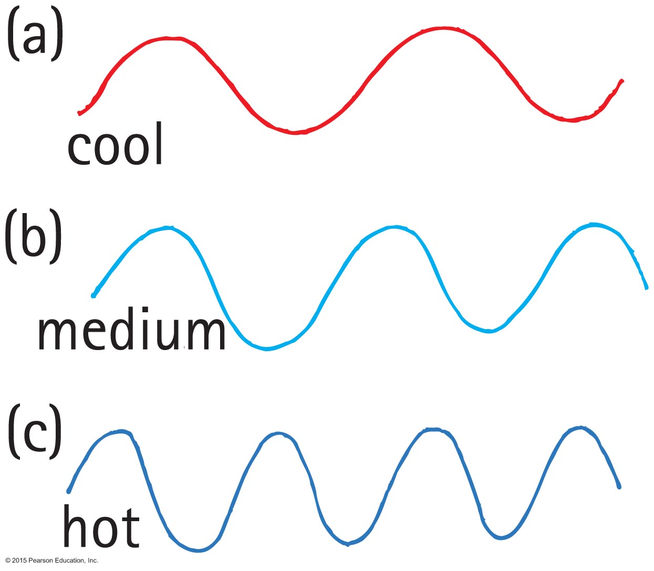
Radiation
Range of temperatures of radiating objects
Room-temperature emission is in the infrared.
Temperature above 500ºC, red light emitted, longest waves visible.
About 600ºC, yellow light emitted.
At 1500ºC, object emits white light (whole range of visible light).

Slide 28
Radiation

Slide 29
Radiation

Slide 30
Radiation
Absorption of radiant energy
Occurs along with emission of radiant energy
Effects of surface of material on radiant energy
Any material that absorbs more than it emits is a net absorber.
Any material that emits more than it absorbs is a net emitter.
Net absorption or emission is relative to temperature of surroundings.

Slide 31
Radiation
Absorption of radiant energy (continued)
Occurs along with emission of radiant energy
Good absorbers are good emitters
Poor absorbers are poor emitters
Example: Radio dish antenna that is a good emitter is also a good receiver (by design, a poor transmitter is a poor absorber).

Slide 32
Radiation CHECK
If a good absorber of radiant energy were a poor emitter, its temperature compared with its surroundings would be
lower.
higher.
unaffected.
None of the above.
Notes:
B. higher.

Slide 33
Radiation CHECK YOUR ANSWER
If a good absorber of radiant energy were a poor emitter, its temperature compared with its surroundings would be
lower.
higher.
unaffected.
None of the above.
Explanation: If a good absorber were not also a good emitter, there would be a net absorption of radiant energy, and the temperature of a good absorber would remain higher than the temperature of the surroundings. Nature is not so!
Notes:
B. higher.

Slide 34
Radiation CHECK
A hot pizza placed in the snow is a net
absorber.
emitter.
Both A and B.
None of the above.
Notes:
B. emitter.

Slide 35
Radiation CHECK YOUR ANSWER
A hot pizza placed in the snow is a net
absorber.
emitter.
Both A and B.
None of the above.
Explanation: Net energy flow ( ) goes from higher to lower temperature. Since the pizza is hotter than the snow, emission is greater than absorption, so it's a net emitter.
Notes:
B. emitter.

Slide 36
Radiation CHECK
Which melts faster in sunshine—dirty snow or clean snow?
Dirty snow
Clean snow
Both A and B.
None of the above.
Notes:
A. Dirty snow

Slide 37
Radiation CHECK YOUR ANSWER
Which melts faster in sunshine—dirty snow or clean snow?
Dirty snow
Clean snow
Both A and B.
None of the above.
Explanation: Dirty snow absorbs more sunlight, whereas clean snow reflects more.
Notes:
A. Dirty snow

Slide 38
Radiation
Reflection of radiant energy
Opposite to absorption of radiant energy
Any surface that reflects very little or no radiant energy looks dark
Examples of dark objects: eye pupils, open ends of pipes in a stack, open doorways or windows of distant houses in the daytime

Slide 39
Reflection
Vantablack:
“It's like, how much more black could this be and the answer is none. None more black.”

Slide 40
Reflection
Vantablack:
“It's like, how much more black could this be and the answer is none. None more black.”

Slide 41
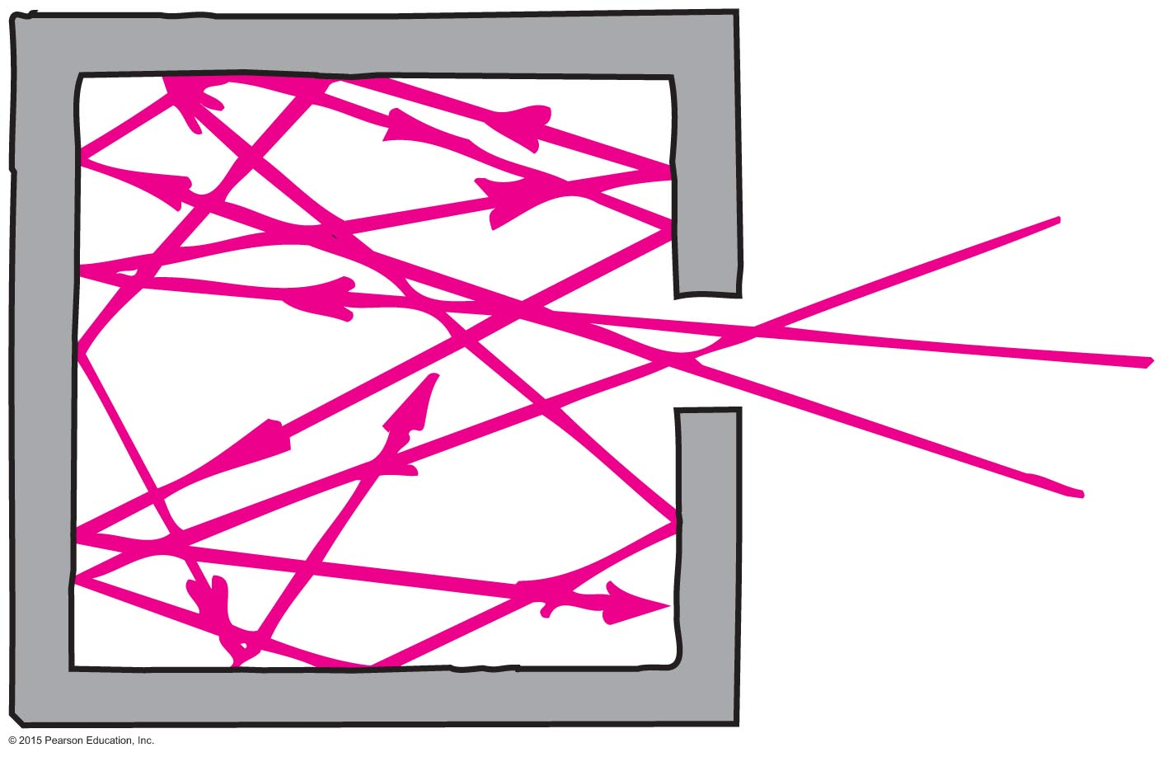
Radiation
Reflection of radiant energy (continued)
Darkness often due to reflection of light back and forth many times partially absorbing with each reflection.
Or, make reflections spread out (stealth)
Good reflectors are poor absorbers.

Slide 42
Radiation CHECK
Which is the better statement?
A black object absorbs energy well.
An object that absorbs energy well is black.
Both say the same thing, so both are equivalent.
Both are untrue.
Notes:
B. An object that absorbs energy well is black.

Slide 43
Radiation CHECK YOUR ANSWER
Which is the better statement?
A black object absorbs energy well.
An object that absorbs energy well is black.
Both say the same thing, so both are equivalent.
Both are untrue.
Explanation:
This is a cause-and-effect question. The color black doesn't draw in and absorb energy. It's the other way around—any object that does draw in and absorb energy, will, by consequence, be black in color.
Notes:
B. An object that absorbs energy well is black.

Slide 44
Newton's Law of Cooling
Newton's law of cooling
Approximately proportional to the temperature difference, ∆T, between the object and its surroundings
In short: rate of cooling ~ ∆T
Example:
Hot apple pie cools more each minute in a freezer than if left on the kitchen table.
Warmer house leaks more internal energy to the outside than a house that is less warm.

Slide 45
Newton's Law of Cooling
Newton's law of cooling (continued)
Applies to rate of warming
Object cooler than its surroundings warms up at a rate proportional to ∆T.
Example: Frozen food will warm faster in a warm room than in a cold room.

Slide 46
Newton's Law of Cooling CHECK
It is commonly thought that a can of beverage will cool faster in the coldest part of a refrigerator. Knowledge of Newton's law of cooling
supports this knowledge.
shows this knowledge is false.
may or may not support this knowledge.
may or may not contradict this knowledge.
Notes:
A. supports this knowledge.

Slide 47
Newton's Law of Cooling CHECK YOUR ANSWER
It is commonly thought that a can of beverage will cool faster in the coldest part of a refrigerator. Knowledge of Newton's law of cooling
supports this knowledge.
shows this knowledge is false.
may or may not support this knowledge.
may or may not contradict this knowledge.
Explanation:
When placed in the coldest part of the refrigerator, the ∆T (i.e., the difference in temperature between the can and its surroundings) will be the largest, so it will cool the fastest.
Notes:
A. supports this knowledge.

Slide 48
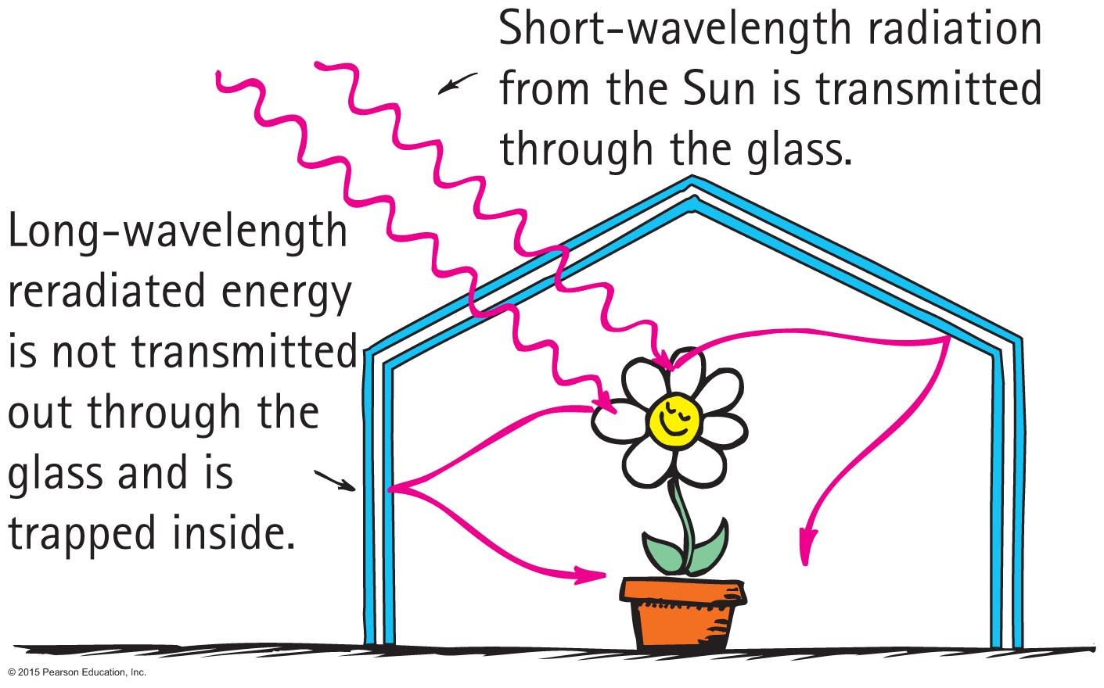
Global Warming and the Greenhouse Effect
Greenhouse effect
Named for a similar temperature-raising effect in florists' greenhouses

Slide 49
Global Warming and the Greenhouse Effect
Understanding greenhouse effect requires two concepts:
All things radiate at a frequency (and therefore wavelength) that depends on the temperature of the emitting object.
Transparency of things depends on the wavelength of radiation.

Slide 50
Global Warming and the Greenhouse Effect
Understanding greenhouse effect requires two concepts (continued)
Example:
Excessive warming of a car's interior when windows are closed on a hot sunny day. Sun's rays are very short and pass through the car's windows. Absorption of Sun's energy warms the car interior. Car interior radiates its own waves, which are longer and don't transmit through the windows. Car's radiated energy remains inside, making the car's interior very warm.

Slide 51
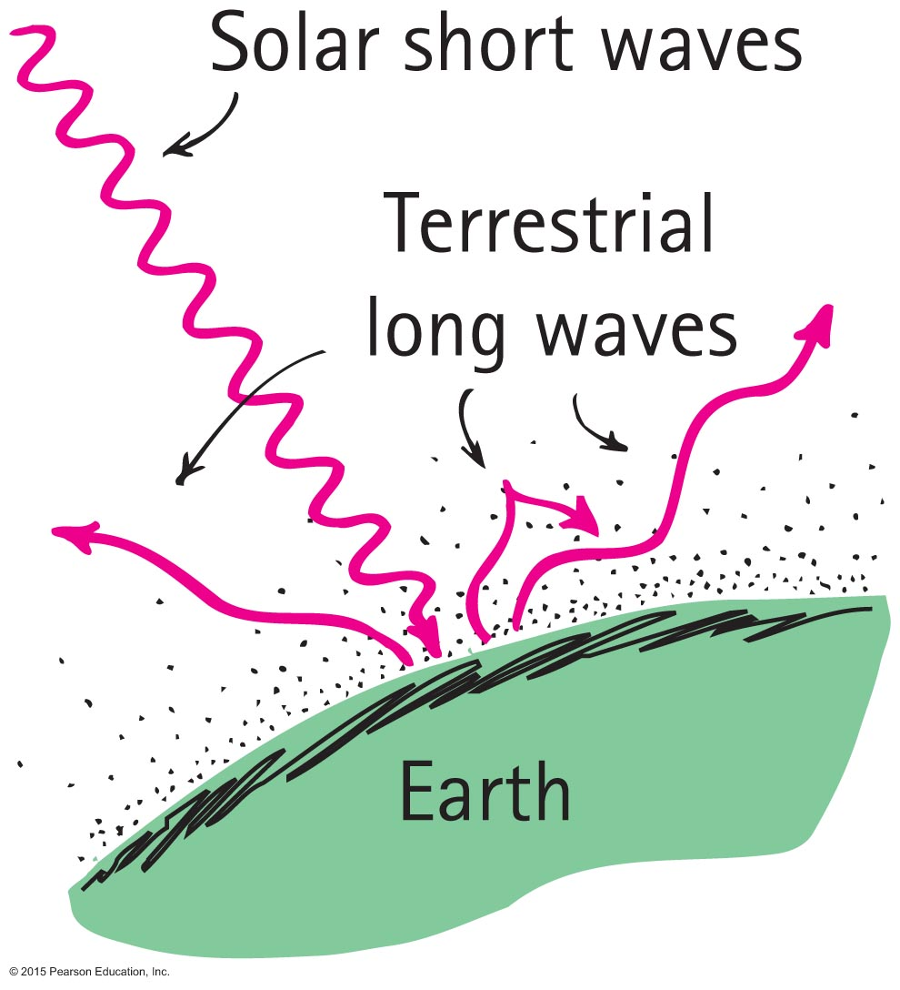
Global Warming and the Greenhouse Effect
Global warming
Energy absorbed from the Sun
Part reradiated by Earth as longer-wavelength terrestrial radiation

Slide 52
Global Warming and the Greenhouse Effect
Global warming (continued)
Terrestrial radiation absorbed by atmospheric gases and re-emitted as long-wavelength terrestrial radiation back to Earth.
Reradiated energy unable to escape, so warming of Earth occurs.
Long-term effects on climate are of present concern.

Slide 53
Global Warming and the Greenhouse Effect CHECK
The "greenhouse gases" that contribute to global warming absorb
more visible radiation than infrared.
more infrared radiation than visible.
visible and infrared radiation about equally.
very little radiation of any kind.
Notes:
B. more infrared radiation than visible.

Slide 54
Global Warming and the Greenhouse Effect CHECK YOUR ANSWER
The "greenhouse gases" that contribute to global warming absorb
more visible radiation than infrared.
more infrared radiation than visible.
visible and infrared radiation about equally.
very little radiation of any kind.
Explanation:
Choice A has the facts backward. Choices C and D are without merit.
Notes:
B. more infrared radiation than visible.

Slide 55
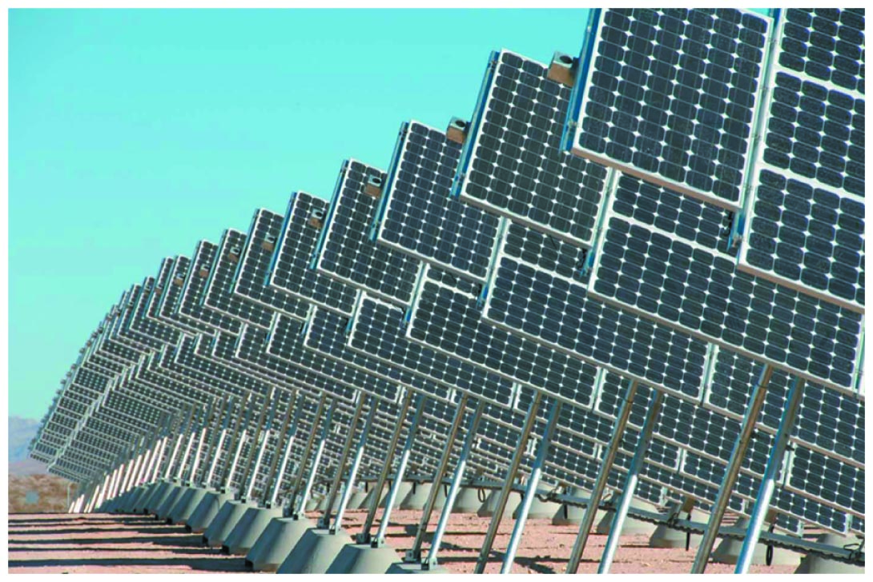
Solar Power
More energy from the sun hits Earth in 1 hour than all of the energy consumed by humans in an entire year.
— Nathan S. Lewis, California Institute of Technology

