Slide 1
Waves
disturbance that propagates through space & time
usually with transfer of energy
Mechanical
requires a medium
Electromagnetic
no medium required
Mechanical waves:
sound, water, seismic …. ‘the wave’
Electromagnetic waves:
all light - radio, microwave, infrared, visible ...

Slide 2
Waves travel & transfer energy from place to place
need not be permanent displacement
e.g., oscillation about fixed point
Mechanical waves require a medium
it must be an elastic medium
cannot be perfectly stiff or perfectly pliable … no wave!
everything moves in unison
only translation
all particles move independently
no propagation

Slide 3
Most waves are of two sorts:
“String” type :
particles oscillating perpendicular to propagation
“Density” type :
particles oscillating parallel to propagation

Slide 4
Describing waves
example: mass on a spring; oscillation perp. to wave direction
y
wavelength λ
A
wave propagation
y0
2A
time
crest
node
A = amplitude = intensity
λ = wavelength = char. size
f = frequency, full periods/sec
y0
trough
time

Slide 5
y
wavelength λ
λ characterizes
SPATIAL variation
f characterizes
TIME variation
A
y0
2A
time
T = Period = how long per cycle
T = 1/f or f = 1/T
frequency - wavelength - velocity:
λf = v = velocity of wave propagation
or vT = λ …. travel one wavelength per period
simplest wave: sinusoid, like y = sin(x)

Slide 6
Doppler Effect:
moving relative to waves

Slide 7
Chapter 20: Sound

Slide 8
This lecture will help you understand:
Nature of Sound
Origin of Sound
Sound in Air
Media That Transmit Sound
Speed of Sound in Air
Reflection of Sound
Refraction of Sound
Energy in Sound Waves
Forced Vibrations
Natural Frequency
Resonance
Interference
Beats

Slide 9
Nature of Sound
Sound is a form of energy that exists whether or not it is heard.

Slide 10
Origin of Sound
Most sounds are waves produced by the vibrations of matter.
For example:
In a piano, a violin, and a guitar, the sound is produced by the vibrating strings;
in a saxophone, by a vibrating reed;
in a flute, by a fluttering column of air at the mouthpiece;
in your voice due to the vibration of your vocal chords.

Slide 11
Origin of Sound
The original vibration stimulates the vibration of something larger or more massive, such as
the sounding board of a stringed instrument,
the air column within a reed or wind instrument, or
the air in the throat and mouth of a singer.
This vibrating material then sends a disturbance through the surrounding medium, usually air, in the form of longitudinal sound waves.

Slide 12
Origin of Sound
Under ordinary conditions, the frequencies of the vibrating source and sound waves are the same.
The subjective impression about the frequency of sound is called pitch.
The ear of a young person can normally hear pitches corresponding to the range of frequencies between about 20 and 20,000 Hertz.
As we grow older, the limits of this human hearing range shrink, especially at the high-frequency end.

Slide 13
Origin of Sound
Sound waves with frequencies below 20 hertz are infrasonic (frequency too low for human hearing).
Sound waves with frequencies above 20,000 hertz are called ultrasonic (frequency too high for human hearing).
We cannot hear infrasonic and ultrasonic sound.

Slide 14
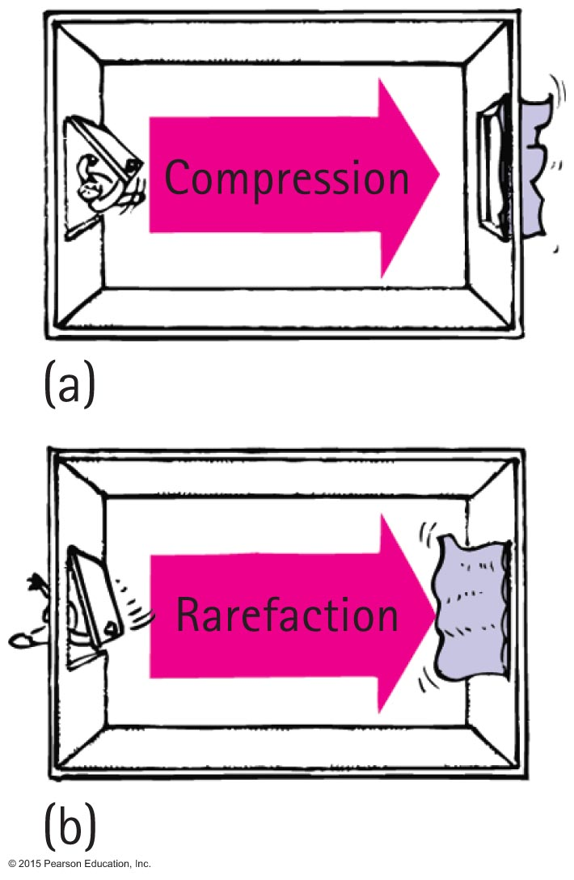
Sound in Air
Sound waves
are vibrations made of compressions and rarefactions.
are longitudinal waves.
require a medium.
travel through solids, liquids, and gases.

Slide 15
Sound in Air
Wavelength of sound
Distance between successive compressions or rarefactions

Slide 16
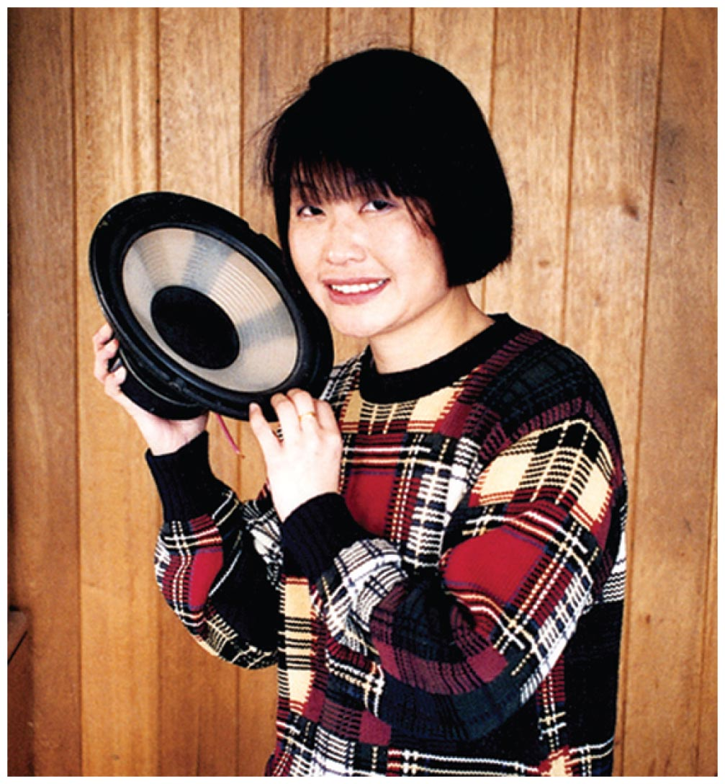
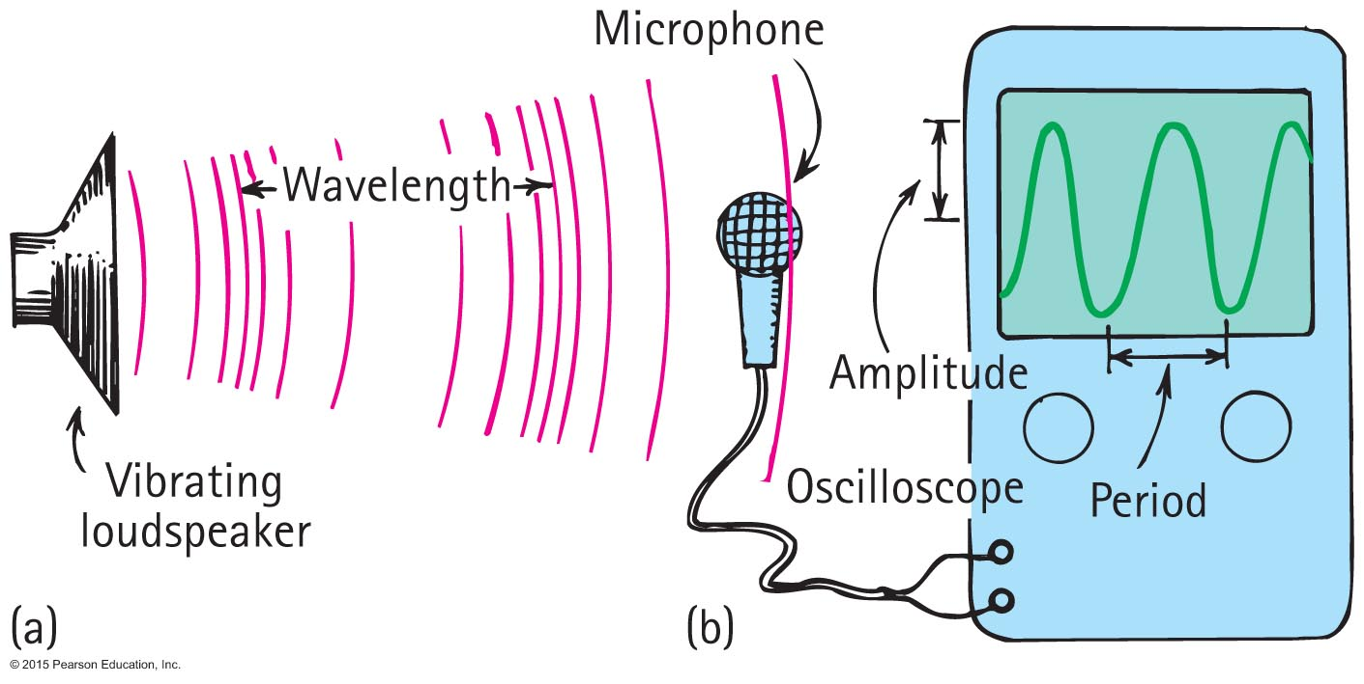
Sound in Air
How sound is heard from a radio loudspeaker
Radio loudspeaker is a paper cone that vibrates.
Air molecules next to the loudspeaker set into vibration.
Produces compressions and rarefactions traveling in air.
Sound waves reach your ears, setting your eardrums into vibration.
Sound is heard.

Slide 17
Media That Transmit Sound
Any elastic substance — solid, liquid, gas, or plasma — can transmit sound.
In elastic liquids and solids, the atoms are relatively close together, respond quickly to one another's motions, and transmit energy with little loss.
Sound travels about 4 times faster in water than in air and about 15 times faster in steel than in air.
Why? Stronger bonding of atoms!

Slide 18
Speed of Sound in Air
Speed of sound
Depends on wind conditions, temperature, humidity
Speed in dry air at 0ºC is about 330 m/s (~740mph)
In water vapor slightly faster.
In warm air faster than cold air.
Each degree rise in temperature above 0ºC, speed of sound in air increases by 0.6 m/s
Speed in water about 4 times speed in air.
Speed in steel about 15 times its speed in air.

Slide 19
Solids
bonds are like springs
atoms respond to each other’s motions
speed of sound <-> crystal structure, bonding
bond strength <-> speed of sound
Liquids – also true, but less so …

Slide 20
Gasses, like air?
“spring force”?
creation of partial vacuum / lower pressure region
air moves in to fill void
Horribly inefficient
Depends on PRESSURE of gas
Depends on WHAT GAS
vacuum (e.g., space) - nothing there to compress/expand
(solid in vacuum … still OK)

Slide 21
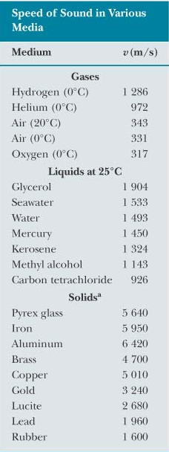
Result: sound is really slow in air
faster in : Warm air (0.6 m/s per ºC)
Humid air (slightly)
about one MILLIONTH light speed
e.g.., golf ball struck 500m away
light: speed is c=3 x 10⁸ m/s
sound:

Slide 22
Speed of Sound in Air CHECK YOUR NEIGHBOR
You watch a person chopping wood and note that after the last chop you hear it 1 second later. How far away is the chopper?
330 m
More than 330 m
Less than 330 m
There's no way to tell.
Notes:
A. 330 m

Slide 23
Speed of Sound in Air CHECK YOUR ANSWER
You watch a person chopping wood and note that after the last chop you hear it 1 second later. How far away is the chopper?
330 m (~1100 ft / 360 yd … baseball/softball or golf)
More than 330 m
Less than 330 m
There's no way to tell.
Notes:
A. 330 m

Slide 24
Speed of Sound in Air CHECK YOUR NEIGHBOR
You hear thunder 2 seconds after you see a lightning flash. How far away is the lightning?
340 m
660 m
More than 660 m
There's no way to tell.
Notes:
B. 660 m/s

Slide 25
Speed of Sound in Air CHECK YOUR NEIGHBOR
You hear thunder 2 seconds after you see a lightning flash. How far away is the lightning?
340 m
660 m (~0.4mi)
More than 660 m
There's no way to tell.
Notes:
B. 660 m/s

Slide 26
Sound carries ENERGY in density waves = pressure modulation
P = F/A = (F*d)/(A*d) = W/V = (energy)/(volume)
variation of pressure = variation of energy per unit volume
sound power = (energy)/(time)
sound intensity = (power)/(unit area)

Slide 27
Sound intensity decreases as 1/(dist)²

Slide 28
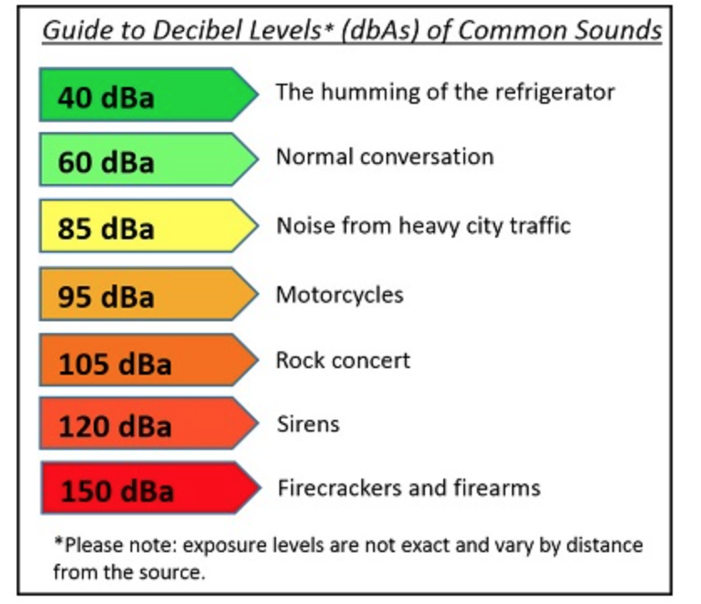
Measure intensity in decibels.
Smallest audible sound (near total silence) is 0 dB.
A sound 10 times more powerful is 10 dB (10¹).
A sound 100 times more powerful is 20 dB (10²).
A sound 1,000 times more powerful is 30 dB (10³).
https://www1.nyc.gov/site/doh/health/health-topics/noise.page

Slide 29
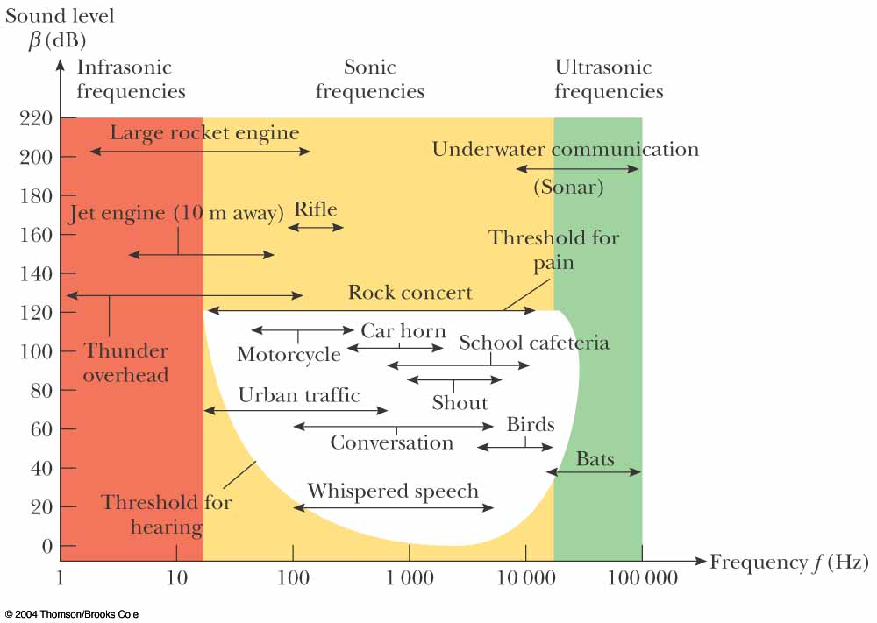

Slide 30
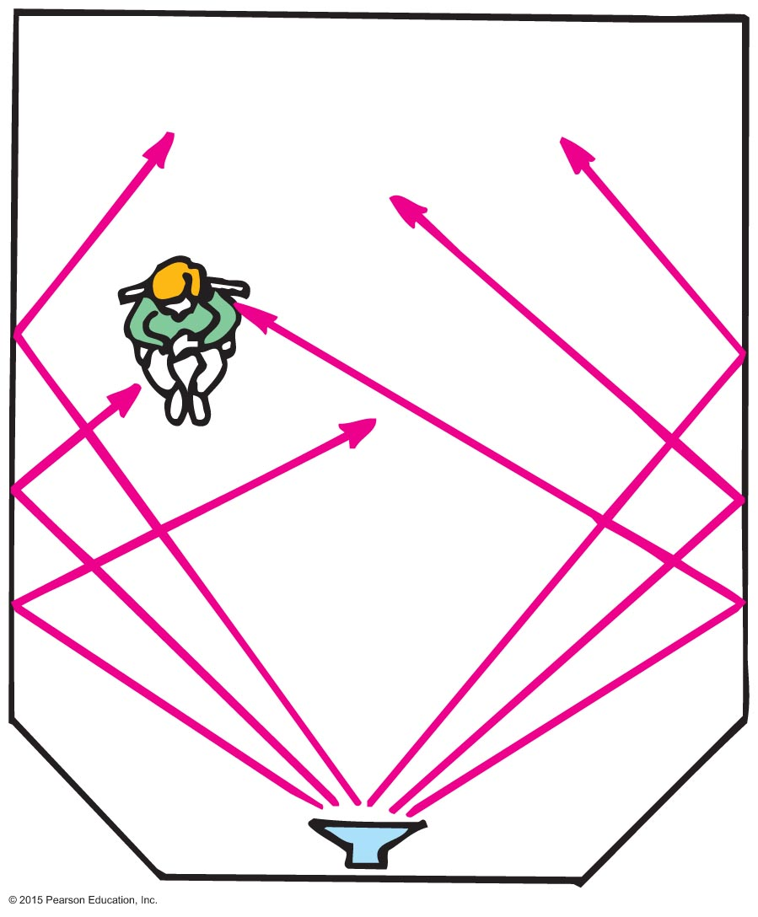
Reflection of Sound
Reflection
Process in which sound encountering a surface is returned
Often called an echo
Multiple reflections—called reverberations

Slide 31
Reverberation
different paths from source to observer are possible
slight difference in path length = time lag
Yuck.

Slide 32
For good sound, this effect must be optimized
walls too reflective: potential reverb problems
walls not reflective enough: “dead” sound, low level
reflected sound = “lively” & “full” … like in the shower
Best:
parabolic or elliptical reflector
Both have focal points

Slide 33
a.k.a. “whispering gallery”
parabolic or elliptical room
St. Paul’s cathedral
London
can hear a whisper across the room

Slide 34
An ellipse has two focal points
any wave passing through one always reflects to other

Slide 35
Reflection of Sound CHECK YOUR NEIGHBOR
Reverberations are best heard when you sing in a room with
carpeted walls.
hard-surfaced walls.
open windows.
None of the above.
Notes:
B. hard-surfaced walls.

Slide 36
Reflection of Sound CHECK YOUR ANSWER
Reverberations are best heard when you sing in a room with
carpeted walls.
hard-surfaced walls.
open windows.
None of the above.
Explanation:
Rigid walls better reflect sound energy. Fabric is absorbent, and open windows let sound energy escape from the room.
Notes:
B. hard-surfaced walls.

Slide 37
Reflection of Sound A situation to ponder…
Consider a person attending a concert that is being broadcast over the radio. The person sits about 45 m from the stage and listens to the radio broadcast with a transistor radio over one ear and a nonbroadcast sound signal with the other ear. Further suppose that the radio signal must travel all the way around the world before reaching the ear.

Slide 38
A situation to ponder… CHECK YOUR NEIGHBOR
Which signal will be heard first?
Radio signal
Nonbroadcast sound signal
Both at the same time.
None of the above.
Notes:
C. Both at the same time.

Slide 39
A situation to ponder… CHECK YOUR ANSWER
Which signal will be heard first?
Radio signal
Nonbroadcast sound signal
Both at the same time.
None of the above.
Explanation:
A radio signal travels at the speed of light, 3 x 10⁸ m/s.
Time to travel 45 m at 340 m/s ≈ 0.13 s. Time to travel 4 x 10⁷ m (Earth's circumference) at 3 x 10⁸ m/s ≈ 0.13 s. Therefore, if you sit farther back at the concert, the radio signal would reach you first!
Notes:
C. Both at the same time.

Slide 40
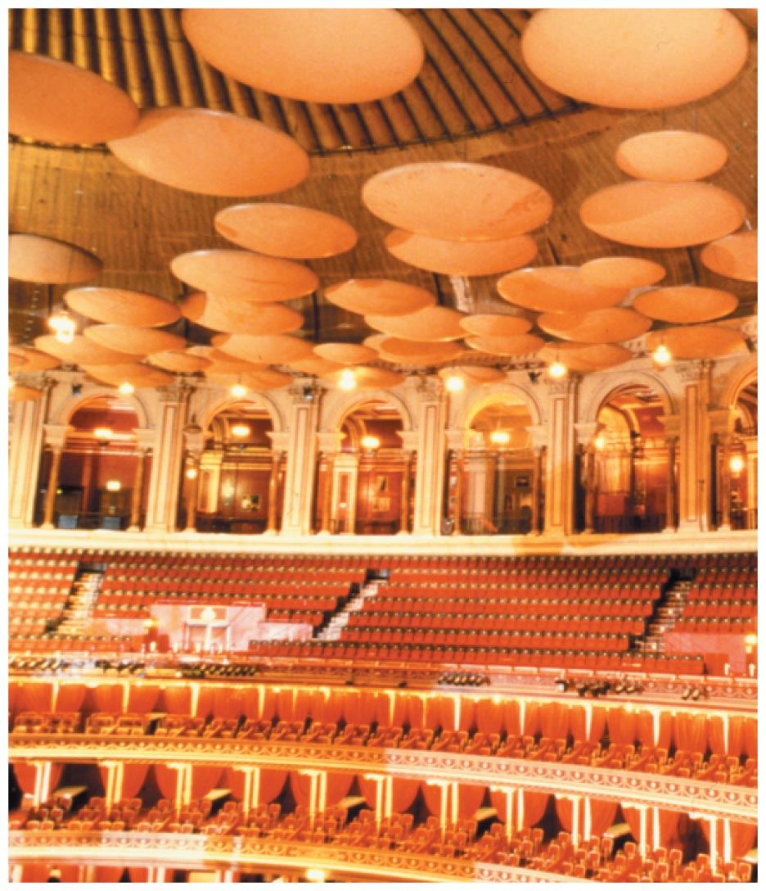
Reflection of Sound
Acoustics
Study of sound
Example: A concert hall aims for a balance between reverberation and absorption. Some have reflectors to direct sound (which also reflect light—so what you see is what you hear).

Slide 41
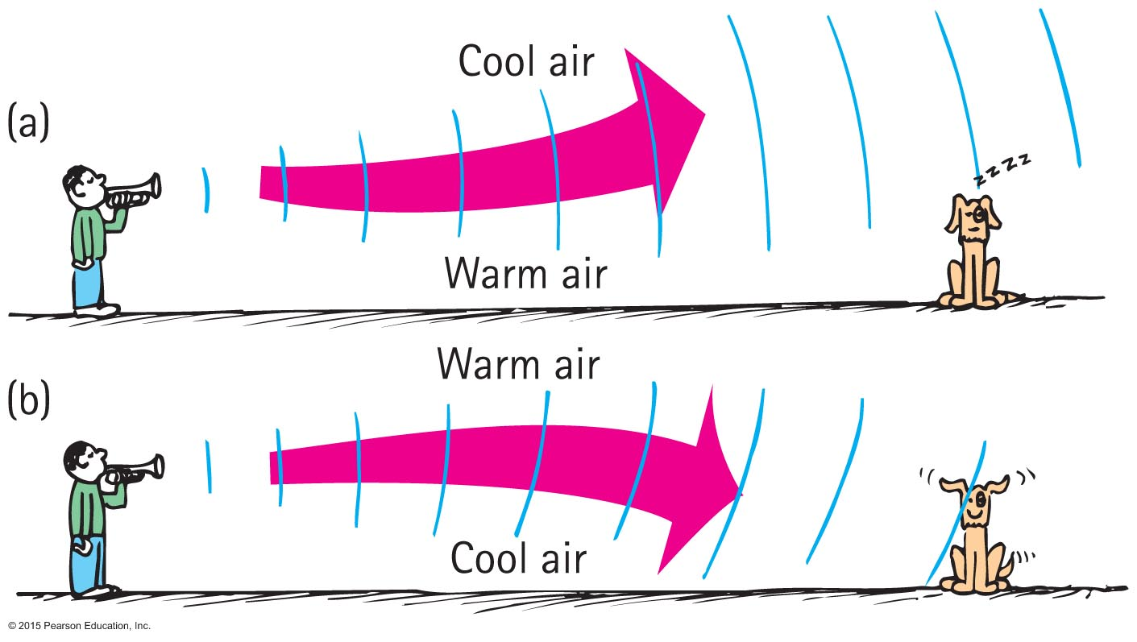
Refraction of Sound
Refraction
Bending of waves—caused by changes in speed affected by
wind variations.
temperature variations.

Slide 42
Happens when the wave speed changes
If the air above the earth is warmer than that at the surface, sound will be bent back downward toward the surface by refraction.
Bends toward cooler, slower side

Slide 43
Refraction of Sound CHECK YOUR NEIGHBOR
When air near the ground on a warm day is warmed more than the air above, sound tends to bend
upward.
downward.
at right angles to the ground.
None of the above.
Notes:
A. upward.

Slide 44
Refraction of Sound CHECK YOUR ANSWER
When air near the ground on a warm day is warmed more than the air above, sound tends to bend
upward.
downward.
at right angles to the ground.
None of the above.
Notes:
A. upward.

Slide 45
Refraction of Sound CHECK YOUR NEIGHBOR
In the evening, when air directly above a pond is cooler than air above, sound across a pond tends to bend
upward.
downward.
at right angles to the ground.
None of the above.
Notes:
B. downward.

Slide 46
Refraction of Sound CHECK YOUR NEIGHBOR
In the evening, when air directly above a pond is cooler than air above, sound across a pond tends to bend
upward.
downward.
at right angles to the ground.
None of the above.
Explanation:
This is why sound from across a lake at night is easily heard.
Notes:
B. downward.

Slide 47
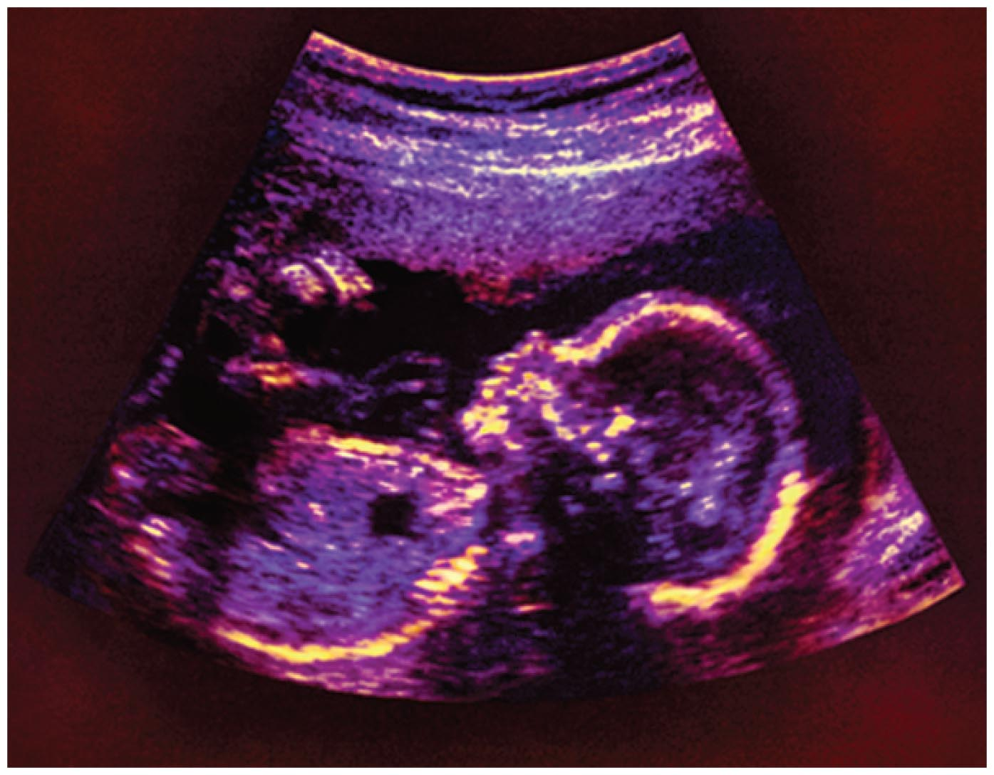
Reflection and Refraction of Sound
Multiple reflection and refractions of ultrasonic waves
Device sends high-frequency sounds into the body and reflects the waves more strongly from the exterior of the organs, producing an image of the organs.
Used instead of X-rays by physicians to see the interior of the body.

Slide 48
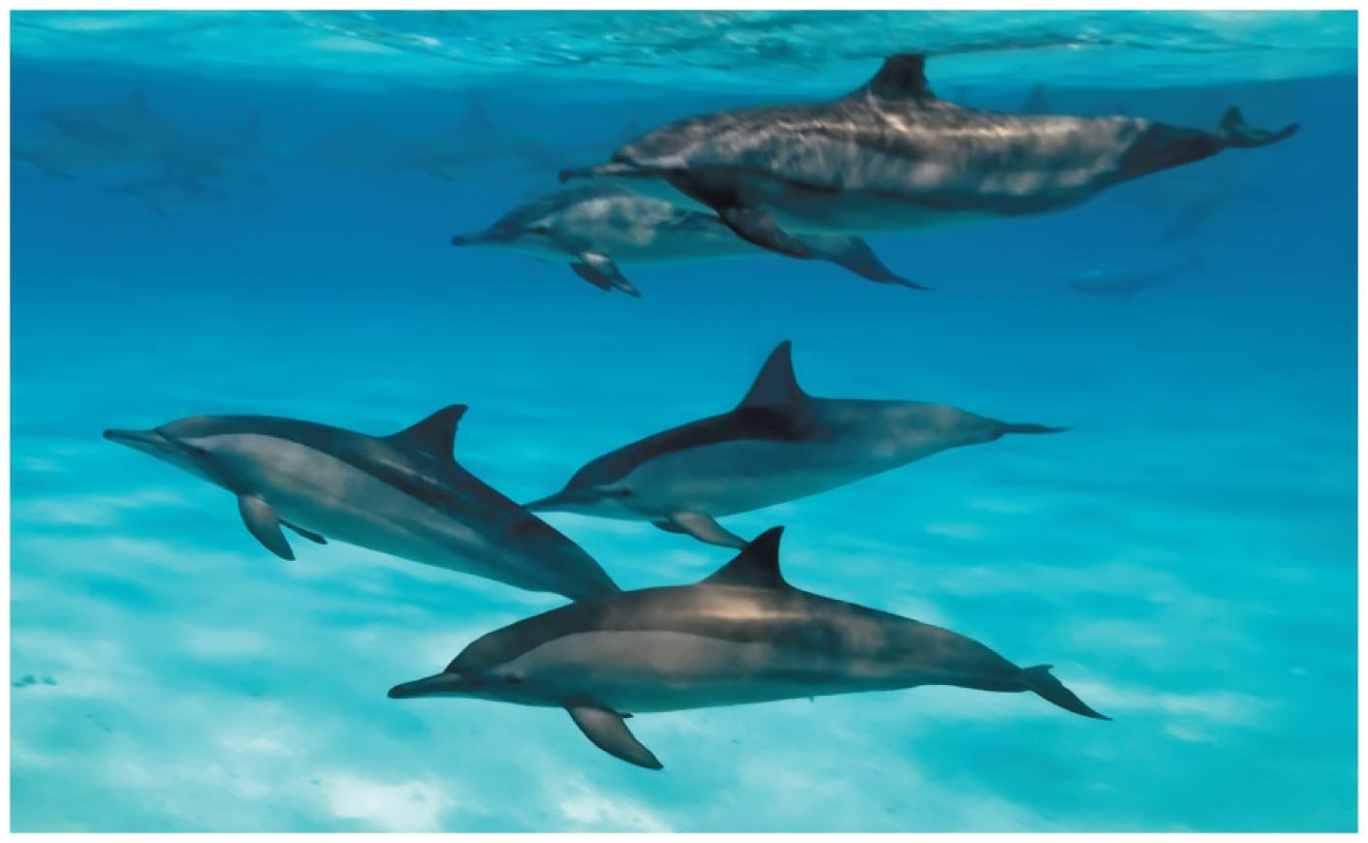
Reflection and Refraction of Sound
Dolphins emit ultrasonic waves to enable them to locate objects in their environment.

Slide 49
Diffraction – bending of waves

Slide 50
Each area near a boundary is a source for new waves
This is how waves ‘bend’ around obstacles
Happens when obstacle size ~ wavelength

Slide 51
This happens with sound!

Slide 53
Forced Vibrations
Forced vibration
Setting up of vibrations in an object by a vibrating force
Example: factory floor vibration caused by running of heavy machinery

Slide 54
Natural Frequency
Natural frequency
Own unique frequency (or set of frequencies)
Dependent on
elasticity
shape of object

Slide 55
Resonance
A phenomenon in which the frequency of forced vibrations on an object matches the object's natural frequency – very effective
Examples:
Swinging in rhythm with the natural frequency of a swing
Tuning a radio station to the "carrier frequency" of the radio station
Troops marching in rhythm with the natural frequency of a bridge (a no-no!)

Slide 56
Resonance
Dramatic example of wind-generated resonance

Slide 57
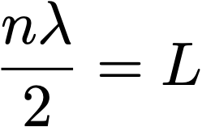
Natural (resonance) frequencies – standing waves
objects have characteristic vibration modes - unique sounds
composition
shape
density
elasticity
e.g., string
n = integer = 1, 2 ,3, …
n = 1 is fundamental (lowest) mode
<- depends on all these

Slide 58
geometry dictates allowed frequencies - fundamental + harmonics
guitar strings: frets change L
what is the velocity v ???

Slide 59
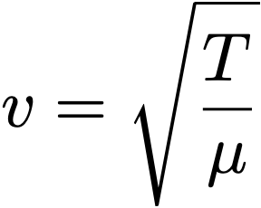
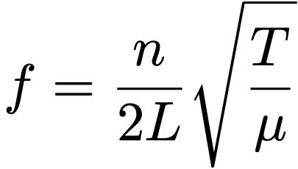
Velocity is related to:
T = Tension (force)
μ = mass per unit length (weight)
string fixed at both ends
change L via FRETS shorter = higher pitch
tune via TENSION tighter = higher pitch
range via MASS thinner = higher pitch
(same deal for a piano, less the frets)

Slide 60
fundamental (n=1)
1st overtone / 2nd harmonic (n=2)
3rd harmonic (n=3)
4th harmonic (n=4)
...
...
it is different if ends are not fixed!

Slide 61
example: air columns (e.g., pipe organ)
we can set up resonance in a fixed tube of air
pipe open at both ends
STANDING WAVES set up in tube
need nodes at the ends
max velocity
zero pressure difference
math? same as for the string
v = 340 m/s for air at RT

Slide 62
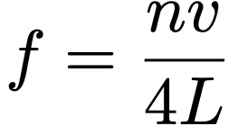
Things are different when we close one end of the pipe!
air velocity is ZERO at one end!
effectively, twice as long
so pitch is twice as low
(also, now n must be ODD)
(not all harmonics are allowed!)

Slide 63
OPEN - OPEN pipes : like strings, all harmonics present
OPEN - CLOSED pipes : only ODD harmonics, 2x lower pitch
presence (or absence) of harmonics changes “tone” or ”timbre”
Total waveform you hear = sum of fundamental + harmonics!

Slide 64
A clarinet is a tube CLOSED on one end - only odd harmonics
A saxophone has a conical bore which is like an open tube
all harmonics present, “harsher” sound
https://pages.mtu.edu/~suits/clarinet.html

Slide 65
Pitch and frequency

Slide 66
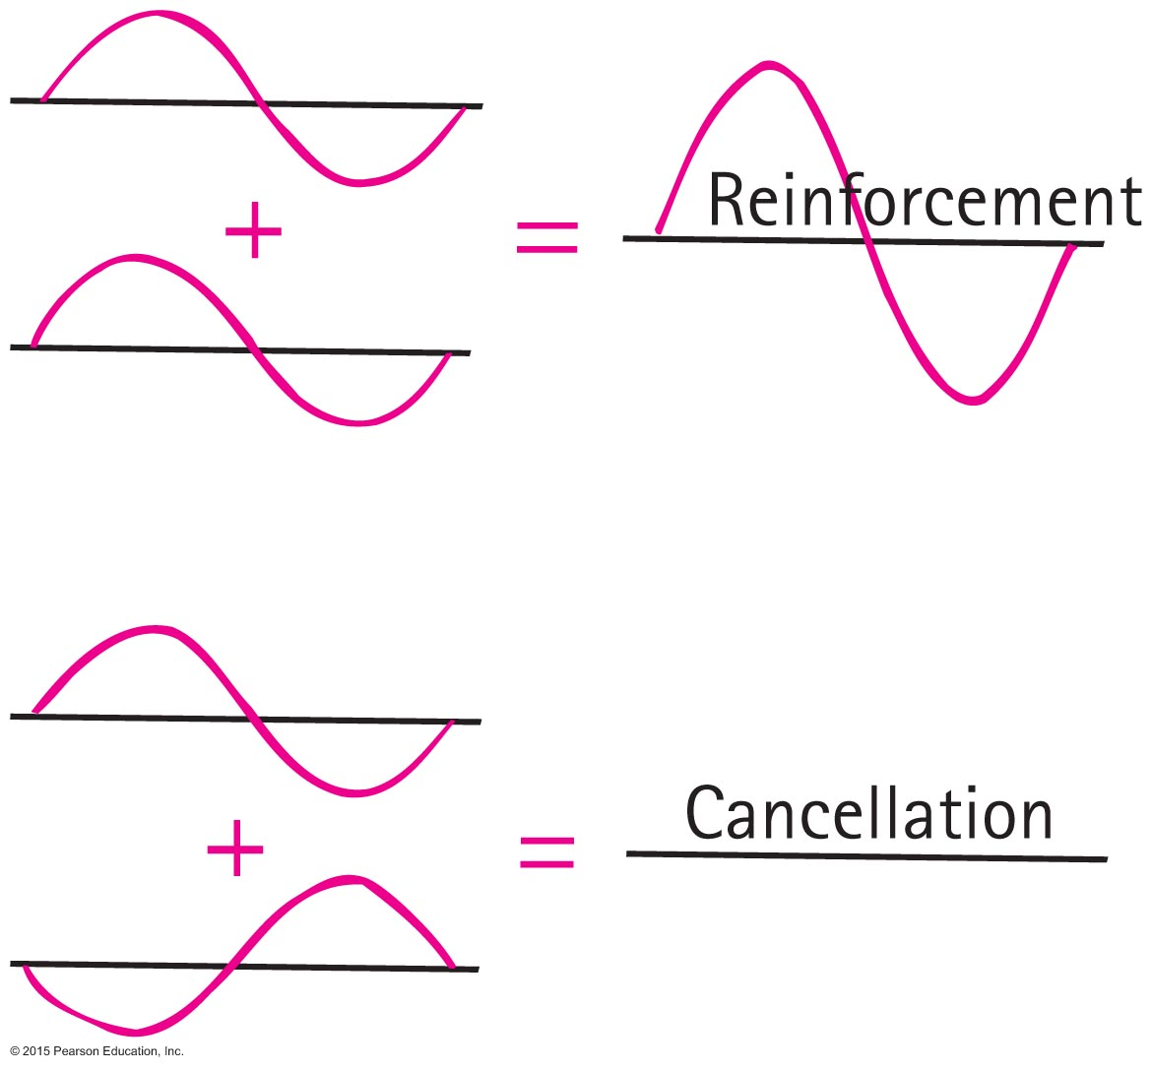
Interference
Interference
Property of all waves and wave motion
Both sound and light
Superposition of waves that may either reinforce or cancel each other

Slide 67
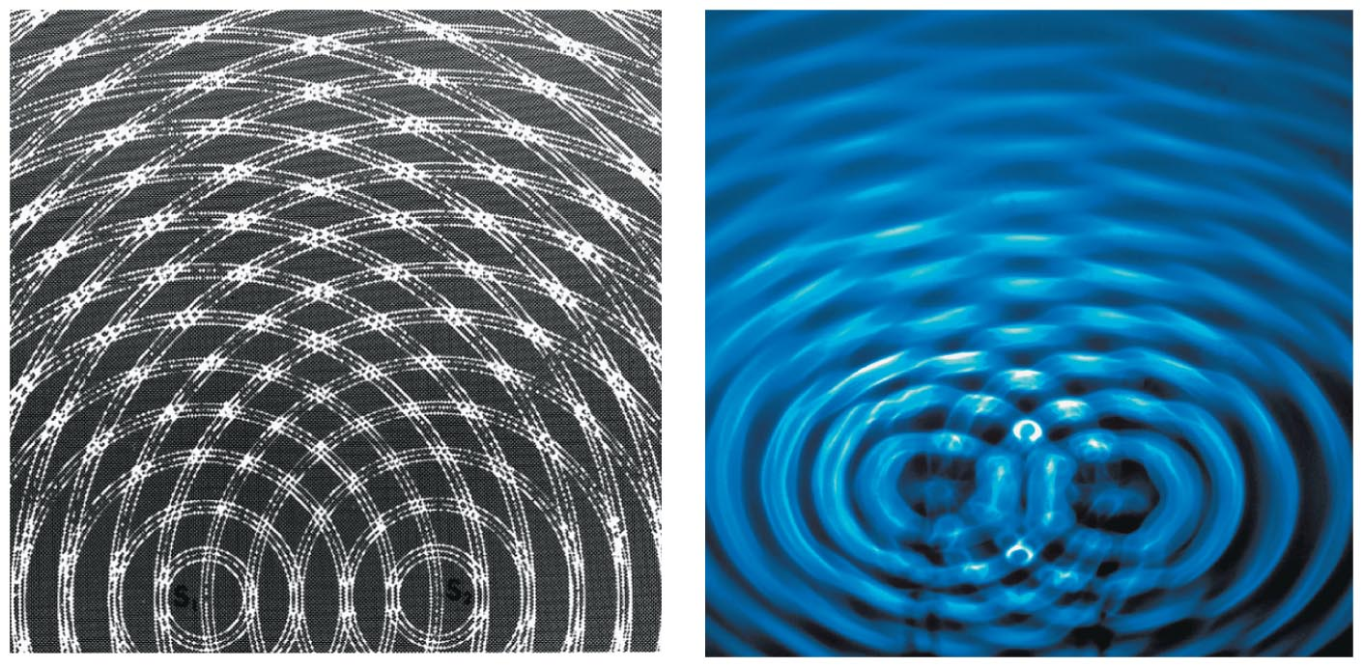
Interference
Two patterns of interference
Constructive interference
increased amplitude when the crest of one wave overlaps the crest of another wave
Destructive interference
reduced amplitude when the crest of one wave overlaps the trough of another wave

Slide 68
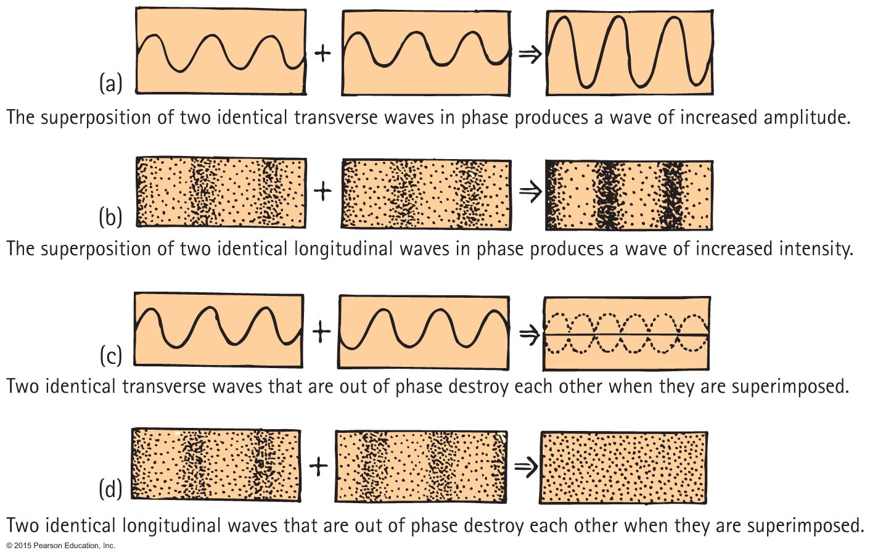
Interference

Slide 69
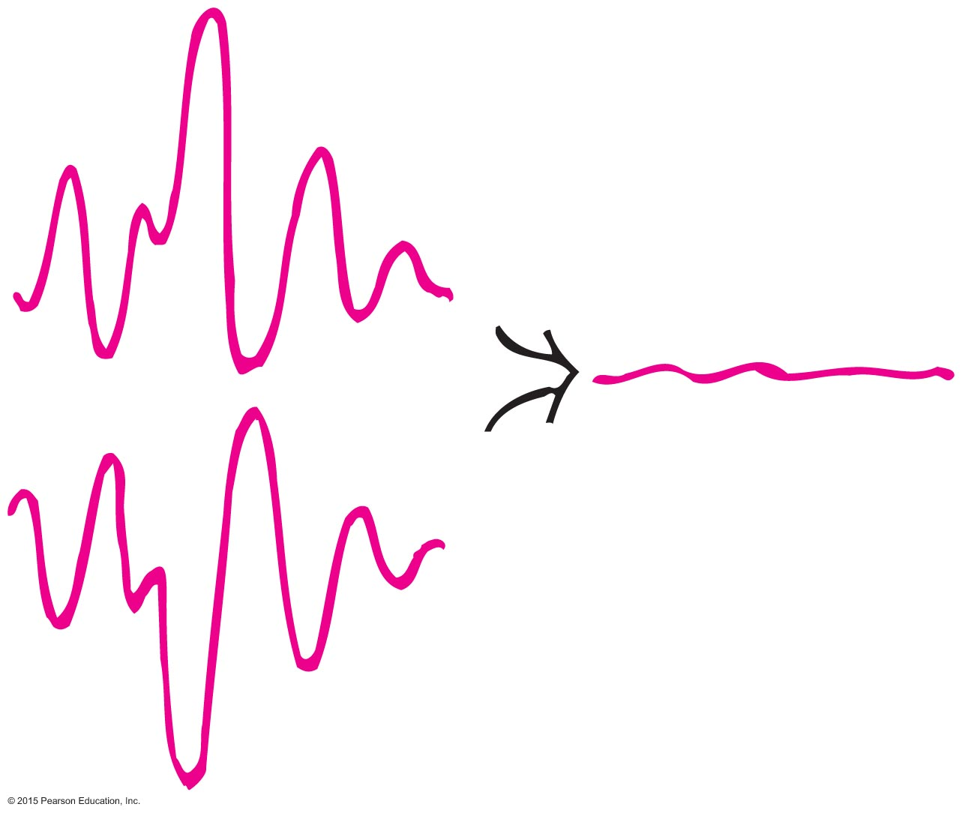
Interference
Application of sound interference
Noise-cancelling headphones
Destructive sound interference in noisy devices such as jackhammers that are equipped with microphones to produce mirror-image wave patterns fed to operator's earphone, canceling the jackhammer's sound

Slide 70
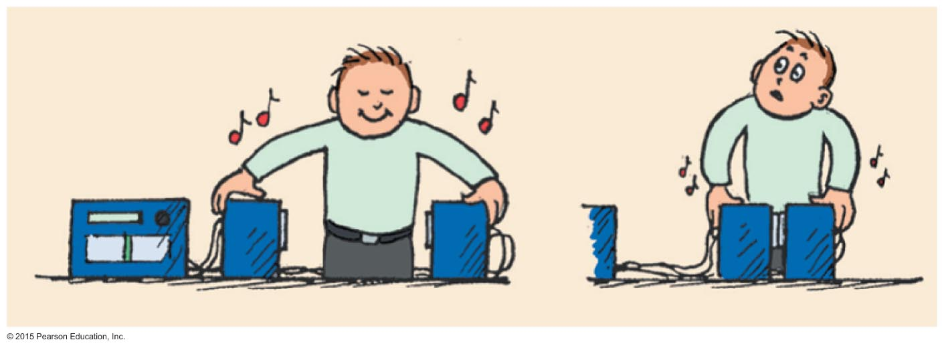
Interference
Application of sound interference (continued)
Sound interference in stereo speakers out of phase sending a monoaural signal (one speaker sending compressions of sound and other sending rarefactions)
As speakers are brought closer to each other, sound is diminished.

Slide 71
Beats
Periodic variations in the loudness of sound due to interference
Occur with any kind of wave
Provide a comparison of frequencies

Slide 72
Beats
Applications
Piano tuning by listening to the disappearance of beats from a tuning fork and a piano key
Tuning instruments in an orchestra by listening for beats between instruments and piano tone

