Slide 1
Chapter 21: Musical Sounds

Slide 2
This lecture will help you understand:
Noise and Music
Musical Sounds
Pitch
Sound Intensity and Loudness
Quality
Musical Instruments
Fourier Analysis
Digital Versatile Discs (DVDs)

Slide 3
Noise and Music
Noise corresponds to an irregular vibration of the eardrum produced by some irregular vibration in our surroundings, a jumble of wavelengths and amplitudes.
White noise is a mixture of a variety of frequencies of sound.

Slide 4
Noise and Music
Music is the art of sound and has a different character.
Musical sounds have periodic tones–or musical notes.
The line that separates music and noise can be thin and subjective.

Slide 5
Musical Sounds
Musical tone
Three characteristics:
Pitch
determined by frequency of sound waves received by the ear
determined by fundamental frequency, lowest frequency
Intensity
determines the perceived loudness of sound
Quality
determined by prominence of the harmonics
determined by presence and relative intensity of the various partials

Slide 6
Pitch
Music is organized on many different levels. Most noticeable are musical notes.
Each note has its own pitch. We can describe pitch by frequency.
Rapid vibrations of the sound source (high frequency) produce sound of a high pitch.
Slow vibrations (low frequency) produce a low pitch.

Slide 7
Pitch
Musicians give different pitches different letter names: A, B, C, D, E, F, G.
Notes A through G are all notes within one octave.
Multiply the frequency on any note by 2, and you have the same note at a higher pitch in the next octave.
A piano keyboard covers a little more than seven octaves.

Slide 8
Pitch
Different musical notes are obtained by changing the frequency of the vibrating sound source.
This is usually done by altering the size, the tightness, or the mass of the vibrating object.

Slide 9
Pitch
High-pitched sounds used in music are most often less than 4000 Hz, but the average human ear can hear sounds with frequencies up to 18,000 Hz.
Some people and most dogs can hear tones of higher pitch than this.
The upper limit of hearing in people gets lower as they grow older.
A high-pitched sound is often inaudible to an older person and yet may be clearly heard by a younger one.

Slide 10
Sound Intensity and Loudness
The intensity of sound depends on the amplitude of pressure variations within the sound wave.
The human ear responds to intensities covering the enormous range from 10^{–12} W/m² (the threshold of hearing) to more than 1 W/m² (the threshold of pain).

Slide 11
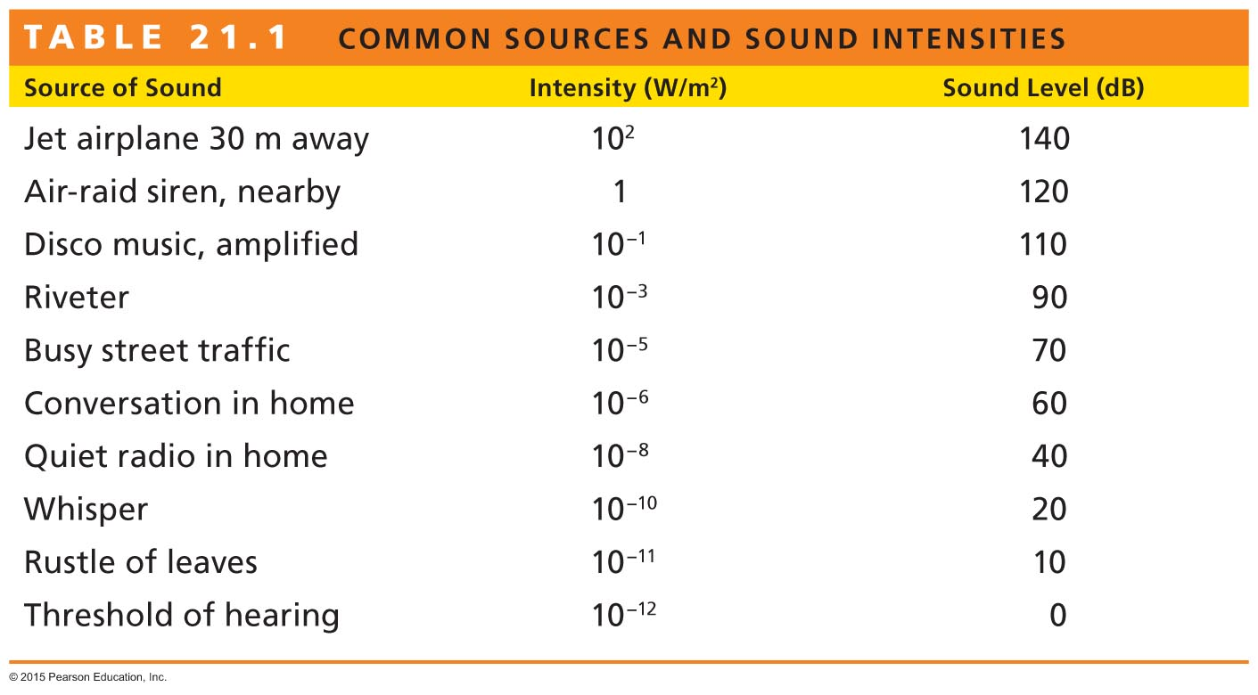
Sound Intensity and Loudness
Because the range is so great, intensities are scaled by factors of 10, with the barely audible 10^{–12} W/m² as a reference intensity called 0 bel (a unit named after Alexander Bell).
A sound 10 times more intense has an intensity of 1 bel (W/m²) or 10 decibels (dB)

Slide 12
Sound Intensity and Loudness
Sound intensity is a purely objective and physical attribute of a sound wave, and it can be measured by various acoustical instruments.
Loudness is a physiological sensation.
The ear senses some frequencies much better than others.
A 3500-Hz sound at 80 decibels sounds about twice as loud to most people as a 125-Hz sound at 80 decibels.
Humans are more sensitive to the 3500-Hz range of frequencies.

Slide 13
Quality
We have no trouble distinguishing between the tone from a piano and a tone of the same pitch from a clarinet.
Each of these tones has a characteristic sound that differs in quality, the "color" of a tone—timbre.
Timbre describes all of the aspects of a musical sound other than pitch, loudness, or length of tone.

Slide 14
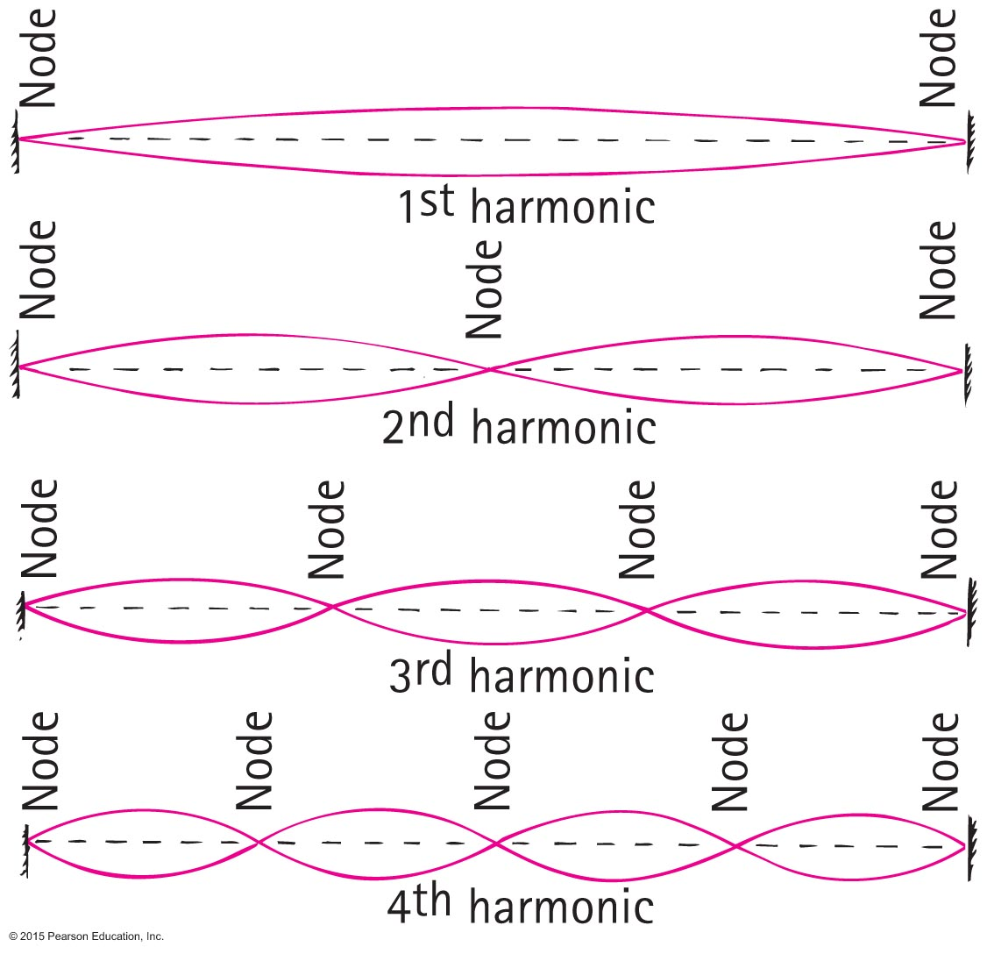
Quality
Most musical sounds are composed of a superposition of many tones differing in frequency.
The various tones are called partial tones, or simply partials. The lowest frequency, called the fundamental frequency, determines the pitch of the note.
A partial tone whose frequency is a whole-number multiple of the fundamental frequency is called a harmonic.
A composite vibration of the fundamental mode and the third harmonic is shown in the figure.

Slide 15
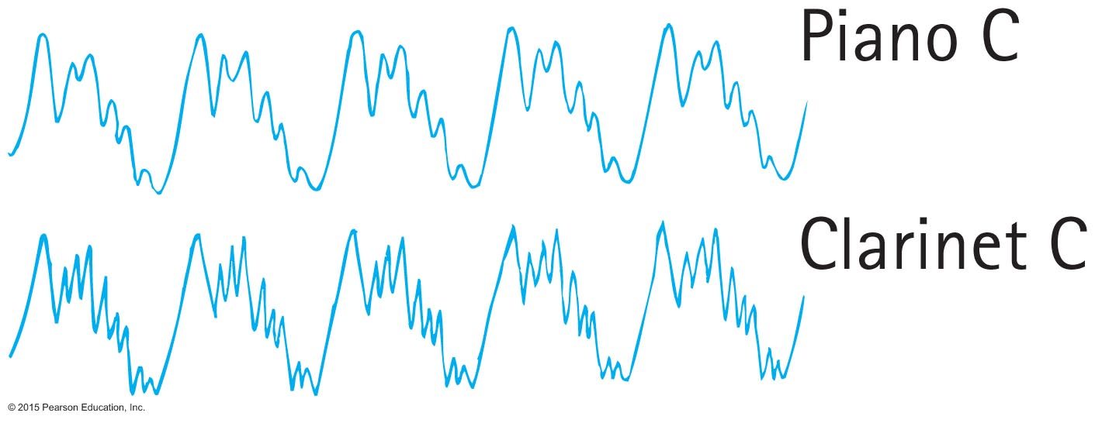
Quality
The quality of a tone is determined by the presence and relative intensity of the various partials.
The sound produced by a certain tone from the piano and a clarinet of the same pitch have different qualities that the ear can recognize because their partials are different.
A pair of tones of the same pitch with different qualities have either different partials or a difference in the relative intensity of the partials.

Slide 16
Musical Instruments
Vibrating strings
Vibration of stringed instruments is transferred to a sounding board and then to the air.
Vibrating air columns
Brass instruments.
Woodwinds—stream of air produced by musician sets a reed vibrating.
Fifes, flutes, piccolos—musician blows air against the edge of a hole to produce a fluttering stream.

Slide 17
Musical Instruments
Percussion
Striking a 2-dimensional membrane.
Tone produced depends on geometry, elasticity, and tension in the vibrating surface.
Pitch produced by changes in tension.

Slide 18
Musical Instruments
Electronic musical instrument
differs from conventional musical instruments
uses electrons to generate the signals that make up musical sounds
modifies sound from an acoustic instrument
demands the composer and player demonstrate an expertise beyond the knowledge of musicology

Slide 19
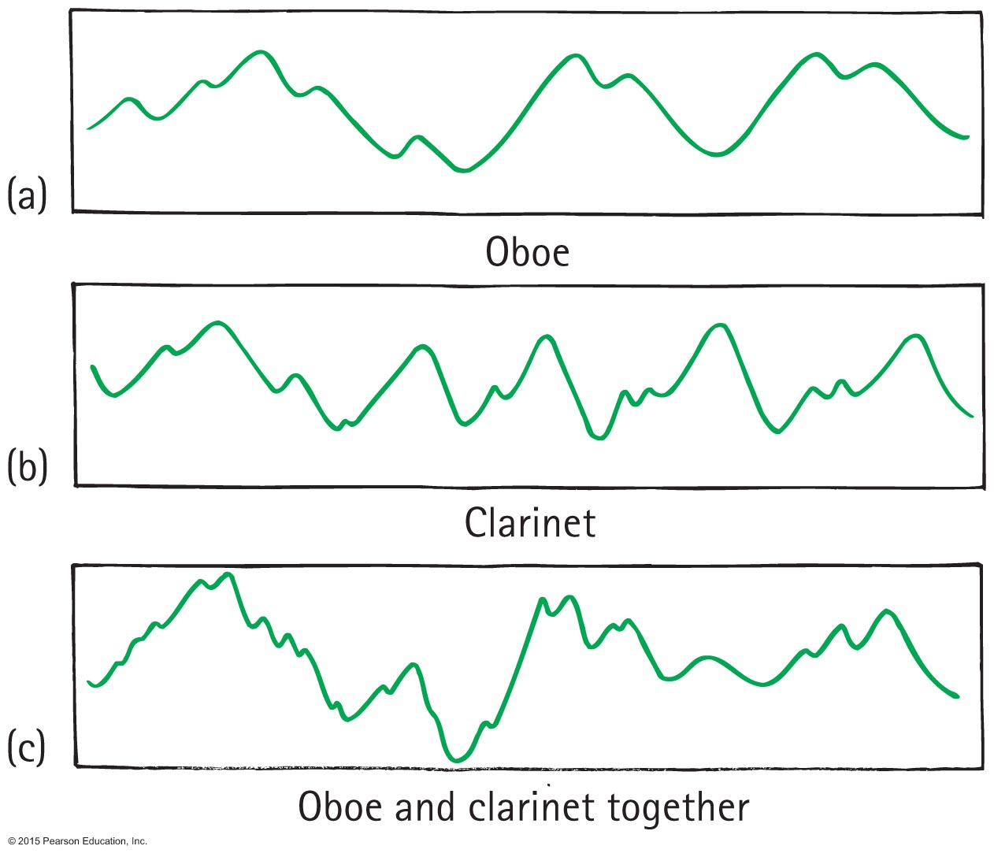
Fourier Analysis
The sound of an oboe displayed on the screen of an oscilloscope looks like this.
The sound of an clarinet displayed on the screen of an oscilloscope looks like this.
The two together look like this.

Slide 20
Fourier Analysis
Fourier discovered a mathematical regularity to the component parts of periodic wave motion.
He found that even the most complex periodic wave motion can be disassembled into simple sine waves that add together.
Fourier found that all periodic waves may be broken down into constituent sine waves of different amplitudes and frequencies.
The mathematical operation for performing this is called Fourier analysis.

Slide 21
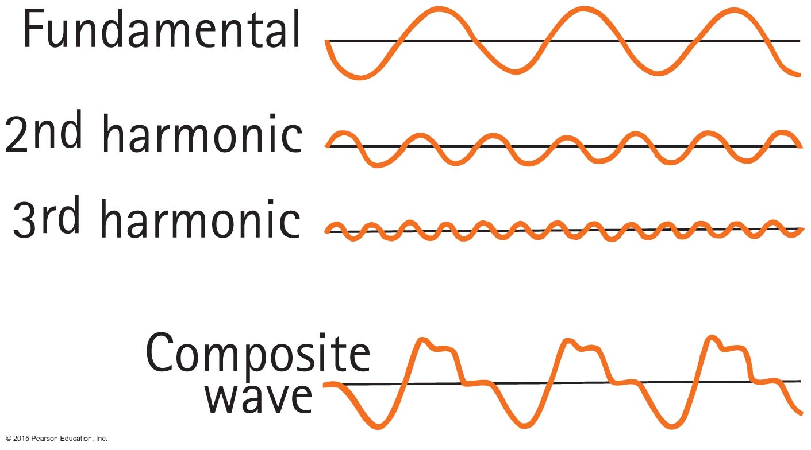
Fourier Analysis
When these pure tones are sounded together, they combine to give the tone of the violin.
The lowest-frequency sine wave is the fundamental and determines the pitch.
The higher-frequency sine waves are the partials that determine the quality.
Thus, the waveform of any musical sound is no more than a sum of simple sine waves.

Slide 22
Digital Versatile Discs (DVDs)
The output of phonograph records was signals like those shown below.
This type of continuous waveform is called an analog signal.
The analog signal can be changed to a digital signal by measuring the numerical value of its amplitude during each split second.

Slide 23
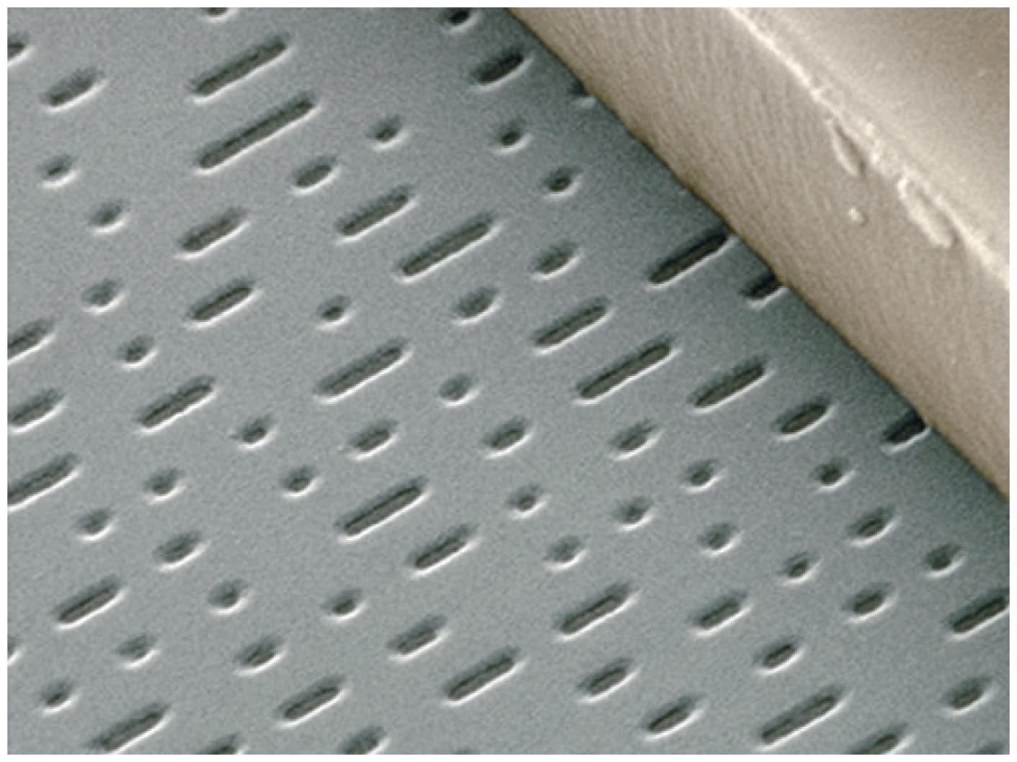
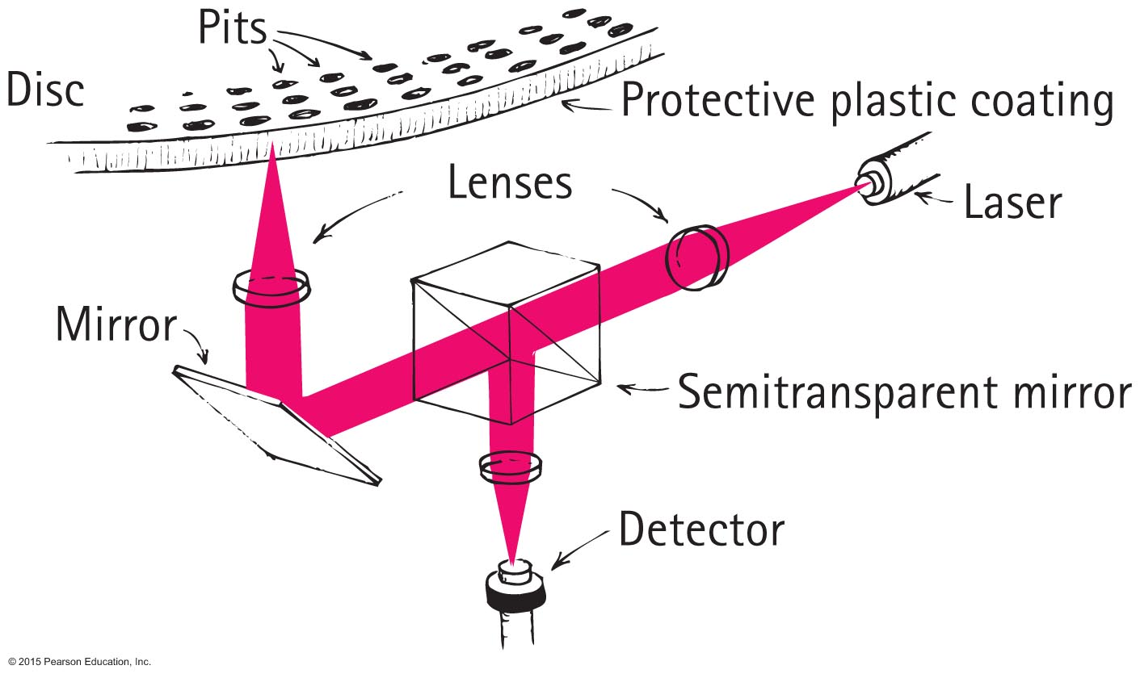
Digital Versatile Discs (DVDs)
Microscopic pits about one-thirtieth the diameter of a strand of human hair are imbedded in the CD or DVD
The short pits corresponding to 0.
The long pits corresponding to 1.
When the beam falls on a short pit, it is reflected directly into the player's optical system and registers a 0.
When the beam is incident upon a passing longer pit, the optical sensor registers a 1.
Hence the beam reads the 1 and 0 digits of the binary code.

