Slide 1
Chapter 16
Waves in One Dimension

Slide 2
Concepts
Chapter 16: Waves in One Dimension

Slide 3
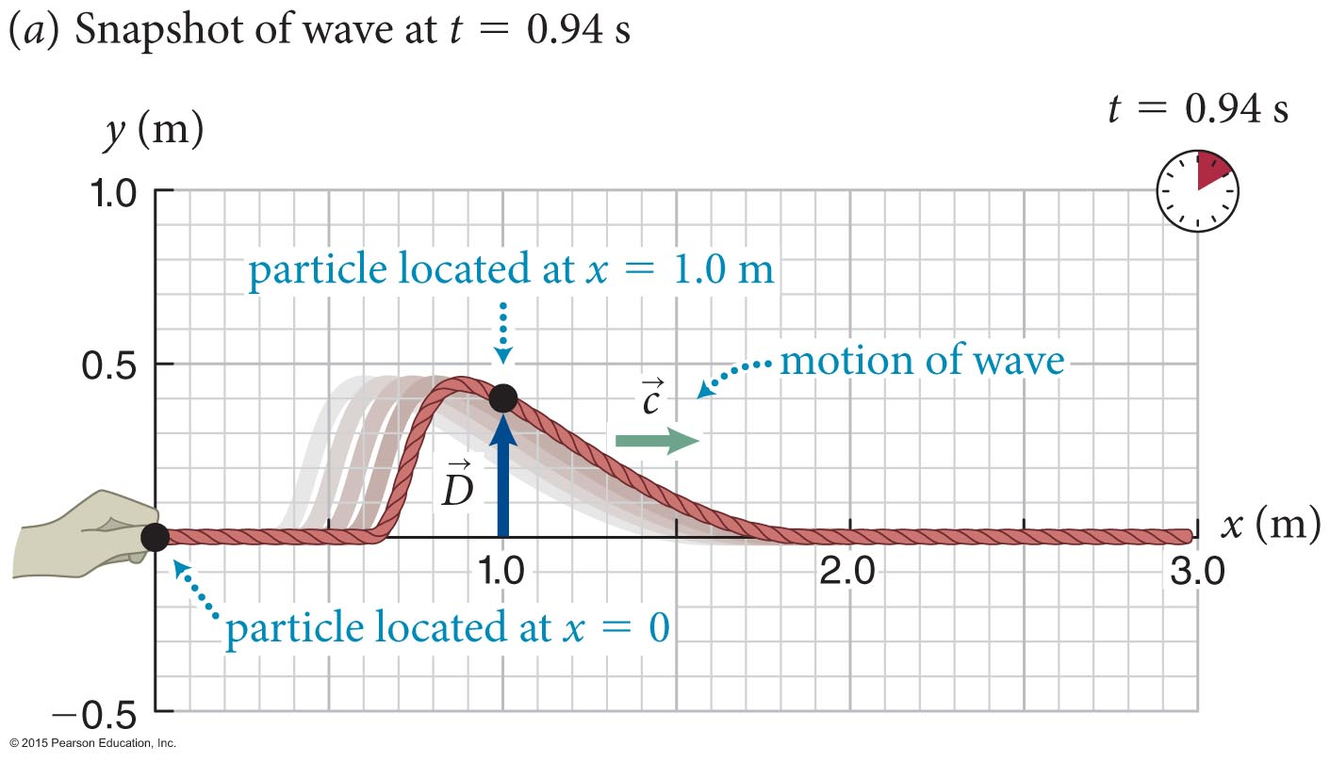
Section Goals
Section 16.1: Representing waves graphically
You will learn to
Visualize waves in one dimension using frame-sequence diagrams and displacement curves.
Differentiate the wave speed, c, and the speed of the particles of the medium, v

Slide 4
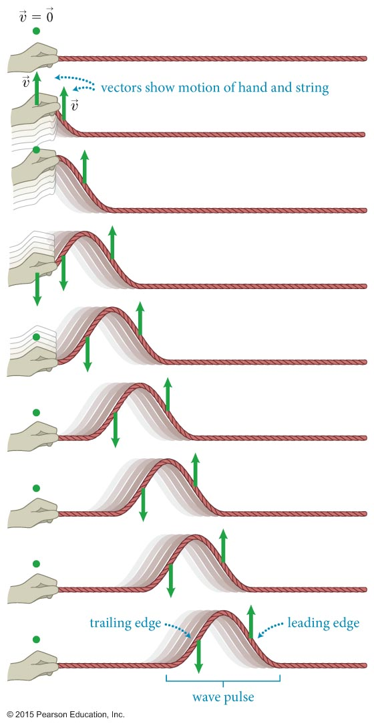
Section 16.1: Representing waves graphically
A transverse wave is a wave in which the medium movement is perpendicular to the wave pulse movement.
For example, a wave pulse travels along a string in a horizontal direction while the particles that make up the string move up and down.

Slide 5
Section 16.1: Representing waves graphically
As we can see from the figure, it is important to realize that
  The motion of a wave (or of a single wave pulse) is distinct from the motion of the particles in the medium that transmits the wave (or pulse).
  Wave moves right, particles move up & down

Slide 6
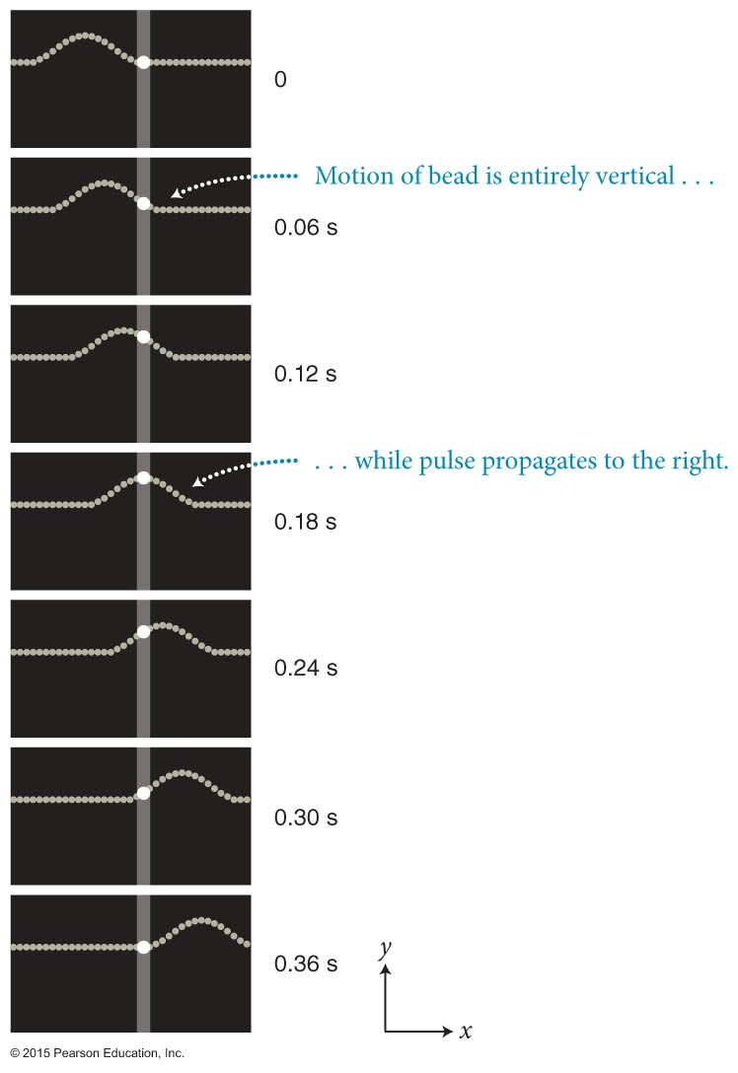
Section 16.1: Representing waves graphically
The wave speed c of a wave pulse along a string is constant.

Slide 7
Section 16.1: Representing waves graphically
Part (a) shows a “snapshot” of a triangular pulse traveling along a string.
The vector represents the displacement of one particular particle located at a position x along the string at a given instant t.

Slide 8
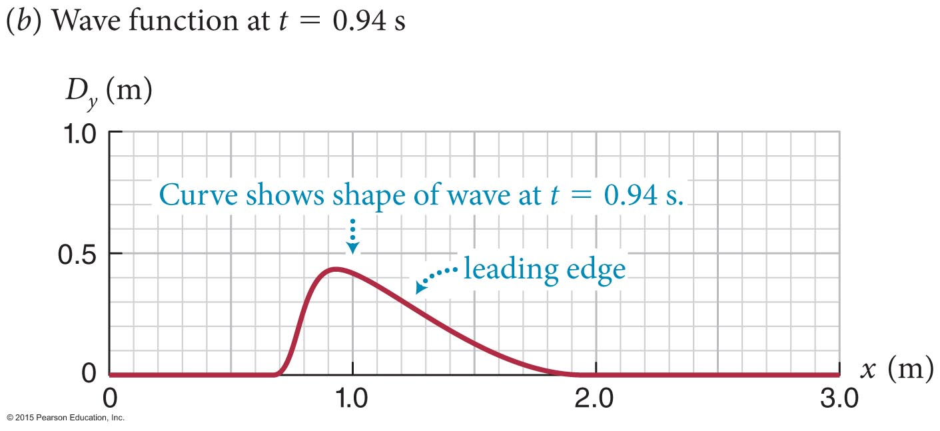
Section 16.1: Representing waves graphically
The graphical representation of all the particle displacements at a given instant is shown in part (b).
The curve gives the y components of the displacements of the particles of the string as a function of the position x along the string.
This is called the wave function.

Slide 9
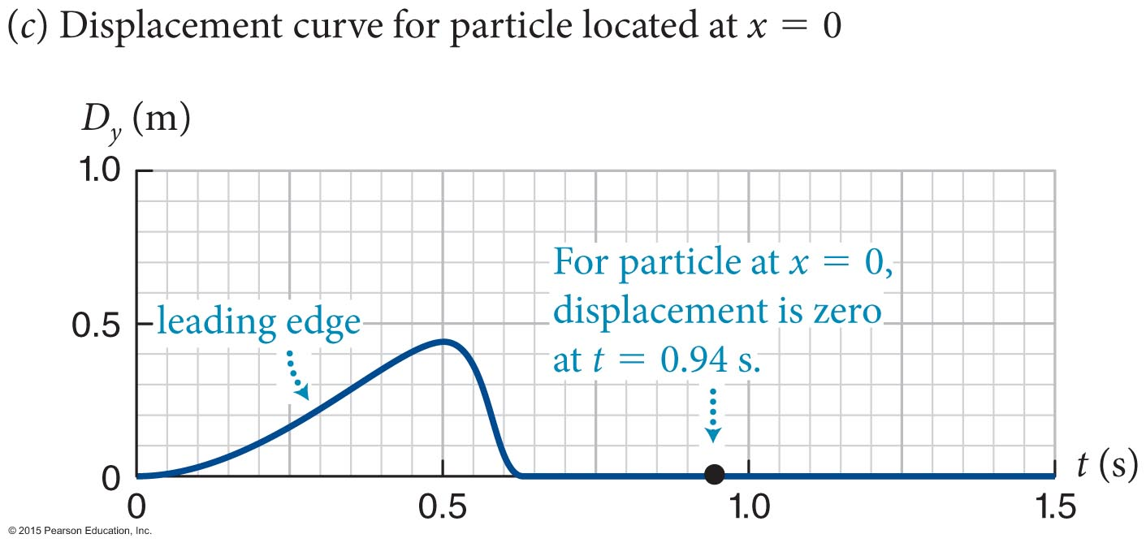
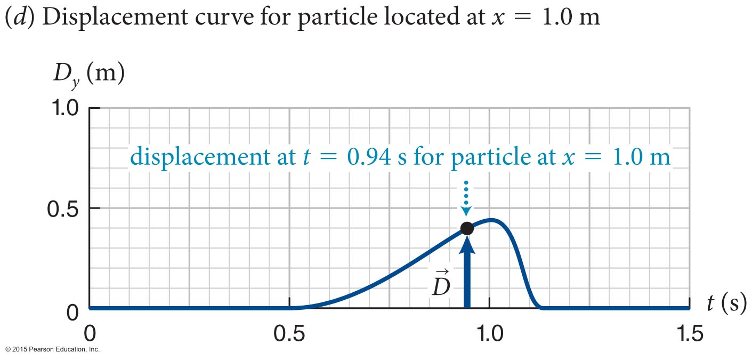
Section 16.1: Representing waves graphically
The wave pulse shown in part (a) can also be represented by plotting the displacement of one particle on the string as a function of time.
Such a plot gives us the displacement curve of the wave pulse.
Parts (c) and (d) show the displacement curve for the particle at x = 0 m and
x = 1.0 m. Note they are mirror images of each other

Slide 10
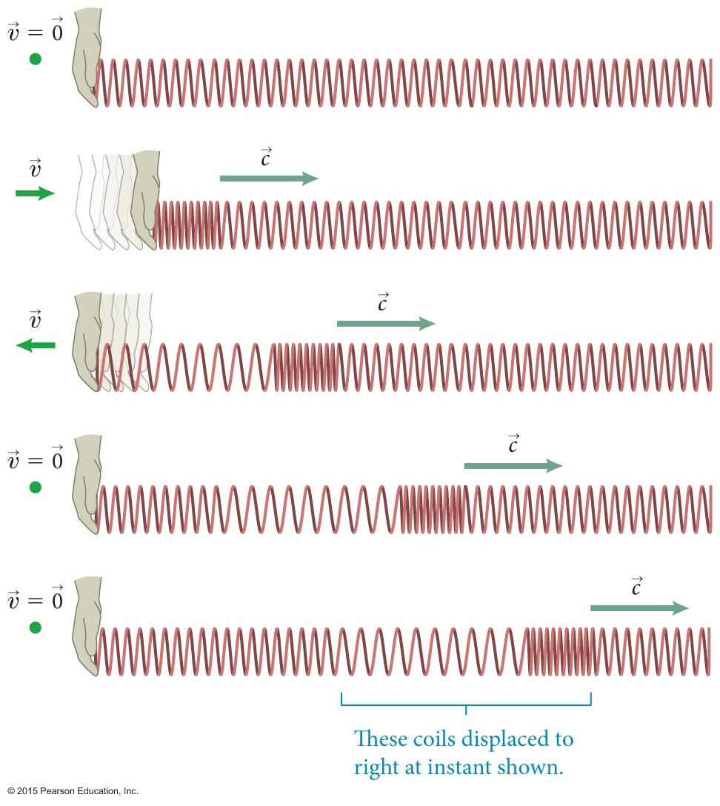
Section 16.1: Representing waves graphically
In a longitudinal wave, the medium movement is parallel to the pulse movement.
Here we see a longitudinal wave propagating along a spring.
If you rapidly displace the left end of the spring back and forth, a disturbance travels down the spring.
Both waves and medium elements move to the right

Slide 11
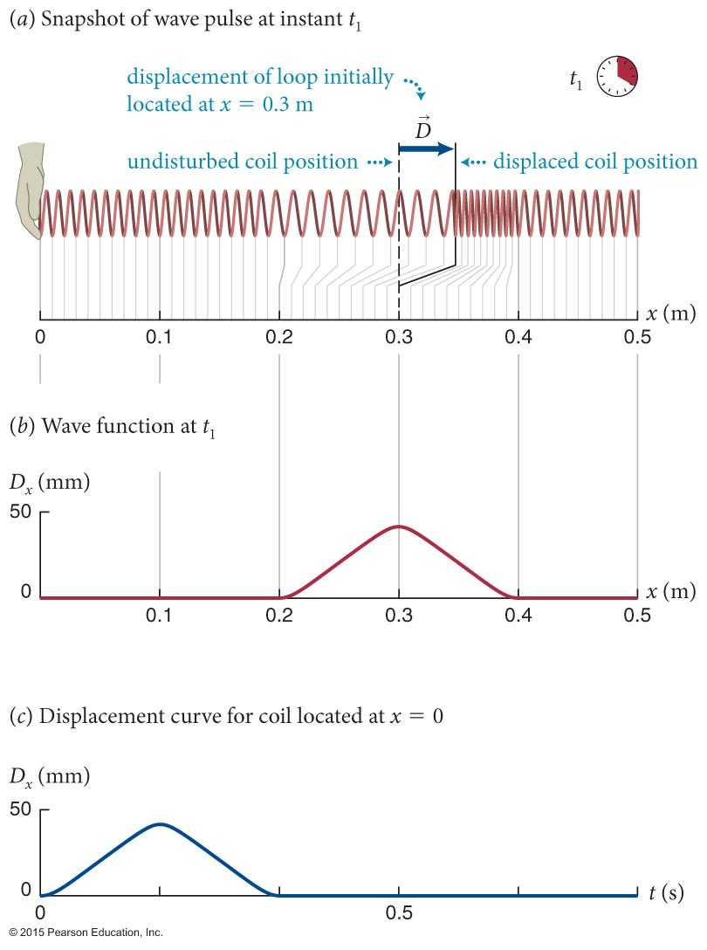
Section 16.1: Representing waves graphically
As shown in the figure, a longitudinal wave can also be represented by wave functions and displacement curves.

Slide 12
Section Goals
Section 16.2: Wave propagation
You will learn to
Analyze the kinematics of wave motion and the time-evolution of the initial disturbance.
Differentiate carefully between the motion of the wave itself and the motion of the particles of the medium the wave propagates through.
Define the wavelength of a periodic wave.

Slide 13
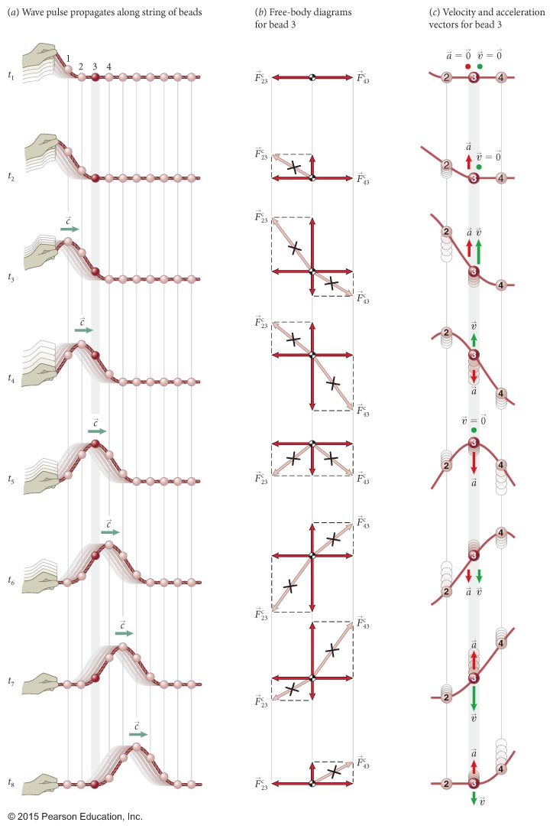
Section 16.2: Wave propagation
Let us consider a collection of beads connected by short strings.
You pull on the first bead, it pulls on the second …
Initial disturbance is the only cause of motion, so motion of any bead related to it alone

Slide 14
Section 16.2: Wave propagation
Two somewhat counterintuitive points:
  When a particle of the string is displaced from its equilibrium position, its velocity v and acceleration a are determined only by the initial disturbance and are independent of the wave speed c.
  For a given disturbance, high wave speeds yield wave pulses that are stretched out and low wave speeds result in pulses that are more compressed.

Slide 15
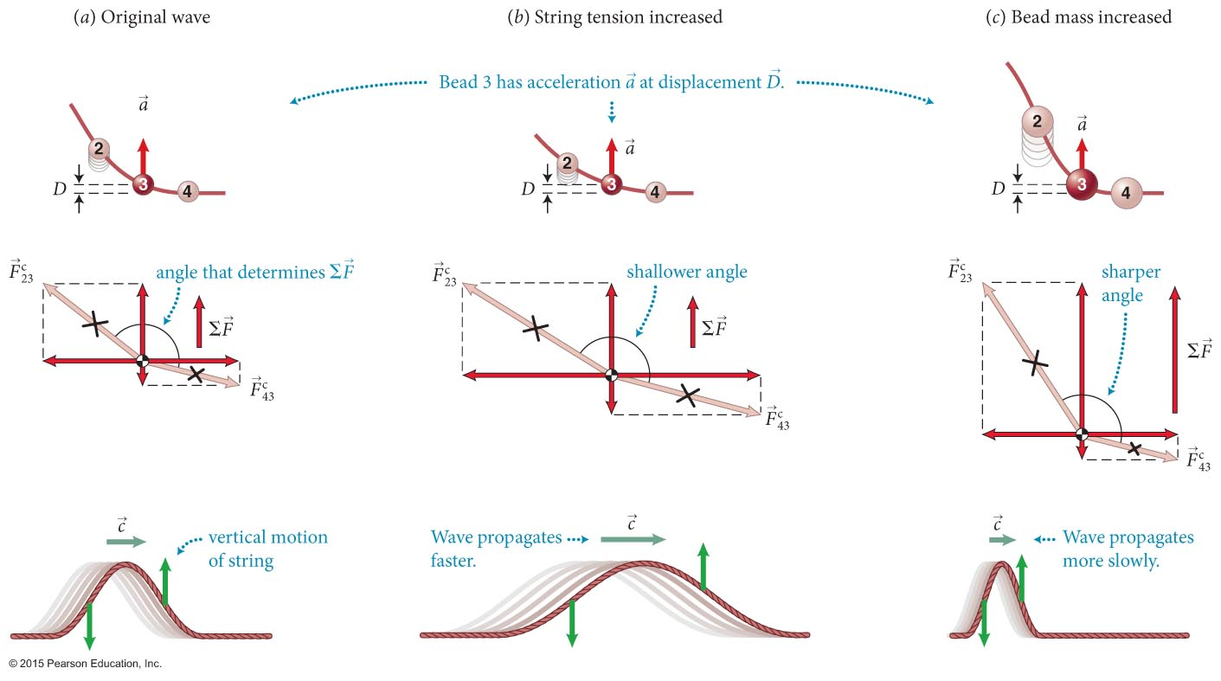
Section 16.2: Wave propagation
As illustrated in the figure, we can determine that
  The speed c of a wave propagating along a string increases with increasing tension in the string and decreases with increasing mass per unit length along the string.
  Think about guitar strings

Slide 16
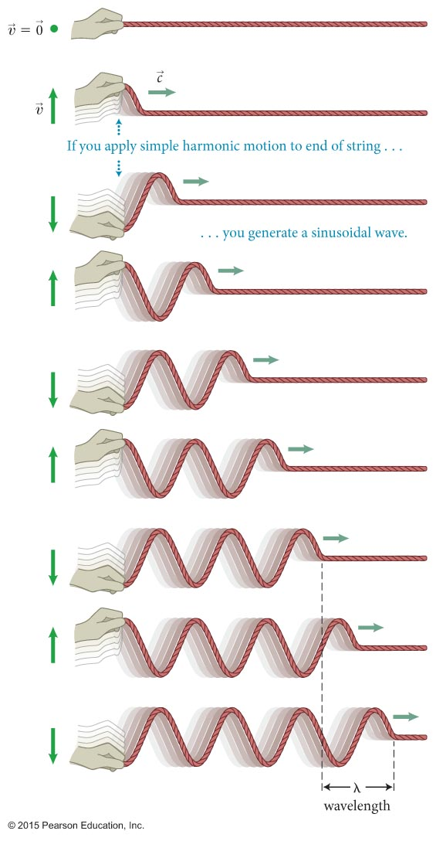
Section 16.2: Wave propagation
If one end of a string is made to execute a periodic motion, the resulting wave is called a periodic wave.
A harmonic wave, shown in the figure, is a type of periodic wave obtained by moving the end of the string so that it oscillates harmonically. (Sinusoidal)
Not all periodic waves are harmonic

Slide 17
Section 16.2: Wave propagation
A periodic wave repeats itself over a distance called the wavelength, denoted by λ.
Each time one point on the string executes a complete oscillation, the wave advances by one wavelength.
Therefore
  The wavelength of a periodic wave is equal to the product of the wave speed and the period of the wave motion.

Slide 18
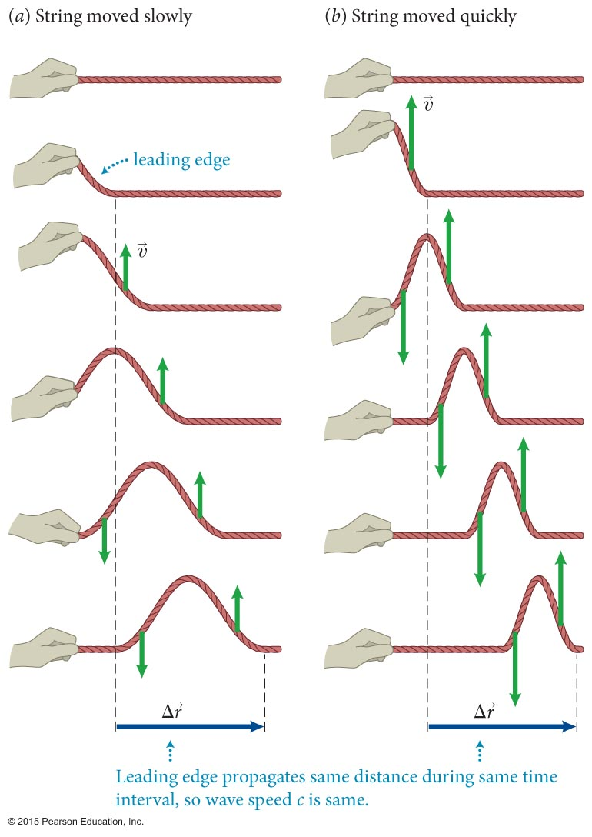
Section 16.2: Wave propagation
As shown in the figure, moving your hand up and down more quickly does not generate a faster-traveling pulse.
To a good approximation, we determine experimentally that
  The speed c of a wave propagating along a string is independent of the velocities of the individual pieces of string. The value of c is determined entirely by the properties of the medium.

Slide 19
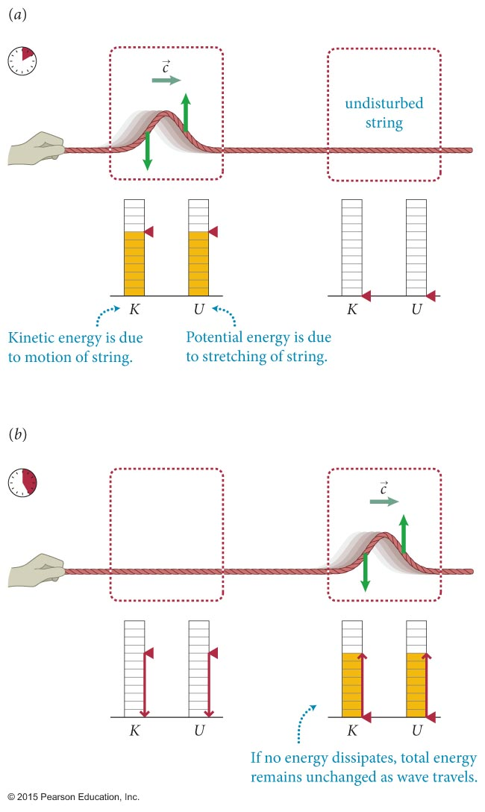
Section 16.2: Wave propagation
The figure illustrates how a propagating wave pulse caries two forms of energy along with it:
  Kinetic energy associated with individual particles
  Elastic potential energy associated with the stretching of the string

Slide 20
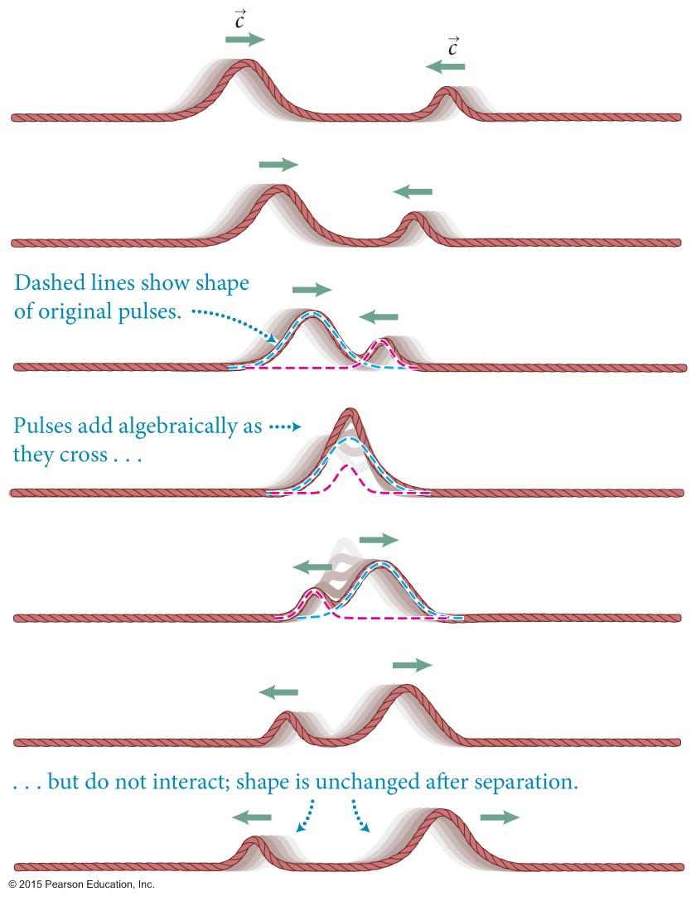
Section Goals
Section 16.3: Superposition of waves
You will learn to
Visualize the superposition of two or more waves traveling through the same region of a medium at the same time.
Define the nodes for a stationary wave disturbance.

Slide 21
Section 16.3: Superposition of waves
Waves exhibit a property known as the superposition of waves:
  If two or more waves overlap in a medium that obeys Hooke’s law, then the resulting wave function at any instant is the algebraic sum of the individual waves.
  Hooke = linear F(x)

Slide 22
Section 16.3: Superposition of waves
The phenomenon of two waves overlapping is called interference.
If two waves with the same sign overlap, the resultant displacement is greater than that of either wave.
This is called constructive interference.

Slide 23

Constructive
http://www.acs.psu.edu/drussell/Demos/superposition/superposition.html

Slide 24
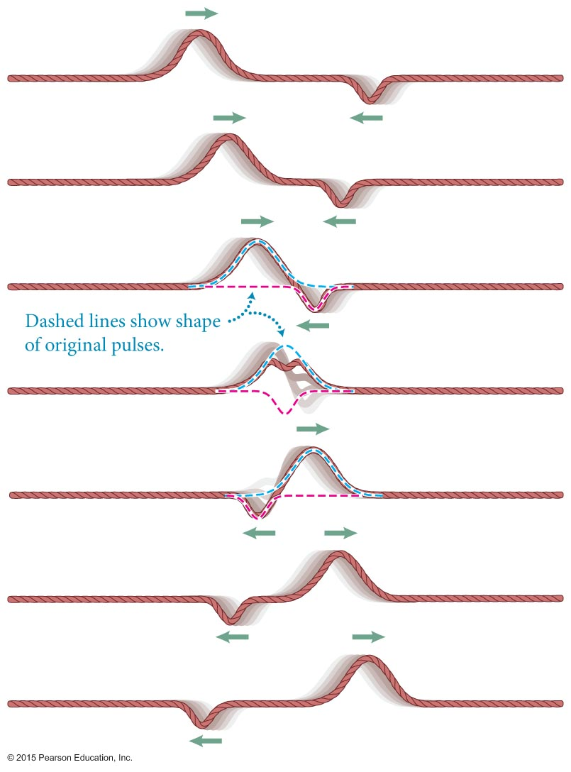
Section 16.3: Superposition of waves
If two waves with opposite signs overlap, the resultant displacement is smaller than that of either wave.
This is called destructive interference.

Slide 25
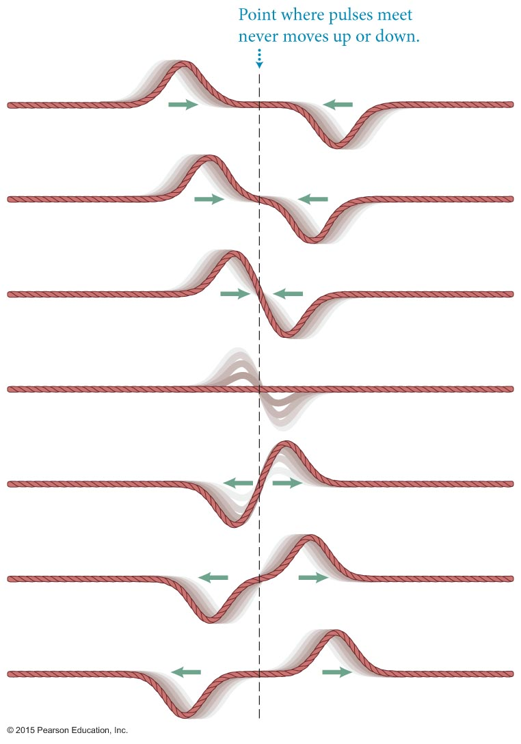
Section 16.3: Superposition of waves
If two waves of same size and shape but having opposite signs cross each other, the displacement of each wave cancels out.
A point that remains stationary in a medium through which waves move is called a node.

Slide 26
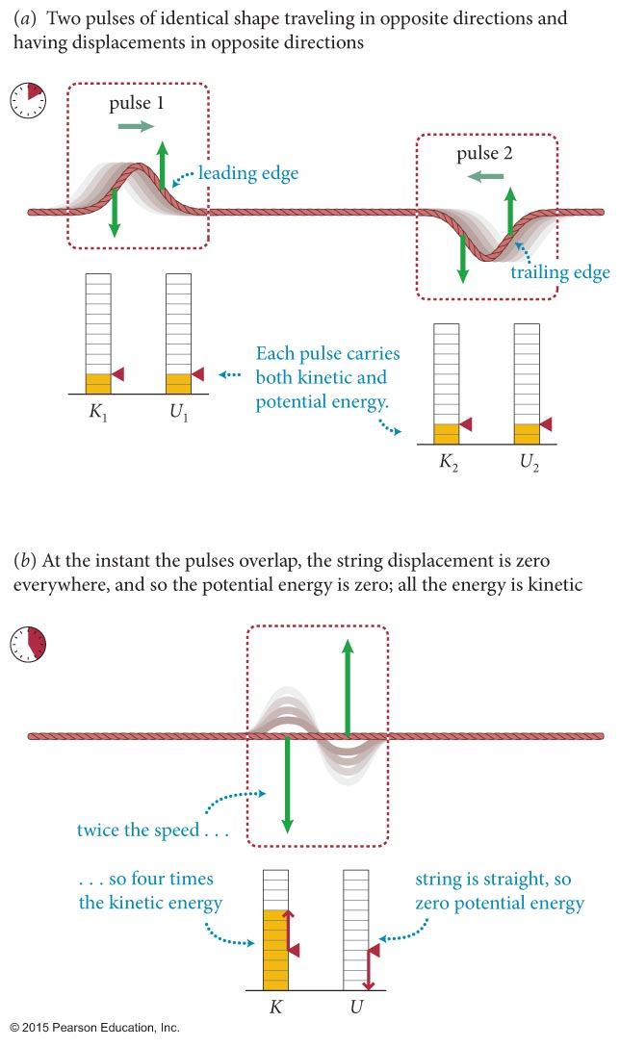
Section 16.3: Superposition of waves
The figure shows the energy makeup of two pulses traveling in opposite directions.
The instant the pulses overlap, the displacement is zero and all the energy is kinetic.
From this we can determine that
  A wave contains equal amounts of kinetic energy and potential energy.
Total: 2K+2U
Total: 4K ⇒ K=U

Slide 27
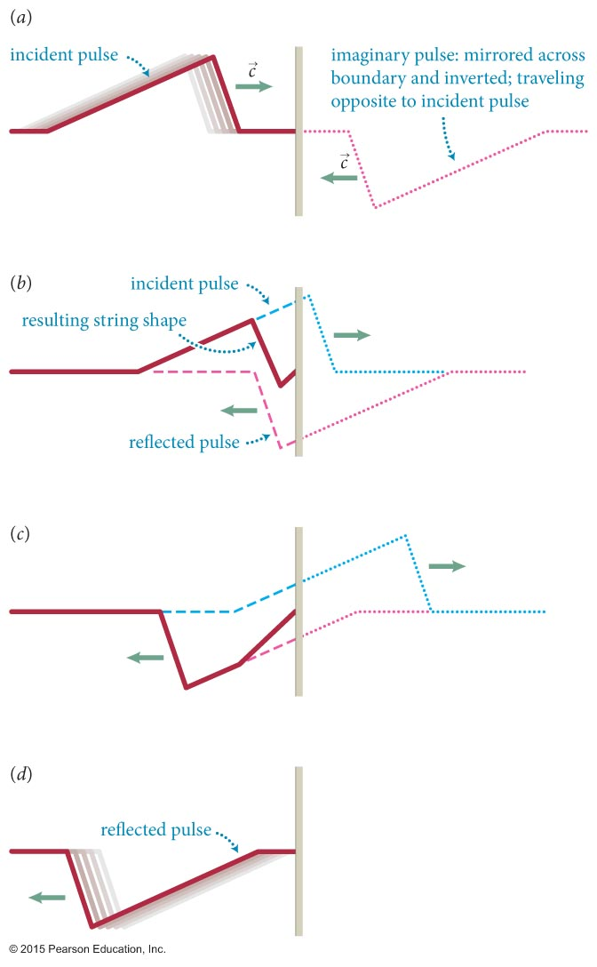
Section Goals
Section 16.4: Boundary effects
You will learn to
Model the reflection of waves from fixed and free ends.
Represent the boundary effects for overlapping waves graphically.

Slide 28
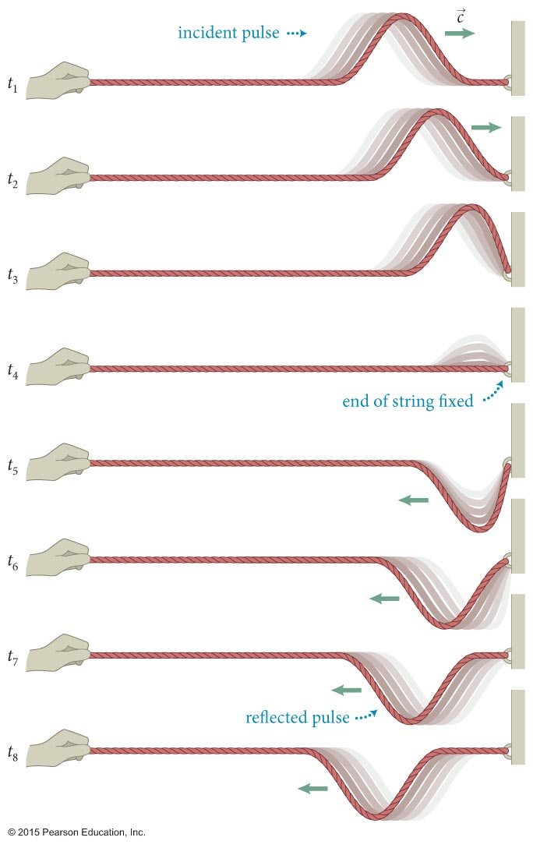
Section 16.4: Boundary effects
When a wave pulse reaches a boundary where the transmitting medium ends, the pulse is reflected back.
Consider a pulse propagating along a string that is anchored to an immovable wall.
The leading edge of the pulse pulls up on the wall, and the wall pulls down on the string.
Therefore, the reflected pulse is inverted.

Slide 29
Section 16.4: Boundary effects
The procedure for determining the shape of a reflected wave pulse can be illustrated using the example shown.
Sum of real pulse and its reflection

Slide 30
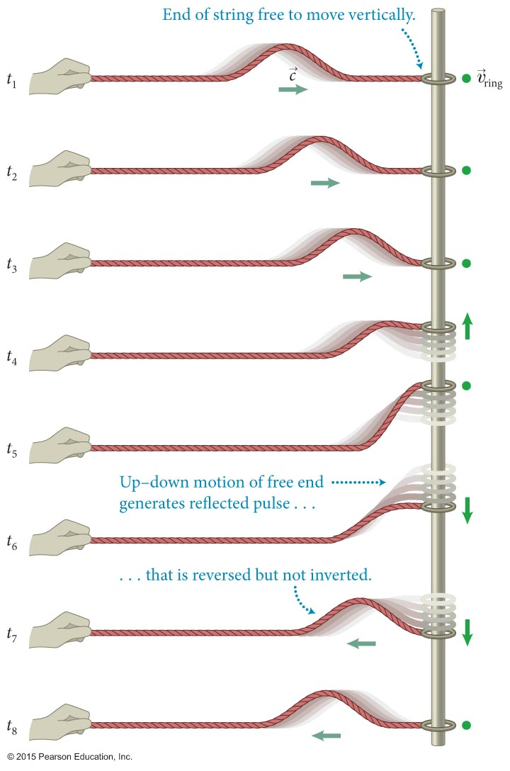
Section 16.4: Boundary effects
Now let us consider reflection from a free end.
As the figure shows, the reflected wave in this case is not inverted.

Slide 31
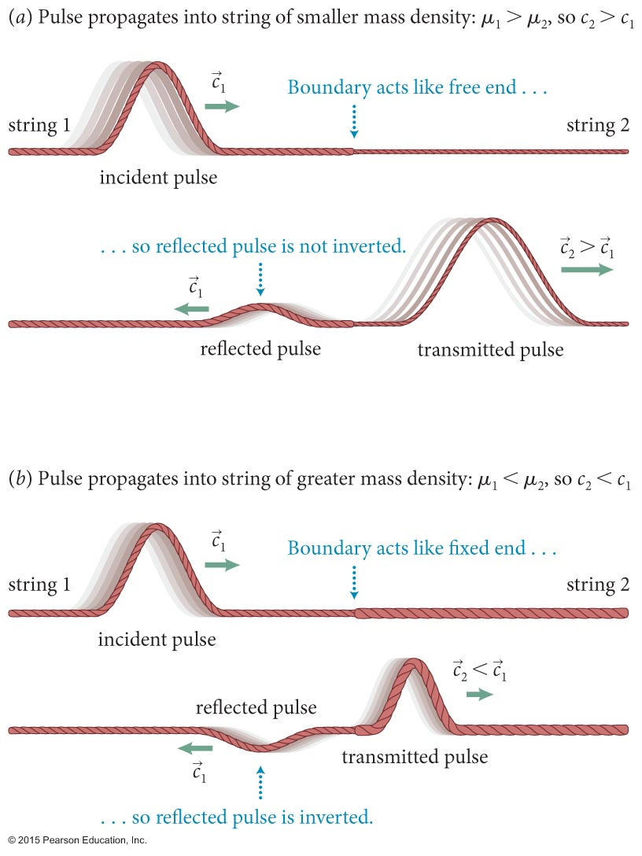
Section 16.4: Boundary effects
When a pulse reaches a boundary between two media, the pulse is partially transmitted and partially reflected.
Mass per unit length is called the linear mass density μ.
The nature of the reflected and transmitted waves depends on whether μ₁ is greater or smaller than μ₂.
A given pulse in a heavy string has a greater affect on a light string (and vice versa)

Slide 32
Quantitative Tools
Chapter 16: Waves in One Dimension

Slide 33
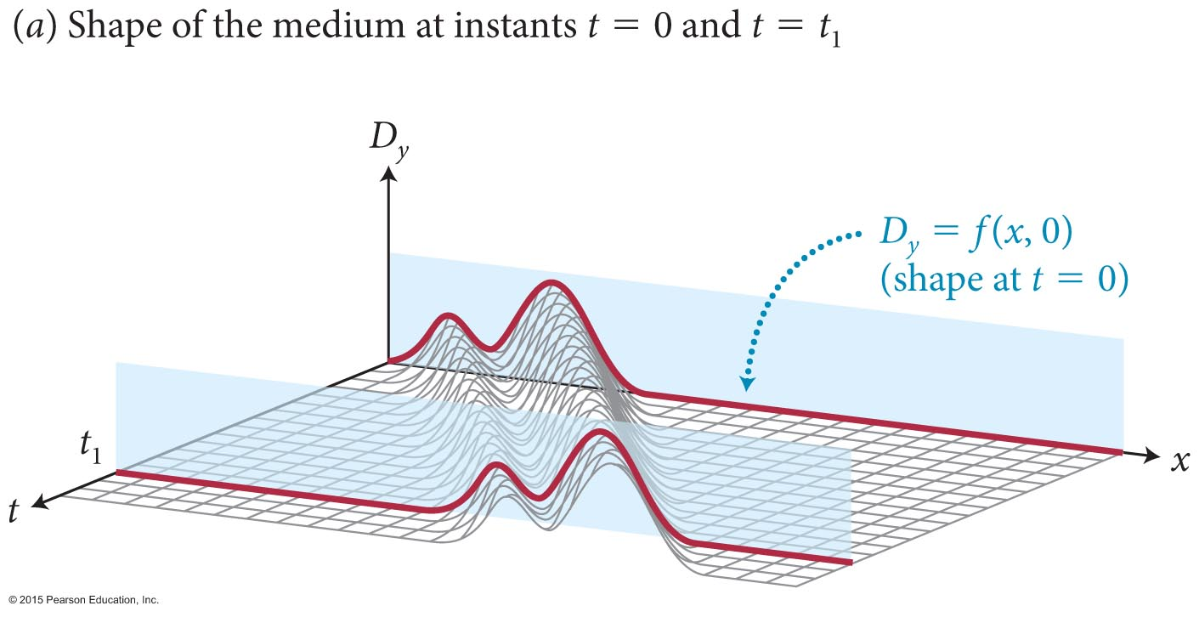
Section Goals
Section 16.5: Wave functions
You will learn to
Represent traveling waves in one dimension mathematically using wave functions.
Model harmonic traveling waves using trigonometric functions.
Define the wave number, k, for a traveling harmonic wave.

Slide 34
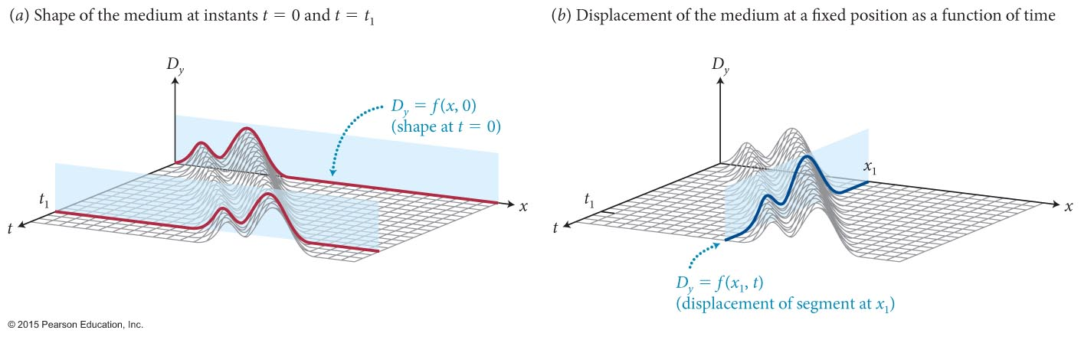
Section 16.5: Wave functions
D_{y} is the displacement of any particle on the string measured in Earth’s reference frame.
We can write D_{y} = f(x, t), where f(x, t) is called the time-dependent wave function.
f(x, t) completely specifies the changing shape of the wave as seen from Earth’s reference frame.
We can show that for a wave propagating at speed c:
D_{y} = f(x – ct)

Slide 35
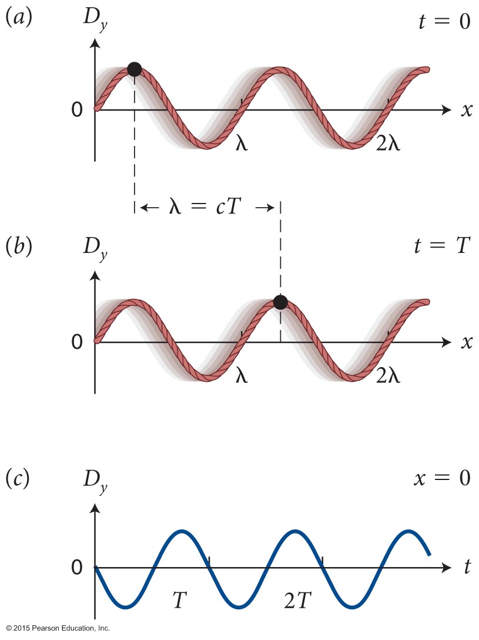
Section 16.5: Wave functions
Let us consider a transverse harmonic wave traveling along a string.
We can see from part (b) that during a time interval of one period, the wave advances by a wavelength.
Because the wave moves at a speed c, and f = 1/T, we get
λf = c

Slide 36
Section 16.5: Wave functions
We have previously defined the angular frequency:
  ω = 2πf = 2π/T “how many periods per sec”
We define the wave number k in a similar way
  k has SI units of m^{–1} “how many waves fit in 1 m”
For a transverse harmonic wave traveling in the positive x direction, the y component of the displacement is
D_{y} = f (x, t) = A sin (kx – ωt + φ_{i})
  φ_{i} is the initial phase or the phase at x = 0, t = 0.
  A is the amplitude.

Slide 37
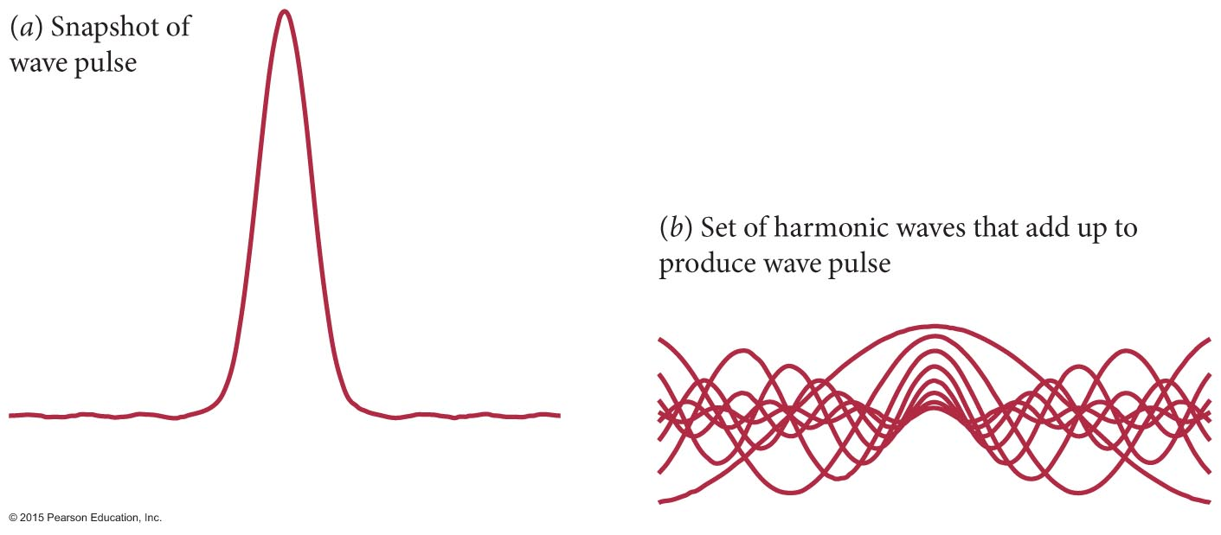
Section 16.5: Wave functions
Fourier’s theorem from Section 15.3 can be applied to waves.
Any wave can be expressed in terms of a sum of sinusoidally varying waves. (sine waves form a complete orthonormal set)
The figure shows a wave pulse obtained by adding together a set of harmonic waves.

Slide 38
Building a square wave
Infinite series of sine waves
Odd frequencies
http://mechatronics.colostate.edu/figures/4-4.jpg

Slide 39
Checkpoint 16.17
(a) Which of the following functions could represent a traveling wave?
(i) A cos(kx + ωt) (ii)
(iii) b(x – ct)²e^{–x} (iv) –(b²t – x)²
(b) Which of the following functions can be made into a traveling wave?
(i) x/(1 + bx²) (ii) xe^{–kx} (iii) x²
16.17

Slide 40
Checkpoint 16.17
(a) Which of the following functions could represent a traveling wave?
(i) A cos(kx + ωt) (ii)
(iii) b(x – ct)²e^{–x} (iv) –(b²t – x)²
All but (iii). The rest have the form f(x-ct).
(b) Which of the following functions can be made into a traveling wave?
(i) x/(1 + bx²) (ii) xe^{–kx} (iii) x²
All of them, with the substitution x → x-ct or x+ct
16.17

Slide 41
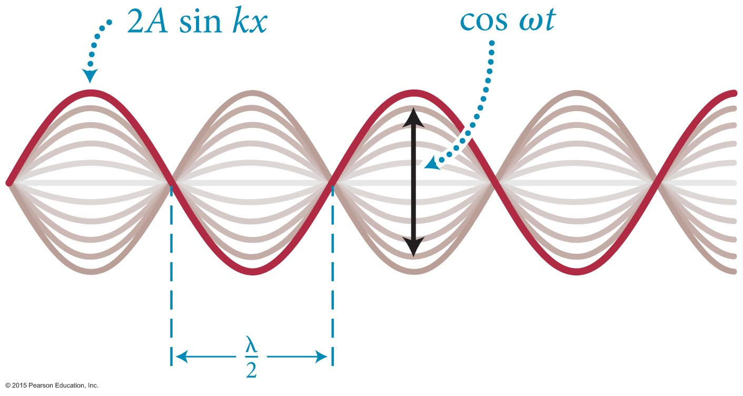
Section Goals
Section 16.6: Standing waves
You will learn to
Establish the geometric and mathematical properties of standing waves.
Derive the mathematical formulas that give the positions of the nodes and antinodes for standing waves on a string fixed at each end.

Slide 42
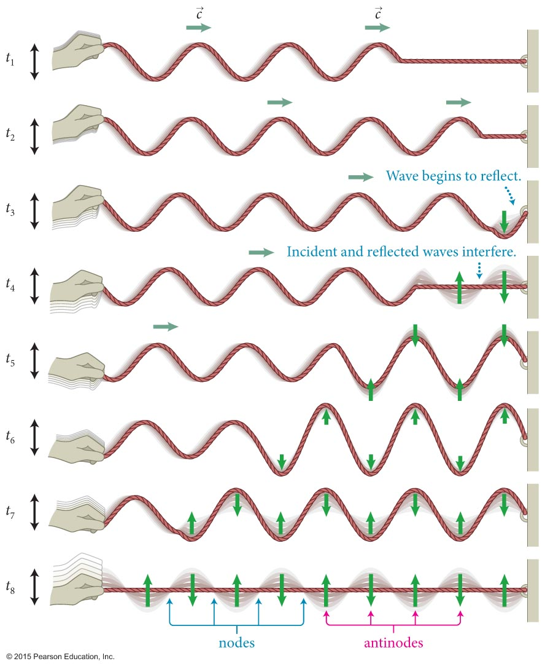
Section 16.6: Standing waves
The figure shows the interference between a incident harmonic wave on a string and the reflected wave from the fixed end of the string.
The points on the string that have zero displacement are called nodes.
Halfway between the nodes are the antinodes where the particles in the medium oscillate with maximum displacement.

Slide 43
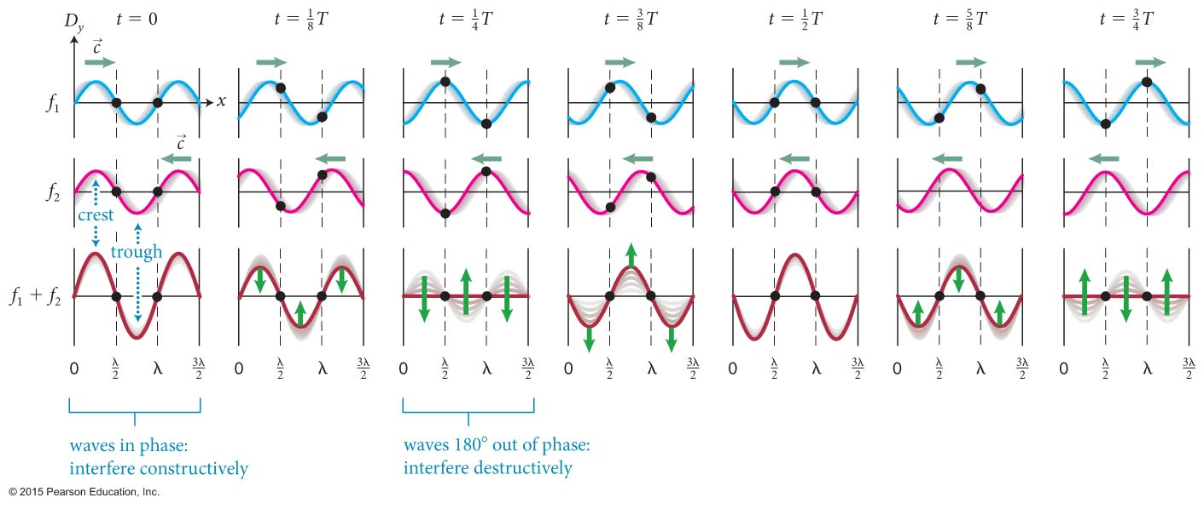
Section 16.6: Standing waves
The pulsating stationary pattern caused by harmonic waves of the same amplitude traveling in opposite direction is called a standing wave.
The figure illustrates how standing waves come about.

Slide 44
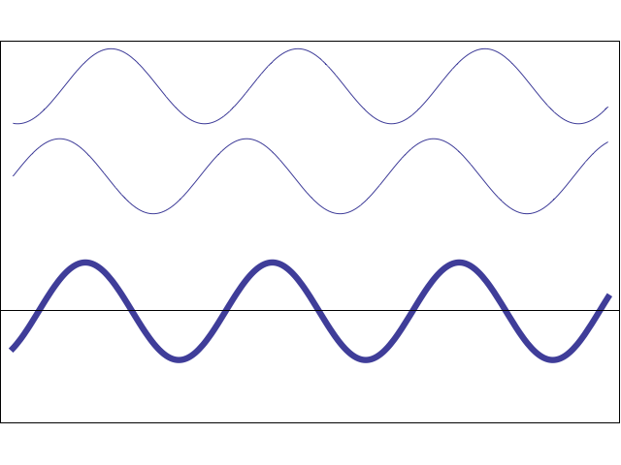
Section 16.6: Standing waves
One wave moves: constructive & destructive interference

Slide 45
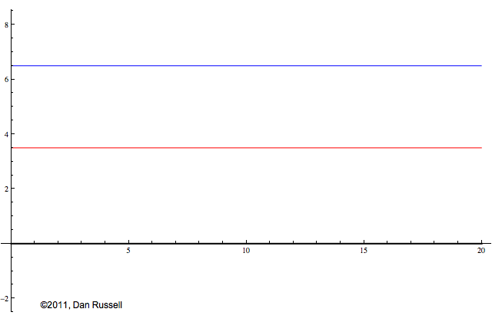
Section 16.6: Standing waves
Waves move at same speed in opposite directions: standing wave

Slide 46
Section 16.6: Standing waves
A sinusoidal wave traveling to the right along the x-axis with angular frequency ω, wave number k, and amplitude A is
D_{1y} = f₁(x, t) = A sin(kx - ωt)
The wave traveling to the left is
D_{2y} = f₂(x, t) = A sin(kx + ωt)
The combined wave is
D_{y} = f₁(x, t) + f₂(x, t) = A[sin(kx - ωt) + sin(kx + ωt)]
By simplifying this using trigonometric identities, we get
D_{y} = f₁(x, t) + f₂(x, t) = 2A sin kx cos ωt = [2A sin kx] cos ωt

Slide 47
Section 16.6: Standing waves
At points that are nodes in a standing wave sin kx must be zero.
Therefore, at these points kx = nπ, where n is a whole number.
Using the definition of k = 2π/λ, we obtain
So, the nodes occur at

Slide 48
Section 16.6: Standing waves
Antinodes occur when sin kx = ±1.
This requires that kx = n(π/2), where n is an odd whole number.
So, the antinodes occur at

Slide 49
Checkpoint 16.19
(a) Do two counter-propagating waves that have the same wavelength but different amplitudes cause standing waves?
(b) Do two counter-propagating waves that have the same amplitude but different wavelengths cause standing waves?
16.19

Slide 50
Checkpoint 16.19
(a) Do two counter-propagating waves that have the same wavelength but different amplitudes cause standing waves?
No. If one amplitude were twice the other, half of it forms a standing wave with the whole of the other one. That leaves half a traveling wave yet.
(b) Do two counter-propagating waves that have the same amplitude but different wavelengths cause standing waves?
No, in this case interference for a given position is constructive at some instants and destructive at others. For a standing wave, it has to be the same at all instants for a given position.
16.19

Slide 51
Section Goal
Section 16.7: Wave speed
You will learn to
Derive equations that give the speed of wave propagation for traveling waves on a uniform mass density string.

Slide 52
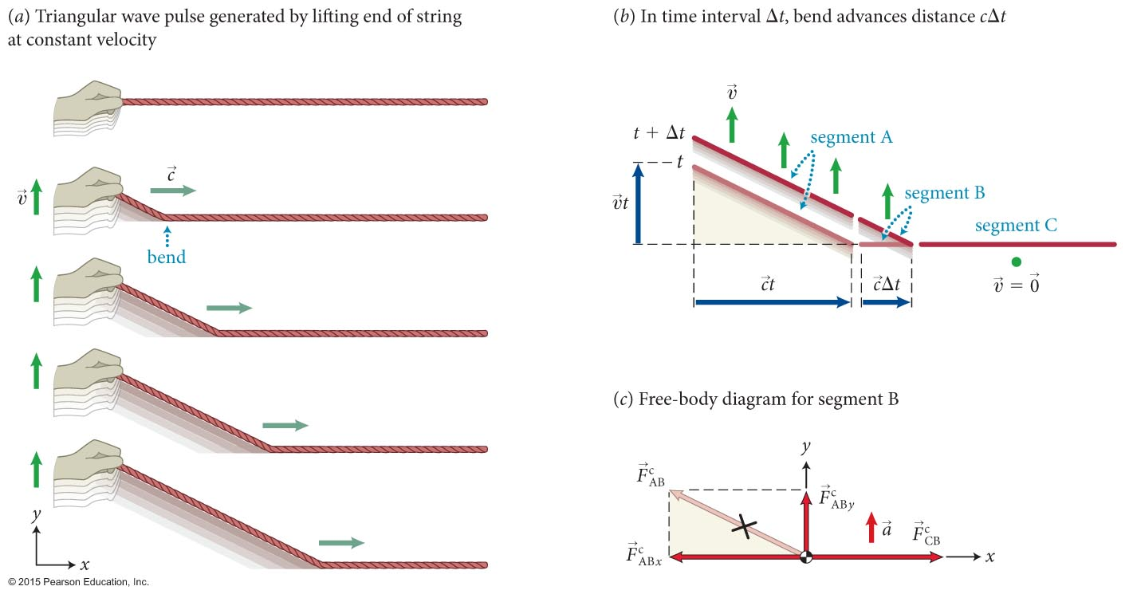
Section 16.7: Wave speed
The procedure for deriving an expression for the wave speed c is illustrated in the figure. The derivation is in the text.

Slide 53
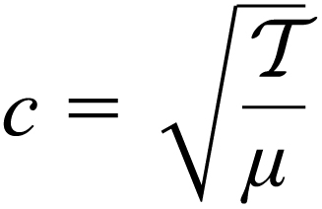

Section 16.7: Wave speed
The mass per unit length of a uniform string is called the linear mass density (μ), and is defined as
We can derive the wave speed of a transverse wave on a string to be
  where is the string tension.
Guitar/piano: tighten to tune, vary string weight to change fundamental tone.

Slide 54
Example 16.4 Measuring mass
Section 16.7: Wave speed
You use a hammer to give a sharp horizontal blow to a 10-kg lead brick suspended from the ceiling by a wire that is 5.0 m long. It takes 70 ms for the pulse generated by the sudden displacement of the brick to reach the ceiling. What is the mass of the wire?

Slide 55
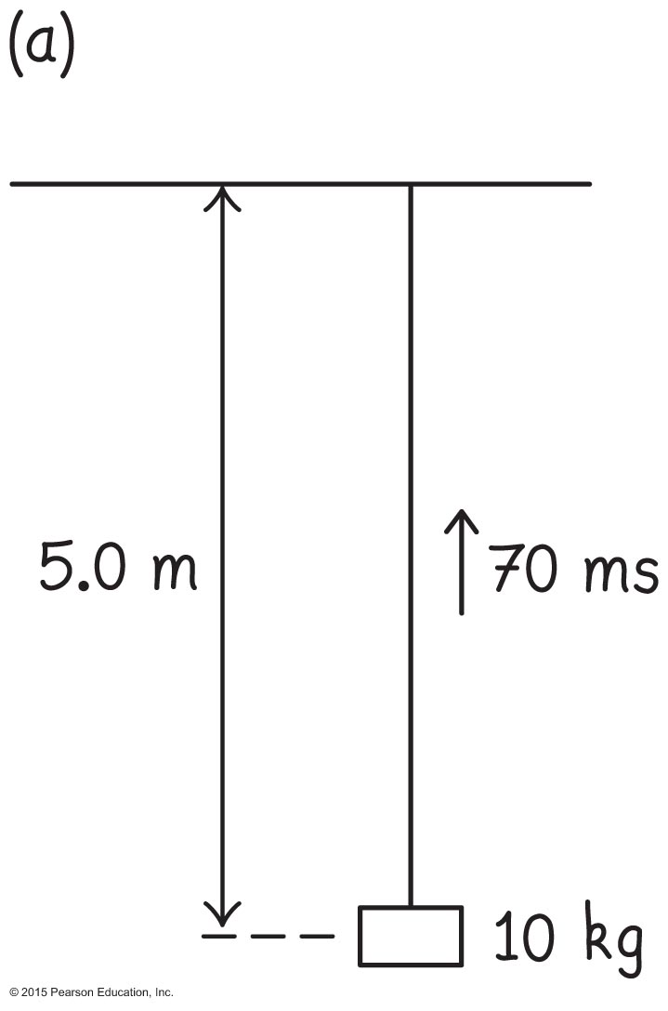
Example 16.4 Measuring mass (cont.)
Section 16.7: Wave speed
❶ GETTING STARTED I begin by making a sketch of the situation (Figure 16.40a). Because I know the pulse travels 5.0 m in 70 ms, I can determine the wave speed along the wire: c = (5.0 m)/(0.070 s) = 71 m/s. This wave speed depends on the linear mass density of the wire and the tension in the wire. The latter is determined by the force exerted by the brick on the wire.

Slide 56
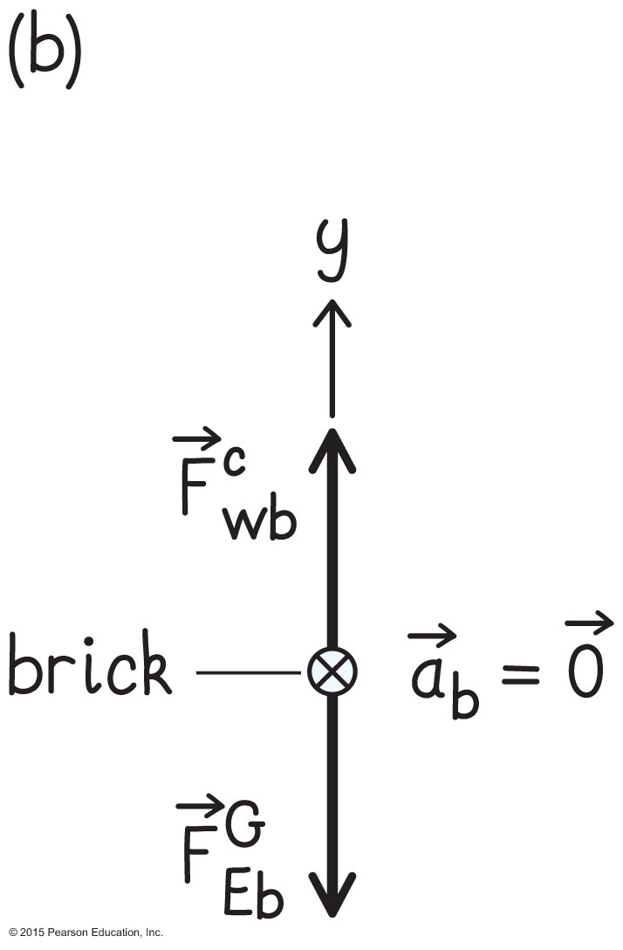
Example 16.4 Measuring mass (cont.)
Section 16.7: Wave speed
❶ GETTING STARTED Because the force exerted by the brick on the wire and the force exerted by the wire on the brick are equal in magnitude, I draw a free-body diagram for the brick (Figure 16.40b) to help me determine that magnitude.

Slide 57
Example 16.4 Measuring mass (cont.)
Section 16.7: Wave speed
❷ DEVISE PLAN To determine the mass of the wire, I can use Eq. 16.25. To use this equation, I must know the length of the wire, which is given, and the linear mass density μ, which I can calculate from Eq. 16.30.
To obtain μ from Eq. 16.30, I need to know c (which I already calculated) and the tension in the wire. The tension is just the weight of the brick.

Slide 58
Example 16.4 Measuring mass (cont.)
Section 16.7: Wave speed
❸ EXECUTE PLAN The tension is equal to the downward force of gravity exerted on the brick: = (10 kg)(9.8 m/s²) = 98 N.
Substituting the values for and c into Eq. 16.30, I calculate the linear mass density of the wire μ = /c² = (98 N)/(71 m/s)² = 0.019 kg/m. The mass of the wire is thus m = (0.019 kg/m)(5.0 m) = 9.5 × 10^{–2} kg. ✔

Slide 59
Example 16.4 Measuring mass (cont.)
Section 16.7: Wave speed
❹ Evaluate result The value I obtain—about 0.1 kg—is not unreasonable for a 5.0-m-long wire that can support a lead brick.

Slide 60
Section 16.7
Question
A vibrating string is clamped at both ends, with one of the clamps being a tension-adjustment screw. By what factor must you change the tension in the string to double its frequency of vibration without changing the wavelength?
2
1/2
2²
(1/2)²
2^{1/2}
(1/2)^{1/2}
None of the above

Slide 61

Section 16.7
Question
A vibrating string is clamped at both ends, with one of the clamps being a tension-adjustment screw. By what factor must you change the tension in the string to double its frequency of vibration without changing the wavelength?
2
1/2
2² – f = c/λ ~ √T. Doubling f means T increases fourfold
(1/2)²
2^{1/2}
(1/2)^{1/2}
None of the above

Slide 62
Section Goals
Section 16.8: Energy transport in waves
You will learn to
Calculate the kinetic and potential energy for a wave disturbance in one dimension.
Express the average power carried by a harmonic wave.

Slide 63
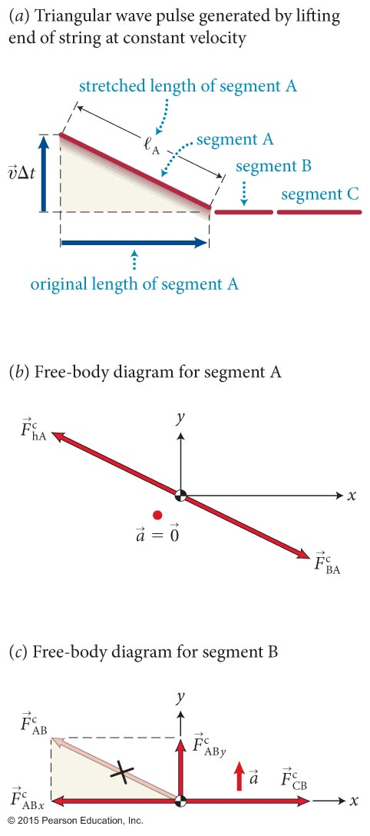
Section 16.8: Energy transport in waves
Let E_{λ} denote the energy that must be supplied over a period T to generate a wave on a string. (one wavelength)
Then the average power that must be supplied to generate the wave is given by
Using the figure, or from simple harmonic motion:
And the average power is

Slide 64
Example 16.5 Delivering energy
Section 16.8: Energy transport in waves
A wire with linear mass density μ = 0.0500 kg/m is held taut with a tension of 100 N. At what rate must energy be supplied to the wire to generate a traveling harmonic wave that has a frequency of 500 Hz and an amplitude of 5.00 mm?

Slide 65
Example 16.5 Delivering energy (cont.)
Section 16.8: Energy transport in waves
❶ Getting started The rate at which energy must be supplied to the wire is the power. Because none of the quantities given varies with time, the (instantaneous) power is equal to the average power, which is given by Eq. 16.42.

Slide 66
Example 16.5 Delivering energy (cont.)
Section 16.8: Energy transport in waves
❷ devise plan To calculate the average power,
I need to know μ and A, both of which are given, as well as ω and c. The angular frequency ω is related to the frequency f by Eq. 15.4, ω = 2πf, and I can obtain the wave speed c from Eq. 16.30.

Slide 67

Example 16.5 Delivering energy (cont.)
Section 16.8: Energy transport in waves
❸ EXECUTE PLAN From Eq. 16.30 I obtain
Equation
15.4 yields ω = 2πf = 2π(500 Hz) = 3.14 x 10³ s^{–1}.
Substituting these values into Eq. 16.42 gives

Slide 68
Example 16.5 Delivering energy (cont.)
Section 16.8: Energy transport in waves
❹ Evaluate result The answer I obtain is a fairly large power—comparable to the power delivered by a 250-W light bulb or by a person exercising. The wave travels very fast, though, and the frequency is high, so the answer is not unreasonable.

Slide 69
Section Goals
Section 16.9: The wave equation
You will learn to
Derive the general equation for the time- and space-evolution of a wave using differential calculus.
Relate the speed of wave propagation, c, to physical quantities for the case of a wave on a string.

Slide 70
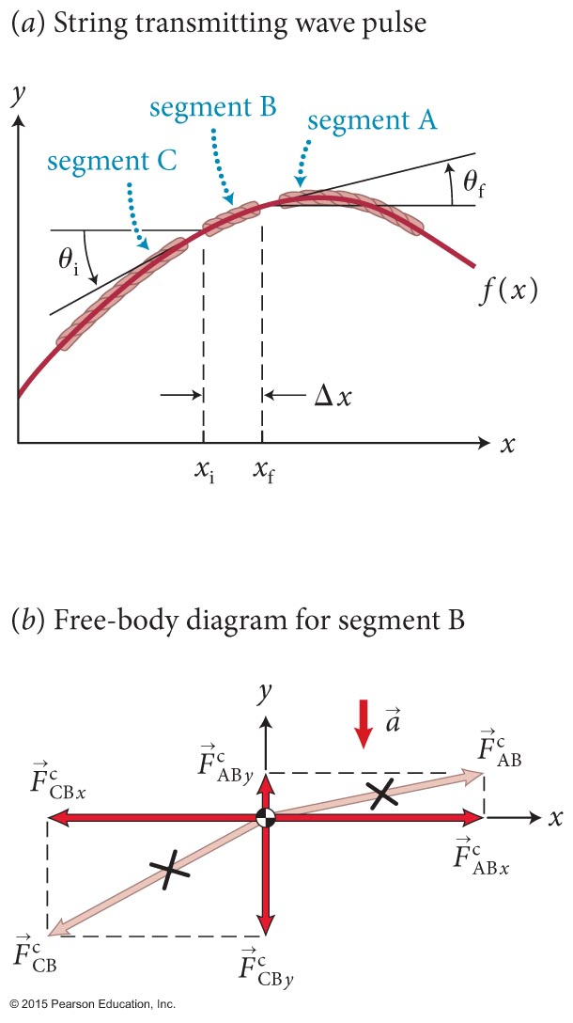
Section 16.9: The wave equation
The figure shows a piece of a string that has been displaced by a passing wave.
With the use of this figure, we can show that the wave function f (x, t) that represents a wave is a solution of the wave equation given by
(Read ∂ as d …)

Slide 71
Exercise 16.6 Sinusoidal solution to the wave equation
Section 16.9: The wave equation
Show that a sinusoidal traveling wave of the form
f (x, t) = A sin(kx – ωt) satisfies the wave equation for any value of k and ω.

Slide 72
Exercise 16.6 Sinusoidal solution to the wave equation (cont.)
Section 16.9: The wave equation
Solution The first partial derivative of f (x, t) with respect to x is
and so the second partial derivative with respect to x is
(1)

Slide 73
Exercise 16.6 Sinusoidal solution to the wave equation (cont.)
Section 16.9: The wave equation
The first partial derivative of f (x, t) with respect to t is
Differentiating again gives

Slide 74
Exercise 16.6 Sinusoidal solution to the wave equation (cont.)
Section 16.9: The wave equation
Multiplying both sides of this equation by 1/c² and using k = ω/c (Eq. 16.11), I obtain
Because the right sides of Eqs. 1 and 2 are equal, the left sides must also be equal, so
which is Eq. 16.51, and so the wave equation is satisfied. ✔
(2)

Slide 75
Exercise 16.6 Sinusoidal solution to the wave equation (cont.)
Section 16.9: The wave equation
Note that this works whether you start with
f (x, t) = A sin(kx – ωt)
Or
f (x, t) = A cos(kx – ωt)
What matters, as with SHM, is that
Both sines and cosines work for this (complex exponentials FTW)

Slide 76
Section 16.9
Question 9
A wave pulse moves along a stretched string. Describe the relationship among the speed at which the pulse moves, the pulse curvature, and the acceleration of small segments of the string.
  Pulse speed ∝ pulse curvature ∝ acceleration
  Pulse speed ∝ pulse curvature ∝ 1/acceleration
  Pulse speed ∝ 1/pulse curvature ∝ acceleration
  1/Pulse speed ∝ pulse curvature ∝ acceleration
  1/Pulse speed ∝ 1/pulse curvature ∝ 1/acceleration

Slide 77
Section 16.9
Question 9
A wave pulse moves along a stretched string. Describe the relationship among the speed at which the pulse moves, the pulse curvature, and the acceleration of small segments of the string.
  4. 1/Pulse speed ∝ pulse curvature ∝ acceleration
  Curvature ~ second derivative w.r.t. position
  Acceleration ~ second derivative w.r.t. time
  wave equation → curvature ~ acceleration
  Established that lower speed waves have higher curvature

Slide 78
Concepts: Representing waves
Chapter 16: Summary
A wave is a disturbance that propagates through material (the medium) or through empty space.
A wave pulse is a single isolated propagating disturbance.
The wave function represents the shape of a wave at any given instant and changes with time as the wave travels.

Slide 79
Concepts: Representing waves
Chapter 16: Summary
The wave speed c is the speed at which a wave propagates. For a mechanical wave, c is different from the speed v of the particles of the medium and is determined by the properties of the medium.
The displacement of any particle of a medium through which a mechanical wave travels is a vector that points from the equilibrium position of the particle to its actual position.

Slide 80
Concepts: Representing waves
Chapter 16: Summary
In a transverse mechanical wave, the particles of the medium move perpendicular to the direction of the pulse movement.
In a longitudinal mechanical wave, these particles move parallel to the direction of the pulse movement.
In a periodic wave, the displacement at any location in the medium is a periodic function of time.
A periodic wave is harmonic when the particle displacement can be represented by a sinusoidally varying function of space and time.

Slide 81
Quantitative Tools: Representing waves
Chapter 16: Summary
If a wave travels in the x direction with speed c and f (x) describes the form (shape) of the wave, then the y component D_{y} of the displacement of a particle of the medium is
D_{y} = f (x – ct)
if the wave travels in the positive x direction and
D_{y} = f (x + ct)
if the wave travels in the negative x direction.
The wavelength λ of a periodic wave is the minimum distance over which the wave repeats itself.

Slide 82
Quantitative Tools: Representing waves
Chapter 16: Summary
For a periodic wave of period T, frequency f, and speed c, the wave number k is
The wavelength λ is
λ = cT,
The angular frequency ω is
The wave speed is
c = λf.

Slide 83
Quantitative Tools: Representing waves
Chapter 16: Summary
For a transverse harmonic wave of amplitude A and initial phase ϕ_{i} traveling in the positive x direction, the y component D_{y} of the displacement of a particle of the medium is
D_{y} = f (x, t) = A sin(kx – ωt + ϕ_{i}).

Slide 84
Concepts: Combining waves
Chapter 16: Summary
Superposition of waves: The resultant displacement of two or more overlapping waves is the algebraic sum of the displacements of the individual waves.
Interference occurs when two waves overlap. The interference is constructive when the displacements due to the two waves are in the same direction and destructive when the displacements are in opposite directions.
If the displacement at a point in space remains zero as a wave travels through, that point is a node. The displacement at other points typically varies with time. If the displacement at a point in space varies over the greatest range as a wave travels through, that point is an antinode.

Slide 85
Concepts: Combining waves
Chapter 16: Summary
When a wave pulse (the incident wave) reaches a boundary where the transmitting medium ends, the pulse is reflected, which means it reverses its direction.
When a wave pulse is reflected from a fixed boundary, the reflected pulse is inverted relative to the incident pulse. When the reflection is from a boundary that is free to move, the reflected pulse is not inverted.
A standing wave is a pulsating stationary pattern caused by the interference of harmonic waves of equal amplitude and wavelengths traveling in opposite directions.

Slide 86
Quantitative Tools: Combining waves
Chapter 16: Summary
If two harmonic waves of equal wavelength λ and equal amplitude A travel in opposite directions on a string, they produce a standing wave. The y component D_{y} of the string displacement at any position x along the string is given by
D_{y} = 2A sin kx cos ωt.
The nodes occur at
The antinodes occur at

Slide 87
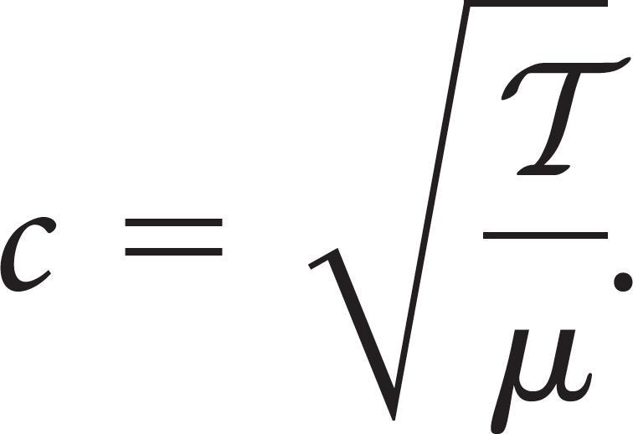
Quantitative Tools: Waves on a string
Chapter 16: Summary
For a uniform string of mass m and length ℓ, the linear mass density μ (mass per unit length) is
The speed of a wave on a string under tension is

Slide 88
Quantitative Tools: Waves on a string
Chapter 16: Summary
The average power P_{av} that must be supplied to generate a wave of period T is
Any function f of the form f (x – ct) or f (x + ct) that represents a wave traveling with speed c is a solution of the wave equation:

