Slide 1
PH301
Patrick LeClair

Slide 2
Contact
pleclair@ua.edu put “PH301” in subject line
Office: Gallalee 208 (enter through Gallalee 206)
Office hours: Mon-Thurs 11-12 and by appointment (email)
ODS accommodations? let me know as soon as you can
Known athletic/academic travel? same

Slide 3
Course content
Like PH105, but with new techniques (esp. math)
Fluency in calculus is assumed. We will use a little of what you learned/are learning in MA238
Get familiar with things like Wolfram Alpha or Mathematica

Slide 4
Schedule (subject to change)
Week 1: Newton’s laws
Week 2: projectile motion (with drag)
Week 3: momentum
Week 4: energy
Week 5: oscillations
Week 6: Calculus of variations
Week 7-8: Lagrangian mechanics

Slide 5
Schedule (subject to change)
Week 9-10: central forces
Week 11: coupled oscillations
Week 12: non-inertial frames
Week 13: rigid body rotation
Week 14: collision theory
Week 15: continuum mechanics, Hamiltonian mechanics
Week 16: review/catch-up

Slide 6
You can find this on Blackboard.

Slide 7
Grading
Exam 1: 20% (Wed 26 Sept)
Exam 2: 20% (Wed 7 Nov)
Homework: 20% (“weekly”)
Participation (online): 10%
Final Exam: 30% (Fri 11 Dec 7-9:30pm)

Slide 8
Homework & Exams
Homework: more or less weekly, show your work, ~10 problems
  posted on Blackboard.
  group work encouraged, but turn in your own
Exams: all ‘show your work’ problems, typically 1 drop problem
  non-obvious formulas/integrals/etc will be given

Slide 9



Slide 10

Our class is using Packback Questions for curious, out-of-class discussion.
Learn how the things you’re learning in class apply to your future
Ask questions about the topics that interest you most
Earn participation points for being curious
Gain new perspectives from reading responses and questions from your peers
Be rewarded for being curious!
Moderation Queue

Slide 11
Why are we using Packback Questions?
Packback will help you apply the information you are learning in class, to how it relates to our everyday lives.
You will gain many academic and professional skills including:
  The ability to ask critical thinking questions
  Use supporting evidence when making a claim
  Learning multiple perspectives from your peers
  Strong writing skills when crafting detailed answers
Packback exists to awaken and fuel the lifelong curiosity in every student.

Slide 12
How does Packback fit into this course?
Gathering information
Lecture
Mastery of Course Objectives
Packback
Quizzes, Tests
Proving knowledge of factual content
Synthesizing & applying information throughout the course
Packback exists to awaken and fuel the lifelong curiosity in every student.

Slide 13
How are we using Packback Questions?
Each week you will be required to:
post 3 times
any combination of asking or answering questions
Packback is worth 10% of your overall grade.
Packback is a valuable part of your learning for this course, therefore is considered as part of your overall grade.
Packback exists to awaken and fuel the lifelong curiosity in every student.

Slide 14
What to post in Packback Questions
Open-ended questions that have more than one right answer
Try question starters like “How could”, “Why”, and “What might happen”
Ask for examples and ideas, instead of answers and definitions
Questions asking for extra help that show your work
Show your work or progress up to where you got stuck
Provide details to explain exactly what you need help with!
Share a resource, article or idea that inspired you and ask for responses
Share the resource (video, article, link) that inspired your curiosity

Slide 15
What not to post in Packback Questions
X
No questions about the tests, homework, or class logistics
For example: “Is class cancelled today?” or “What’s the answer to #4?”
X
No duplicate questions or answers
X
No profanity or inflammatory language; be kind and mindful
X
No cheating (this is not a place to get answers to homework)
X
No Closed-Ended Questions (Questions with only one right answer)
X
No plagiarism, or posts that are primarily quotes from other sources

Slide 16
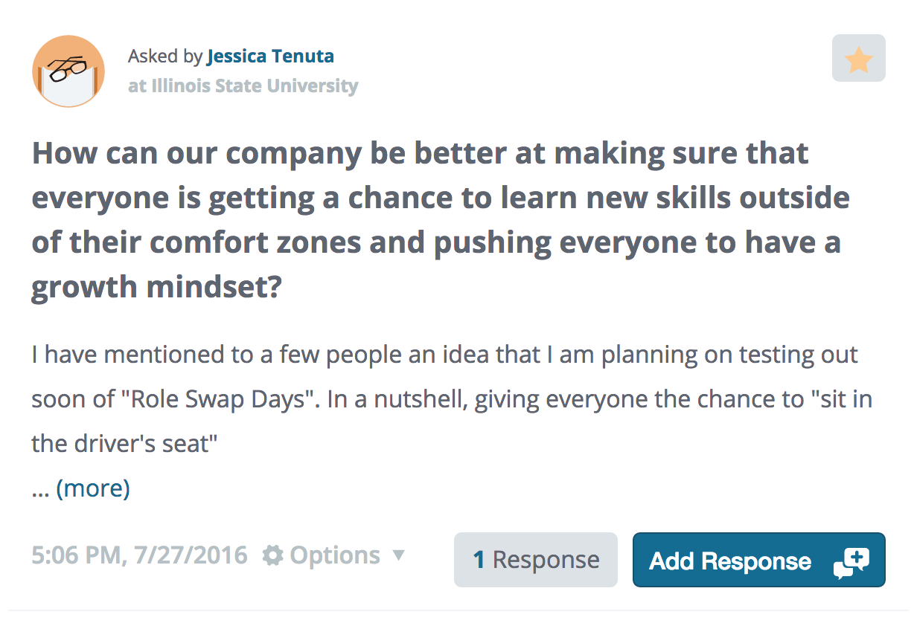
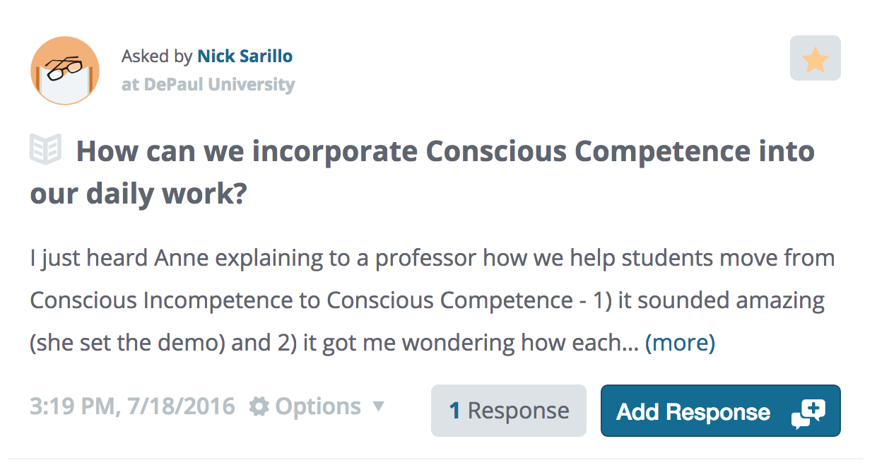
The Featured Tab
The Featured Tab keeps all the best posts in your community just one click away.
How do posts get featured?
The Community Health Algorithm suggests great posts to your Professor.
Packback Moderators or your professor hand-feature the “can’t miss” posts each week for you to read.
Featured Posts
Featured
Label
A quick way to
identify featured
posts

Slide 17
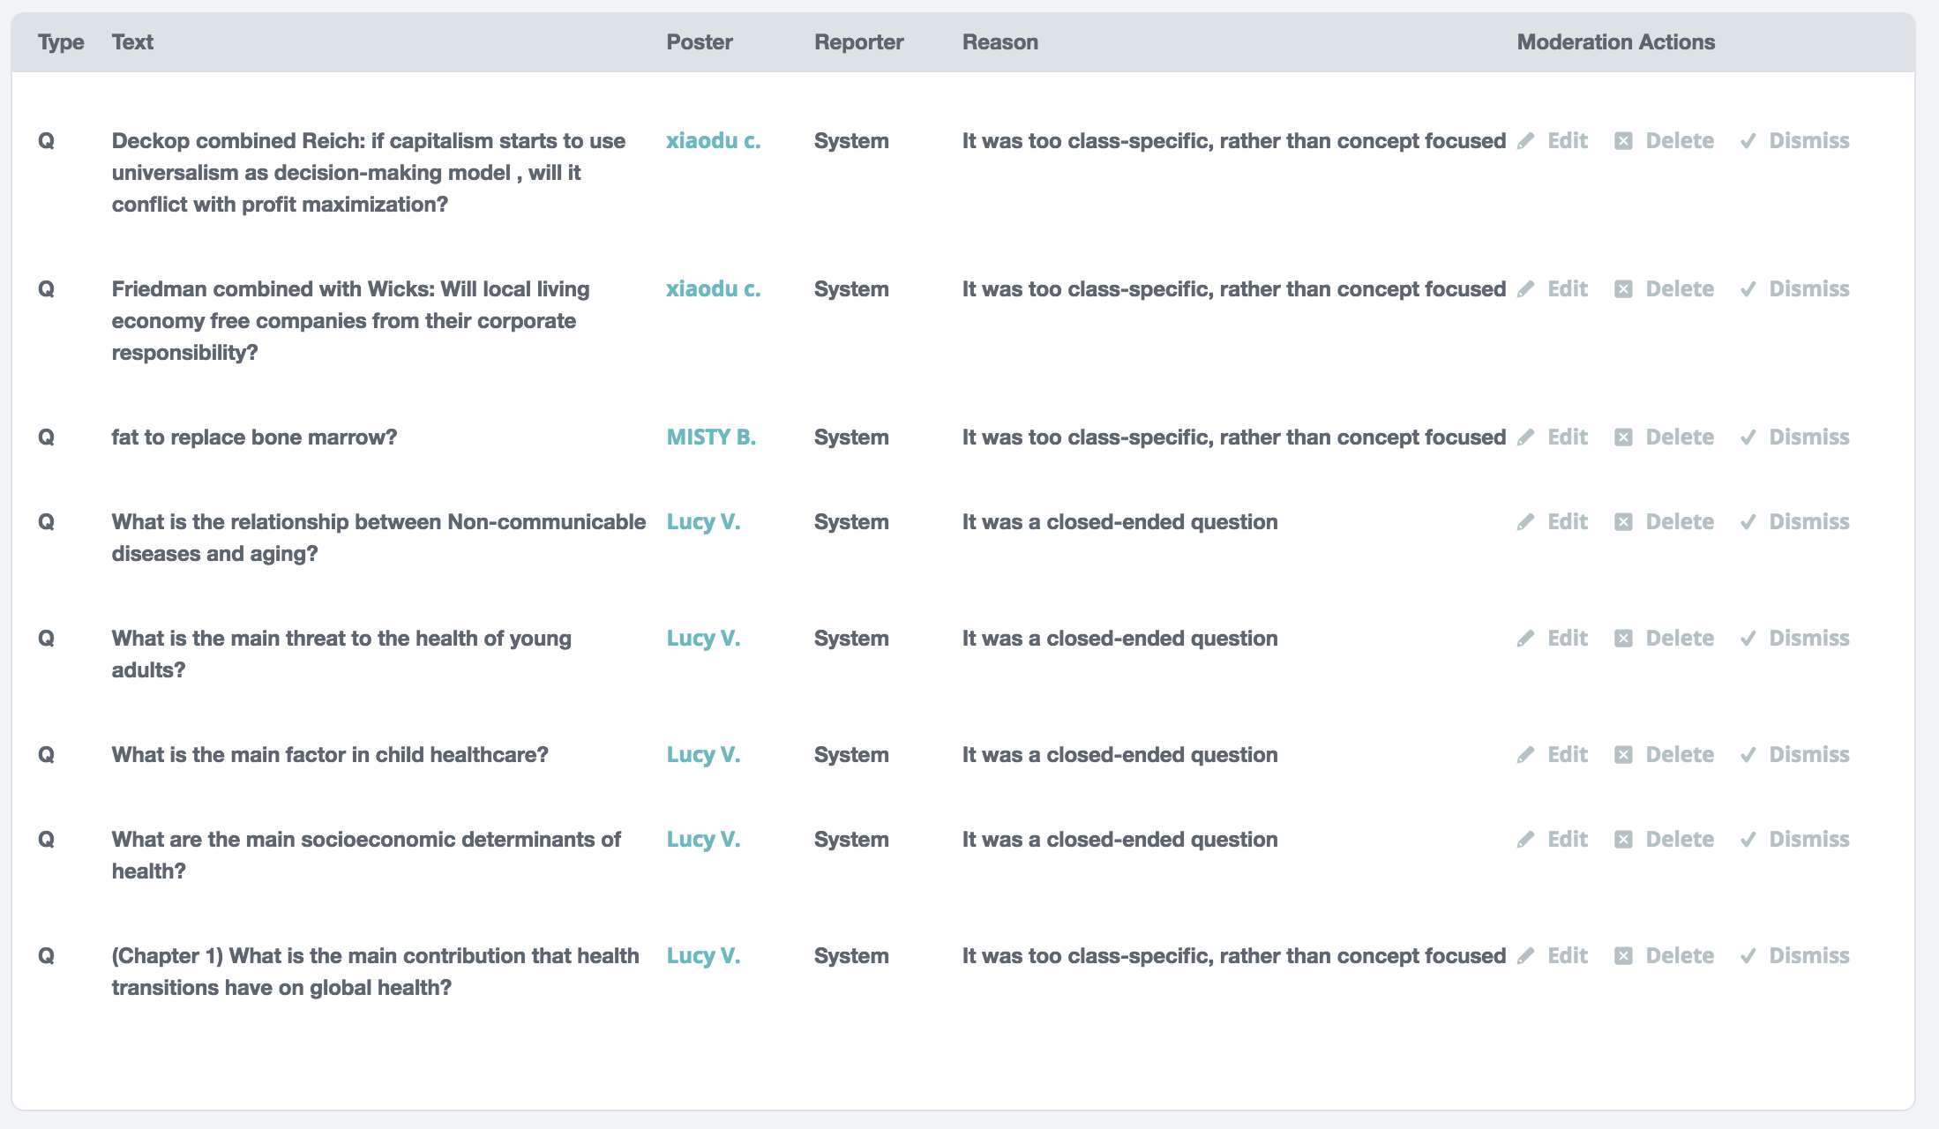
This question is flagged. If you add a response on this thread, it may be deleted.
“Flagged” Posts
If your post is “Flagged”, it was flagged by a community member OR detected by our algorithm for potentially violating a Community Guideline.
Will all “Flagged” posts be deleted?
No! Flagged posts are reviewed by our Moderators. Just because a post is flagged does not mean it will be deleted.
Very short answers will always be removed.
Reporter
Flagged
by AI
Moderation Queue
Too Class-Specific
“Flag” Reason
Algorithm
Criteria
Triggered
Too Class-Specific
John S.
Not a Question
Moderator Actions
Closed-Ended
Edit
Dismiss
Delete
Closed-Ended
What is the definition of diaspora?
System
Close-Ended
What the is the answer to #2?
System
Too Class-Specific
When did the civil war end?
System
Closed-Ended

Slide 18
“Moderated” Posts
This question is flagged. If you add a response on this thread, it may be deleted.
If your post was “Flagged”, and it ultimately violated a Community Guideline, it will be moderated
What does it mean if my post is “moderated”?
Moderated posts are removed from the curiosity feed.
You will then be sent a coaching email and prompted to edit and re-publish the post.
Note: this post must be re-published by the deadline, or you will not receive credit for that post.
Reporter
Flagged
by AI
Moderation Queue
Too Class-Specific
“Flag” Reason
Algorithm
Criteria
Triggered
Too Class-Specific
John S.
Not a Question
Moderator Actions
Closed-Ended
Edit
Dismiss
Delete
Closed-Ended
What is the definition of diaspora?
System
Close-Ended
What the is the answer to #2?
System
Too Class-Specific
When did the civil war end?
System
Closed-Ended

Slide 19

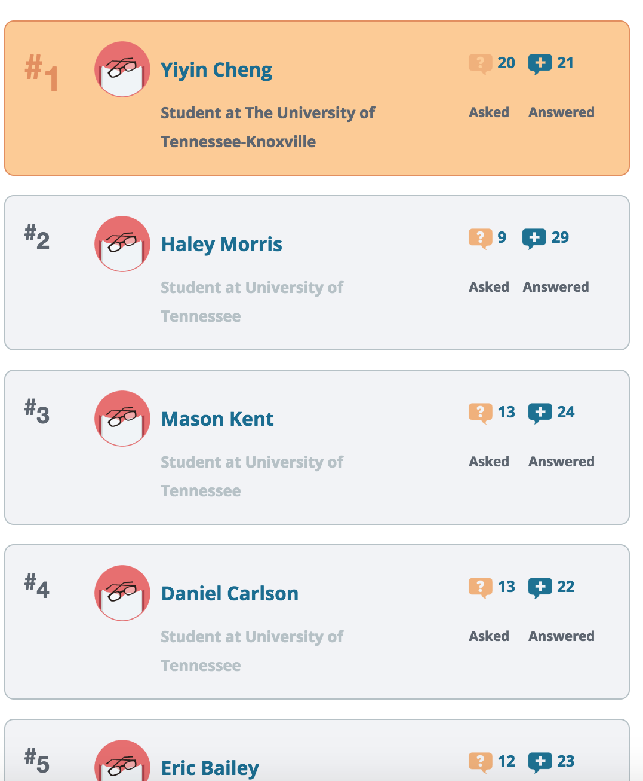
The Learner
Leaderboard
1200
Curiosity
Points
Learner Leaderboard
100%
Participation
Weekly
See how your Curiosity Score stacks up to your classmates in the Learner Leaderboard
How the Curiosity Score is calculated
Depth: How detailed your post is
Presentation: How much effort was used
Credibility: Did your post cite sources?
Your professor may grade based on Curiosity Scores.
12%
Featured
Posts
10%
First
Responder
…

Slide 20
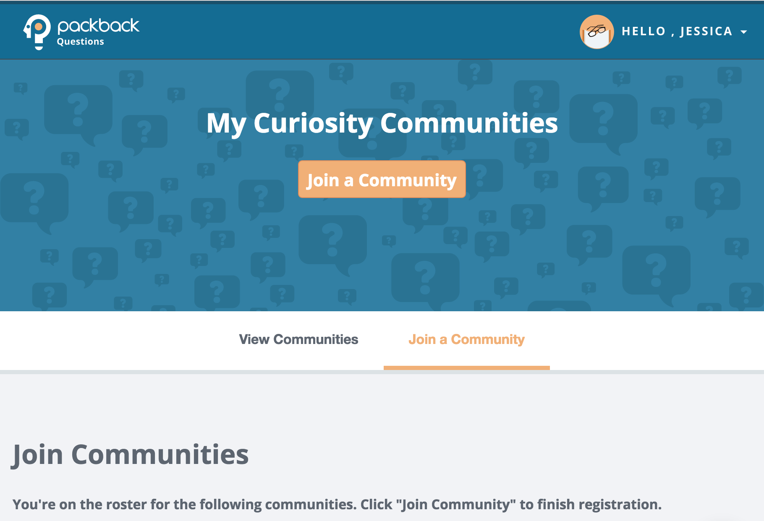
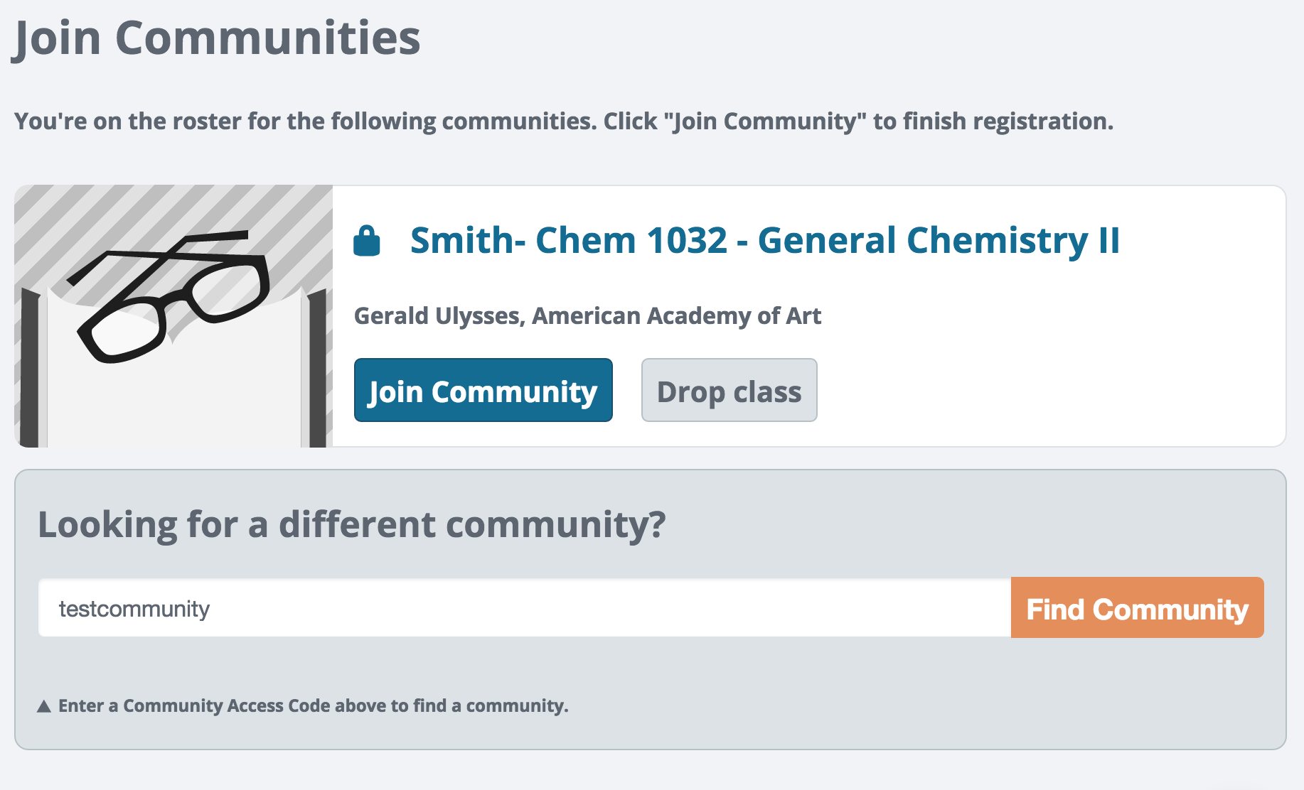
How to get started on Packback
Check your inbox for an email from Packback
  The email may be directed to spam, so search your entire inbox for an email from holla@packback.co.
Finish creating your account (if you received an email) OR create a new account
  If you were on your professor’s roster, that means we will have created an account for you. You just need to set your password.
Log in & navigate to the “Join a Community” tab
  If you see your class, click the “Join Community” button on the community to finish registration.
  If you do NOT see your class, enter the access code from the syllabus into “Find Community” module.
CODE:
1F5E90BA-68A7-11E0-7CBA-E554510FA1E0

Slide 21

Have any questions?
Check our Help Desk, click “Contact Us” or email holla@packback.co
What should I ask Packback?
  Why didn’t my payment process?
  What is my Curiosity Score?
  Why is my question flagged?
  Anything Packback related…
What should I ask my professor?
  When is the next test?
  How should I study for the final?
  My dog ate my homework?
  Anything else NOT Packback related…

Slide 22
Packback
a controlled version of GroupMe (which A&S is well aware of)
like Reddit or StackExchange
post 3 times per week (Q+A, any combo)
  up/down vote both Q & A
start next week

Slide 23
Misc
no formal attendance policy
  exams may rely on things we do in class
  quizzes are possible but unlikely
missing exams: bad
  if you know ahead of time, let me know
  if not possible, ASAP after
  acceptable reason = makeup or weight final
will try to get graded work back quickly, grades on Blackboard

Slide 24
Today
A bit of review from Ch. 1. Hopefully it is really review.

