Slide 1
Chapter 9
Work

Slide 2
Homework
Let’s go over a few homework problems

Slide 3
8.35
Homework
A 50-kg skier heads down a slope, reaching a speed of 21 km/h. She then slides across a horizontal snow field but hits a rough area. Assume the snow before the rough area is so slippery that you can ignore any friction between the skis and the snow.
If the frictional force exerted by the snow in the rough area is 40 N, how far across the rough area does the skier travel before stopping?

Slide 4
8.35
Homework
Watch units
You know the acceleration is a_{x} = –F/m
Know initial, final velocities and acceleration
Don’t know time
Want displacement …

Slide 5
8.36
Homework
A 2.19-kg cart on a long, level, low-friction track is heading for a small electric fan at 0.25 m/s . The fan, which was initially off, is turned on. As the fan speeds up, the magnitude of the force it exerts on the cart is given by at², where a = 0.0200 N/s².
What is the speed of the cart 3.5 s after the fan is turned on?
After how many seconds is the cart's velocity zero?

Slide 6
8.36
Homework
You know the force, a_{x} = -F/m. (- b/c opposes motion)
Change in velocity is
For the second part? You want v_{f} = 0, solve for t

Slide 7
8.42
Homework
You are climbing a rope straight up toward the ceiling.
What is the magnitude of the force you must exert on the rope in order to accelerate upward at 1.1 m/s², assuming your inertia is 61 kg ?

Slide 8
8.42
Homework
Start with a free body diagram:
This generates math

Slide 9
8.45
Homework
Assume that the block on the table in (Figure 1) has half the inertia of the hanging block. You push the block on the table to the right so that it starts to move. The magnitude of the frictional force exerted by the table on the table block is half the magnitude of the gravitational force exerted on this block.

Slide 10
8.45
Homework
Acceleration after removing hand?
Start with two free body diagrams:
This generates math – combine & solve for a.

Slide 11
8.45
Homework
Second part - now push the block to the left?
The only thing that changes is that friction now acts to the right.
Change the sign of the friction force and repeat

Slide 12
8.55
Homework
When a 6.0-kg box is hung from a spring, the spring stretches to 57 mm beyond its relaxed length.
In an elevator accelerating upward at 2.0 m/s², how far does the spring stretch with the same box attached?

Slide 13
8.55
Homework
Free body diagrams: at rest, in motion
At rest (left) gives you spring constant
Use that in the equation generated from the moving diagram

Slide 14
8.55
Homework
A horizontal force F_{slide} is exerted on a 9.0-kg box sliding on a polished floor. As the box moves, the magnitude of F_{slide} increases smoothly from 0 to 5.0 N in 5.0 s.
What is the box's speed at t = 5.0 s if it starts from rest? Ignore any friction between the box and the floor.
What is the box's speed at t = 5.0 s if at t = 0 it has a velocity of 3.5 m/s in the direction opposite the direction of F_{slide}? Ignore any friction between the box and the floor.

Slide 15
8.55
Homework
Need an equation for force. Increases smoothly means linear: F(t) = at (in this case a = 1)
Then: impulse can be found:
Difference in A, B? only initial velocity, force is negative in part B

Slide 16
Chapter 9 Preview
Looking Ahead: Work done by a constant force
In order for a force to do work on an object, the point of application of the force must undergo a displacement.
Work is the ‘useful’ application of a force
The SI unit of work is the joule (J).

Slide 17
Chapter 9: Work
Forces can change the physical state of an object (internal energy) as well as its state of motion (kinetic energy).
To describe these changes in energy, physicists use the concept of work:
  Work is the change in the energy of a system due to external forces.
The SI unit of work is the joule (J).

Slide 18
Section 9.1: Force displacement
Work amounts to a mechanical transfer of energy, either from a system to the environment or from the environment to a system.
Do external force always cause a change in energy on a system?
  To answer this question, it is helpful to consider an example

Slide 19
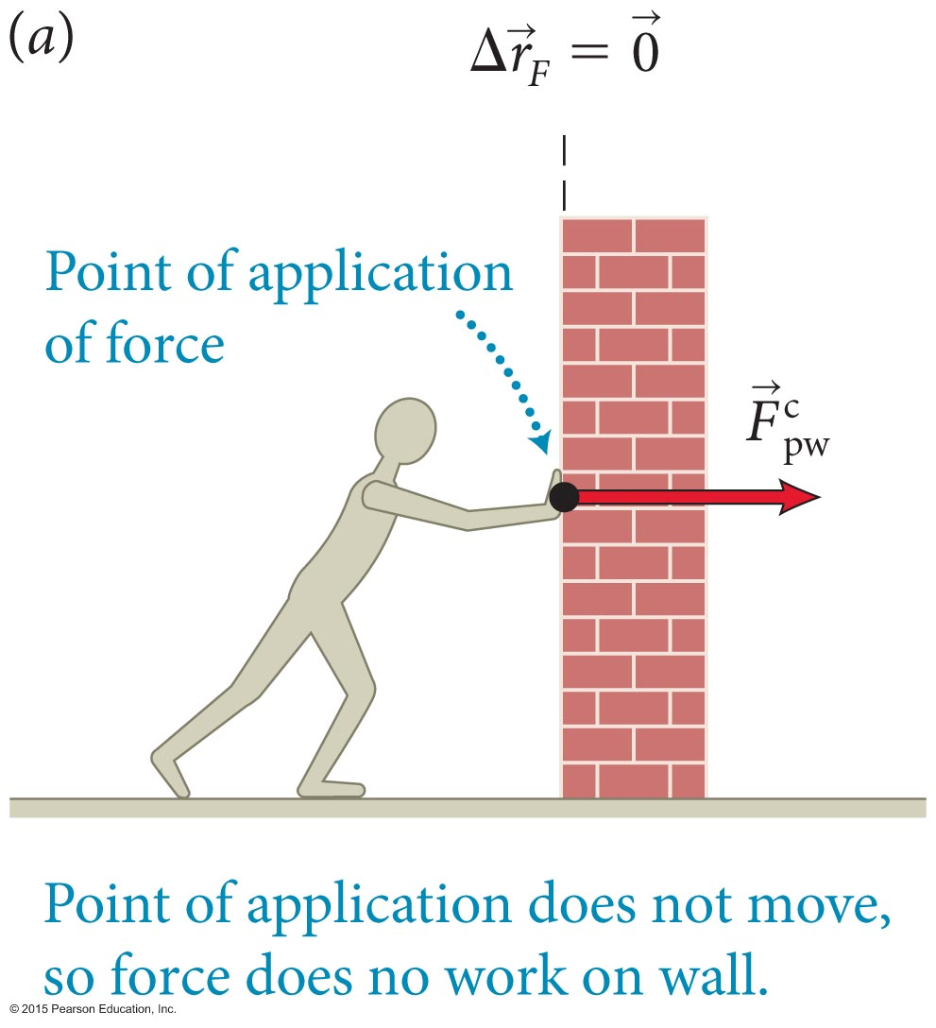
Checkpoint 9.1
Imagine pushing against a brick wall as shown in Figure 9.1a. (a) Considering the wall as the system, is the force you exert on it internal or external? (b) Does this force accelerate the wall? Change its shape? Raise its temperature? (c) Does the energy of the wall change as a result of the force you exert on it? (d) Does the force you exert on the wall do work on the wall?
9.1

Slide 20
Checkpoint 9.1
Imagine pushing against a brick wall.
Considering the wall as the system, is the force you exert on it internal or external? external
Does this force accelerate the wall? Change its shape? Raise its temperature? no, no, no
Does the energy of the wall change as a result of the force you exert on it? no
Does the force you exert on the wall do work on the wall?
  no
9.1

Slide 21
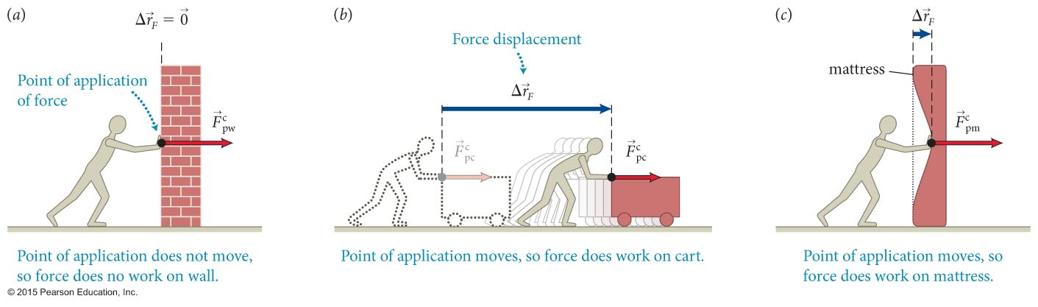
Section 9.1: Force displacement
Even though the work is zero in (a), it is nonzero in (b) and (c).
In order for a force to do work, the point of application of the force must undergo a displacement.
The displacement of the point of application of the force is called the force displacement.

Slide 22
Exercise 9.1 Displaced forces
Section 9.1: Force displacement
For which of the following forces is the force displacement nonzero:
the force exerted by a hand compressing a spring
the force exerted by Earth on a ball thrown upward,
the force exerted by the ground on you at the instant you jump upward,
the force exerted by the floor of an elevator on you as the elevator moves downward at constant speed?

Slide 23
Exercise 9.1 Displaced forces (cont.)
Section 9.1: Force displacement
SOLUTION (a), (b), and (d).
(a) The point of application of the force is at the hand, which moves to compress the spring.
(b) The point of application of the force of gravity exerted by Earth on the ball is at the ball, which moves.
(c) The point of application is on the ground, which doesn’t move.
(d) The point of application is on the floor of the elevator, which moves. ✔

Slide 24
Checkpoint 9.2
You throw a ball straight up in the air. Which of the following forces do work on the ball while you throw it? Consider the interval from the instant the ball is at rest in your hand to the instant it leaves your hand at speed υ.
The force of gravity exerted by Earth on the ball.
The contact force exerted by your hand on the ball.
9.2

Slide 25
Checkpoint 9.2
You throw a ball straight up in the air. Which of the following forces do work on the ball while you throw it? Consider the interval from the instant the ball is at rest in your hand to the instant it leaves your hand at speed υ. (a) The force of gravity exerted by Earth on the ball. (b) The contact force exerted by your hand on the ball.
both do work – for both, the point of application is the ball, and this point moves as you launch the ball
(your hand has to move to launch the ball)
9.2

Slide 26
Section 9.1
Question 1
A woman holds a bowling ball in a fixed position. The work she does on the ball
  depends on the weight of the ball.
  cannot be calculated without more information.
  is equal to zero.

Slide 27

Section 9.1
Question 1
A woman holds a bowling ball in a fixed position. The work she does on the ball
  depends on the weight of the ball.
  cannot be calculated without more information.
  is equal to zero.

Slide 28
Section 9.1
Question 2
A man pushes a very heavy load across a horizontal floor. The work done by gravity on the load
  depends on the weight of the load.
  cannot be calculated without more information.
  is equal to zero.

Slide 29
Section 9.1
Question 2
A man pushes a very heavy load across a horizontal floor. The work done by gravity on the load
  depends on the weight of the load.
  cannot be calculated without more information.
  is equal to zero.
  gravity acts vertically, the displacement is horizontal. the work is against the frictional force

Slide 30
Section Goal
Section 9.2: Positive and negative work
You will learn to
Determine how the sign of the work done depends on the vector relationship between the force and the displacement.

Slide 31
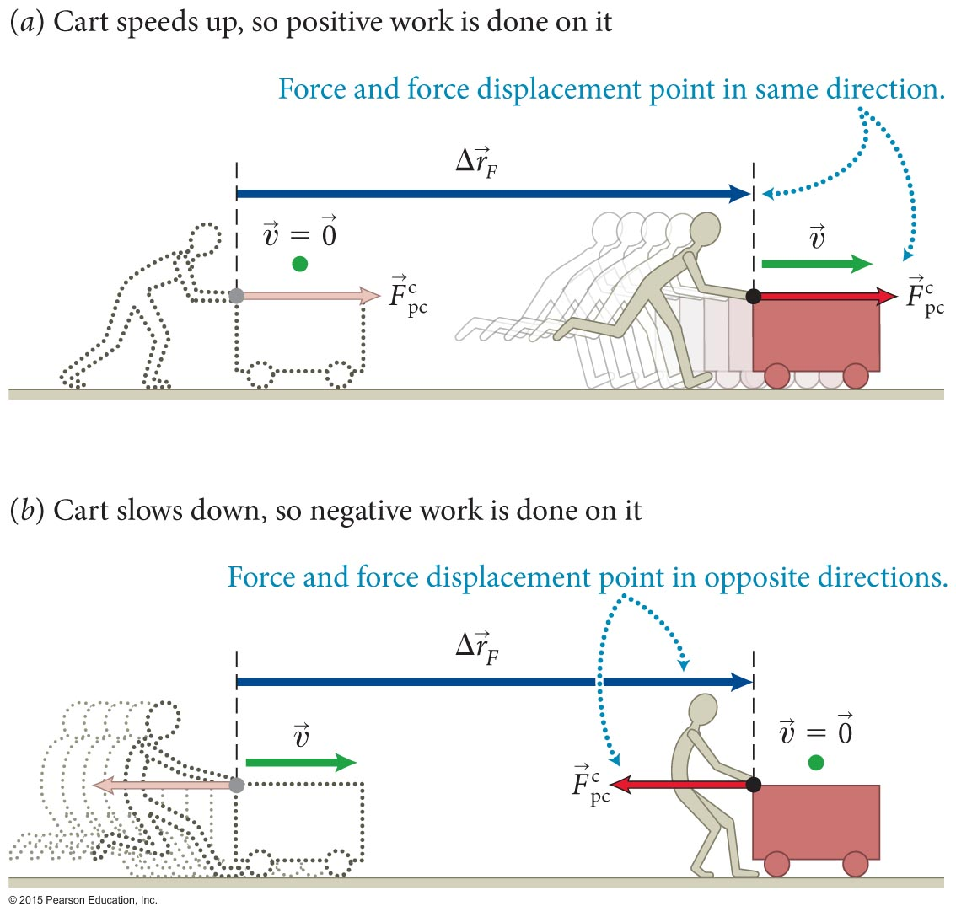
Section 9.2: Positive and negative work
When the work done by an external force on a system is positive, the change in energy is positive, and when work is negative, the energy change is negative.
External force adds or subtracts energy from system
Examples of negative and positive work are illustrated in the figure
The work done by a force on a
system is positive when the force
and the force displacement point
in the same direction and negative
when they point in opposite
directions.

Slide 32
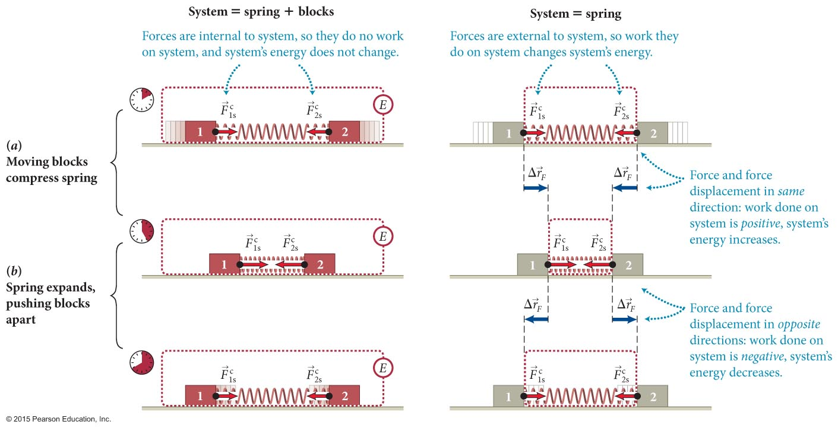
Section 9.2: Positive and negative work
Let us now consider a situation involving potential energy.
First, we consider the spring + blocks to be a closed system.
In this case the change in potential energy will manifest as a change in the kinetic energy of the blocks, keeping the total energy constant.
Because no external forces are exerted on the system, no work is involved.

Slide 33
Section 9.2: Positive and negative work
Next, consider the spring by itself as the system.
When the compressed spring is released, the decrease in the energy of the spring implies the work done by the block on the spring is negative.
The force exerted on the spring by the block and the force displacement are in opposite directions, which confirms that the work is negative.

Slide 34
Checkpoint 9.3
A ball is thrown vertically upward.
As it moves upward, it slows down under the influence of gravity. Considering the changes in energy of the ball, is the work done by Earth on the ball positive or negative?
After reaching its highest position, the ball moves downward, gaining speed. Is the work done by the gravitational force exerted on the ball during this motion positive or negative?
9.3

Slide 35
Checkpoint 9.3
A ball is thrown vertically upward.
(a) As it moves upward, it slows down under the influence of gravity. Considering the changes in energy of the ball, is the work done by Earth on the ball positive or negative?
  As it moves upward, KE decreases, E_{int} is constant. The ball’s energy (K + E_{int}) decreases, so work is negative (force & displacement opposite)
(b) After reaching its highest position, the ball moves downward, gaining speed. Is the work done by the gravitational force exerted on the ball during this motion positive or negative?
  Ball’s energy now increases, so work is positive (force & displacement in same direction)
9.3

Slide 36
Exercise 9.2 Positive and negative work
Section 9.2: Positive and negative work
Is the work done by the following forces positive, negative, or zero? In each case the system is the object on which the force is exerted.
(a) the force exerted by a hand compressing a spring, (b) the force exerted by Earth on a ball thrown upward, (c) the force exerted by the ground on you at the instant you jump upward
(d) the force exerted by the floor of an elevator on you as the elevator moves downward at constant speed.

Slide 37
Exercise 9.2 Positive and negative work (cont.)
Section 9.2: Positive and negative work
SOLUTION
(a) Positive. To compress a spring, I must move my hand in the same direction as I push. ✔
(b) Negative. The force exerted by Earth points downward; the point of application moves upward. ✔
(c) Zero, because the point of application is on the ground, which doesn’t move. ✔
(d) Negative. The force exerted by the elevator floor points upward; the point of application moves downward. ✔

Slide 38
Section 9.2
Question 3
You throw a ball up into the air and then catch it. How much work is done by gravity on the ball while it is in the air?
  A positive amount
  A negative amount
  Cannot be determined from the given information
  Zero

Slide 39
Section 9.2
Question 3
You throw a ball up into the air and then catch it. How much work is done by gravity on the ball while it is in the air?
  A positive amount
  A negative amount
  Cannot be determined from the given information
  Zero – comes back to where it started

Slide 40
Checkpoint 9.5
Suppose that instead of the two moving blocks in Figure 9.3a, just one block is used to compress the spring while the other end of the spring is held against a wall.
Is the system comprising the block and the spring closed?
When the system is defined as being only the spring, is the work done by the block on the spring positive, negative, or zero? How can you tell?
Is the work done by the wall on the spring positive, negative, or zero?
9.5

Slide 41
Checkpoint 9.5
Suppose that instead of the two moving blocks in Figure 9.3a, just one block is used to compress the spring while the other end of the spring is held against a wall.
Is the system comprising the block and the spring closed?
  yes – no changes in motion or state in environment
When the system is defined as being only the spring, is the work done by the block on the spring positive, negative, or zero? How can you tell?
positive – force on spring is in direction point of contact moves
(c) Is the work done by the wall on the spring positive, negative, or zero?
  zero – point of contact doesn’t move
9.5

Slide 42
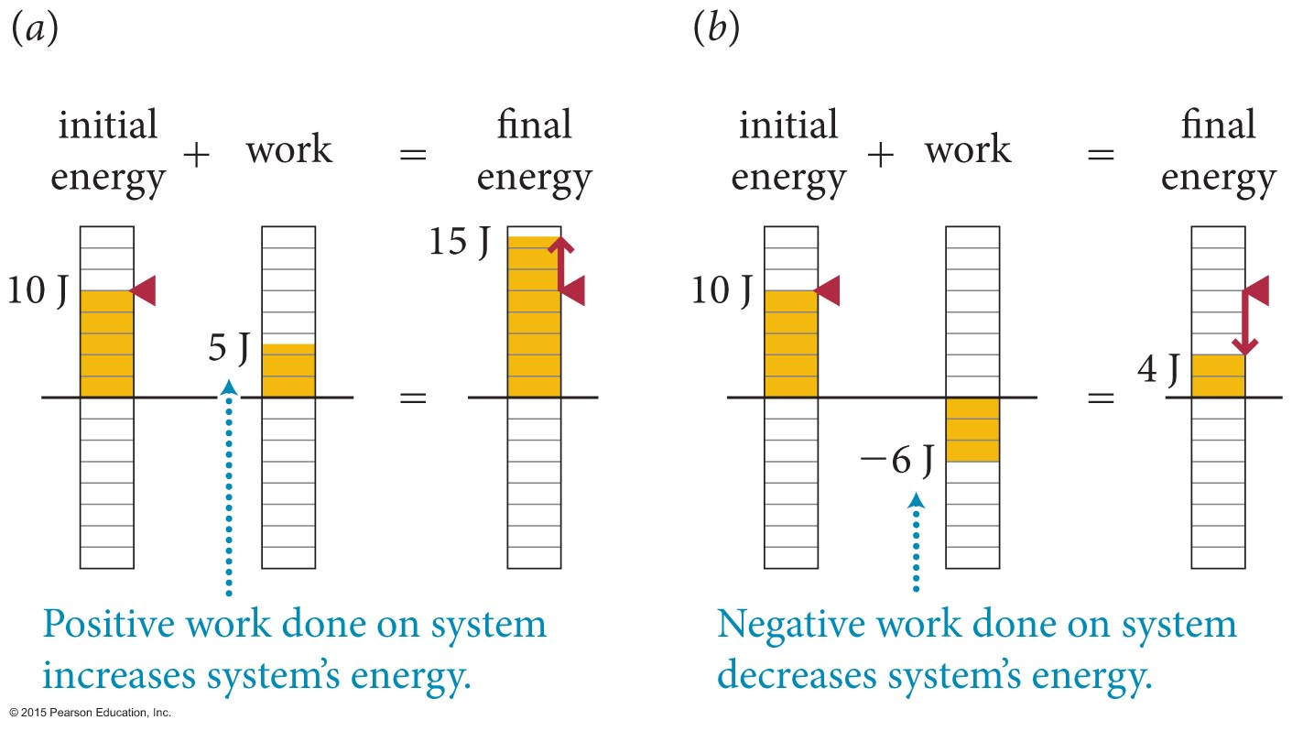
Section 9.3: Energy diagrams
We can use energy bar charts to visually analyze situations involving work.
This is why the sign is important

Slide 43
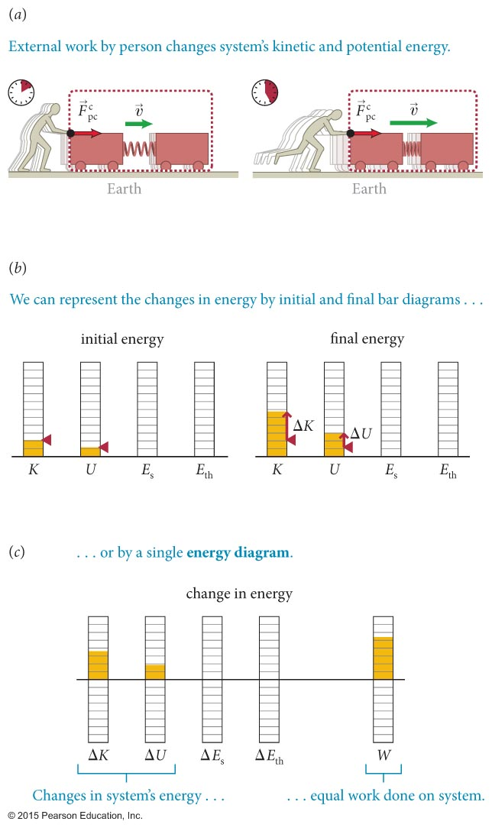
Section 9.3: Energy diagrams
Because any of the four kinds of energy can change in a given situation, we need more details in our energy bar charts [part (b)].
As shown in part (c), we can also draw one set of bars for change in each category of energy, and a fifth bar to represent work done by external forces.
  These are called energy diagrams.

Slide 44
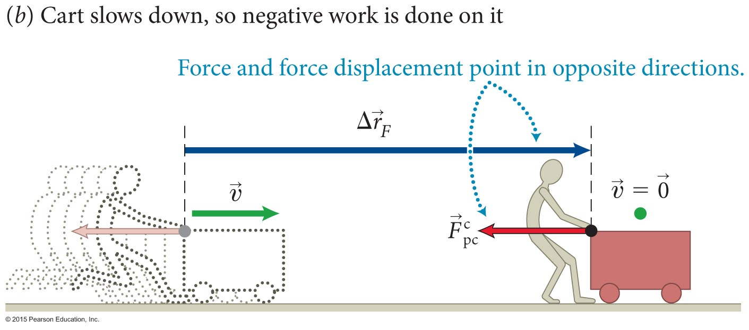
Checkpoint 9.6
Draw an energy diagram for the cart in Figure 9.2b.
9.6

Slide 45
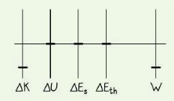
Checkpoint 9.6
The cart’s KE decreases to zero, no changes in other forms of energy.
Person’s force is to the left, displacement to the right: work is negative.
Change in KE should be same as work done in magnitude
9.6

Slide 46
Exercise 9.4 Compressing a spring
Section 9.3: Energy diagrams
A block initially at rest is released on an inclined surface. The block slides down, compressing a spring at the bottom of the incline; there is friction between the surface and the block.
Consider the time interval from a little after the release, when the block is moving at some initial speed υ, until it comes to rest against the spring. Draw an energy diagram for the system that comprises the block, surface, and Earth.

Slide 47
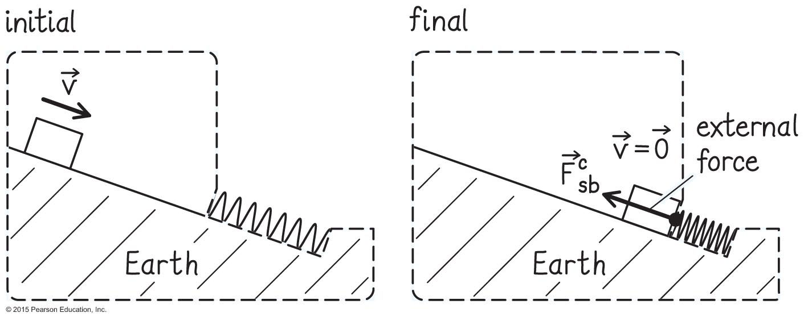
Exercise 9.4 Compressing a spring (cont.)
Section 9.3: Energy diagrams
SOLUTION I begin by listing the objects that make up the system: block, surface, and Earth. Then I sketch the initial and final states of the system (Figure 9.8). The spring exerts external forces on the system.

Slide 48
Exercise 9.4 Compressing a spring (cont.)
Section 9.3: Energy diagrams
SOLUTION The bottom end of the spring exerts a force on the surface edge, but this force has a force displacement of zero. The top end of the spring exerts a force on the block. Because this force undergoes a nonzero force displacement, I include it in my diagram and show a dot at its point of application.

Slide 49
Exercise 9.4 Compressing a spring (cont.)
Section 9.3: Energy diagrams
SOLUTION Next I determine whether there are any energy changes. Kinetic energy: The block’s kinetic energy goes to zero, and the kinetic energies of the surface and Earth do not change. Thus the kinetic energy of the system decreases, and ΔK is
negative.

Slide 50
Exercise 9.4 Compressing a spring (cont.)
Section 9.3: Energy diagrams
SOLUTION Potential energy: As the block moves downward, the gravitational potential energy of the block-Earth system decreases, and so ΔU is negative. (Because the spring gets compressed, its elastic potential energy changes, but the spring is not part of the system.)

Slide 51
Exercise 9.4 Compressing a spring (cont.)
Section 9.3: Energy diagrams
SOLUTION Source energy: none (no fuel, food, or other source of energy is converted in this problem). Thermal energy: As the block slides, energy is dissipated by the friction between the surface and the block, so ΔE_{th} is positive.

Slide 52
Exercise 9.4 Compressing a spring (cont.)
Section 9.3: Energy diagrams
SOLUTION To determine the work done on the system, I look at the external forces exerted on it. The point of application of the external force exerted by the spring on the block undergoes a force displacement opposite the direction of the force, so that force does negative work on the system.

Slide 53
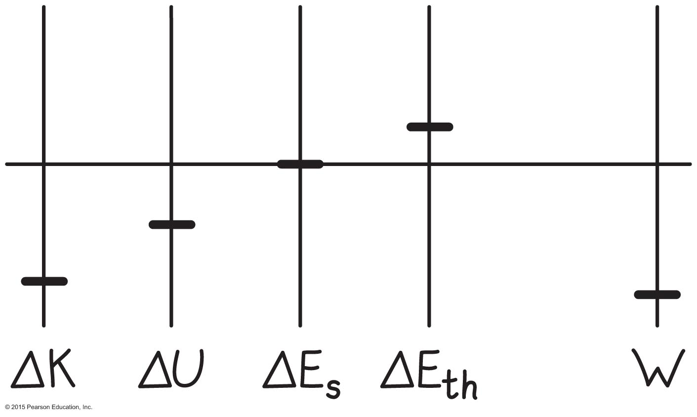
Exercise 9.4 Compressing a spring (cont.)
Section 9.3: Energy diagrams
SOLUTION Thus the work done on the system by the external forces is negative, and the W bar extends below the baseline (Figure 9.9). I adjust the lengths of the bars so that the length of the W bar is equal to the sum of the lengths of the other three bars, yielding the energy diagram shown in Figure 9.9. ✔

Slide 54
Exercise 9.4 Compressing a spring (cont.)
Section 9.3: Energy diagrams
SOLUTION
The change in kinetic energy is equal to the work done
The change in potential energy shows up as thermal energy (friction)
Now we could do math – all energy changes plus work sum to zero

Slide 55
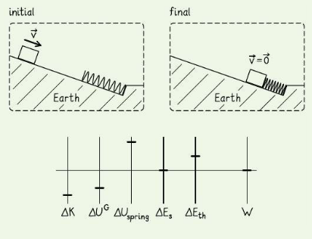
Checkpoint 9.7
Draw an energy diagram for the situation presented in Exercise 9.4, but choose the system that comprises block, spring, surface, and Earth. (i.e., include the spring now)
Which changes should be equal? No external force now, no work.
9.7
What was work is now a change in PE
Distinction depends on choice of system!

Slide 56
Section Goals
Section 9.4: Choice of system
You will learn to
Choose an appropriate system for a physical problem of interest in order to systematically account for the various energy changes.
Recognize that a system chosen for which friction acts across the boundary is difficult to analyze. This is because in these situations thermal energy is generated in both the environment and the system, making energy accounting for the system problematic.

Slide 57
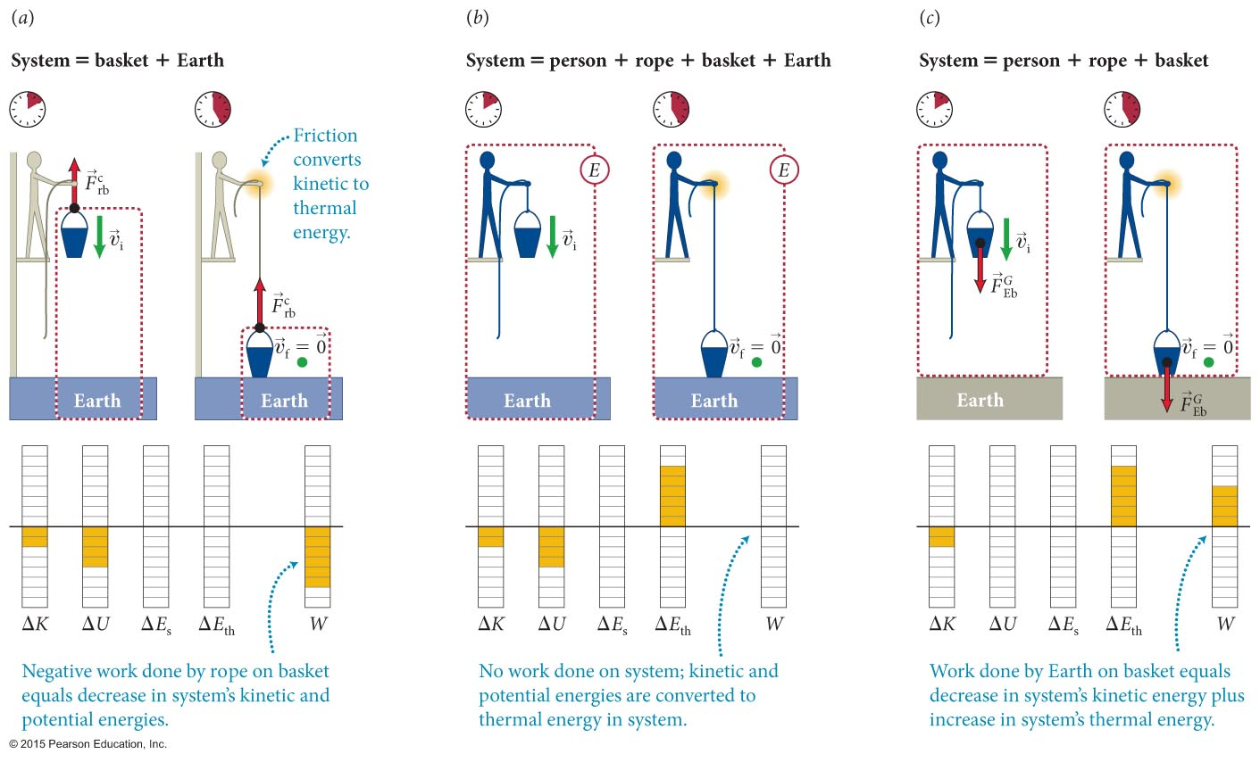
Section 9.4: Choice of system
Different choices of systems lead to different energy diagrams.
What is “work” in one context is energy conversion in another
Work is involved when an external agent acts with a force

Slide 58
Section 9.4: Choice of system
Need to be careful not to double count gravitational potential energy!
It is important to remember the following point:
  Gravitational potential energy always refers to the relative position of various parts within a system, never to the relative positions of one component of the system and its environment.
In other words, depending on the choice of system, the gravitational interaction with the system can appear in energy diagrams as either a change in gravitational potential energy or work done by Earth, but not both.
Earth outside system? Probably work (earth = external agent then) …

Slide 59
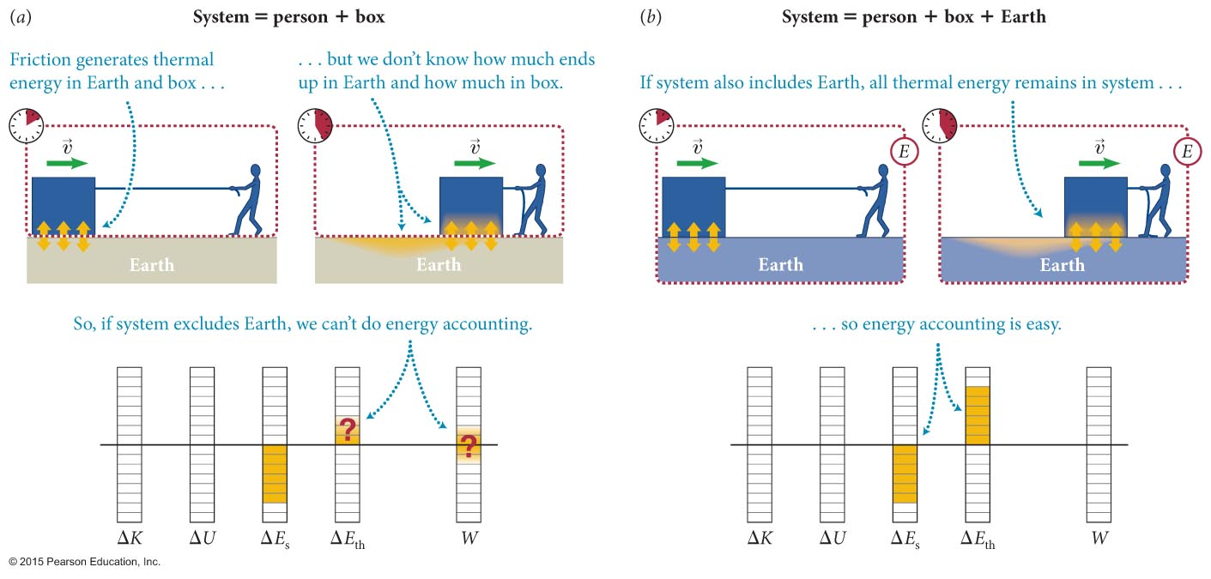
Section 9.4: Choice of system
As seen in the figure, the thermal energy generated (in this case due to friction) ends up on both surfaces.
As seen in part (a), certain choices of systems lead to complications:
  When drawing an energy diagram, do not choose a system for which friction occurs at the boundary of the system.

Slide 60
Section 9.4
Question 5
A person pulls a box along the ground at a constant speed. If we consider Earth and the box as our system, what can we say about the net external force on the system?
  It is zero because the system is isolated.
  It is nonzero because the system is not isolated.
  It is zero even though the system is not isolated.
  It is nonzero even though the system is isolated.
  None of the above

Slide 61
Section 9.4
Question 5
A person pulls a box along the ground at a constant speed. If we consider Earth and the box as our system, what can we say about the net external force on the system?
  It is zero because the system is isolated.
  It is nonzero because the system is not isolated.
  It is zero even though the system is not isolated.
  It is nonzero even though the system is isolated.
  None of the above

Slide 62
Chapter 9: Self-Quiz #2
Consider a weightlifter holding a barbell motionless above his head.
(a) Is the sum of the forces exerted on the barbell zero?
(b) Is the weightlifter exerting a force on the barbell?
(c) If the weightlifter exerts a force, does this force do any work on the barbell?
(d) Does the energy of the barbell change?
(e) Are your answers to parts (c) and (d) consistent in light of the relationship between work and energy?

Slide 63
Answer
Chapter 9: Self-Quiz #2
(a) Yes, because the barbell remains motionless.
(b) Yes. He exerts an upward force to counter the downward gravitational force.
(c) No, because the point at which the lifter exerts a force on the barbell is not displaced.
(d) No, it just sits there.
(e) They are consistent. If no work is done on a system, the energy of the system does not change.

Slide 64
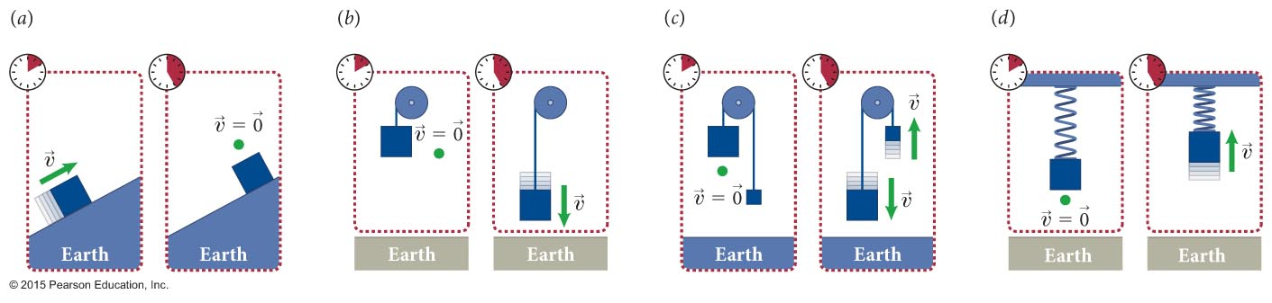
Chapter 9: Self-Quiz #3
Do any of the systems in the figure undergo a change in potential energy?
If yes, is the change positive or negative? Ignore any friction.

Slide 65
Chapter 9: Self-Quiz #3
Do any of the systems in the figure undergo a change in potential energy?
If yes, is the change positive or negative? Ignore any friction.
Yes: U^{G} changes
No: F^{G} is external
Yes: U^{G} changes
Yes: U^{S} changes

Slide 66
Quantitative Tools
Chapter 9: Work

Slide 67
Section 9.5: Work done on a single particle
When work is done by external forces on a system, the energy change in the system is given by the energy law:
ΔE = W
To determine the work done by an external force, we will consider the simple case of a particle:
  Particle refers to any object with an inertia m and no internal structure (ΔE_{int} = 0).
Only the kinetic energy of a particle can change, so
ΔE = ΔK (particle)
The constant force acting on the particle give is it an acceleration given by

Slide 68
Section 9.5: Work done on a single particle
Consider the motion of the particle in time interval
Δt = t_{f} – t_{i}. From Equations 3.4 and 3.7, we can write
υ_{x,f} = υ_{x,i} + a_{x}Δt
The kinetic energy change of the particle is given by
Combining the above equations we get,
where Δx_{F} is the force displacement.

Slide 69
Section 9.5: Work done on a single particle
Since ΔE = W, and for a particle ΔE = ΔK, we get
  W = F_{x}Δx_{F} (constant force exerted on particle, one dimension)
The equation above in words:
  For motion in one dimension, the work done by
  a constant force exerted on a particle equals the product of the x component of the force and the force displacement.
If more than one force is exerted on the particle, we get
W = (ΣF_{x})Δx_{F} (constant forces exerted on particle,
one dimension)
This is called the work equation.

Slide 70
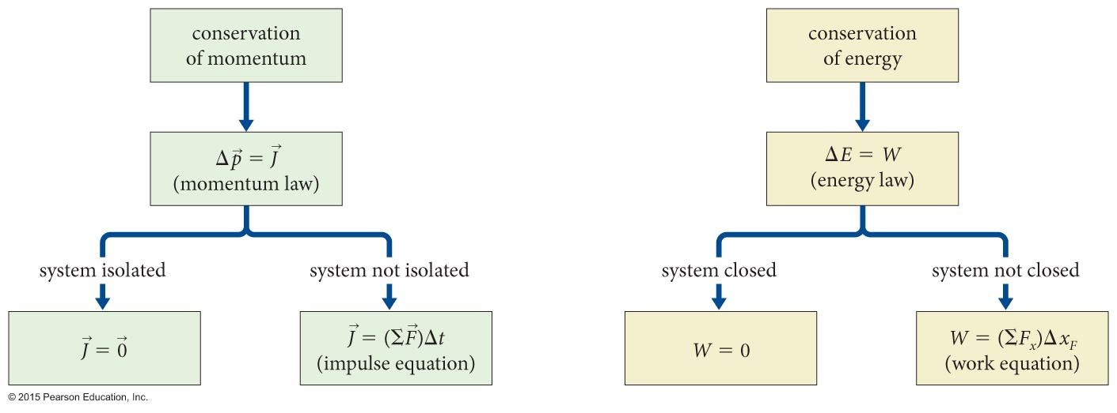
Section 9.5: Work done on a single particle
Notice the parallel between our treatment of momentum/impulse and energy/work, as illustrated in the figure.

Slide 71
Example 9.6 Work done by gravity
Section 9.5: Work done on a single particle
A ball of inertia m_{b} is released from rest and falls vertically. What is the ball’s final kinetic energy after a displacement Δx = x_{f} – x_{i}?

Slide 72
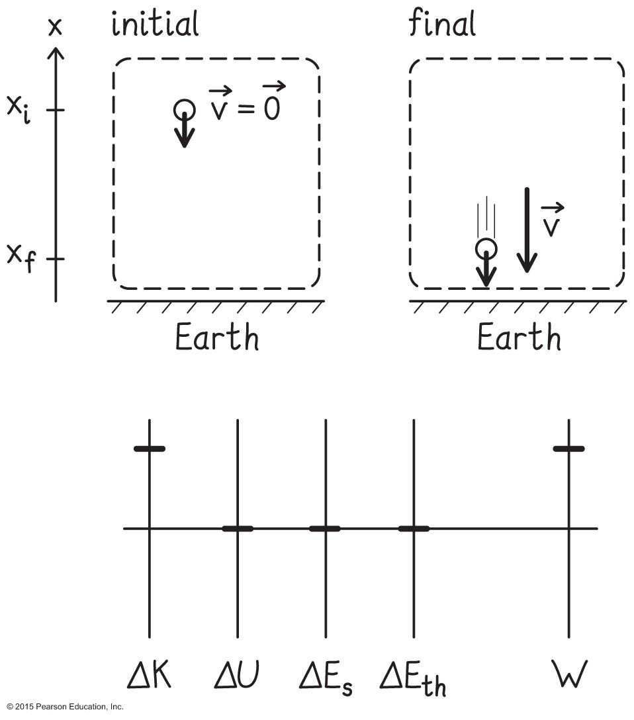
Example 9.6 Work done by gravity (cont.)
Section 9.5: Work done on a single particle
❶ GETTING STARTED I begin by making a sketch of the initial and final conditions and drawing an energy diagram for the ball (Figure 9.17). I choose an x axis pointing upward.

Slide 73
Example 9.6 Work done by gravity (cont.)
Section 9.5: Work done on a single particle
❶ GETTING STARTED Because the ball’s internal energy doesn’t change as it falls (its shape and temperature do not change), I can treat the ball as a particle. Therefore only its kinetic energy changes.

Slide 74
Example 9.6 Work done by gravity (cont.)
Section 9.5: Work done on a single particle
❶ GETTING STARTED I can also assume air resistance is small enough to be ignored, so that the only external force exerted on the ball is a constant gravitational force. This force has a nonzero force displacement and so does work on the ball. I therefore include this force in my diagram.

Slide 75
Example 9.6 Work done by gravity (cont.)
Section 9.5: Work done on a single particle
❷ DEVISE PLAN If I treat the ball as a particle,
the change in the ball’s kinetic energy is equal to the work done on it by the constant force of gravity, the x component of which is:
  (The minus sign means that the force points in the negative x direction.)
To calculate the work done by this force on the ball, I use Eq. 9.8.

Slide 76
Example 9.6 Work done by gravity (cont.)
Section 9.5: Work done on a single particle
❸ EXECUTE PLAN Substituting the x component of the gravitational force exerted on the ball and the force displacement x_{f} – x_{i} into Eq. 9.8, I get

Slide 77
Example 9.6 Work done by gravity (cont.)
Section 9.5: Work done on a single particle
❸ EXECUTE PLAN Because the work is equal to the change in kinetic energy and the initial kinetic energy is zero, I have W = ΔK = K_{f} – 0 = K_{f.}, so
✔

Slide 78
Example 9.6 Work done by gravity (cont.)
Section 9.5: Work done on a single particle
❹ EVALUATE RESULT Because the ball moves in the negative x direction, Δx = x_{f} – x_{i} is negative and so the final kinetic energy is positive (as it should be).

Slide 79
Example 9.6 Work done by gravity (cont.)
Section 9.5: Work done on a single particle
❹ EVALUATE RESULT An alternative approach is to consider the closed Earth-ball system. For that system, the sum of the gravitational potential energy and kinetic energy does not change, and so, from Eq. 7.13,
No work done here - the gravitational force is internal
Because the ball starts at rest, υ_{i} = 0, and so I obtain the same result for the final kinetic energy:

Slide 80
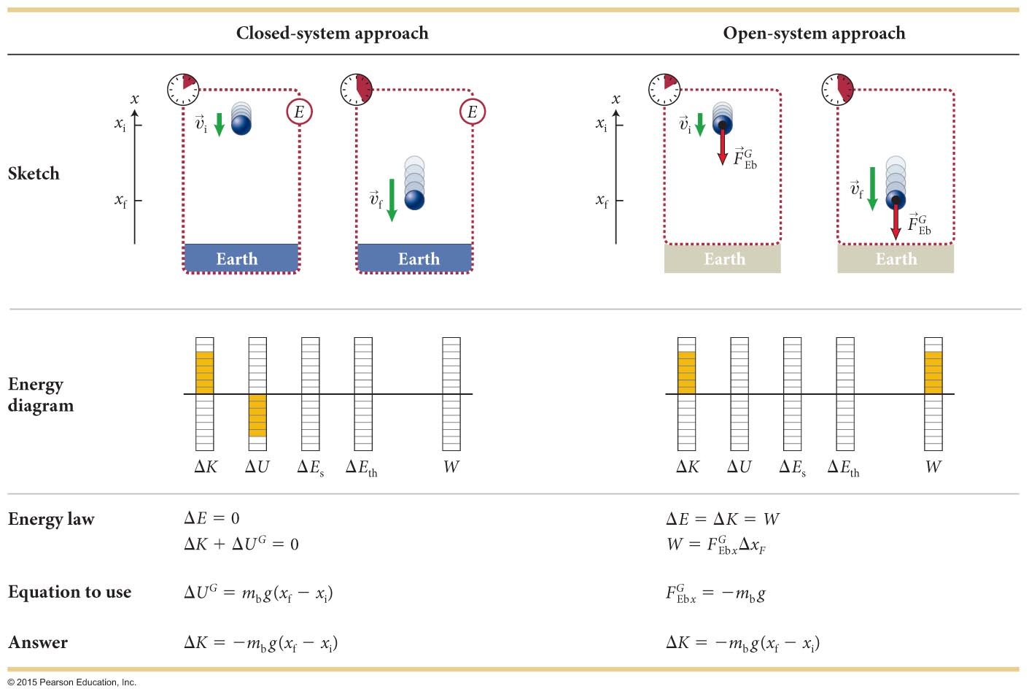
Section 9.5: Work done on a single particle
The two approaches used in the previous example are shown schematically in the figure.

Slide 81
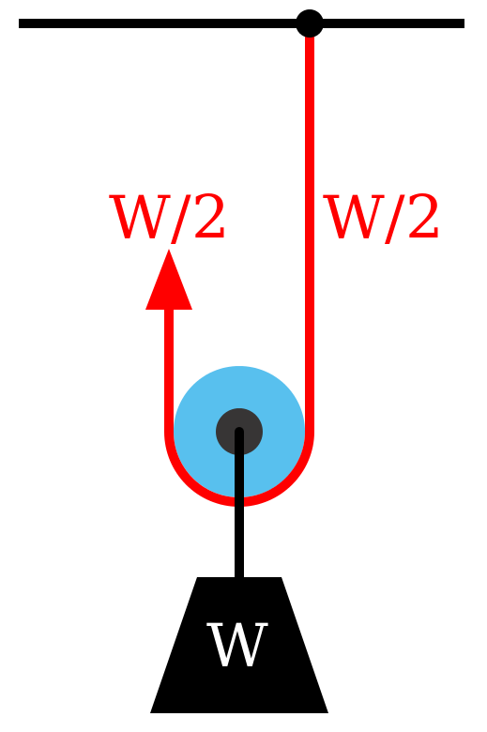
Interlude: what is a pulley good for?
Why use a pulley?
Simple pulley redirects force
Pull down to move object up
But now you use two ropes
  each has same tension
Net downward force: W
Net upward: W/2 + W/2
let the ceiling do half the pulling!

Slide 82
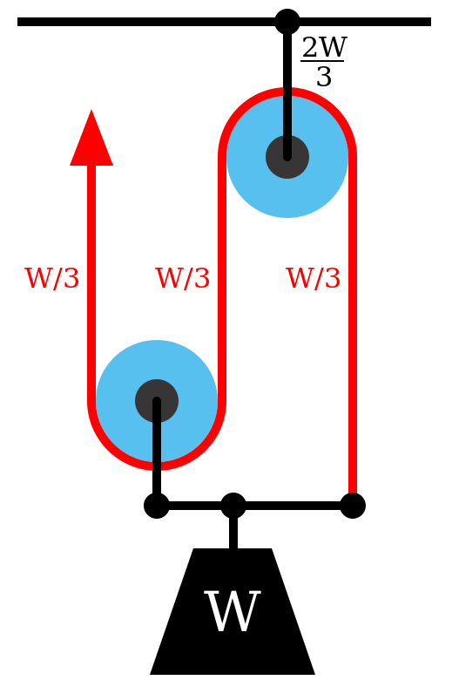
Pulley
Compound pulley? Why not use more ropes!
Same rope, same tension, but split it up
3 sections, pull with 1/3 weight
tension same everywhere in the rope if it is light!

Slide 83
Pulley
Work?
if load moves by x, you have to pull L
Work done by you = work by gravity
(W/3)L = Wx so L = 3x
pull with 1/3 the force
pay with 3x the distance

Slide 84
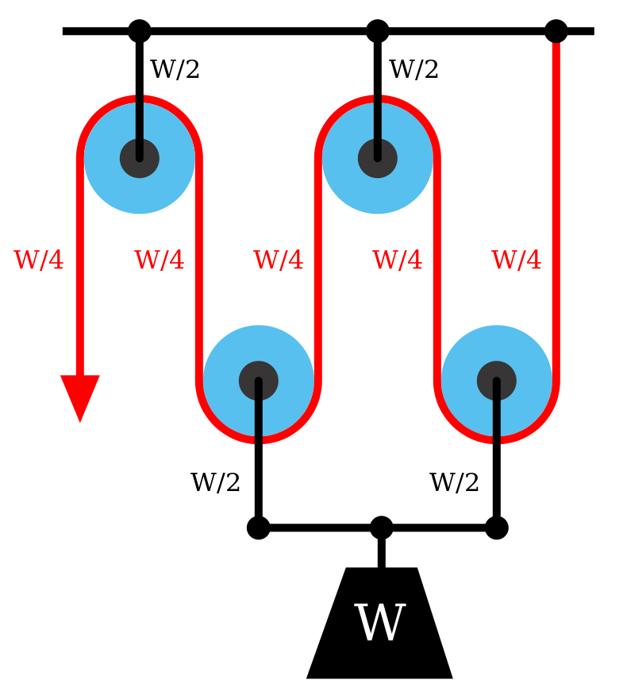
Pulley
Pull with ¼ the force, but 4 times as far
Mechanical advantage – trade force for distance

Slide 85
Drag forces
Resistance in a fluid or gas
Depends on:
  Speed v (laminar) or v² (turbulent)
  Shape (factor D, all speeds)
  Cross sectional area (A)
  Surface finish (D, esp. high speed “skin friction”)
  Density of fluid/gas (ρ high speed)
  Viscosity of fluid (η low speed)

Slide 86
Low speed drag in 1D: solvable
acceleration is a_{drag} ~ -bv
b is the drag coefficient
add to this acceleration of +g due to gravity
Qualitatively similar for high speeds
Leads to a terminal velocity
Image: wikipedia, “Drag (physics)

Slide 87
So what is “high speed”
Depends on balance of inertial and viscous forces
If the object has characteristic length L, characterized by Reynolds number
For Re << 1, nice laminar flow
  Viscous forces dominate
For Re ~ 10, turbulent
  Inertial forces dominate
Small viscosity = more easily turbulent
Image: wikipedia, “Reynolds number”

Slide 88
So?
Say we have a 1mm particle in air at 10 m/s (22 mph)
Turbulent! How about a 1um particle at 10 m/s?
Only laminar below ~1m/s. Pollen is already 10-100um
Laminar? Very fine dust, bacteria swimming
most stuff is turbulent, and this is just terrible

Slide 89
Where does high speed drag come from?
Have to move air out of the way.
Mass of air to move?
Change in momentum?
Force = time rate of change
(add a drag coefficient ‘fudge factor’ D to handle shape/etc.)

Slide 90
How to calculate?
Drag forces for turbulent flow don’t often admit analytic solutions
Make computers do the work. Let’s say we start at rest at the origin at time t=0, with only gravity
a[0] = -g
v[0] = 0
x[0] = 0
How about some infinitesimally small time later?

Slide 91
A time dt later
How about one step later?

Slide 92
Notice a pattern
We can use a known starting point and just increment one step dt at a time!
Need stopping condition (e.g., x = -h to hit ground)
Advantage? Can trivially add any acceleration

Slide 93
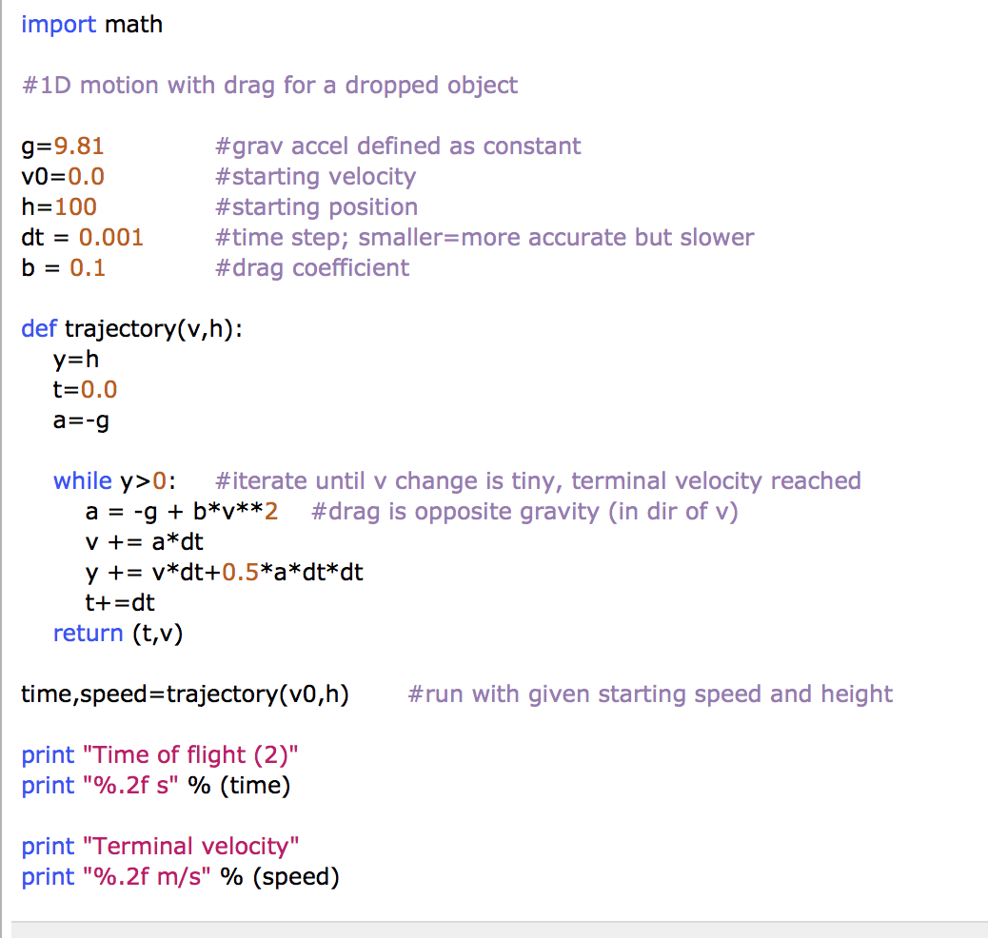
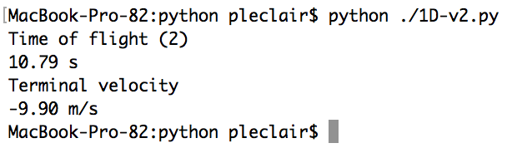
Example (python)

Slide 94
So what?
You can do this on your phone
You are mostly science & engineering majors, this will totally come up again
Don’t be afraid of code. Much better than labs, you can’t break anything.
Some examples:
http://faculty.mint.ua.edu/~pleclair/ph125/python/

Slide 95
Section 9.5
Question 6
When you do positive work on a particle, its kinetic energy
  increases.
  decreases.
  remains the same.
  We need more information about the way the work was done.

Slide 96
Section 9.5
Question 6
When you do positive work on a particle, its kinetic energy
  increases.
  decreases.
  remains the same.
  We need more information about the way the work was done.

Slide 97
Section Goals
Section 9.6: Work done on a many-particle system
You will learn to
Extend the work-force-displacement relationship for single objects to systems of interacting objects.
Recognize that only external forces contribute to the work done for many particle systems. Since the internal forces are members of an interaction pair the work done by that pair of forces always sums to zero.

Slide 98
Example 9.7 Landing on his feet
Section 9.6: Work done on a many-particle system
A 60-kg person jumps off a chair and lands on the floor at a speed of 1.2 m/s. Once his feet touch the floor surface, he slows down with constant acceleration by bending his knees. During the slowing down, his center of mass travels 0.25 m.
Determine the magnitude of the force exerted by the floor surface on the person and the work done by this force on him.

Slide 99
I have no idea what to do.
What?
What is the physics?
  person’s KE changes
  external forces cause this change
  the change in KE must be due to the work done by these forces
Figure the change in KE and the work done by gravity slowing down. From work you get force, knowing the displacement.

Slide 100
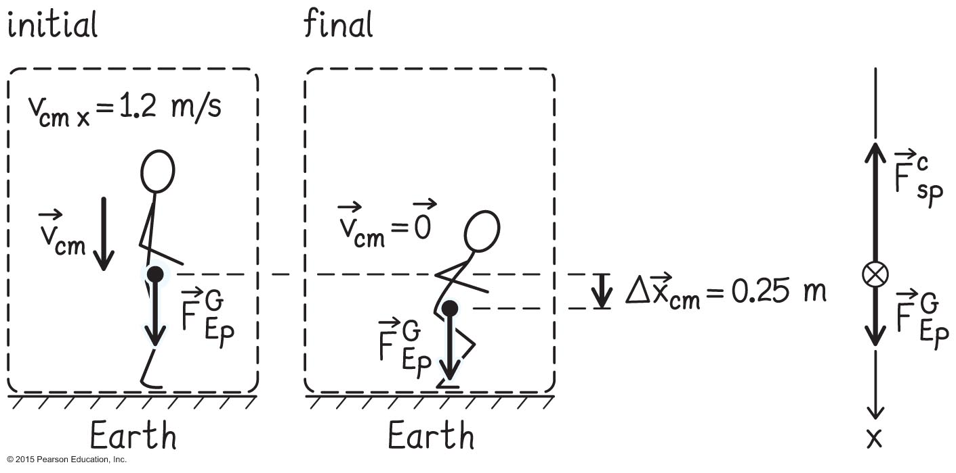
Example 9.7 Landing on his feet (cont.)
Section 9.6: Work done on a many-particle system
➊ GETTING STARTED I begin by making a sketch of the initial and final conditions, choosing my person as the system and assuming the motion to be entirely vertical (Figure 9.21).

Slide 101
Example 9.7 Landing on his feet (cont.)
Section 9.6: Work done on a many-particle system
➊ GETTING STARTED I point the x axis downward in the direction of motion, which means that the x components of both the displacement and the velocity of the center of mass are positive: Δx_{cm} = +0.25 m and υ_{cm x} = +1.2 m/s.

Slide 102
Example 9.7 Landing on his feet (cont.)
Section 9.6: Work done on a many-particle system
➊ GETTING STARTED Two external forces are exerted on the person: a downward force of gravity exerted by Earth and an upward contact force exerted by the floor surface. Only the point of application of the force of gravity undergoes a displacement, and so I need to include only that force in my diagram.

Slide 103
Example 9.7 Landing on his feet (cont.)
Section 9.6: Work done on a many-particle system
➋ DEVISE PLAN Knowing the initial center-of-mass velocity, I can use Eq. 9.13 to calculate the change in the person’s translational kinetic energy ΔK_{cm}.
This change in kinetic energy must equal the work done by the net external force.
From that and the displacement Δx_{cm}= +0.25 m we can find the vector sum of the forces exerted on the person.

Slide 104
Example 9.7 Landing on his feet (cont.)
Section 9.6: Work done on a many-particle system
➋ DEVISE PLAN If I then subtract the force of gravity, I obtain the force exerted by the floor surface on the person. To determine the work done by this force on the person, I need to multiply it by the force displacement.

Slide 105
Example 9.7 Landing on his feet (cont.)
Section 9.6: Work done on a many-particle system
➋ DEVISE PLAN Because the person slows down as he travels downward, his acceleration is upward and so the vector sum of the forces is upward too. To remind myself of this, I draw a free-body diagram in which the arrow for the upward contact force is longer than the arrow for the downward force of gravity.
+a

Slide 106
Example 9.7 Landing on his feet (cont.)
Section 9.6: Work done on a many-particle system
❸ EXECUTE PLAN Because the person ends at rest, his final translational kinetic energy is zero

Slide 107
Example 9.7 Landing on his feet (cont.)
Section 9.6: Work done on a many-particle system
❸ EXECUTE PLAN Substituting this value and the displacement of the center of mass into Eq. 9.14 yields
This is the net force. We need the free body diagram to disentangle the forces.

Slide 108
Example 9.7 Landing on his feet (cont.)
Section 9.6: Work done on a many-particle system
❸ EXECUTE PLAN To obtain the force exerted by the floor from this vector sum, look back to the free body diagram: just two forces.
✔

Slide 109
Example 9.7 Landing on his feet (cont.)
Section 9.6: Work done on a many-particle system
❸ EXECUTE PLAN To determine the work done by this force on the person, I must multiply the x component of the force by the force displacement.
The point of application is the floor, which doesn’t move. This means that the force displacement is zero, so the work done on the person by the surface is zero too: W = 0. ✔

Slide 110
Example 9.7 Landing on his feet (cont.)
Section 9.6: Work done on a many-particle system
➍ EVALUATE RESULT The contact force is negative because it is directed upward, as I expect. Its magnitude is larger than that of the force of gravity, as it should be in order to slow the person down.

Slide 111
Section Goals
Section 9.7: Variable and distributed forces
You will learn to
Derive the relationship for the work done by a variable force.
Interpret the work done by a variable force graphically.
Understand that distributed forces, like friction, have no single point of application on an object.

Slide 112
Section 9.7: Variable and distributed forces
The acceleration of the center of mass of a system consisting of many interacting particles is given by
Following the same derivation as in the single-particle system, we can write
So?
  treat object as a point particle, concentrated at center of mass
  work done in moving the center of mass gives change in center of mass kinetic energy
  if you can calculate a ball, you can calculate a wrench

Slide 113
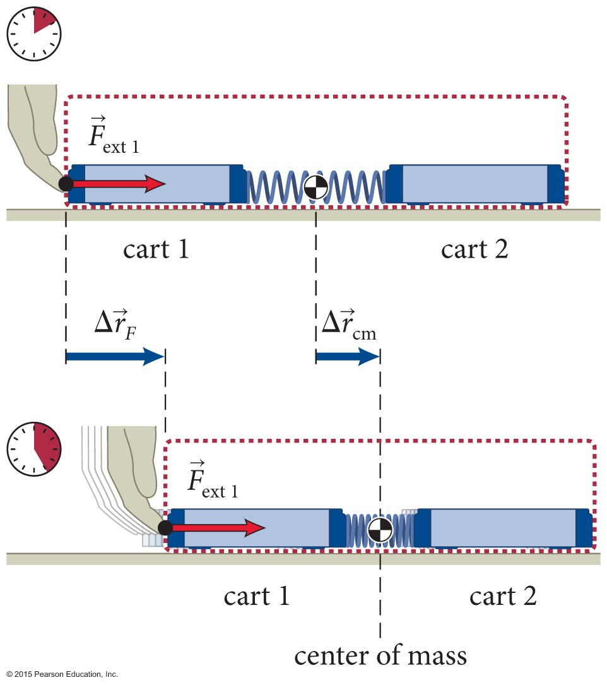
Section 9.7: Variable and distributed forces
For a system of many particles
K = K_{cm} + K_{conv} – there is some KE due to internal motion of constituents
Therefore, ΔK_{cm} ≠ ΔE, and since ΔE = W, we can see that
ΔK_{cm} ≠ W (many-particle system)
This is explicitly illustrated in the example shown in the figure.
The external force on cart 1 increases the kinetic energy and the internal energy of the system.

Slide 114
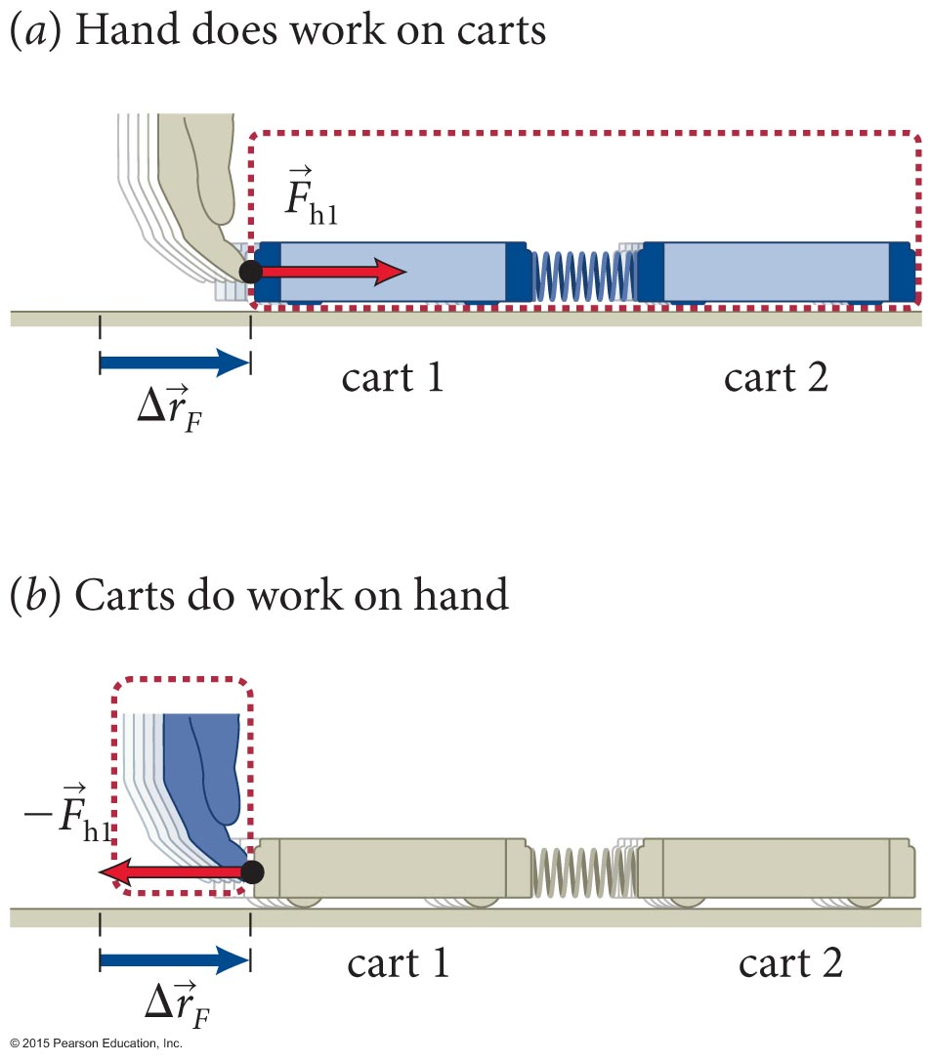
Section 9.7: Variable and distributed forces
To determine the work done by external forces on a many particle system, we can use the fact that W_{env} = –W_{sys}.
This makes sense – work is what crosses the boundary, and a loss to the environment is the same as a gain to the system (& vice versa)
We can see from the figure that the work done by the two-cart system on the hand
is = –F_{h1x}Δx_{F}.
Then the work done by the external force on the two-cart system is
  W = F_{ext 1x}Δx_{F} (constant nondissipative force, one dimension)

Slide 115
Section 9.7: Variable and distributed forces
Generalizing this work equation to many-particle systems subject to several constant forces, we get
or
If we consider a varying force F(x), we take infinitesimal displacements, and this becomes an integral
work is the area under the force-displacement curve!

Slide 116
Example 9.8 Spring work
Section 9.7: Variable and distributed forces
A brick of inertia m compresses a spring of spring constant k so that the free end of the spring is displaced from its relaxed position. What is the work done by the brick on the spring during the compression?

Slide 117
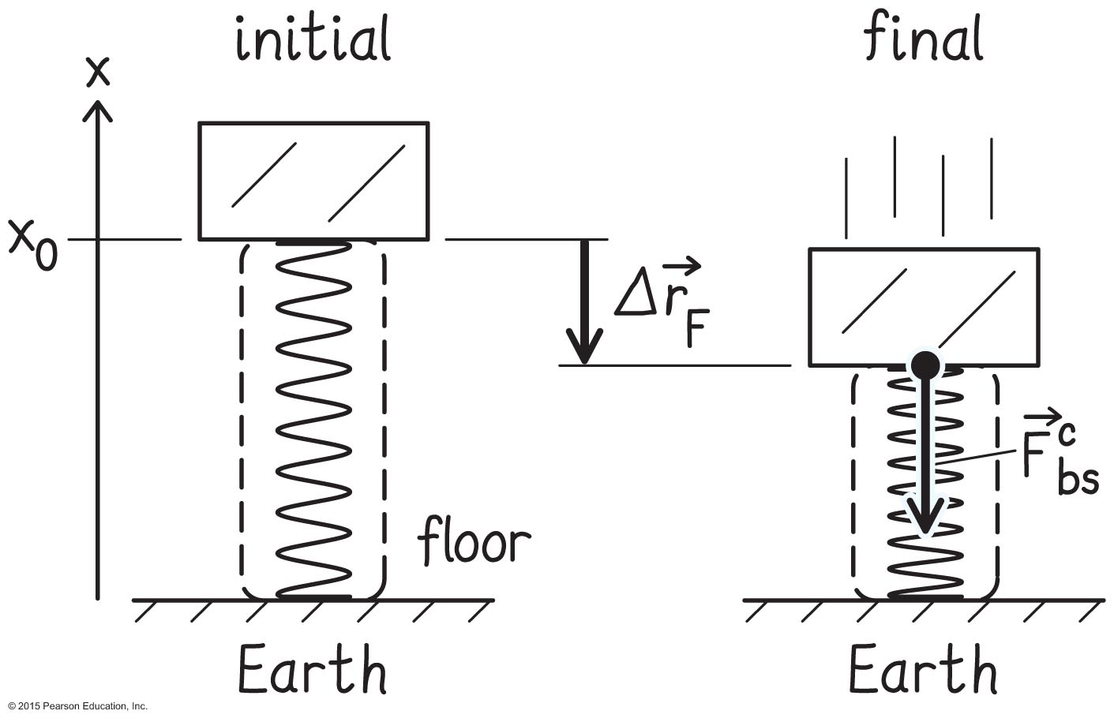
Example 9.8 Spring work (cont.)
Section 9.7: Variable and distributed forces
➊ GETTING STARTED I begin by making a sketch of the situation as the free end of the spring is compressed from its relaxed position x₀ to a position x (Figure 9.23). Because I need to calculate the work done by the brick on the spring, I choose the spring as my system.

Slide 118
Example 9.8 Spring work (cont.)
Section 9.7: Variable and distributed forces
➊ GETTING STARTED Three forces are exerted on the spring: contact forces exerted by the brick and by the floor, and the force of gravity. As usual when dealing with compressed springs, I ignore the force of gravity exerted on the spring (see Section 8.6).

Slide 119
Example 9.8 Spring work (cont.)
Section 9.7: Variable and distributed forces
➊ GETTING STARTED Only the force exerted by the brick on the spring undergoes a nonzero force displacement, so I need to show only that force in my diagram. Because the brick and spring do not exert any forces on each other when the spring is in the relaxed position, I do not draw this force in the initial state.

Slide 120
Example 9.8 Spring work (cont.)
Section 9.7: Variable and distributed forces
➋ DEVISE PLAN I need to calculate the work done by the brick on the spring. I could use Eq. 9.22 if I knew the force the brick exerts on the spring.
That force is not given, but the force exerted by the brick on the spring and the force exerted by the spring on the brick form an interaction pair: I can use Eq. 8.20 to determine and then use it in Eq. 9.22.

Slide 121
Example 9.8 Spring work (cont.)
Section 9.7: Variable and distributed forces
❸ EXECUTE PLAN Equation 8.20 tells me that the x component of the force exerted by the spring on the brick varies depending on how far the spring is compressed:
F_{sb x} = –k(x – x₀),
where x₀ is the coordinate of the relaxed position of the free end of the spring.

Slide 122
Example 9.8 Spring work (cont.)
Section 9.7: Variable and distributed forces
❸ EXECUTE PLAN The x component of the force exerted by the brick on the spring is thus
F_{bs x} = +k(x – x₀).
Because x₀ > x, F_{bs x} is negative, which means that
points in the same direction as the force displacement. Thus the work done by the brick on the spring is positive.
(1)

Slide 123
Example 9.8 Spring work (cont.)
Section 9.7: Variable and distributed forces
❸ EXECUTE PLAN Now I substitute Eq. 1 into
Eq. 9.22 and work out the integral to determine the work done by the brick on the spring:
limits of integration? start & end points of motion
✔
(2)

Slide 124
Example 9.8 Spring work (cont.)
Section 9.7: Variable and distributed forces
➍ Evaluate result Because the spring constant k is always positive (see Section 8.9 on Hooke’s law), the work done by the brick on the spring is also positive. This is what I expect because the work done in compressing the spring is stored as potential energy in the spring.

Slide 125
Section 9.7
Question 7
When you plot the force exerted on a particle as a function of the particle’s position, what feature of the graph represents the work done on the particle?
  The maximum numerical value of the force
  The area under the curve
  The value of the displacement
  You need more information about the way the work was done.

Slide 126
Section 9.7
Question 7
When you plot the force exerted on a particle as a function of the particle’s position, what feature of the graph represents the work done on the particle?
  The maximum numerical value of the force
  The area under the curve
  The value of the displacement
  You need more information about the way the work was done.

Slide 127
Section 9.8
Question 8
A sports car accelerates from zero to 30 mph in 1.5 s. How long does it take for it to accelerate to 60 mph, assuming that the power delivered by the engine is independent of velocity and neglecting friction?
  2.0 s
  3.0 s
  4.5 s
  6.0 s
  9.0 s
  12.0 s

Slide 128
Section 9.8
Clicker Question 8
A sports car accelerates from zero to 30 mph in 1.5 s. How long does it take for it to accelerate to 60 mph, assuming that the power delivered by the engine is independent of velocity and neglecting friction?
  2.0 s
  3.0 s
  4.5 s
  6.0 s twice the speed, four times as long.
  9.0 s
  12.0 s

Slide 129
Concepts: Work done by a constant force
Chapter 9: Summary
In order for a force to do work on an object, the point of application of the force must undergo a displacement.
The SI unit of work is the joule (J).
The work done by a force is positive when the force and the force displacement are in the same direction and negative when they are in opposite directions.

Slide 130
Quantitative Tools: Work done by a constant force
Chapter 9: Summary
When one or more constant forces cause a particle or a rigid object to undergo a displacement Δx in one dimension, the work done by the force or forces on the particle or object is given by the work equation:
In one dimension, the work done by a set of constant nondissipative forces on a system of particles or on a deformable object is

Slide 131
Quantitative Tools: Work done by a constant force
Chapter 9: Summary
If an external force does work W on a system, the energy law says that the energy of the system changes by an amount
ΔE = W
For a closed system, W = 0 and so ΔE = 0.
For a particle or rigid object, ΔE_{int} = 0 and so
ΔE = ΔK
For a system of particles or a deformable object,

Slide 132
Concepts: Energy diagrams
Chapter 9: Summary
An energy diagram shows how the various types of energy in a system change because of work done on the system.
In choosing a system for an energy diagram, avoid systems for which friction occurs at the boundary because then you cannot tell how much of the thermal energy generated by friction goes into the system.

Slide 133
Concepts: Variable and distributed forces
Chapter 9: Summary
The force exerted by a spring is variable (its magnitude and/or direction changes) but nondissipative (no energy is converted to thermal energy).
The frictional force is dissipative and so causes a change in thermal energy. This force is also a distributed force because there is no single point of application.

Slide 134
Quantitative Tools: Variable and distributed forces
Chapter 9: Summary
The work done by a variable nondissipative force on a particle or object is
If the free end of a spring is displaced from its relaxed position x₀ to position x, the change in its potential energy is
If a block travels a distance d_{path} over a surface for which the magnitude of the force of friction is a constant the energy dissipated by friction (the thermal energy) is

Slide 135
Concepts: Power
Chapter 9: Summary
Power is the rate at which energy is either converted from one form to another or transferred from one object to another.
The SI unit of power is the watt (W), where
1 W = 1 J/s.

Slide 136
Quantitative Tools: Power
Chapter 9: Summary
The instantaneous power is
If a constant external force F_{ext x} is exerted on an object and the x component of the velocity at the point where the force is applied is υ_{x}, the power this force delivers to the object is

