Slide 1
Chapter 10
Motion in a Plane

Slide 2
Basically like the last one
Exam 2 details
~20 multiple choice. Chapters 7-10
Ch. 7.1-10 interactions (energy)
  1, 5-7 interaction basics
  2, 8-9 potential energy
  3-4, 8, 10 dissipative forces
Ch. 8.1-10 force
  1-5, 7 characteristics of force
  6, 8, 9 important forces
  1, 4-5, 7 effects of forces
  10 impulse

Slide 3
Basically like the last one
Exam 2 details
Ch. 9.1-8 Work
  1-2, 5-6 work by constant force
  3-4 energy diagrams
  7 variable & distributed forces
  8 power
Ch. 10.3-5, 7 Motion in a plane
  7 projectile motion
  2-3 forces in 2D
  4 friction
  5 work
  (need to know 1-2, 6 info on vectors, but not tested directly)

Slide 4
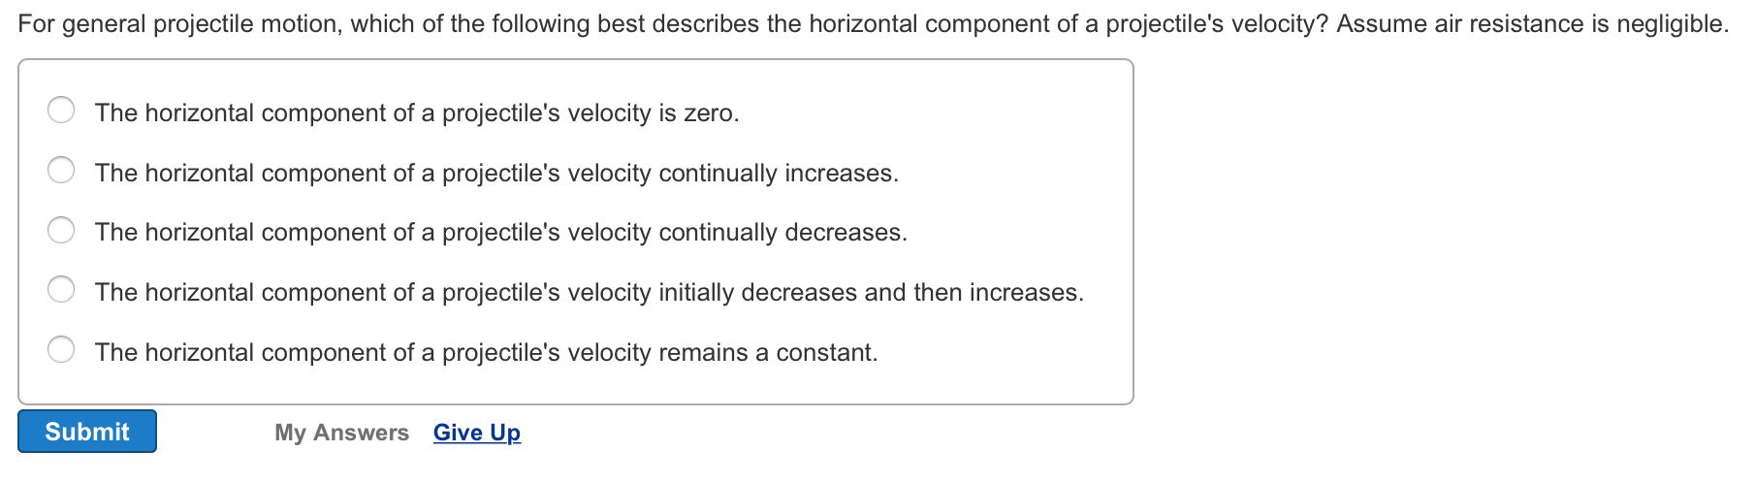
10.09
Reading Quiz

Slide 5
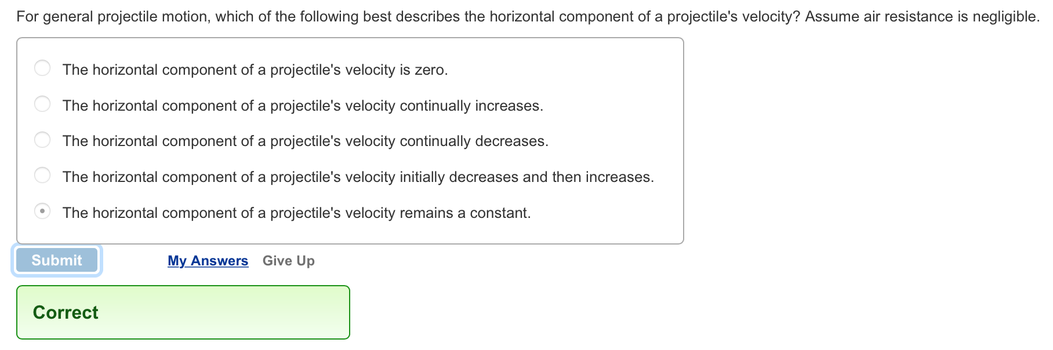
10.09
Reading Quiz

Slide 6
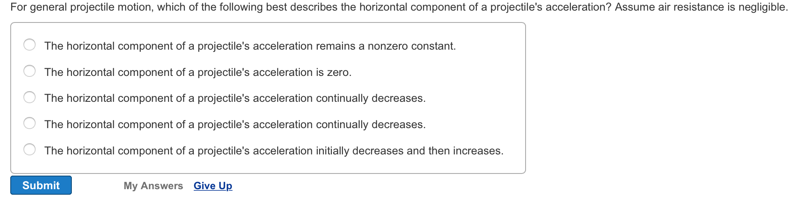
10.10
Reading Quiz

Slide 7
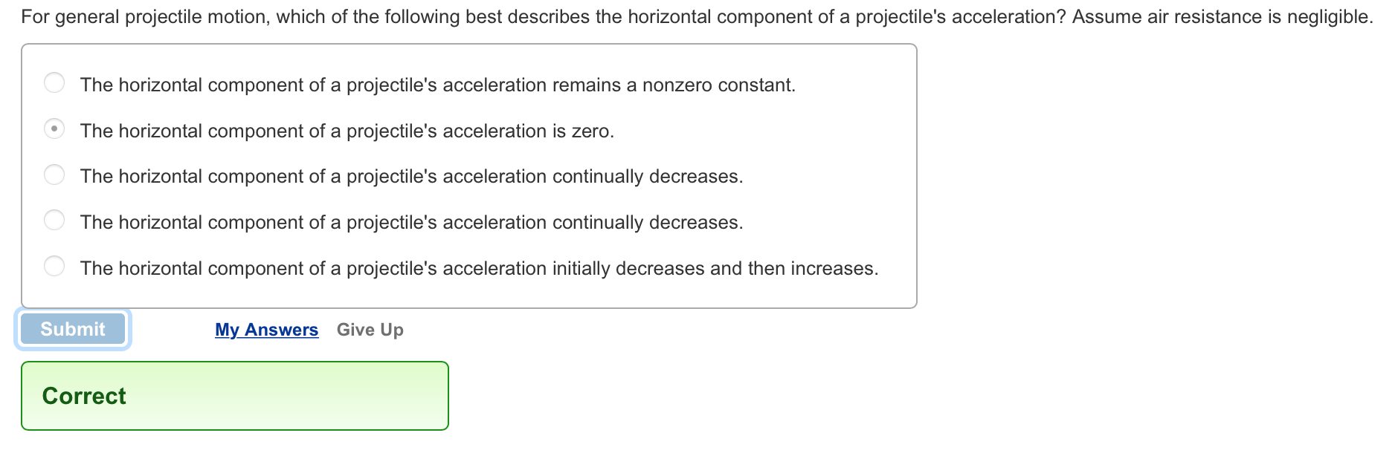
10.10
Reading Quiz
No interaction in horizontal direction!
Vector-speak: there is no component of gravitational acceleration
that points in the horizontal direction

Slide 8
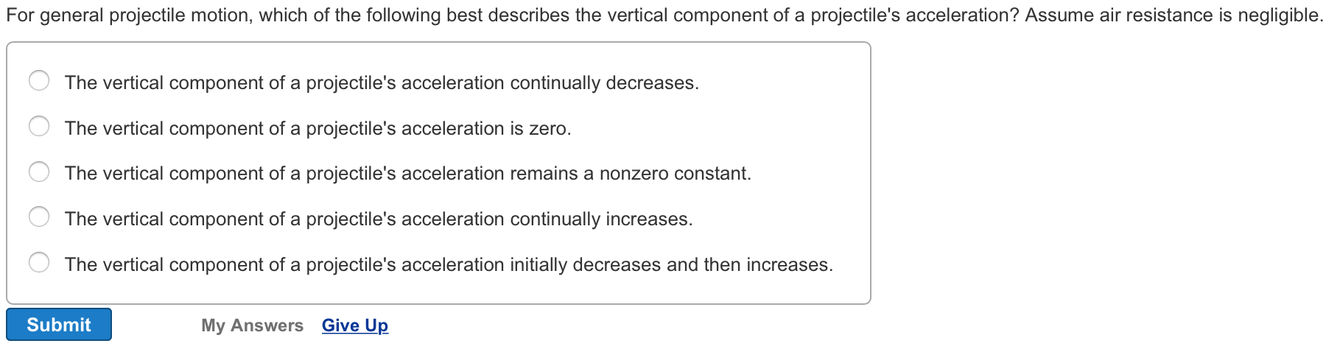
10.11
Reading Quiz

Slide 9
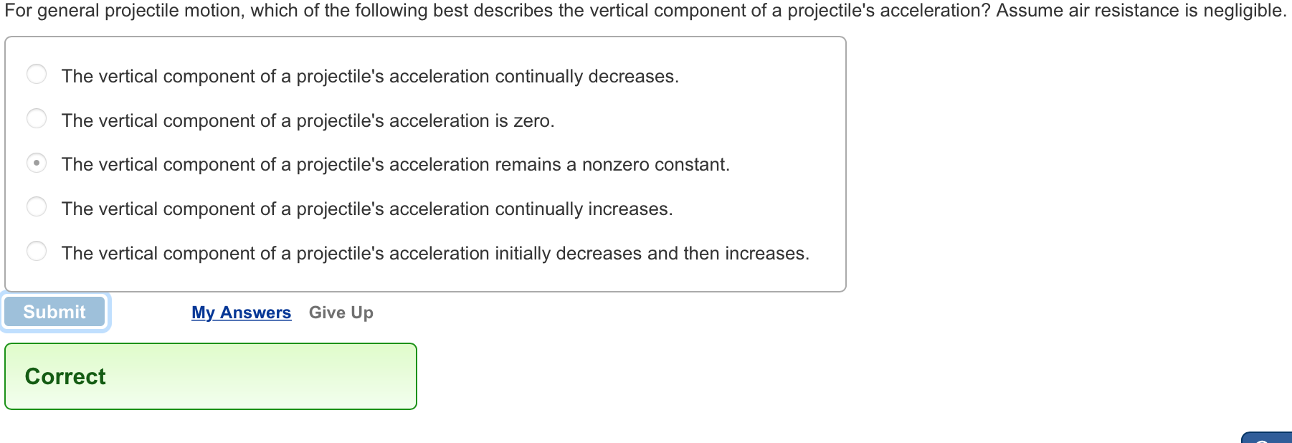
10.11
Reading Quiz
Still just gravity in the vertical direction

Slide 10
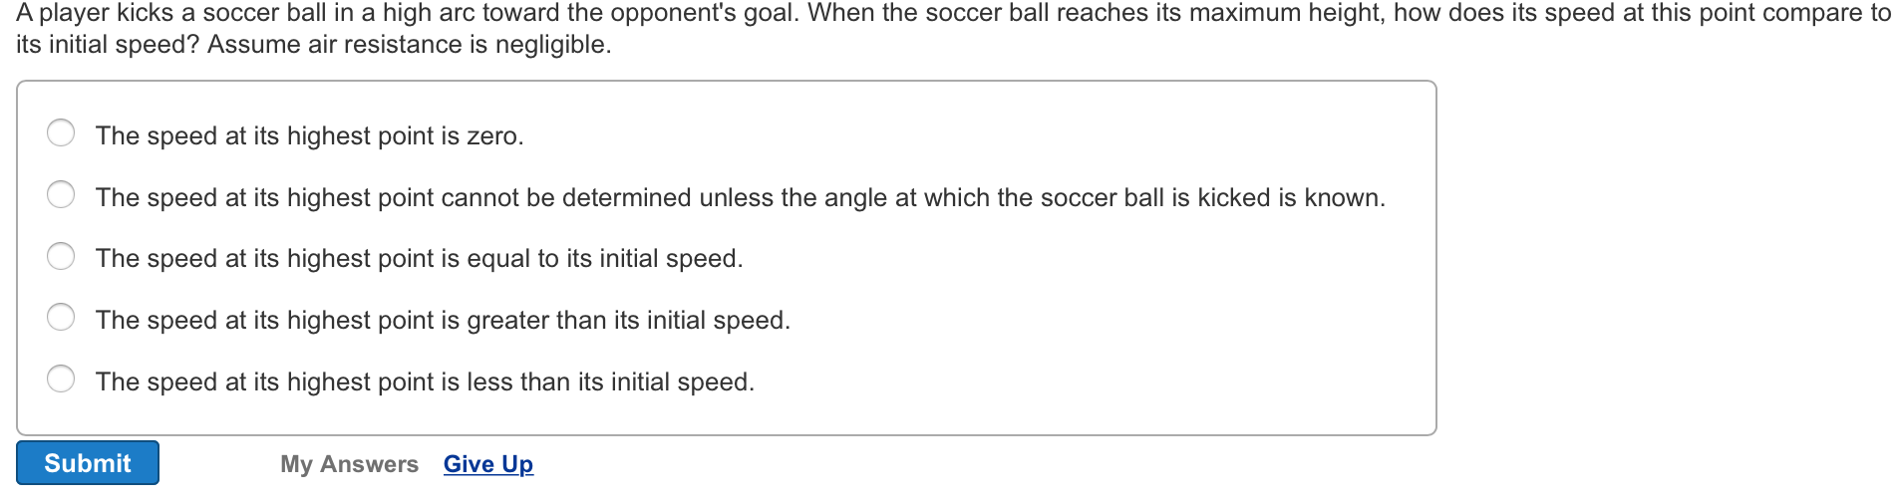
10.13
Reading Quiz

Slide 11
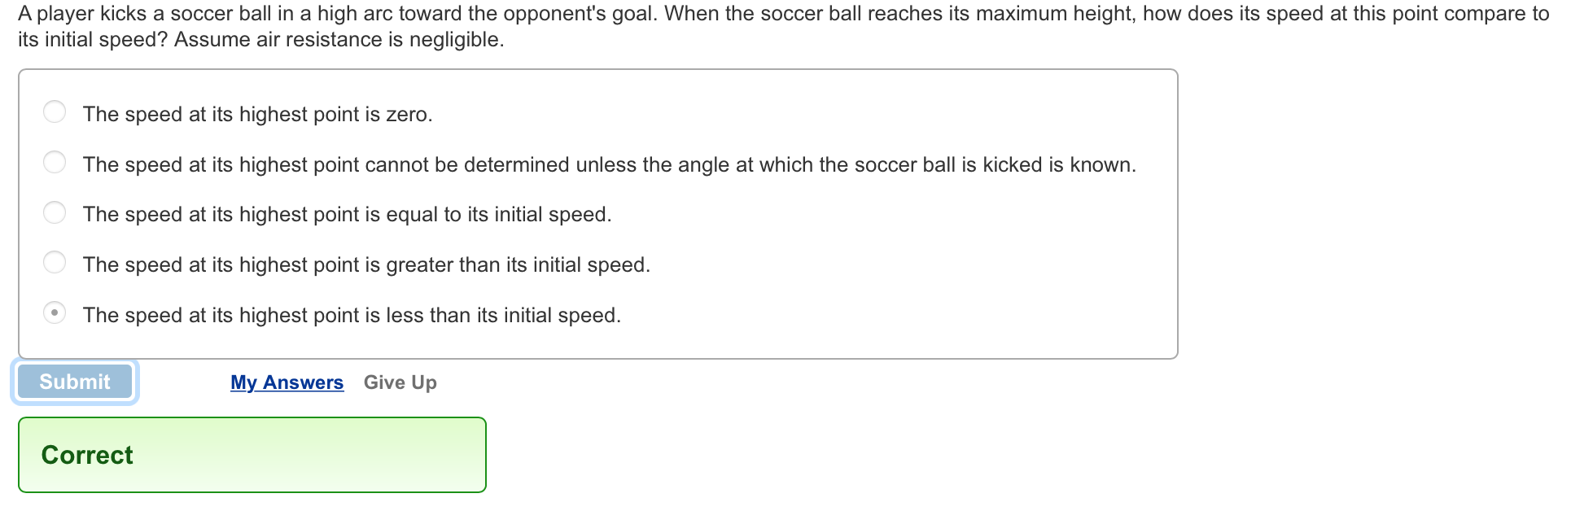
10.13
Reading Quiz
Horizontal component doesn’t change.
Vertical component goes to zero at max height.
Net speed is vector sum of these two, must be lower at top.

Slide 12
Concepts (cont.)
Chapter 10: Motion in a plane

Slide 13
Section Goals
Section 10.3: Decomposition of forces
You will learn to
Apply the vector decomposition technique to analyze the motion of a brick along an inclined surface.
Realize that choosing a coordinate system such that one of the axes lies along the direction of acceleration of the object allows you to break the problem neatly into two parts.

Slide 14
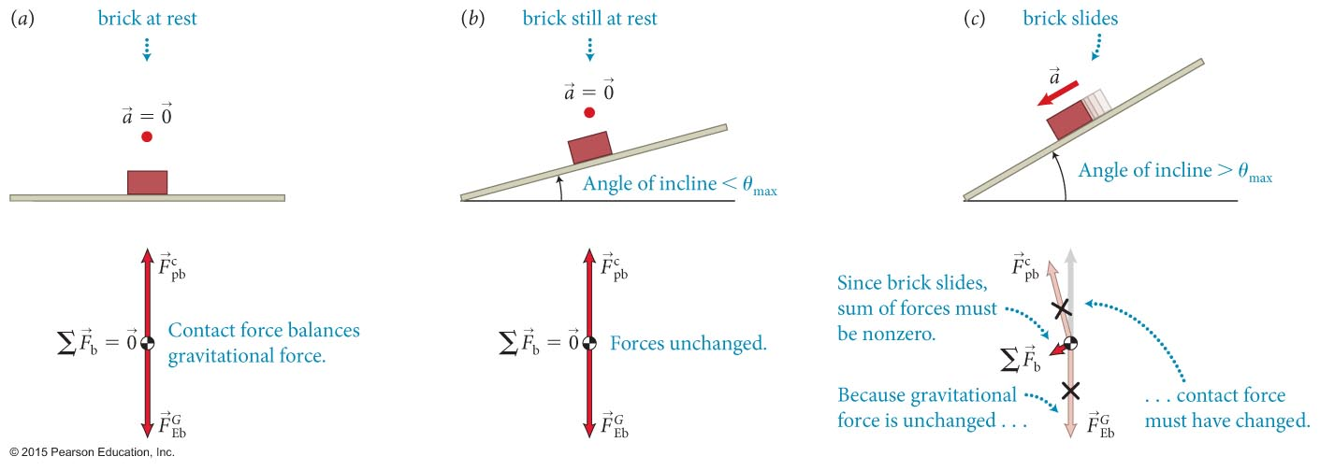
Section 10.3: Decomposition of forces
The figure shows a brick lying on a horizontal plank and then the plank is gently tilted.
When the angle of incline exceeds a θ_{max} the brick accelerates down the incline.
Then, the vector sum of the forces exerted on the brick must also point down the incline

Slide 15
Section 10.3: Decomposition of forces
Because the brick is constrained to move along the surface of the plank, it make sense to choose the x axis along surface
The force components parallel to the surface are called tangential components.
The force components perpendicular to the surface are called normal components. Normal components must cancel here!
Contact force contains friction as tangential part

Slide 16
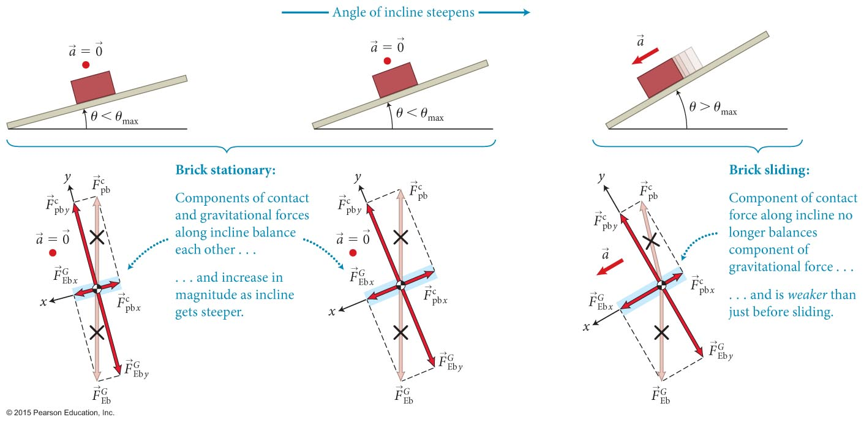
Section 10.3: Decomposition of forces
Can resolve all forces into two components:
  Component along the ramp
  Component perpendicular to ramp

Slide 17
Section 10.3: Decomposition of forces
The brick problem suggests which axes we should choose in a given problem:
  If possible, choose a coordinate system such that one of the axes lies along the direction of the acceleration of the object under consideration.
Will it make a difference in the final answer?
  No, but it can make things easier

Slide 18
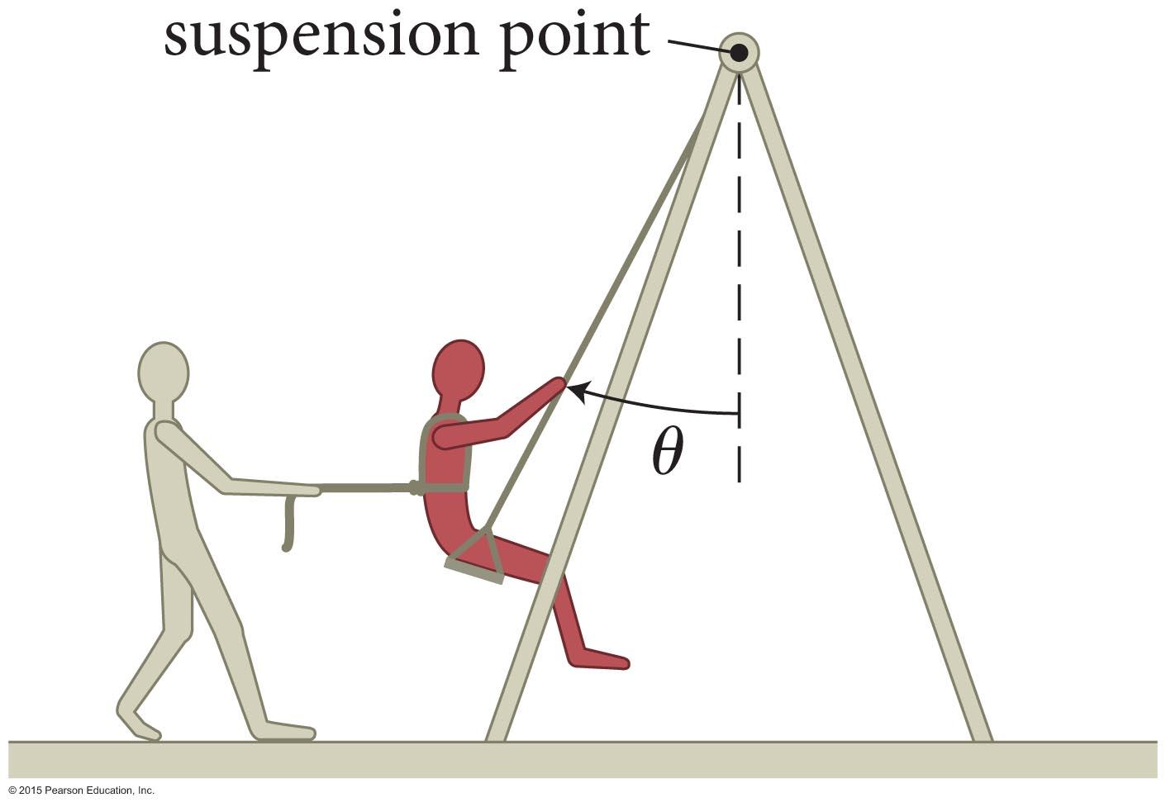
Example 10.2 Pulling a friend on a swing
Section 10.3: Decomposition of forces
Using a rope, you pull a friend sitting on a swing (Figure 10.16). (a) As you increase the angle θ, does the magnitude of the force required to hold your friend in place increase or decrease?

Slide 19
Example 10.2 Pulling a friend on a swing (cont.)
Section 10.3: Decomposition of forces
(b) Is the magnitude of that force larger than, equal to, or smaller than the magnitude of the gravitational force
exerted by Earth on your friend? (Consider the situation for both small and large values of θ.)

Slide 20
Example 10.2 Pulling a friend on a swing (cont.)
Section 10.3: Decomposition of forces
(c) Is the magnitude of the force exerted by the swing on your friend larger than, equal to, or smaller than

Slide 21
Example 10.2 Pulling a friend on a swing (cont.)
Section 10.3: Decomposition of forces
(a) As you increase the angle θ, does the magnitude of the force required to hold your friend in place increase or decrease?
(b) Is the magnitude of that force larger than, equal to, or smaller than the magnitude of the gravitational force
exerted by Earth on your friend?
(c) Is the magnitude of the force exerted by the swing on your friend larger than, equal to, or smaller than

Slide 22
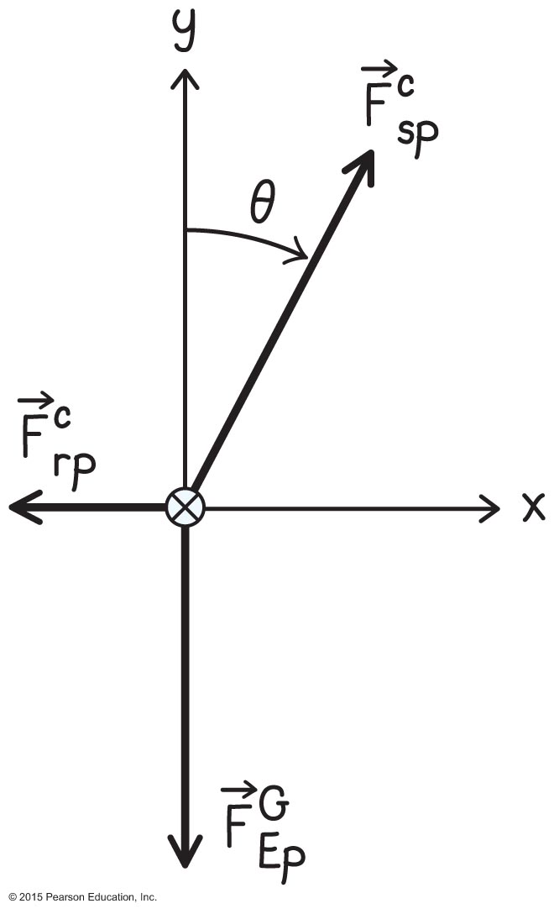
Example 10.2 Pulling a friend on a swing (cont.)
Section 10.3: Decomposition of forces
❶ GETTING STARTED I begin by drawing a free-body diagram of your friend (Figure 10.17). Three forces are exerted on him: the force of gravity directed vertically downward, the horizontal force exerted by the rope, and a force exerted by the swing seat.

Slide 23
Example 10.2 Pulling a friend on a swing (cont.)
Section 10.3: Decomposition of forces
❶ GETTING STARTED This latter force is exerted by the suspension point via the chains of the swing and is thus directed along the chains. I therefore choose a horizontal x axis and a vertical y axis, so that two of the three forces lie along axes. Because your friend’s acceleration is zero, the vector sum of the forces must be zero.

Slide 24
Example 10.2 Pulling a friend on a swing (cont.)
Section 10.3: Decomposition of forces
❷ DEVISE PLAN Because your friend is at rest, the vectors along the two axes must add up to zero. The best way to see how the magnitude of the force exerted by the rope must change as θ is increased is to draw free-body diagrams showing different values of θ. To answer parts b and c, I can compare the various forces in my free-body diagrams.

Slide 25
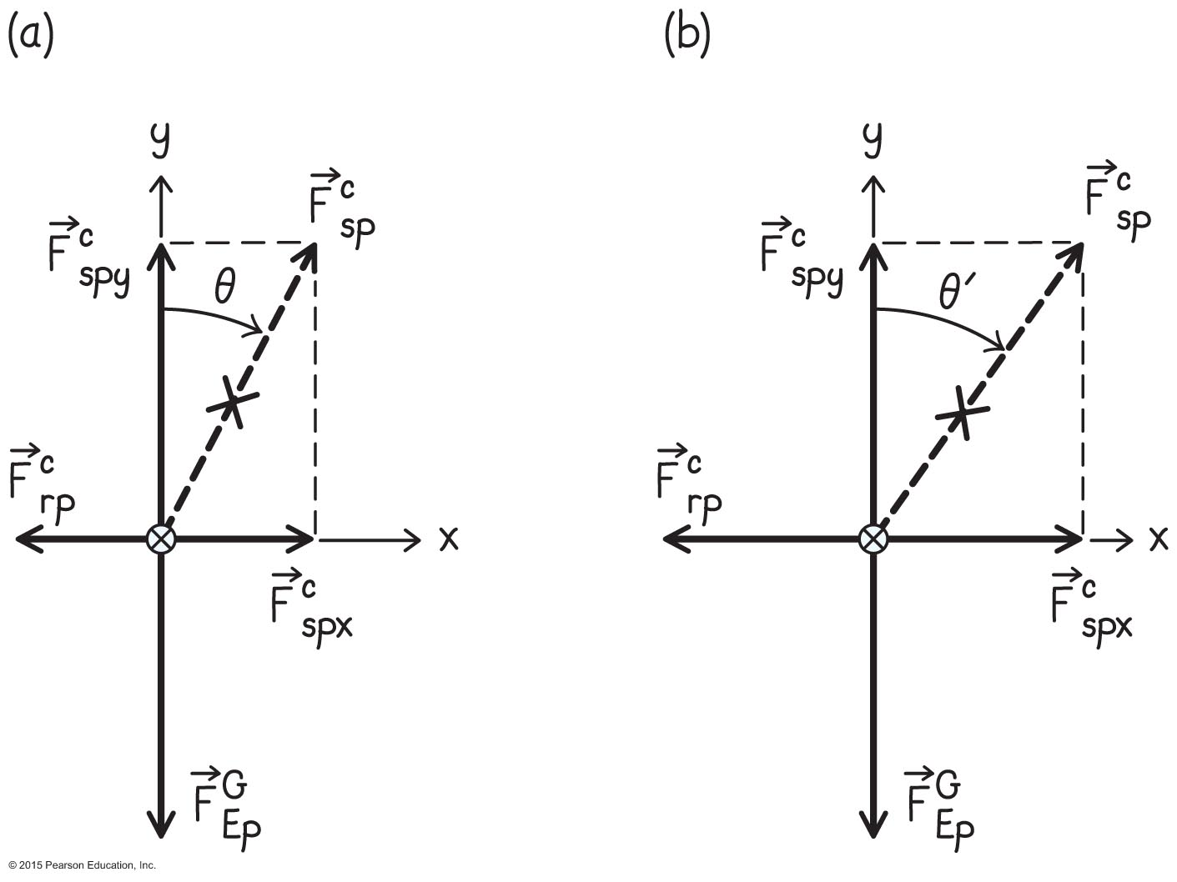
Example 10.2 Pulling a friend on a swing (cont.)
Section 10.3: Decomposition of forces
❸ EXECUTE PLAN (a) I begin by decomposing into x and y components (Figure 10.18a). Because the forces must add to zero along both axes, I conclude from my diagram that must be equal in magnitude to the downward force of gravity. Likewise, must be equal in magnitude to the horizontal force the rope exerts on your friend.

Slide 26
Example 10.2 Pulling a friend on a swing (cont.)
Section 10.3: Decomposition of forces
❸ EXECUTE PLAN Next, I draw a second free-body diagram for a larger angle θ (Figure 10.18b). As θ increases, must remain equal in magnitude to (otherwise your friend would accelerate vertically). As Figure 10.18b shows, increasing θ while keeping constant requires the magnitude of to increase.

Slide 27
Example 10.2 Pulling a friend on a swing (cont.)
Section 10.3: Decomposition of forces
❸ EXECUTE PLAN Because your friend is at rest, the forces in the horizontal direction must add up to zero and so So if the magnitude of increases, the magnitude of must increase, too. ✔

Slide 28
Example 10.2 Pulling a friend on a swing (cont.)
Section 10.3: Decomposition of forces

Slide 29
Example 10.2 Pulling a friend on a swing (cont.)
Section 10.3: Decomposition of forces
❸ EXECUTE PLAN (c)
Therefore, must always be larger than when θ ≠ 0.
✔
Since the y component of the force of the seat already equals the force of gravity, the total force of the seat must be always greater

Slide 30
Example 10.2 Pulling a friend on a swing (cont.)
Section 10.3: Decomposition of forces
❹ EVALUATE RESULT I know from experience that you have to pull harder to move a swing farther from its equilibrium position, and so my answer to part a makes sense. With regard to part b, when the swing is at rest at 45º, the forces and on your friend make the same angle with the force and so and should be equal in magnitude.

Slide 31
Example 10.2 Pulling a friend on a swing (cont.)
Section 10.3: Decomposition of forces
❹ EVALUATE RESULT The force of gravity is independent of the angle, but the force exerted by the rope increases with increasing angle, and so it makes sense that for angles larger than 45º, is larger than In part c, because the vertical component of the force exerted by the seat on your friend always has to be equal to the force of gravity, adding a horizontal component makes larger than as I found.

Slide 32
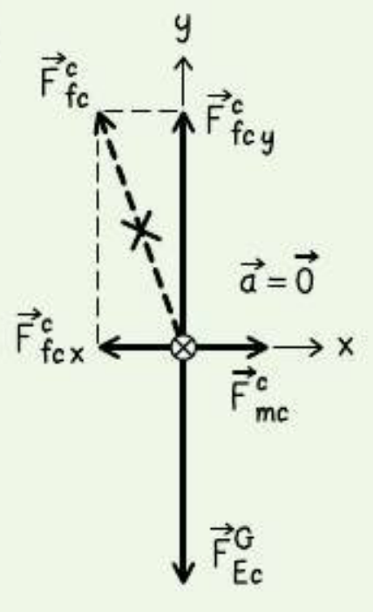
Checkpoint 10.4
You decide to move a heavy file cabinet by sliding it across the floor. You push against the cabinet, but it doesn’t budge. Draw a free-body diagram for it.
10.4
You apply a horizontal force, but it still doesn’t move. That means the contact force must have a horizontal component as well as a vertical component!
Vertical = weight
Horizontal = friction

Slide 33
Section Goals
Section 10.4: Friction
You will learn to
Recognize that when the contact forces acting between two interacting surfaces are decomposed, the tangential component is the force of friction.
The normal component is called the normal force.
Classify the friction force present when the surfaces are not moving relative to each other as static friction, and when they move relative to each other as kinetic friction.

Slide 34
Checkpoint 10.5
Consider pushing a heavy file cabinet across a floor.
The tangential component of the contact force exerted by the floor on the cabinet has to do with friction.
(a) Suppose you push the file cabinet just enough to keep it moving at constant speed. Draw a free-body diagram for the cabinet while it slides at constant speed. (b) Suddenly you stop pushing. Draw a free-body diagram for the file cabinet at this instant.
10.5

Slide 35
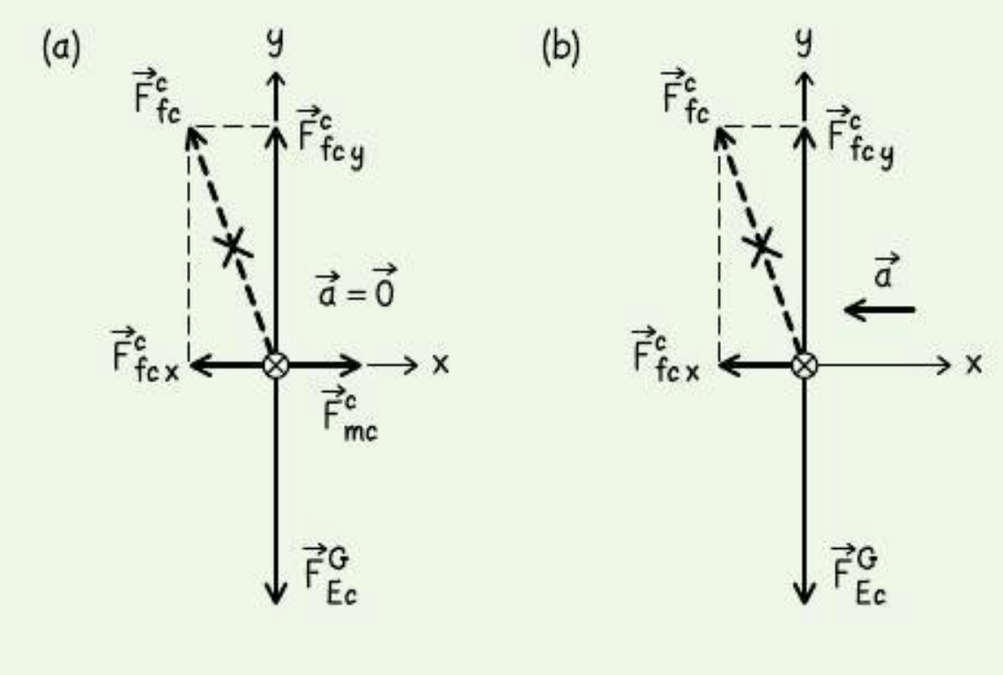
slides at constant
speed while pushing
stopped pushing
(but still in motion)

Slide 36
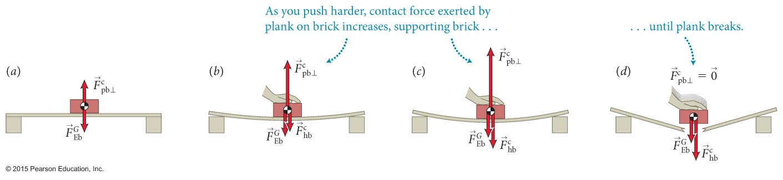
Section 10.4: Friction
Consider the contact force exerted by the floor on the cabinet:
  The normal component is called the normal force and the tangential component is the force of friction.
  To understand the difference between normal and frictional forces, consider the brick on a horizontal wooden plank.
  As seen in the figure, the normal force takes on whatever value to balance the net downward force, up to the breaking point.

Slide 37
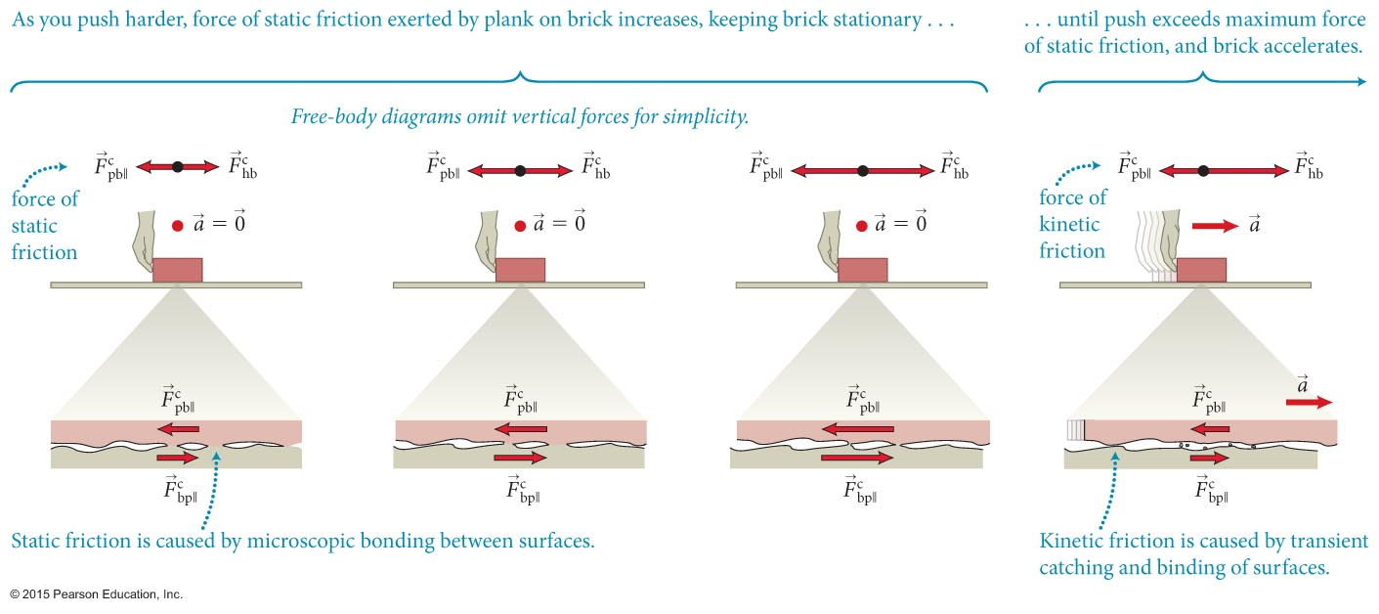
Section 10.4: Friction
Now consider gently pushing the brick to the right, as shown.
  The horizontal frictional force is caused by microscopic bonds between the surfaces in contact.
  As you push the brick, the net effect of these microscopic forces is to hold the brick in place.
  As you increase your push force, this tangential component of the contact force grows.

Slide 38
Section 10.4: Friction
The friction exerted by the surfaces that are not moving relative to each other is called static friction.
When the horizontal push force exceeds the maximum force of static friction, the brick will accelerate.
The friction force exerted by the surfaces when they move relative to each other is call kinetic friction, which is caused by transient microscopic bonds between the two surfaces.

Slide 39
Section 10.4
Question 3
You push horizontally on a crate at rest on the floor, gently at first and then with increasing force until you cannot push harder. The crate does not move. What happens to the force of static friction between crate and floor during this process?
It is always zero.
It remains constant in magnitude.
It increases in magnitude.
It decreases in magnitude.
More information is needed to decide.

Slide 40

Section 10.4
Question 3
You push horizontally on a crate at rest on the floor, gently at first and then with increasing force until you cannot push harder. The crate does not move. What happens to the force of static friction between crate and floor during this process?
It is always zero.
It remains constant in magnitude.
It increases in magnitude.
It decreases in magnitude.
More information is needed to decide.

Slide 41
Section 10.4: Friction
The main differences between the normal force and the force of static friction are
  The maximum value of the force of static friction is generally much smaller than the maximum value of the normal force.
  Once the maximum value of the normal force is reached, the normal force disappears, but once the maximum value of the force of static friction is reached, there still is a smaller but nonzero force of kinetic friction.

Slide 42
Section 10.10
Question 9
In a panic situation, many drivers make the mistake of locking their brakes and skidding to a stop rather than applying the brakes gently. A skidding car often takes longer to stop. Why?
This is a misconception; it doesn’t matter how the brakes are applied.
The coefficient of static friction is larger than the coefficient of kinetic friction.
The coefficient of kinetic friction is larger than the coefficient of static friction.

Slide 43
Section 10.10
Question 9
In a panic situation, many drivers make the mistake of locking their brakes and skidding to a stop rather than applying the brakes gently. A skidding car often takes longer to stop. Why?
This is a misconception; it doesn’t matter how the brakes are applied.
The coefficient of static friction is larger than the coefficient of kinetic friction. Skidding means you use kinetic friction, which provides less force!
The coefficient of kinetic friction is larger than the coefficient of static friction.

Slide 44
Section Goal
Section 10.5: Work and Friction
You will learn to
Recognize that kinetic force causes energy dissipation and static friction causes no energy dissipation.

Slide 45
Section 10.5: Work and Friction
Like normal force, the force of static friction is an elastic force that causes no irreversible change.
The force of elastic friction causes no energy dissipation (no force displacement)
Kinetic friction does cause irreversible change, including causing microscopic damage to the surfaces.
The force of kinetic friction is not an elastic force and so causes energy dissipation.

Slide 46
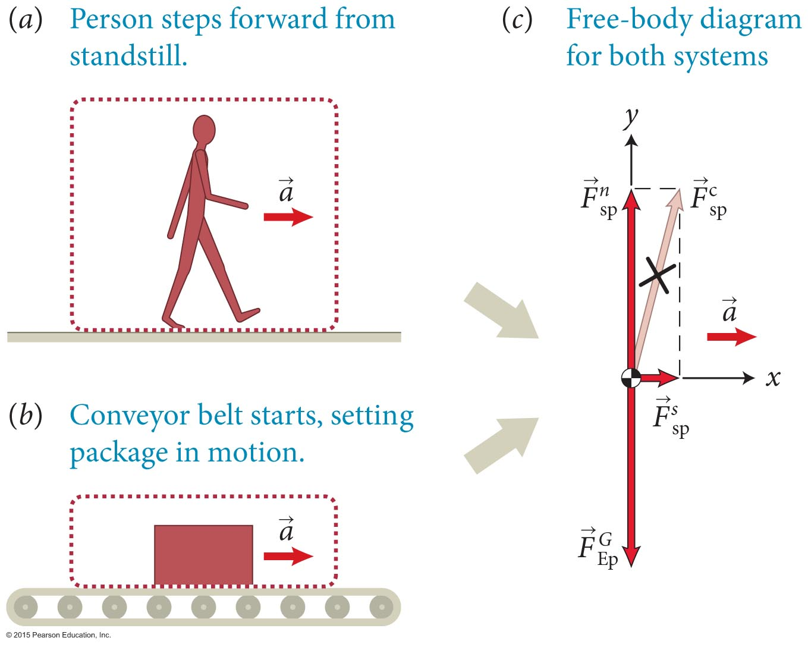
Section 10.5: Work and Friction
Consider the two cases shown in the figure.
Both of these cases are examples where the object is accelerated by static friction.

Slide 47
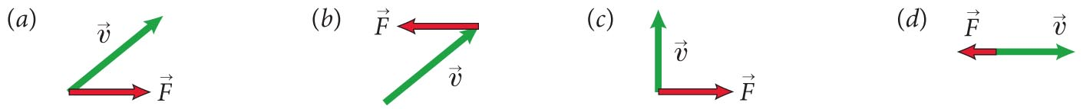
Chapter 10: Self-Quiz #1
In the diagram below, the velocity of an object is given along with the vector representing a force exerted on the object. For each case, determine whether the object’s speed increases, decreases, or remains constant. Also determine whether the object’s direction changes in the clockwise direction, changes in the counterclockwise direction, or doesn’t change.

Slide 48
Chapter 10: Self-Quiz #1
In the diagram below, the velocity of an object is given along with the vector representing a force exerted on the object. For each case, determine whether the object’s speed increases, decreases, or remains constant. Also determine whether the object’s direction changes in the clockwise direction, changes in the counterclockwise direction, or doesn’t change.
increases
turns CW
decreases
turns CCW
constant
turns CW
decreases
no turning

Slide 49
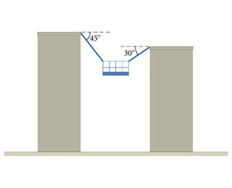
10.30
Tension in the right cable is 790N
What is the tension in the left cable?
What is the inertia of the platform?

Slide 50
Free body diagram
T₂
T₁
45º
30º
mg

Slide 51
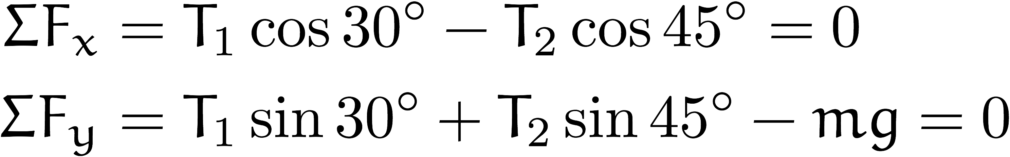
Static situation
Forces sum to zero as vectors
Sum of components along each axis also zero!
T₂
T₁
45º
30º
mg

Slide 52
Static situation
Know T₁ = 790N
T₂
T₁
45º
30º
mg

Slide 53
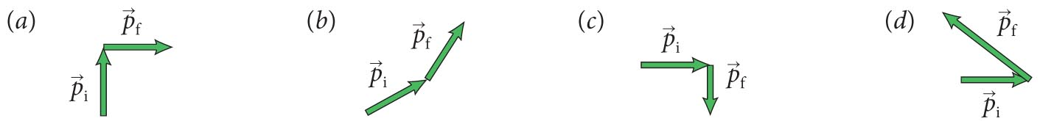
Chapter 10: Self-Quiz #3
Each diagram in the figure below indicates the momentum of an object before and after a force is exerted on it. For each case determine the direction of the force.

Slide 54
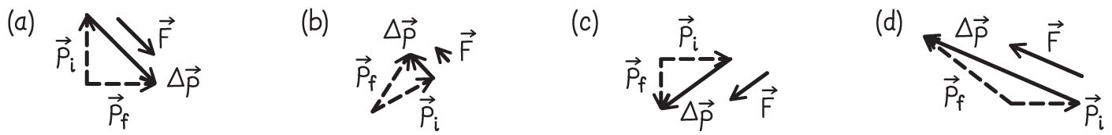
Answer
Chapter 10: Self-Quiz #3
In each case the force is parallel to
(Figure 10.26).

Slide 55
Homework (due Monday)
9.44
A) Same constant force, which compresses less?
B) Same displacement, which has larger k?

Slide 56
Homework
9.66
A) Average power during acceleration?
P_{av} = ΔE/Δt = (ΔK + ΔU^{G})/Δt
ΔU = mgΔy , Δy = ½(v_{f} + v_{i})Δt
B) During cruising? ΔK = 0
ΔU = mgΔy
P_{av} = mgΔy/Δt … note Δy/Δt = v_{y}

Slide 57
Homework
9.63
Force gets you acceleration, acceleration gets you displacement. Together you get work.
P = dW/dt

Slide 58
Homework
9.49
Need to find k from force & displacement, then you can find energy stored in spring. Where does it go?
If it is fired vertically, not all of the spring’s energy goes into kinetic energy …

Slide 59
Homework
9.76
Work is done while dog is in contact with ground
find Δy_{cm}, work is force times this
Gravitational energy change? mgΔy_{jump} – once you have Δy_{jump}, just account for how far off the ground it started

Slide 60
Homework
10.03
Ball falls in a parabolic arc. The straight line distance is therefore a lower bound ...
10.22
Balance forces along the ramp. You know what the gravitational acceleration down the ramp is, tension must counter this.
W = F_{x}Δx – what is displacement along ramp?
9.71 it is just like the dog one.

Slide 61
Quantitative Tools
Chapter 10: Motion in a plane
Slide 12-61

Slide 62
Section Goals
Section 10.6: Vector algebra
You will learn to
Represent vectors using polar coordinates and rectangular coordinates.
Express rectangular coordinates in terms of polar coordinates and vice versa using trigonometry.
Determine the sum of vectors using their components.

Slide 63
Example 10.4 Speeding ball
Section 10.6: Vector algebra
A ball is thrown at an angle of 30º to the horizontal at a speed of 30 m/s. Write the ball’s velocity in terms of rectangular unit vectors.

Slide 64
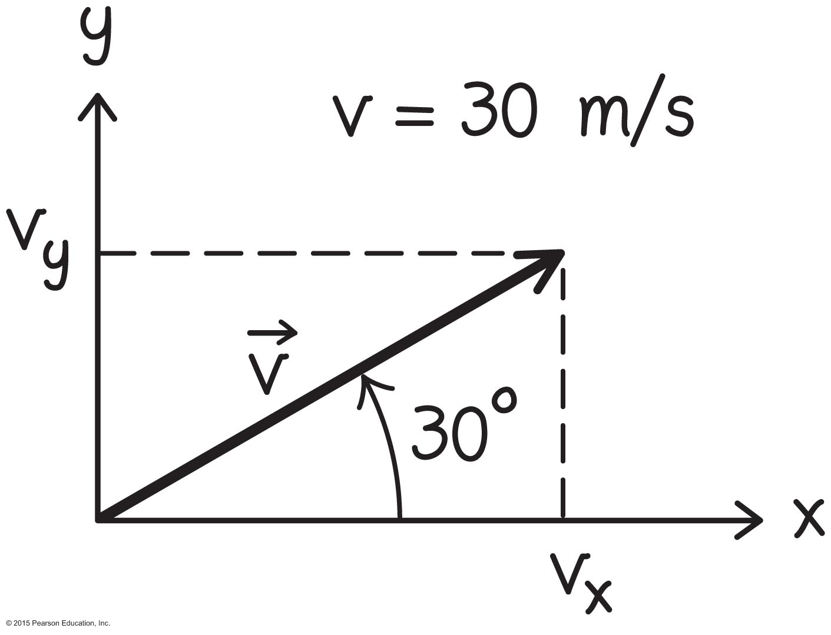
Example 10.4 Speeding ball (cont.)
Section 10.6: Vector algebra
❶ GETTING STARTED I begin by making a sketch showing the velocity vector and its decomposition in a rectangular coordinate system (Figure 10.30). I position the x axis along the horizontal in the direction of motion and the y axis along the vertical. I label the x and y components of the ball’s velocity υ_{x} and υ_{y}, respectively.

Slide 65
Example 10.4 Speeding ball (cont.)
Section 10.6: Vector algebra
❷ DEVISE PLAN Equation 10.5 tells me that the velocity vector can be written as To determine the x and y components, I apply trigonometry to the triangle made up by υ, υ_{x}, and υ_{y}.

Slide 66
Example 10.4 Speeding ball (cont.)
Section 10.6: Vector algebra
❸ EXECUTE PLAN From my sketch I see that
cos θ = υ_{x} /υ and sin θ = υ_{y} /υ, where υ = 30 m/s and
θ = 30º. Therefore υ_{x} = υ cos θ and υ_{y} = υ sin θ.

Slide 67
Example 10.4 Speeding ball (cont.)
Section 10.6: Vector algebra
❸ EXECUTE PLAN Substituting the values given for υ and θ, I calculate the rectangular components:
υ_{x} = (30 m/s)(cos 30º) = (30 m/s)(0.87) = +26 m/s
υ_{y}= (30 m/s)(sin 30º) = (30 m/s)(0.50) = +15 m/s.
The velocity in terms of unit vectors is thus

Slide 68
Example 10.4 Speeding ball (cont.)
Section 10.6: Vector algebra
❹ EVALUATE RESULT The x and y components are both positive, as I expect because I chose the direction of the axis in the direction that the ball is moving, and the magnitude of υ_{x} is larger than that of υ_{y}, as it should be for a launch angle that is smaller than 45º. I can quickly check my math by using Eq. 10.6 to calculate the magnitude of the velocity:
which is the speed at which the ball is launched.

Slide 69
Section Goals
Section 10.7: Projectile motion in two
dimensions
You will learn to
Infer that knowing how to decompose vectors
allows us to separate motion in a plane to two
one-dimensional problems.
Apply the equations for constant acceleration motion we developed in Chapter 3 to projectile motion.

Slide 70
Section 10.7: Projectile motion in two
dimensions
The position vector of an object moving in two dimensions is
The object’s instantaneous velocity is
Similarly, instantaneous acceleration components are
Decomposing vectors into components allows us to separate motion in a plane into two one-dimensional problems.

Slide 71


Slide 72
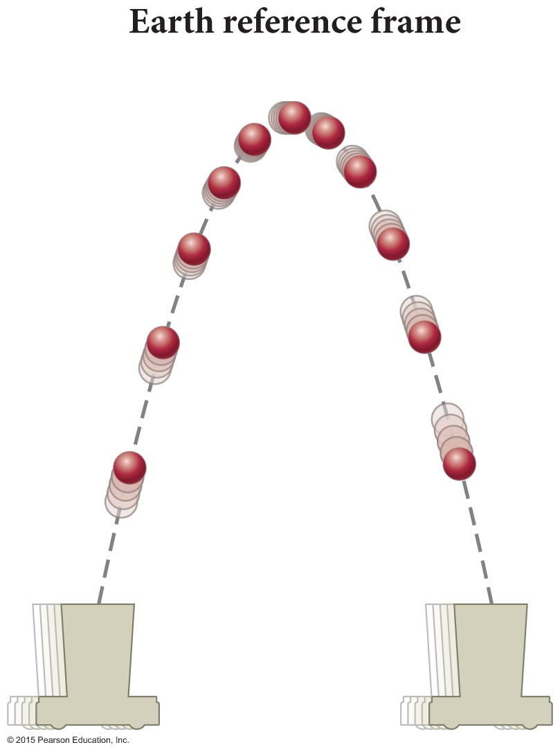
Section 10.7: Projectile motion in two
dimensions
Consider the motion of a ball launched straight up from a cart moving at a constant velocity (see the figure on the previous slide).
The resulting two-dimensional projectile motion in Earth’s reference frame is the curved trajectory shown in the figure.
The balls has a constant downward acceleration of a_{y} = –g.

Slide 73
Section 10.7: Projectile motion in two
dimensions
In Earth’s reference frame, the ball’s initial velocity is
The ball’s launch angle relative to the x axis is
Using a_{x} = 0 and a_{y} = –g in Equations 3.4 and 3.8, we get
υ_{x,f} = υ_{x,i} (constant velocity)
υ_{y,f} = υ_{y,i} – gΔt (constant acceleration)
x_{f} = x_{i} + υ_{x,i} Δt (constant velocity)

Slide 74
Example 10.5 Position of highest point
Section 10.7: Projectile motion in two
dimensions
The ball of Figure 10.32 is launched from the origin of an xy coordinate system. Write expressions giving, at the top of its trajectory, the ball’s rectangular coordinates in terms of its initial speed υ_{i} and the acceleration due to gravity g.

Slide 75
Example 10.5 Position of highest point (cont.)
Section 10.7: Projectile motion in two
dimensions
❶ GETTING STARTED Because the ball is launched from the origin, x_{i} = 0 and y_{i} = 0. As the ball moves upward, the vertical component of its velocity, υ_{y}, is positive. After crossing its highest position, the ball moves downward, and so now υ_{y} is negative. As the ball passes through its highest position, therefore, υ_{y} reverses sign, so at that position υ_{y} = 0.

Slide 76
Example 10.5 Position of highest point (cont.)
Section 10.7: Projectile motion in two
dimensions
❷ DEVISE PLAN Taking the highest position as
my final position and then substituting υ_{y,f} = 0 into
Eq. 10.18, I can determine the time interval Δt_{top} it takes the ball to travel to this position. Once I know Δt_{top}, I can use Eqs. 10.19 and 10.20 to obtain the ball’s coordinates at the top.

Slide 77
Example 10.5 Position of highest point (cont.)
Section 10.7: Projectile motion in two
dimensions
❸ EXECUTE PLAN Substituting υ_{y,f} = 0 into
Eq. 10.18, I get
0 = υ_{y,i} – gΔt_{top}.
Solving for Δt_{top} then yields
(1)

Slide 78
Example 10.5 Position of highest point (cont.)
Section 10.7: Projectile motion in two
dimensions
❸ EXECUTE PLAN Using x_{i} = 0, y_{i} = 0 in Eqs. 10.19 and 10.20, I then calculate the location of the highest position:
and
✔

Slide 79
Example 10.5 Position of highest point (cont.)
Section 10.7: Projectile motion in two
dimensions
❹ EVALUATE RESULT Because the ball moves at constant velocity in the horizontal direction, the
x coordinate of the highest position is the horizontal velocity component υ_{x,i} multiplied by the time interval it takes to reach the top (given by Eq. 1). The y coordinate of the highest position does not depend on υ_{x,i} as
I expect because the vertical and horizontal motions are independent of each other.

Slide 80
Example 10.6 Range of projectile
Section 10.7: Projectile motion in two
dimensions
How far from the launch position is the position at which the ball of Figure 10.32 is once again back in the cart? (This distance is called the horizontal range of the projectile.)

Slide 81
Example 10.6 Range of projectile (cont.)
Section 10.7: Projectile motion in two
dimensions
❶ GETTING STARTED As we saw in Example 3.6, the time interval taken by a projectile to return to its launch position from the top of the trajectory is equal to the time interval Δt_{top} it takes to travel from the launch position to the top. I can therefore use the Δt_{top} expression I found in Example 10.5 to solve this problem.

Slide 82
Example 10.6 Range of projectile (cont.)
Section 10.7: Projectile motion in two
dimensions
❷ DEVISE PLAN If the time interval it takes the ball to travel from its launch position to the top is Δt_{top}, then the time interval the ball is in the air is 2Δt_{top}. Because the ball travels at constant velocity in the horizontal direction, I can use Eq. 10.19 to obtain the ball’s range.

Slide 83
Example 10.6 Range of projectile (cont.)
Section 10.7: Projectile motion in two
dimensions
❸ EXECUTE PLAN From Example 10.5, I have
Δt_{top} = υ_{y,i}/g, and so the time interval spent in the air is Δt_{flight} = 2υ_{y,i}/g. Substituting this value into Eq. 10.19 yields
✔

Slide 84
Example 10.6 Range of projectile (cont.)
Section 10.7: Projectile motion in two
dimensions
❹ EVALUATE RESULT Because the trajectory is an inverted parabola, the top of the parabola lies midway between the two locations where the parabola intercepts the horizontal axis. So the location at which the parabola returns to the horizontal axis lies a horizontal distance twice as far from the origin as the horizontal distance at the top. In Example 10.5 I found that x_{top} = υ_{x,i}υ_{y,i}/g. The answer I get for the horizontal range is indeed twice this value.

Slide 85
Section 10.7
Question 6
A baseball player hits a fly ball that has an initial velocity for which the horizontal component is 30 m/s and the vertical component is 40 m/s. What is the speed of the ball at the highest point of its flight?
Zero
30 m/s
40 m/s

Slide 86
Section 10.7
Question 6
A baseball player hits a fly ball that has an initial velocity for which the horizontal component is 30 m/s and the vertical component is 40 m/s. What is the speed of the ball at the highest point of its flight?
Zero
30 m/s
40 m/s

Slide 87
Section 10.7
Question 7
What is the shape of the path of an object launched at an angle to the vertical, assuming that only the force of gravity is exerted on the object?
A straight line
A harmonic curve
A parabola
None of the above

Slide 88
Section 10.7
Question 7
What is the shape of the path of an object launched at an angle to the vertical, assuming that only the force of gravity is exerted on the object?
A straight line
A harmonic curve
A parabola
None of the above

Slide 89
Section 10.7
We know:
These are parametric equations x(t) and y(t)
We should be able to eliminate t!
Given v_{x,i} = v_{i} cos θ and v_{y,i} = v_{i} sin θ …
Parabolic path! Presumes launch from (0,0).
No gravity? Straight line.
x_{f} = x_{i} + υ_{x,i} Δt (constant velocity)

Slide 90
Section Goal
Section 10.8: Collisions and momentum in two dimensions
You will learn to
Apply the conservation of momentum equations to collisions in two dimensions.

Slide 91
Section 10.8: Collisions and momentum in two dimensions
As we saw in Chapter 5, momentum conservation states that the momentum of an isolated system of colliding objects does not change, or
Momentum is a vector, so in two dimensions momentum change must be expressed in terms of the components.
Conservation of momentum in two dimensions is given by
Δp_{x} = Δp_{1x} + Δp_{2x} = m₁(υ_{1x,f} – υ_{1x,i}) + m₂(υ_{2x,f} – υ_{2x,i}) = 0
Δp_{y} = Δp_{1y} + Δp_{2y} = m₁(υ_{1y,f} – υ_{1y,i}) + m₂(υ_{2y,f} – υ_{2y,i}) = 0
as with motion equations and forces:
perpendicular axes are treated completely separately

Slide 92
Section Goal
Section 10.9: Work as the product of two vectors
You will learn to
Understand that the work done by gravity is independent of path.
Define the scalar product of two vectors.
Associate work done by nondissipative forces with the scalar product of the force vector and the displacement vector.

Slide 93
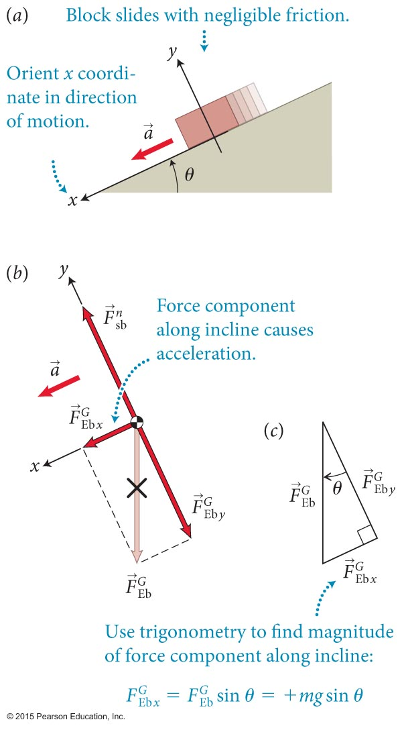
Section 10.9: Work as the product of two vectors
Consider a block sliding down an incline as shown (ignore friction).
The x component of the force of gravity is what causes the block to accelerate
The magnitude of the resulting acceleration is

Slide 94
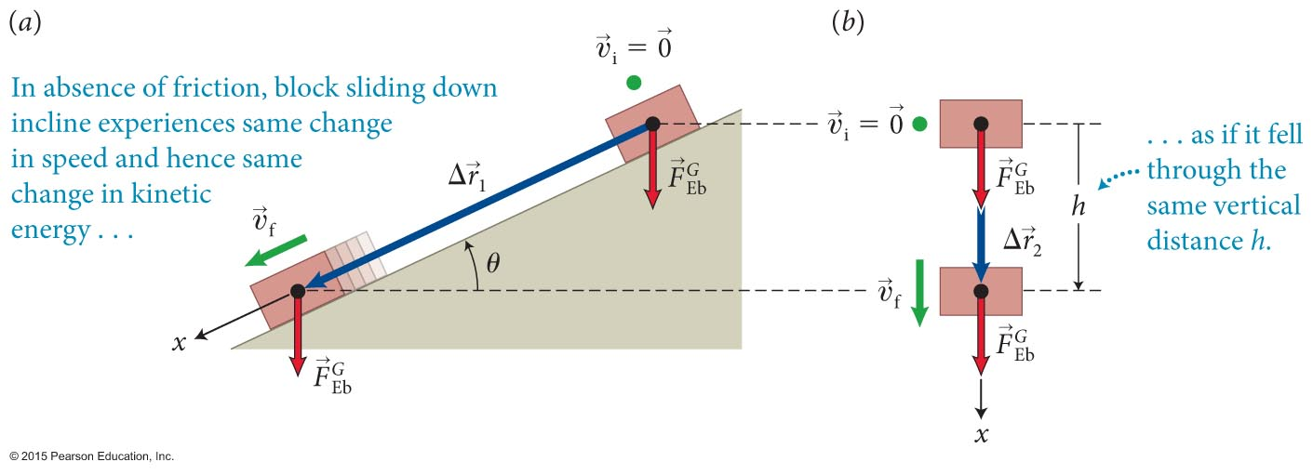
Section 10.9: Work as the product of two vectors
As illustrated in the figure, the block begins at rest (υ_{x,i} = 0) at position x_{i} = 0 and drops a height h.
The displacement along the incline is Δx = +h/sinθ.
The time the block takes to cover this distance is obtained from Equation 3.7:
from which we obtain

Slide 95
Section 10.9: Work as the product of two vectors
Using Equation 3.4 and Equation 10.25, the blocks final kinetic energy is then
Substituting in for time:
Because the blocks initial kinetic energy is zero, we get
We can get the same result by using the work equation:
        only force parallel to displacement matters!

Slide 96
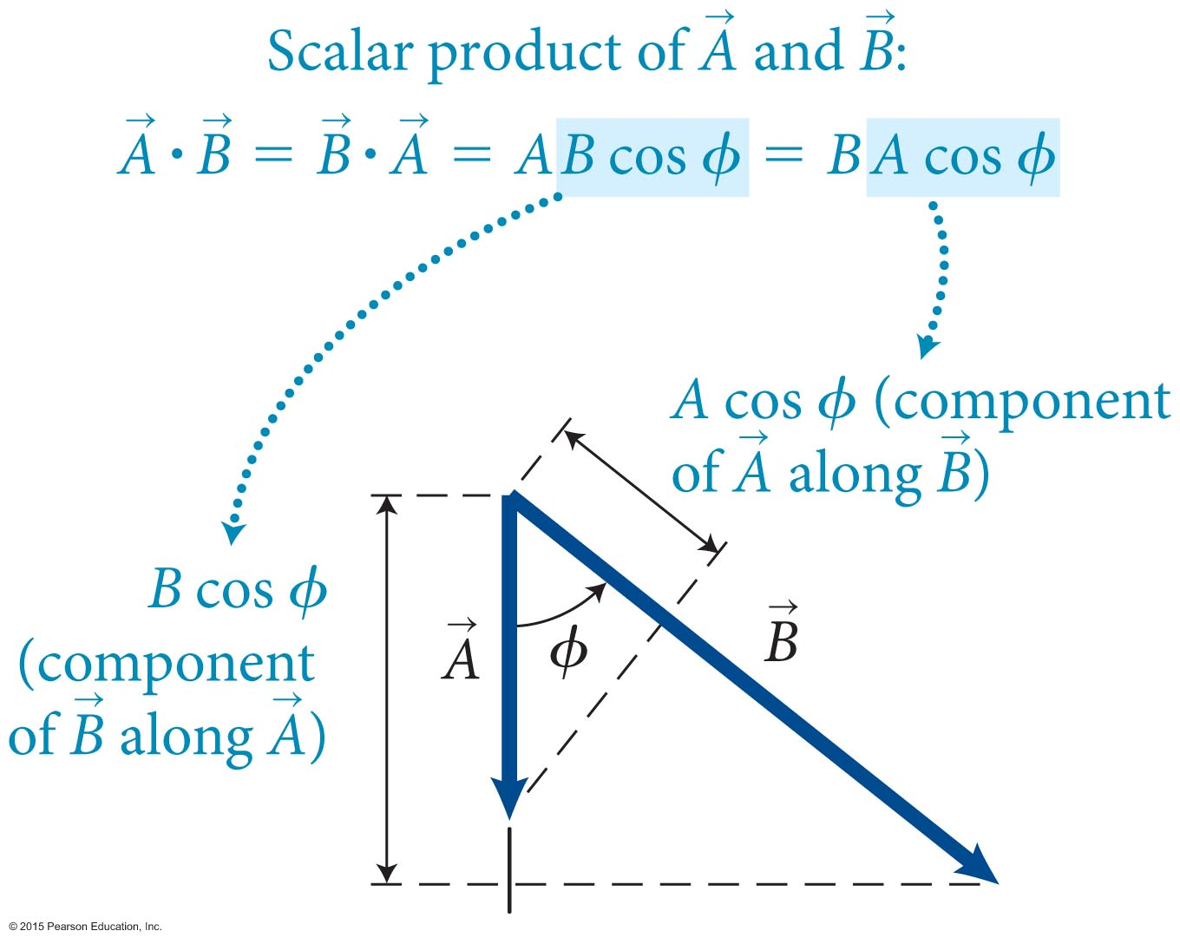
Section 10.9: Work as the product of two vectors
If the angle between and is ϕ, the scalar product of the two vectors is
The scalar product is commutative:
Physically?
Projecting out the component of one vector that is parallel to another
(A)(parallel part of B)
(B) (parallel part of A)

Slide 97
Section 10.9
Question 8
Under what circumstances could the scalar product of two vectors be zero?
When the vectors are parallel to each other
When the vectors are perpendicular to each other
When the vectors make an acute angle with each other
None of the above

Slide 98
Section 10.9
Question 8
Under what circumstances could the scalar product of two vectors be zero?
When the vectors are parallel to each other
When the vectors are perpendicular to each other
When the vectors make an acute angle with each other
None of the above

Slide 99
Section 10.9: Work as the product of two vectors
We can write work as a scalar product:
The normal force does no work, because ϕ = 90º between the normal force and the force displacement.
The work done by gravity on the block is
where θ is the angle of the incline.
However, since ϕ = π/2 – θ, cos ϕ = sin ϕ, so W = mgh.
If force and force displacement are opposite (ϕ = 180º), then work is negative.

Slide 100
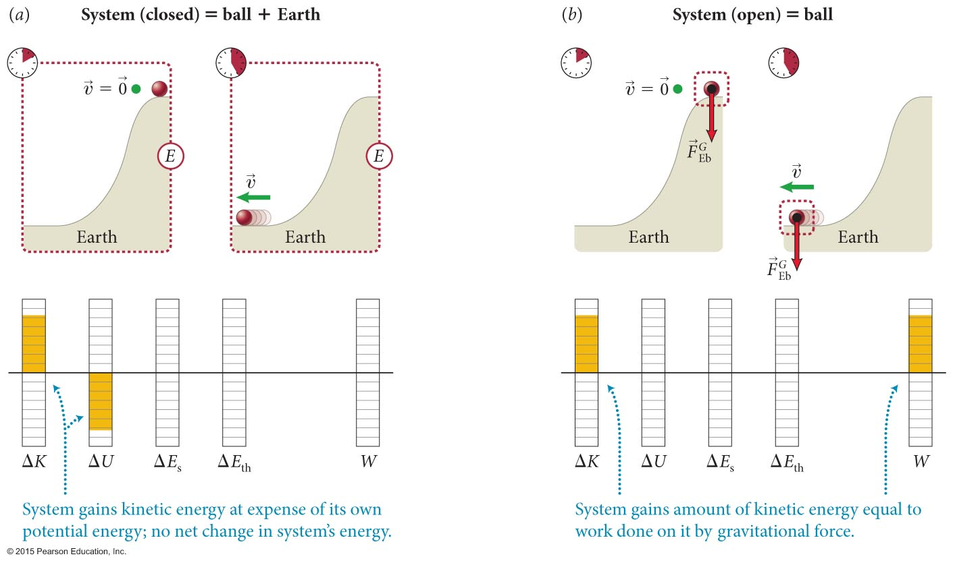
Section 10.9: Work as the product of two vectors
Consider a ball sliding down an incline with negligible friction:
If the closed system = ball + Earth, ΔK_{b} + ΔU^{G} = 0
If the closed system = ball, then ΔK_{b} = W, where W = mgh is work done by gravity.

Slide 101
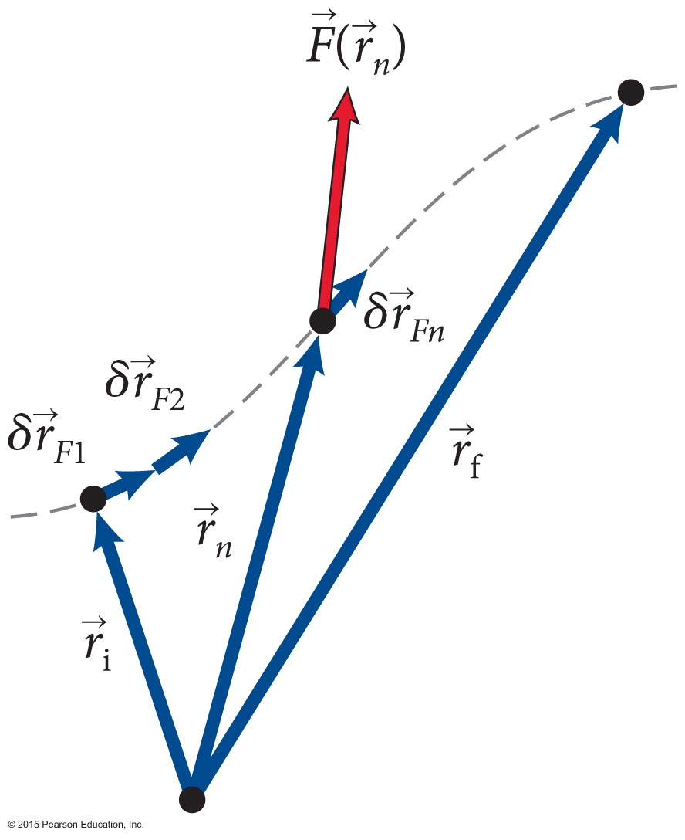
Section 10.9: Work as the product of two vectors
Let us generalize the previous result to forces that are not constant,
Start by subdividing the force displacement into many small fragments Work done by a variable force over a small displacement is
The work done over the entire force displacement is:

Slide 102
Section Goal
Section 10.10: Coefficients of Friction
You will learn to
Understand that the work done by gravity is independent of path.
Define the scalar product of two vectors.
Associate work done by nondissipative forces with the scalar product of the force vector and the displacement vector.

Slide 103
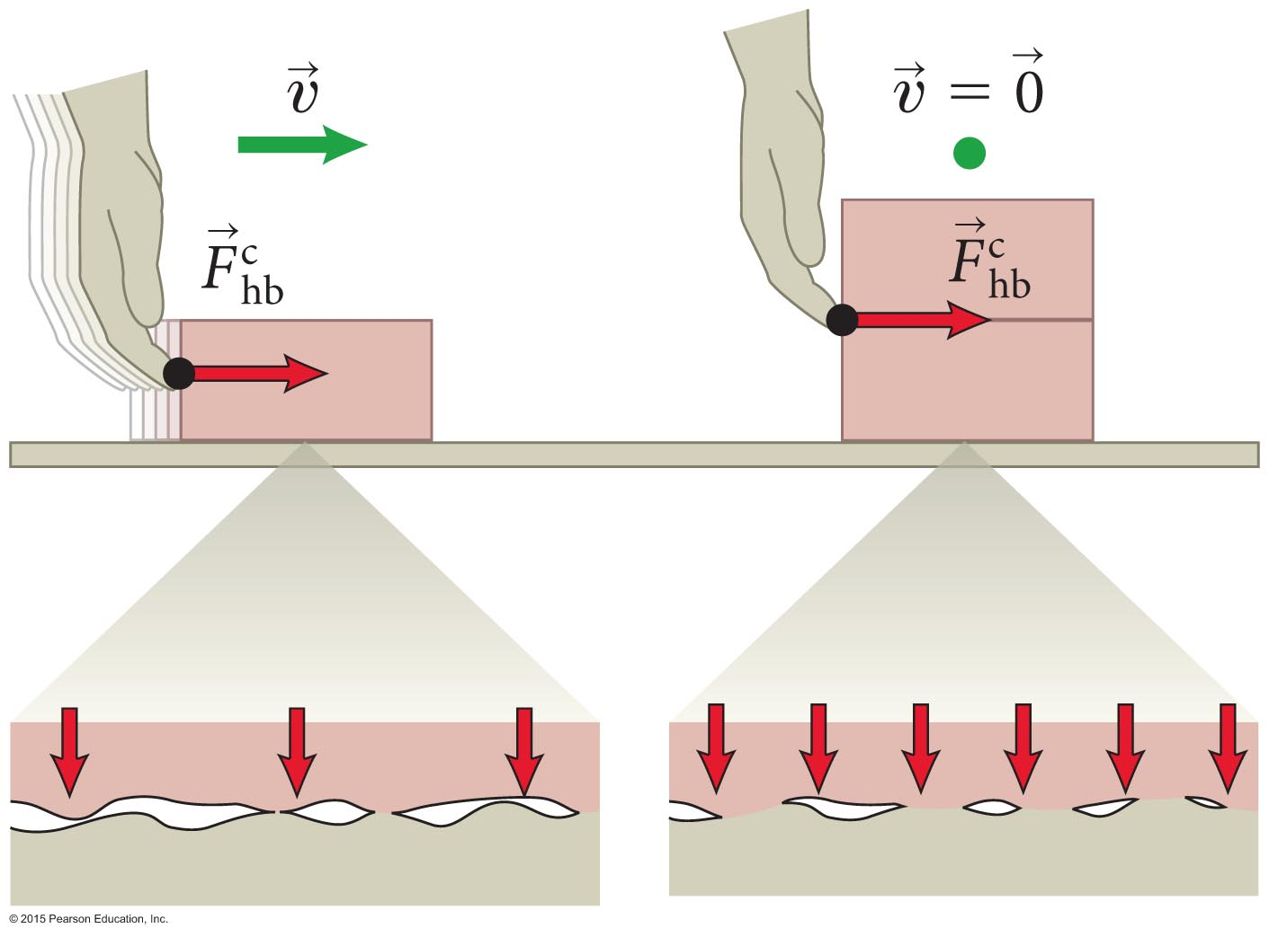
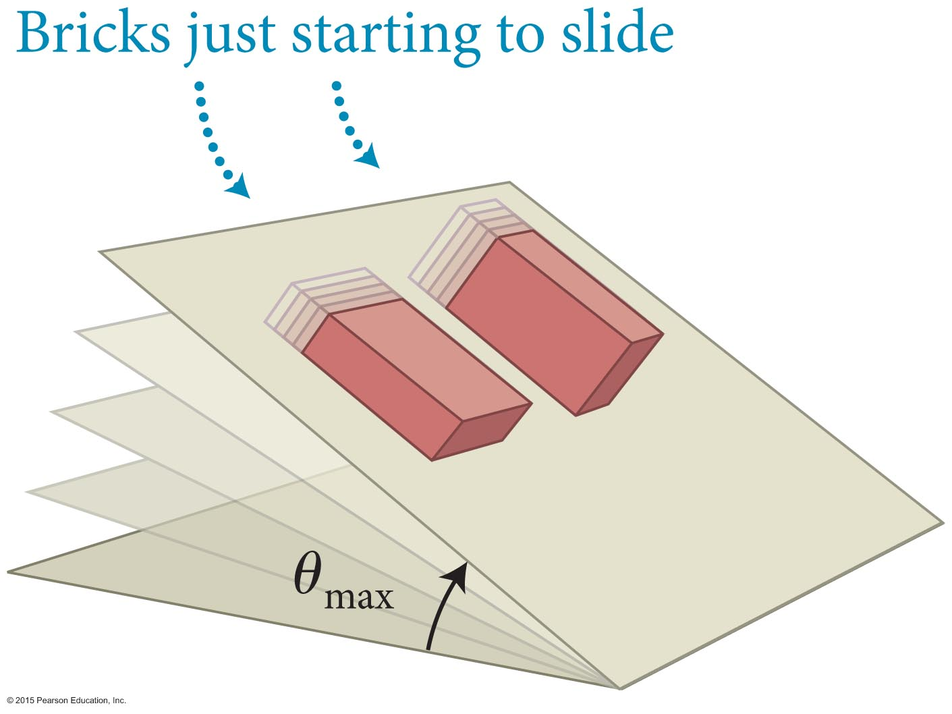
Section 10.10: Coefficients of Friction
Let us now develop a quantitative description of friction:
The figure illustrates the following observations.
  The maximum force of static friction exerted by a surface on an object is proportional to the force with which the object presses the surface.
  The force of static friction does not depend on the contact area.***
  *** so long as the surfaces are otherwise the same

Slide 104
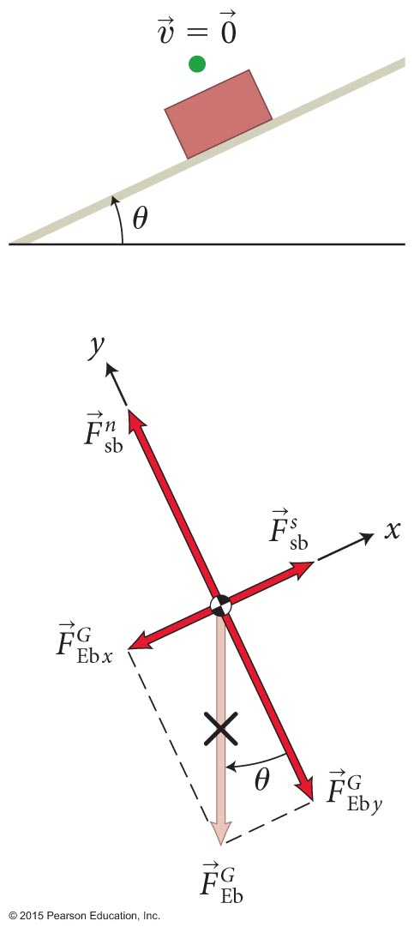
Section 10.10: Coefficients of Friction
As we have just determined, the maximum magnitude of the static friction force must be proportional to as seen in the figure.
Therefore, for any two surfaces 1 and 2 we have
The unitless proportionality constant μ_{s} is called the coefficient of static friction.
This upper limit means that the magnitude of static friction must obey the following condition:

Slide 105
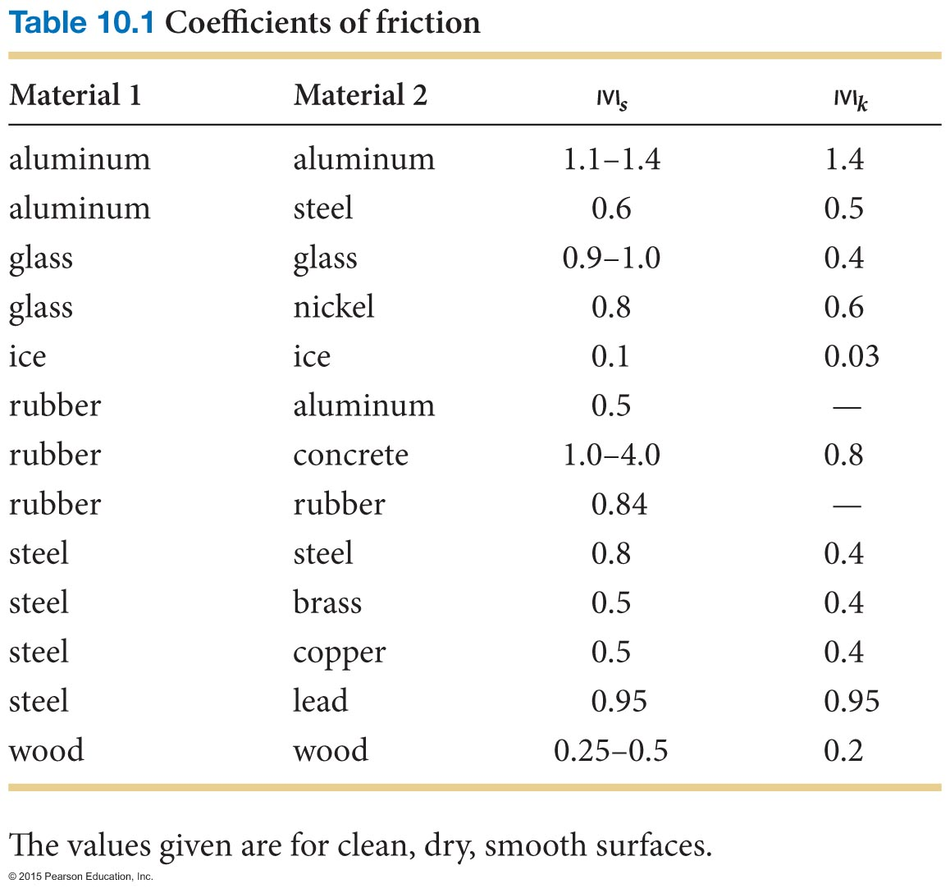
Section 10.10: Coefficients of Friction

Slide 106
Procedure: Working with frictional forces
Section 10.10: Coefficients of Friction
1. Draw a free-body diagram for the object of interest. Choose your x axis parallel to the surface and the y
axis perpendicular to it, then decompose your forces along these axes. Indicate the acceleration of the object.

Slide 107
Procedure: Working with frictional forces
Section 10.10: Coefficients of Friction
The equation of motion in the y direction allows you to determine the sum of the y components of the forces in that direction:
Constraint: Unless the object is accelerating in the normal direction, a_{y} = 0.
  Substitute the y components of the forces from your free-body diagram. The resulting equation allows you to determine the normal force.

Slide 108
Procedure: Working with frictional forces
Section 10.10: Coefficients of Friction
The equation of motion in the x direction is
Constraint: If the object is not accelerating along the surface, a_{x} = 0.
  Substitute the x components of the forces from your free-body diagram. The resulting equation allows you to determine the frictional force.

Slide 109
Procedure: Working with frictional forces
Section 10.10: Coefficients of Friction
4. If the object is not slipping, the normal force and the force of static friction should obey Inequality 10.54.

Slide 110
Example 10.8 Pulling a friend up a hill
Section 10.10: Coefficients of Friction
A hiker is helping a friend up a hill that makes an angle of 30º with level ground. The hiker, who is farther up the hill, is pulling on a cable attached to his friend. The cable is parallel to the hill so that it also makes an angle of 30º with the horizontal. If the coefficient of static friction between the soles of the hiker’s boots and the surface of the hill is 0.80 and his inertia is 65 kg, what is the maximum magnitude of the force he can exert on the cable without slipping?

Slide 111
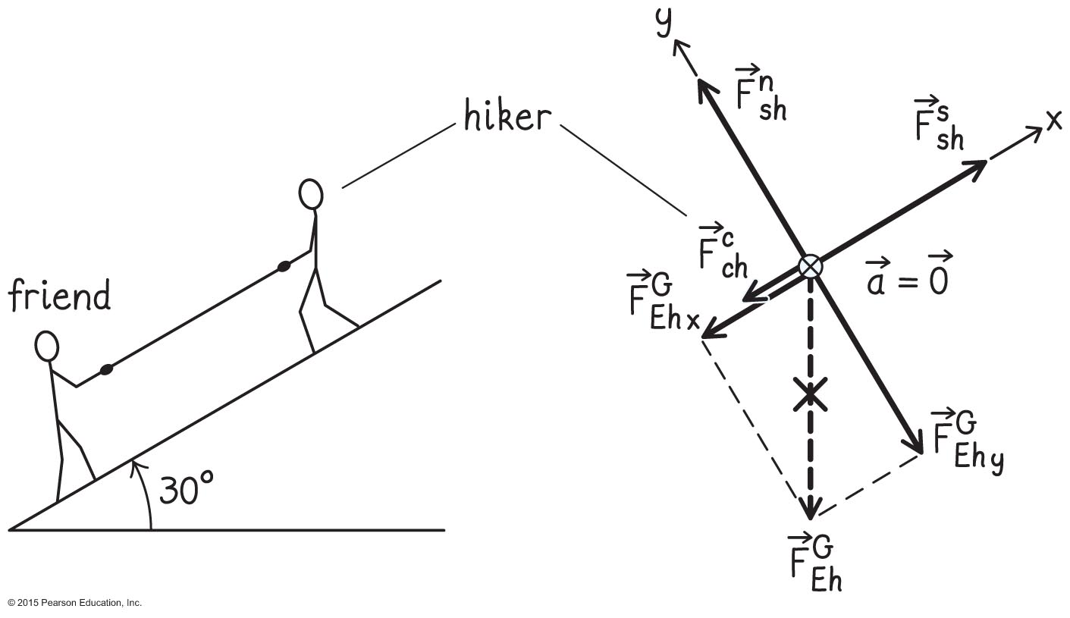
Example 10.8 Pulling a friend up a hill (cont.)
Section 10.10: Coefficients of Friction
❶ GETTING STARTED I begin by making a sketch and drawing the free-body diagram for the hiker (Figure 10.43). I chose an x axis that points up the hill and the y axis perpendicular to it.

Slide 112
Example 10.8 Pulling a friend up a hill (cont.)
Section 10.10: Coefficients of Friction
❶ GETTING STARTED The forces exerted on the hiker are a force exerted by the cable and directed down the hill (this force forms an interaction pair with the force the hiker exerts on the cable), the force of gravity , and the contact force exerted by the surface of the hill on the hiker.

Slide 113
Example 10.8 Pulling a friend up a hill (cont.)
Section 10.10: Coefficients of Friction
❶ GETTING STARTED This last force has two components: the normal force and the force of static friction . The force of static friction is directed up the hill. If the hiker is not to slip, his acceleration must be zero, and so the forces in the normal (y) and tangential (x) directions must add up to zero.

Slide 114
Example 10.8 Pulling a friend up a hill (cont.)
Section 10.10: Coefficients of Friction
❷ DEVISE PLAN Following the suggested procedure, I’ll write the equation of motion along the two axes, setting the acceleration in each direction to zero.
Then I use Inequality 10.54 to determine the maximum force that the hiker can exert without slipping.

Slide 115
Example 10.8 Pulling a friend up a hill (cont.)
Section 10.10: Coefficients of Friction
❸ EXECUTE PLAN Because the magnitude of the force of gravity exerted on the hiker is mg, I have in the y direction
where the minus sign in –mg cos θ indicates that is in the negative y direction.
θ

Slide 116
Example 10.8 Pulling a friend up a hill (cont.)
Section 10.10: Coefficients of Friction
❸ EXECUTE PLAN Likewise, I have in the x direction
θ

Slide 117
Example 10.8 Pulling a friend up a hill (cont.)
Section 10.10: Coefficients of Friction
❸ EXECUTE PLAN If the hiker is not to slip, the force of static friction must not exceed its maximum value. Substituting and using Inequality 10.54, I get

Slide 118
Example 10.8 Pulling a friend up a hill (cont.)
Section 10.10: Coefficients of Friction
❸ EXECUTE PLAN The problem asks me about the magnitude of the force exerted by the hiker on the cable, which is the same as the magnitude of the force exerted by the cable on the hiker, so

Slide 119
Example 10.8 Pulling a friend up a hill (cont.)
Section 10.10: Coefficients of Friction
❸ EXECUTE PLAN Substituting the values given, I obtain
✔

Slide 120
Example 10.8 Pulling a friend up a hill (cont.)
Section 10.10: Coefficients of Friction
❹ EVALUATE RESULT A force of 1.2 × 10² N corresponds to the gravitational force exerted by Earth on an object that has an inertia of only 12 kg, and so the hiker cannot pull very hard before slipping. I know from experience, however, that unless I can lock a foot behind some solid object, it is impossible to pull hard on an inclined surface, and thus the answer I obtained makes sense.

Slide 121
Example 10.9 Object accelerating on a conveyor belt
Section 10.10: Coefficients of Friction
While designing a conveyor belt system for a new airport, you determine that, on an incline of 20º, the magnitude of the maximum acceleration a rubber belt can give a typical suitcase before the suitcase begins slipping is 4.0 m/s². What is the coefficient of static friction for a typical suitcase on rubber?

Slide 122
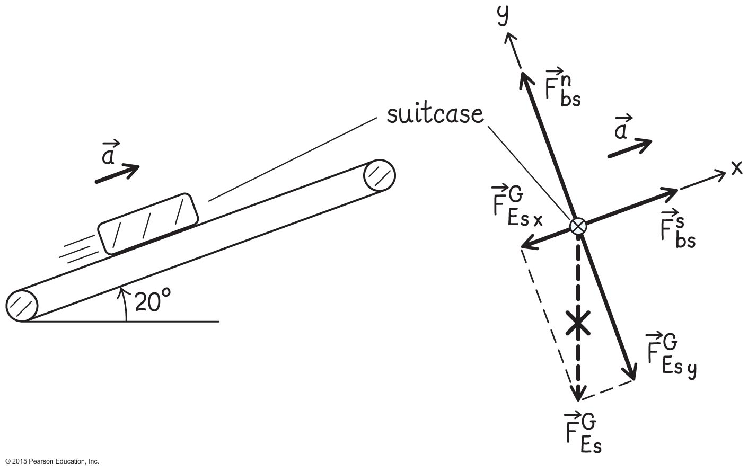
Example 10.9 Object accelerating on a conveyor belt (cont.)
Section 10.10: Coefficients of Friction
❶ GETTING STARTED: I begin by making a sketch and drawing a free-body diagram for the suitcase, choosing the x axis along the conveyor belt in the direction of acceleration and the y axis upward and perpendicular to it (Figure 10.44). I also draw the upward acceleration of the suitcase along the incline.

Slide 123
Example 10.9 Object accelerating on a conveyor belt (cont.)
Section 10.10: Coefficients of Friction
❷ DEVISE PLAN As in Example 10.8, I write out the equation of motion along both axes. The x component of the acceleration is a_{x} = +a, where the magnitude of the acceleration is a = 4.0 m/s². I can then use Inequality 10.54 to determine the coefficient of static friction.

Slide 124
Example 10.9 Object accelerating on a conveyor belt (cont.)
Section 10.10: Coefficients of Friction
❸ EXECUTE PLAN The equations of motion in the x and y directions are
with m the inertia of the suitcase.
(1)
(2)

Slide 125
Example 10.9 Object accelerating on a conveyor belt (cont.)
Section 10.10: Coefficients of Friction
❸ EXECUTE PLAN If a_{x} represents the maximum acceleration at which the suitcase does not slip, the force of static friction must be maximum. Substituting Eq. 10.46 for _{max} into Eq. 1, I get

Slide 126
Example 10.9 Object accelerating on a conveyor belt (cont.)
Section 10.10: Coefficients of Friction
❸ EXECUTE PLAN Solving this equation for μ_{s} and substituting from Eq. 2, I obtain
✔

Slide 127
Example 10.9 Object accelerating on a conveyor belt (cont.)
Section 10.10: Coefficients of Friction
❹ EVALUATE RESULT From Table 10.1, I see that the value I obtained for the coefficient for static friction is close to the coefficient for rubber against rubber and therefore reasonable. I also note that the inertia m of the suitcase, which is not given, drops out of the final result.

Slide 128
Section 10.10: Coefficients of Friction
Once surfaces start to slip relative to each other, the force of kinetic friction is relative to the normal force
where μ_{k} is called the coefficient of kinetic friction.
The kinetic coefficient μ_{k} is always smaller then μ_{s}.
Other than this, problem solving proceeds the same way

Slide 129
Concepts: Vectors in two dimensions
Chapter 10: Summary
To add two vectors and , place the tail of at the head of .Their sum is the vector drawn from tail of
to the head of .
To subtract from , reverse the direction of and then add the reversed to .
Any vector can be written as
where A_{x} and A_{y} are the components of along the x and y axes.

Slide 130
Quantitative Tools: Vectors in two dimensions
Chapter 10: Summary
The magnitude of any vector is
and the angle θ that makes with the positive x axis is given by
If is the vector sum of and , the component of are
The scalar product of two vectors and that make an angle ϕ when placed tail to tail is

Slide 131
Concepts: Projectile motion in two dimensions
Chapter 10: Summary
For a projectile that moves near Earth’s surface and experiences only the force of gravity, the acceleration has a magnitude g and is directed downward.
The projectile’s horizontal acceleration is zero, and the horizontal component of its velocity remains constant.
At the highest point in the trajectory of a projectile, the vertical velocity component υ_{y} is zero, but the vertical component of the acceleration is g and is directed downward.

Slide 132
Quantitative Tools: Projectile motion in two dimensions
Chapter 10: Summary
If a projectile is at a position (x, y), its position vector is
If a projectile has position components x_{i} and y_{i} and velocity components υ_{x,i} and υ_{y,i} at one instant, then its acceleration, velocity, and position components a time interval Δt later are

Slide 133
Concepts: Collisions and momentum in two dimensions
Chapter 10: Summary
Momentum is a vector, so in two dimensions its changes in momentum must be accounted for by components.
This means two equations, one for the x component and one for the y component of momentum.
The coefficient of restitution is a scalar and is accounted for by a single equation.

Slide 134
Quantitative Tools: Collisions and momentum in two dimensions
Chapter 10: Summary
Δp_{x} =Δp_{1x} + Δp_{2x} = m₁(υ_{1x,f} – υ_{1x,i}) + m₂(υ_{2x,f} – υ_{2x,i}) = 0
Δp_{y} =Δp_{1y} + Δp_{2y} = m₁(υ_{1y,f} – υ_{1y,i}) + m₂(υ_{2y,f} – υ_{2y,i}) = 0

Slide 135
Concepts: Forces in two dimensions
Chapter 10: Summary
In two-dimensional motion, the component of the acceleration parallel to the instantaneous velocity changes the speed and the component of the acceleration perpendicular to the instantaneous velocity changes the direction of the instantaneous velocity.
When choosing a coordinate system for a problem dealing with an accelerating object, if possible make one of the axes lie along the direction of the acceleration.

Slide 136
Concepts: Friction
Chapter 10: Summary
When two surfaces touch each other, the component of the contact force perpendicular (normal) to the surfaces is called the normal force and the component parallel (tangential) to the surfaces is called the force of friction.
The direction of the force of friction is such that the force opposes relative motion between the two surfaces. When the surfaces are not moving relative to each other, we have static friction.

Slide 137
Concepts: Friction
Chapter 10: Summary
When the forces are moving relative to each other, we have kinetic friction.
The magnitude of the force of kinetic friction is independent of the contact area and independent of the relative speeds of the two surfaces.

Slide 138
Quantitative Tools: Friction
Chapter 10: Summary
The maximum magnitude of the force of static friction between any two surfaces 1 and 2 is proportional to the normal face:
where μ_{s} is the unitless coefficient of static friction. This upper limit means that the magnitude of the frictional force must obey the condition
The magnitude of the force of kinetic friction is also proportional to the normal face:
where μ_{k} ≤ μ_{s} is the unitless coefficient of kinetic friction.

Slide 139
Concepts: Work
Chapter 10: Summary
For a sliding object, the normal force does no work because this force is perpendicular to the direction of the object’s displacement.
The force of kinetic friction is a nonelastic force and thus causes energy dissipation.
The force of static friction is an elastic force and so causes no energy dissipation.
The work done by gravity is independent of path.

Slide 140
Quantitative Tools: Work
Chapter 10: Summary
The work done by a constant nondissipative force when the point of application of the force undergoes a displacement
is
The work done by a variable nondissipative force when the point of application of the force undergoes a displacement is
This is the line integral of the force over the path traced out by the point of application of the force.

Slide 141
Quantitative Tools: Work
Chapter 10: Summary
For a variable dissipative force, the change in the thermal energy is
When an object descends a vertical distance h, no matter what path it follows, the work gravity does on it is
W = mgh.

Slide 142
Example 10.7 Pucks colliding
Section 10.8: Collisions and momentum in two dimensions
Pucks 1 and 2 slide on ice and collide. The inertia of puck 2 is twice that of puck 1. Puck 1 initially moves at 1.8 m/s; puck 2 initially moves at 0.20 m/s in a direction that makes an angle of 45º with the direction of puck 1. After the collision, puck 1 moves at 0.80 m/s in a direction that makes an angle of 60º with its original direction. What are the speed and direction of puck 2 after the collision?

Slide 143
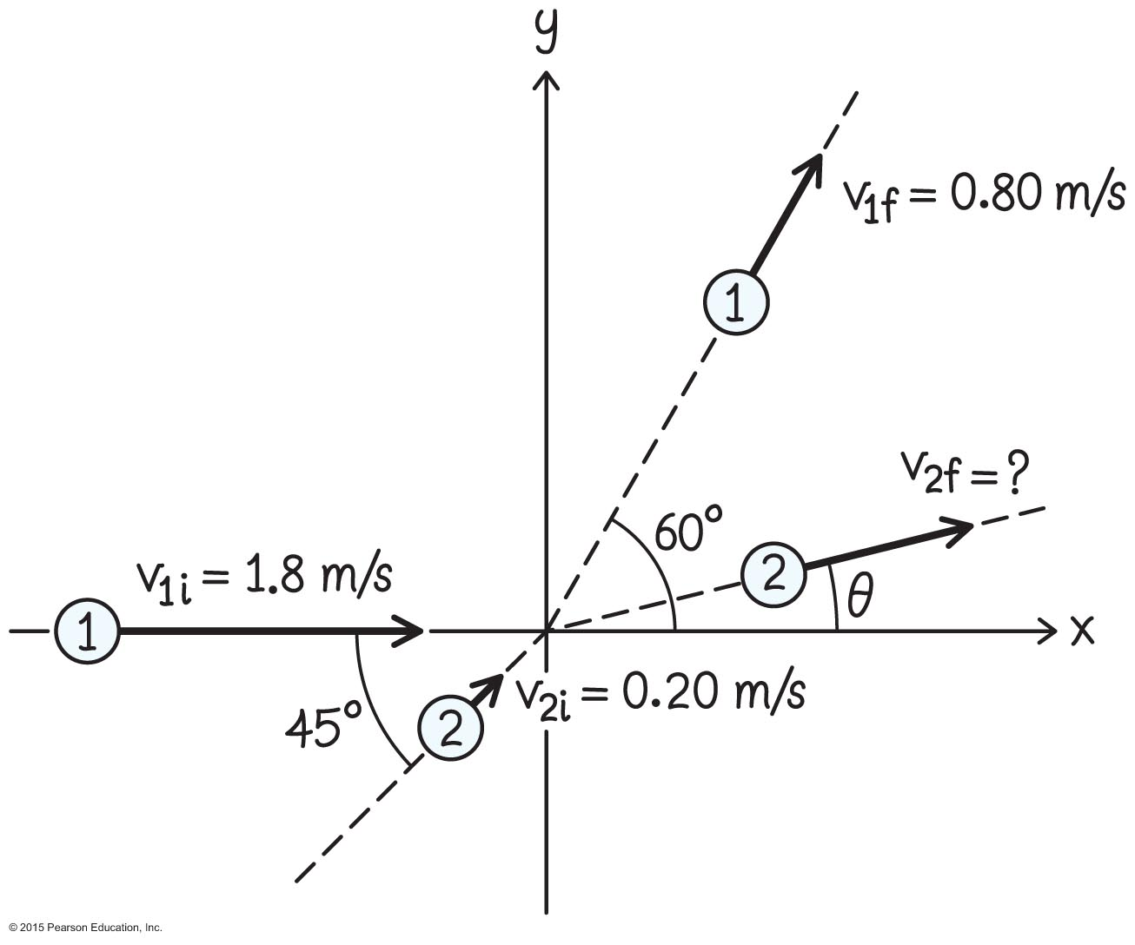
Example 10.7 Pucks colliding (cont.)
Section 10.8: Collisions and momentum in two dimensions
❶ GETTING STARTED Because it takes place on a surface, the collision is two-dimensional. I begin by organizing the given information in a sketch (Figure 10.33). I let puck 1 move along the x axis before the collision. Then I add puck 2, which initially moves at an angle of 45º to the x axis.

Slide 144
Example 10.7 Pucks colliding (cont.)
Section 10.8: Collisions and momentum in two dimensions
❶ GETTING STARTED I draw puck 1 after the collision moving upward and to the right along a line that makes an angle of 60º with the x axis. I don’t know anything about the motion of puck 2 after the collision, and so I arbitrarily draw it moving to the right and upward.
I label the pucks and indicate the speeds I know. I need to determine the final speed υ_{2f} of puck 2 and the angle θ between its direction of motion after the collision and the x axis.

Slide 145
Example 10.7 Pucks colliding (cont.)
Section 10.8: Collisions and momentum in two dimensions
❷ DEVISE PLAN Equations 10.21 and 10.22 give the relationship between the initial and final velocities of the two pucks. I know the x and y components of both initial velocities and, after decomposing the x and y components of the final velocity of puck 1. Thus
I can use Eqs. 10.21 and 10.22 to obtain values for the two components of Using these component values, I can calculate υ_{2f} and θ.

Slide 146
Example 10.7 Pucks colliding (cont.)
Section 10.8: Collisions and momentum in two dimensions
❸ EXECUTE PLAN The two unknown components are υ_{2x,f} and υ_{2y,f}. Solving Eq. 10.21, for υ_{2x,f}, I get
[(0.80 m/s) cos 65º – (1.8 m/s)]
+ (0.20 m/s) cos 45º
= 0.84 m/s.

Slide 147
Example 10.7 Pucks colliding (cont.)
Section 10.8: Collisions and momentum in two dimensions
❸ EXECUTE PLAN Solving Eq. 10.22 for υ_{2y,f} , I get
(0.80 m/s) sin 60º + (0.20 m/s) sin 45º
= – 0.21 m/s.

Slide 148
Example 10.7 Pucks colliding (cont.)
Section 10.8: Collisions and momentum in two dimensions
❸ EXECUTE PLAN Using these values, I obtain the final speed of puck 2 and its direction of motion:
= 0.87 m/s
or θ = –14º.
✔
✔

Slide 149
Example 10.7 Pucks colliding (cont.)
Section 10.8: Collisions and momentum in two dimensions
❹ EVALUATE RESULT My positive result for υ_{2x,f} and negative result for υ_{2y,f} tell me that after the collision, puck 2 moves in the positive x direction and the negative y direction. Both of these directions make sense: I can see from my sketch that the x component of the velocity of puck 1 decreases in the collision.
The corresponding decrease in the x component of its momentum must be made up by an increase in the x component of the momentum of puck 2.

Slide 150
Example 10.7 Pucks colliding (cont.)
Section 10.8: Collisions and momentum in two dimensions
❹ EVALUATE RESULT Given that puck 2 initially moves in the positive x direction, it must continue to do so after the collision. In the y direction, I note that because υ_{1y,i} is zero, the y component of the momentum of puck 1 increases in the positive y direction by an amount m₁υ_{1y,f} = m₁[(0.80 m/s) sin 60º] = m₁(0.69 m/s). Therefore the y component of the momentum of puck 2 must undergo a change of equal amount in the negative y direction.

Slide 151
Example 10.7 Pucks colliding (cont.)
Section 10.8: Collisions and momentum in two dimensions
❹ EVALUATE RESULT Because the initial y component of the momentum of puck 2 is smaller than this value, m₂υ_{2y,i} = 2m₁υ_{2y,i} = 2m₁[(0.20 m/s) sin 45º] = m₁(0.28 m/s), puck 2 must reverse its direction of motion in the y direction, yielding a negative value for υ_{2y,f}, in agreement with what I found.

Slide 152
Checkpoint 10.10
Is the collision in Example 10.7 elastic?
10.10

