Slide 1
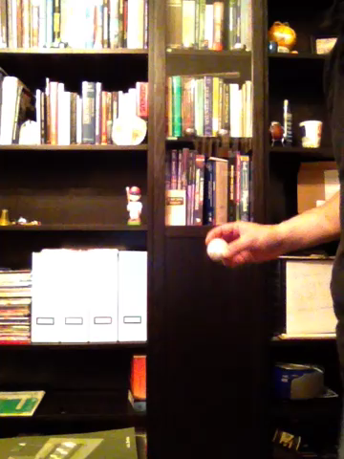

Slide 3
gives g~9.2

Slide 5
gives g~9.8

