Slide 2
Student Feedback
Spring 2019 Student Feedback Survey
Packback is an AI-supported online discussion platform that is a space to develop critical thinking, curiosity, and writing skills.
“In past classes where Packback wasn’t used, I wasn’t all that interested in the material. I just did what I had to do to pass the class. I didn’t think I’d care about a GenEd ever before Packback.”

Slide 3
The Impact
Critical Questioning skills are essential to college and post-grad life:
In asking effective questions while interviewing to select the right job after graduation.
In identifying opportunities for innovation, when starting a business, or working within a team.
In learning new skills independently after graduation, to keep adapting to a changing world!

Slide 4
Objectives
Our specific Packback course objectives
In this class, we’re using Packback to:
Discuss material together in more detail outside class
Think and discuss about the applications of course content
Satisfy your curiosity!

Slide 5
Course Design
How Packback discussion fits into this course
Packback will be used in this course as a way to integrate and apply course concepts.
Remembering new factual information and course concepts.
Course
Lecture
Mastery of
Course
Objectives
Analyzing, Evaluating, and Generating discussion into broader contexts.
Proving Understanding of course information and concepts.
Packback
Quizzes,
Tests

Slide 6
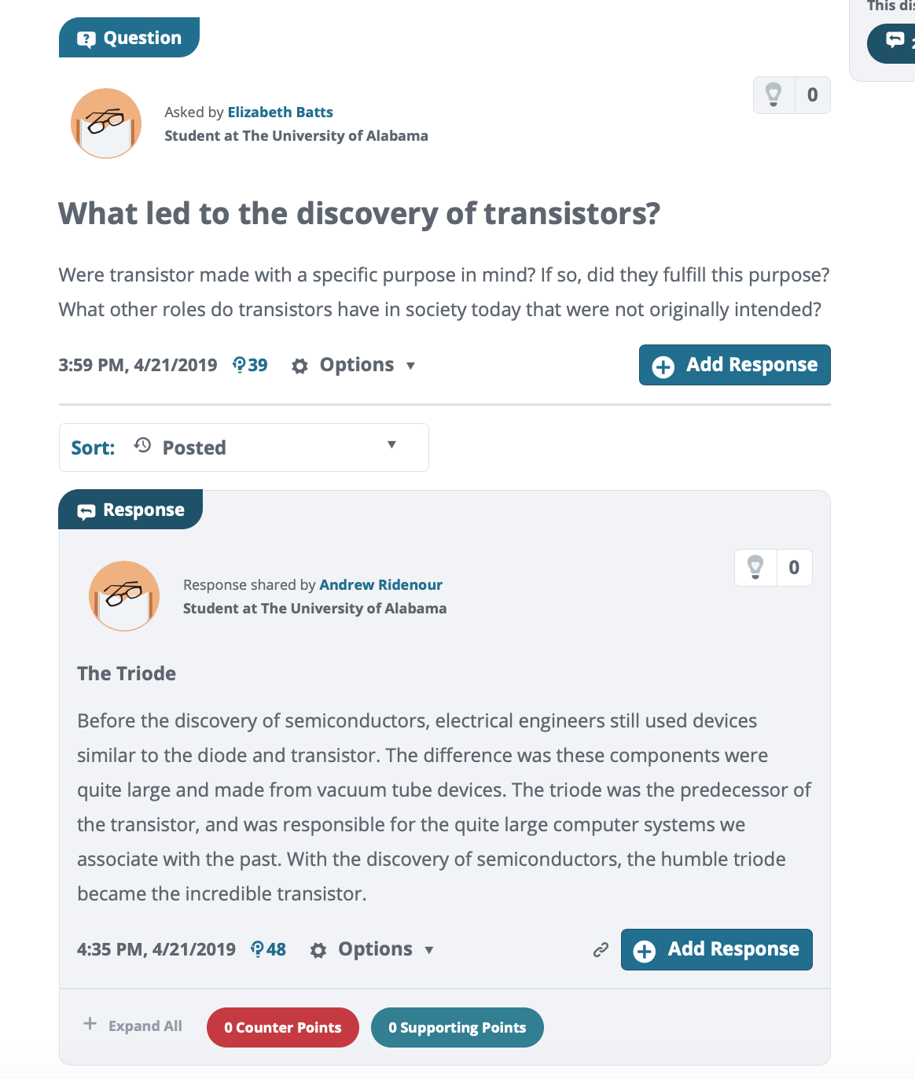
Example
Ideally: add a supporting link

Slide 7
Participation requirements
& How you will be graded

Slide 8
Grading & Requirements
Packback is worth 10% of your final grade!
This is an important assignment, please take it seriously as it will affect your final grade.
It is essentially a letter grade difference, and all you have to do is post online. Which you are already doing elsewhere anyway.

Slide 9
Grading & Requirements
Participation Requirements
Weekly Deadline
[Monday] at [11:59 PM]
What to Post
per Deadline period
Post 3 Questions + Responses (any combination)
Other Expectations
Some ‘catch up’ is allowed, within reason

Slide 10
Packback’s AI
& How to check your grade

Slide 11
Auto-Moderation
Posts on Packback are Reviewed by AI
Packback’s AI
Packback’s AI “flags” posts that may be violating community guidelines.
Posts are then reviewed by Packback moderators.
Offending posts are Moderated and no longer count for credit.
Packback’s AI flags for:
[ Maintain a minimum average curiosity score of 50 points per week ]
[ Partial Credit / No Partial Credit ]
Packback’s AI auto-flags for:
Plagiarism
Closed-Ended Questions (e.g. “What is the definition of mitosis?”)
Class Logistics Posts (e.g. “When is the next test”?)
Low effort / Low detail posts

Slide 12
Auto-Moderation
What happens if your post is moderated?
Post is “Flagged”
If your post is “Flagged”, you have not yet lost points!
At this time, your post is still published and still counts for credit.
Post is “Moderated”
If your post is moderated, it is unpublished and no longer counts for credit.
If your post is “Moderated”, you receive an email notifying you.
Post is “Republished”
From the email, you can “edit & re-publish” the post.
Doing so will earn back your points for the post without penalty, so long as you edit before grades are entered.

Slide 13
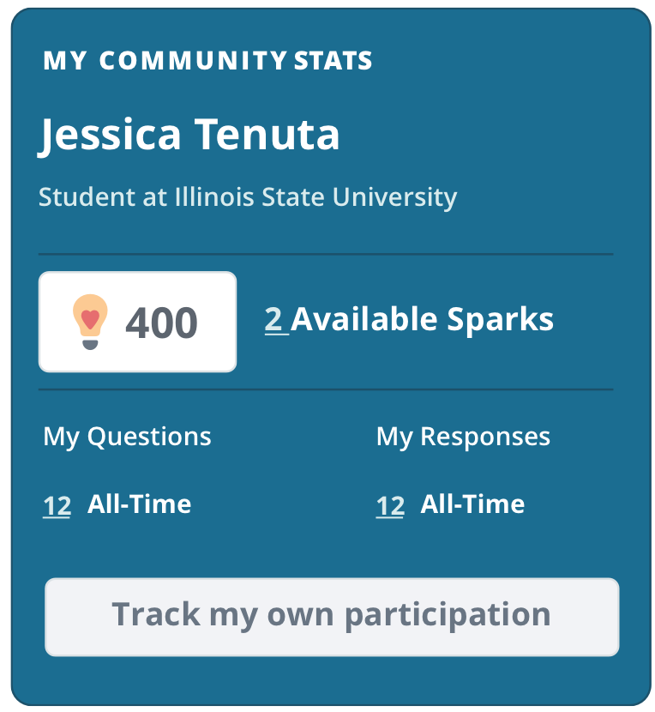
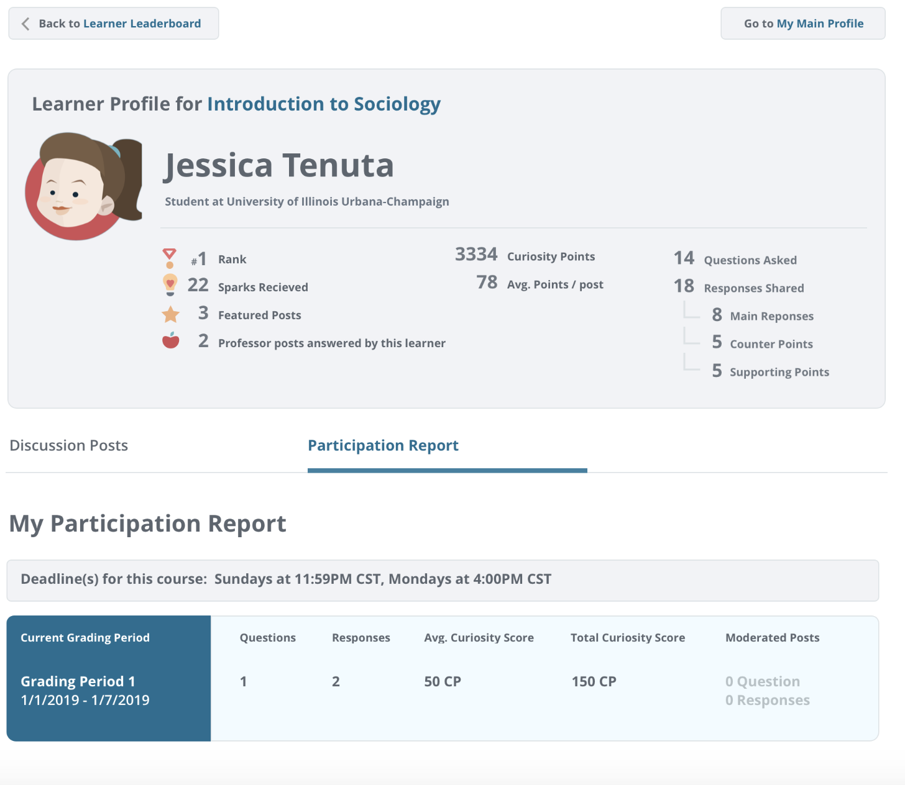
Monitor Progress
Track Participation
Your Name
You can check your current participation by Deadline period to make sure you’ve earned your full points for the week.
Your Name
Note: If you have any Moderated posts, you can track them here!

Slide 14
Getting started
& Getting help

Slide 15
Register
Registering for Packback
You will have received an invitation in your school email inbox.
Follow the instructions in the email to checkout and finish registration.
Be sure to create an account with the same email where you were sent the invitation!
Don’t see it? Check Spam!
Didn’t get an email?
Sign up directly on Packback
Click “Join Community” button
Enter the “Community Look-Up Key” from our course syllabus
You only need this key if you didn’t get the invite.

Slide 16
Register
Registering for Packback
community look-up key for this course is:
40e05ca8-310b-4047-ab07-0956af794364
get the access code via RedShelf link
on BlackBoard page - fee then waived

Slide 17
Get Help!
Need Help? Email Holla@packback.co
Packback’s support team is available 7 days a week, and will help you will all technical issues.
Do NOT email me with Packback issues; their team will be able to help faster!

