Slide 1
Design Tactics
Getting through your project from start to finish
P. LeClair
PH 4/591 Fall 2022

Slide 2
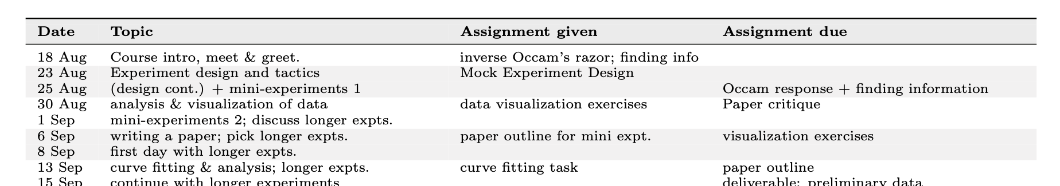

Slide 3
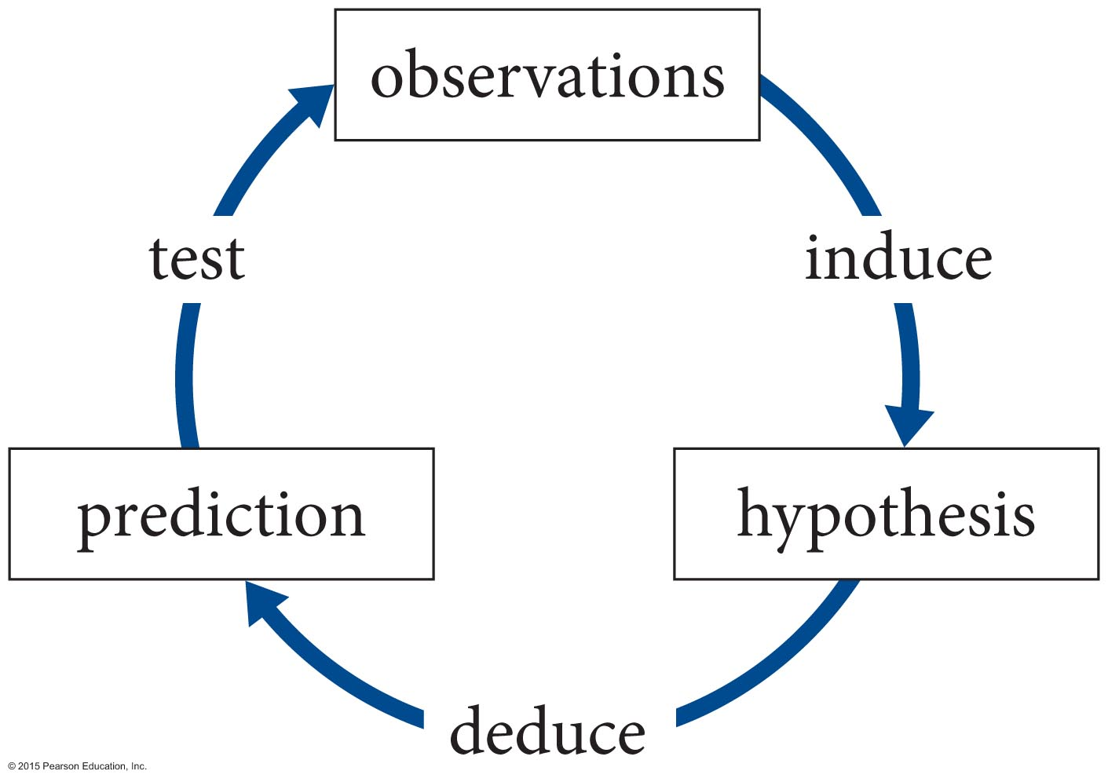
A starting point
The Scientific Method - an iterative process by which we try to construct laws of nature.
If the prediction is inaccurate, you modify the hypothesis
If the predictions prove to be accurate test after test it is elevated to the status of a law or a theory.

Slide 4
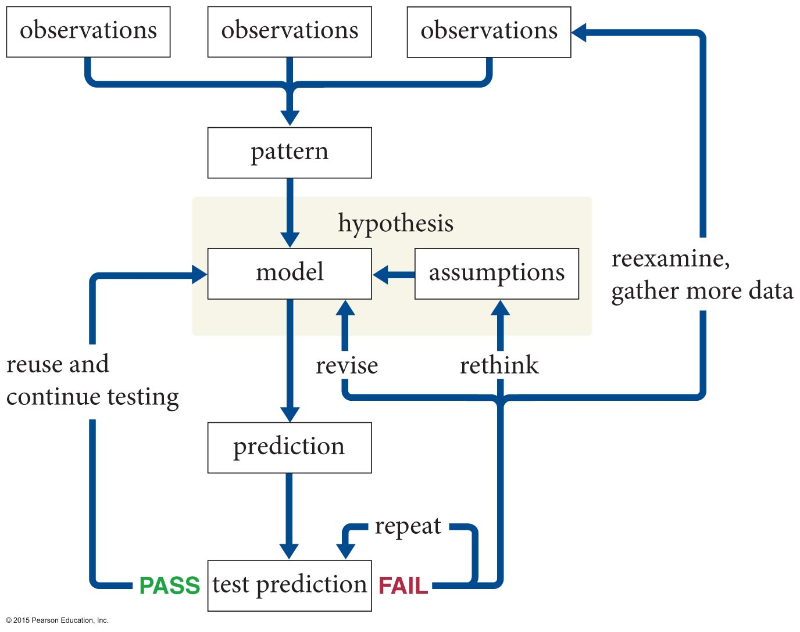
Models ftw
forming a hypothesis almost always involves developing a model
a model is a simplified conceptual representation of some phenomenon.
But you know this …
How do you actually do stuff?

Slide 5
Models and Methods
Abstract the requirements to get to crux of the problem and essential characteristics
Emphasize selection of appropriate processes and techniques
Step-by-step from qualitative to quantitative
Deliberate variation and combination of solution elements of different complexity

Slide 6
OK, you have an idea. Now what?
Properly defining the problem? The solution?
How design your experiment or project?
How do you figure out how to execute the plan?
How do you work in a team to solve it?
How to communicate your results?
Buying $5 models with 50¢ data and other Panglossian problems.

Slide 7
Plan and Play Nice With Others
The “lone genius” and “flash of inspiration” tropes were never true (ditto for ageism)
You will have to work in a team
This stuff is hard work
It can’t happen incoherently or without planning (if it could, someone already did it)
There are Tools and Tactics that you can use
There are Processes to guide you

Slide 8
Remember “transferrable skills”?
Sounds a lot like engineering design? You’re not wrong.
It is a blurry (and uninteresting) line.
It is all about doing something systematically, doing it well, and looking at what you are doing objectively.
We aren’t just fiddling with the knobs on the LHC or JWST after all. There are plans.

Slide 9
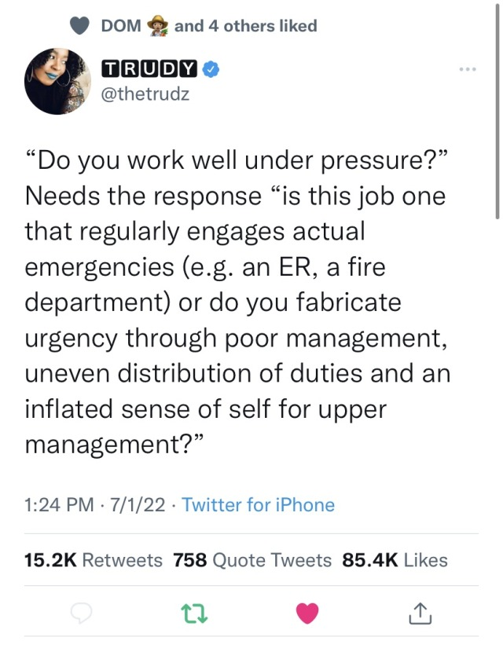
Try to relax
Speaking of which:
I didn’t design this to be a high-pressure class
If it is, let’s figure out why

Slide 10
Activities, broadly
Conceptualizing – search for solution principles
Embodying – general arrangement and preliminary ‘shape’ of materials and methods (aka: quick and dirty solution, proof of principle)
Detailing – finalizing details and making it go (now we are Professionals)
Throughout – computing, drawing, info gathering, iteration and feedback

Slide 11
Skills and activities
These come up at various phases of the design & implementation of your research
Decision making
Project management
Communication
Collaboration
Synergies among the skill areas

Slide 12
Decision making
Sound and well-reasoned. Not ‘gut feeling’
Systematically evaluate info & alternatives.
Ensure clear rationale forms for each
Establish criteria, eliminate biases.
Data gathering, brainstorming, and testing
Fit all this together
  systematic & iterative approach

Slide 13
Project management
Focus on actual tasks & activities needed
Working agreements
Priorities
Scheduling
Record keeping
Continuous quality improvement

Slide 14
Communication
More than technical skills needed to succeed
Must communicate your ideas
Must communicate with a team
Must listen
Must remain calm and be willing to change your mind
You must keep the team on the same page

Slide 15
Collaboration
Again: the solitary genius narrative is a myth
The great achievements you’re thinking of were often based on teamwork and collaboration, or at least building on others’ work (or just straight stealing credit)
This is a way of life for scientists & engineers, the problems are too big to tackle alone
Also: a skill that needs to be learned

Slide 16
Synergies
All these skill areas need to be applied together in an integrated way
Make a working agreement (decision making, collaboration)
Schedule tasks, assignments (proj. mgmt.)
Plan when to meet (mgmt., collab., comm.)
How to document it all (mgmt., comm.)

Slide 17
Other characteristics
Iteration is key – and fast enough!
  Keep iteration loops small for efficiency
Stepwise, sequential vs concurrent
  Stepwise: each step waits on the prior one
    If it fails or requires revision: start over
  Concurrent: get the next step started ASAP
    As soon as possible or plausible perhaps
    Initial results may be enough to start modeling or designing next experiment, for example
    What can be done in parallel sensibly? What must be simultaneous or sequential?

Slide 18
Phases of design
Usual steps, but process is iterative
  Constantly defining & redefining, changing gears
1: define the problem
2: formulate solutions
3: develop models and experiments
4: implementation and presentation
Will come up throughout the course

Slide 19
Phases of design
Phase 1: Define the Problem
Formulate problem statement
Identify functional requirements
Recognize constraints & limitations
Define schedule and form a team
… but go back as needed
… iteration is crucial
Phase 2: Formulating Solutions
Identifying alternatives
Defining parameters
Evaluate & analyze alternatives
Select potential solution
move on …
Phase 3: Models & Experiments
Select overall model
Analyze design
Preliminary tests
Revise, refine, critique
Phase 4: Implement & Present
Implement missing experiments
Mockup presentation of whole
Follow up
Define the end

Slide 20
Yes, this is all a bit much
We could just be screwing around in the lab. We’re past the point of my pre-arranging everything to ensure it works out.
But: if we don’t start with some discipline and organization to our approach, we’ll never add it later.
“We don't rise to the level of our expectations; we fall to the level of our training.” – Archilochus
“You do not rise to the level of your goals you fall to the level of your systems” – James Clear, Atomic Habits

Slide 21
Phase 1: defining the problem
Why are you doing this?
  What has been done already? literature
What is the hypothesis?
  What are the consequences of it? Testable?
What do you hope to learn?
What constraints are present?
  Physical vs technical vs economic, etc

Slide 22
Phase 1: defining the problem
3 basic components of a problem
  An undesirable initial state
  A desirable goal state
  Obstacles that prevent moving from initial to goal state at a particular point in time
Obstacles:
  Means to overcome unknown and must be found
  Mean are known but super complicated – systematic investigation not possible
  Goals are vague or not formulated clearly – must remove conflicts until they are

Slide 23
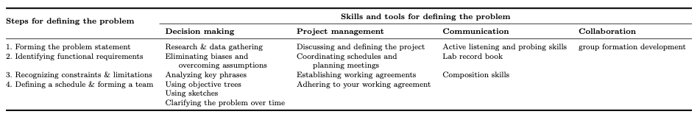
Phase 1: defining the problem
  Problems also have complexity and uncertainty

Slide 24
Phase 1: defining the problem
Balance of being open-ended enough to not preclude cool ideas but well-defined enough to be actionable.
Your first attempts will be open-ended and loosely structured. That’s fine.
Define in a way others can understand
  You will be part of a team

Slide 25
Phase 1: defining the problem
Background research: you must know what has been done already
  Read the literature, keep an open mind
  Find experts to talk to when you can
  Place your work in context
  Avoid duplicating, but with an eye toward replicating earlier results as a starting point

Slide 26
Phase 1: defining the problem
Eliminating biases and overcoming assumptions
  Relying solely on literature is also not good
    Mistakes and biases propagate. Think it through.
  Are you only using the familiar tools?
  Are you limiting or biasing yourself?
  Working within a team can help
  It doesn’t mean reinventing the wheel, but keep asking why, and why again

Slide 27
Phase 1: defining the problem
What is the actual problem – requires placing it in broader context
Example: rare-earth-free permanent magnets
  On the surface: hard-to-mine materials, etc
  But also: sticky political problem coupled with horrifically dirty mining processes
  The actual problem is only partly scientific
  Meaning: moving target!
Example: parking downtown. Not an engineering problem!

Slide 28
Phase 1: defining the problem
Identifying functional requirements
  Must be a need, or an open question
  Must be one you & your team can address
Recognize constraints & limitations
  “what” and “how” are shaped by “but” and “however”
  we can’t actually get the LHC to do our experiment, what can we learn from what they’ve already done?

Slide 29
Phase 1: defining the problem
Planck-LED
LEDs
visible emission
transparent housing
I(V) hardware
V source
I meter
V meter
~350-800nm?
low intensity
variety of colors
accessible leads
0-5V
0-10mA
PC control
0-10mA
PC read
0-5V
PC read
spectrometer
software
control V, measure V & I
save data
plot data
Objective tree: Planck-LED experiment (PH255)

Slide 30
Phase 1: defining the problem
Sketches are key. Label and date them.
Clarify the problem over time; may involve going back to the basic problem statement
Define a schedule and form a team
  Regular meeting times/formats/locations
  Coordinate your schedules, give & take
  Schedule of ordered activities & reviews
  Always give a cushion

Slide 31

Phase 1: defining the problem
Keep track of stuff. E.g., shared files on Box.
Modify as you go. Change roles as needed.
Particularly if no one is obviously in charge!

Slide 32
Phase 1: defining the problem
Working as a team is by far the hardest part.
“Look to your left, look to your right. One of those people is going to disappoint you soon.”
Hahaha. No really. Just be open with each other and learn to compromise. It will be fine.

Slide 33
Phase 1: defining the problem
You will need to meet.
  Establish specific times, start and end and places
    Can agree to start each class with a short planning meeting
  Have a plan for the meeting. Why are you there?
  Have an end goal – we will finish X
  If you can’t do the last two, don’t meet
Learn to prioritize.
  50% finished always beats 0% finished
  Perfect is the enemy of good

Slide 34
Phase 1: defining the problem
Leave the meeting knowing when you meet next and why
Set a working agreement for the meantime
Set channels of communication
Be patient with each other, stuff happens.

Slide 35
Phase 2: formulating solutions
Systematically explore & evaluate alternatives
Usually more than one solution
What are the tradeoffs? Options & constraints.
Solving one aspect may confound another
Right now, or soon?
  Who do you need on your team?
  What techniques are you going to need?

Slide 36
Phase 2: formulating solutions
Your longer experiments will be like this
You will be given a starting point and must design the path forward
Some paths are objectively better than others
But some less-ideal paths are more reasonable than others, you will have to compromise

Slide 37
Phase 2: formulating solutions
Decision-making behaviors
  Recognize dependencies
  Estimate importance and urgency
  Persistence and flexibility
  Failures cannot be avoided
Define goals, clarify boundary conditions.
Search for variants, evaluate on merits.
Decide!

Slide 38
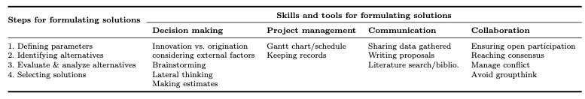
Phase 2: formulating solutions

Slide 39
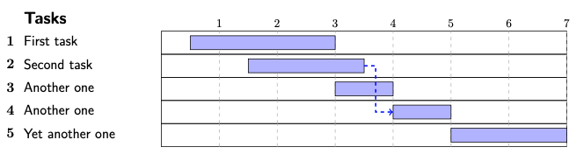
Phase 2: formulating solutions
What is a Gantt chart? A fancy schedule.
You will see them again. Keys:
  Identify tasks
  Identify time sequence
  Estimated task duration

Slide 40
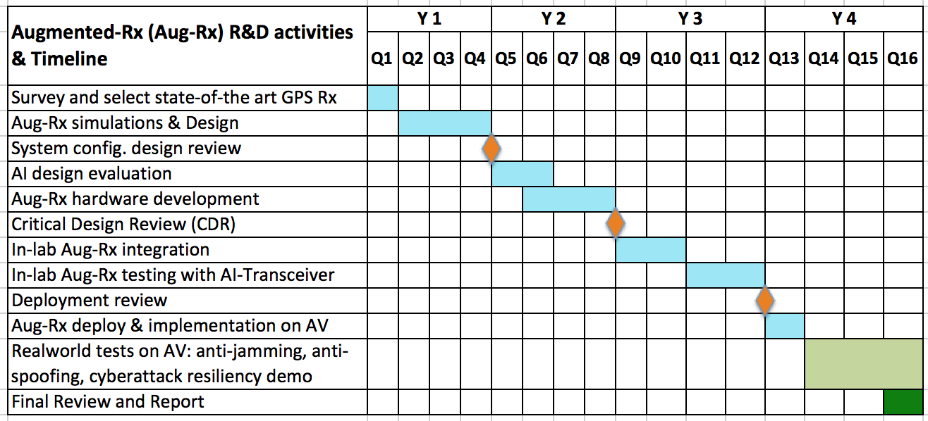
Phase 2: formulating solutions
An example from a proposal.
Easy to make in a spreadsheet
Figure 5: AI-augmented-Rx activities and timeline

Slide 41
Phase 2: formulating solutions
Conflict in your group is normal.
  Keep in mind this is just a class
It is too early for it yet, hopefully
So, I’ll leave a few things at the end for later
Note deliverable 1 is a work plan and team survey

Slide 42
Phase 3: models & experiments
Translate ideas into practice
Hands-on phase! Prototypes!
Sub-functions that were “black boxes” must now be concrete
As results and analysis come in …
  Revise alternatives. Refine or reevaluate problem?
The first experiment always goes wrong
  but it is only a failure if you fail to learn from it

Slide 43
Phase 3: models & experiments
Example: materials discovery
Develop algorithm for work
Plenty of ‘start over’ steps!

Slide 44
Phase 3: models & experiments
Example: Fe-V-Ge alloy system
  At first nothing was stable
  Revisions based on data charted a path forward
  Led to a nice bit of work
  The real key was to forget what we were looking for and focus on what was in front of us

Slide 45
Fe_{(3-x)}V_{x}Ge System
Fe₂VGe(7D 900C, 7D 1000C & 7D 850C)
Fe_{1.5}VGe
Fe_{2.5}V_{0.5}Ge (5D,7D &14D at 950C)
(Cubic & 0.032% V rich dots)
Fe_{2.15}V_{0.85}Ge( 7D 950C & 15D 900C)
Fe_{2.375}V_{0.625}Ge (7D 950)
(Cubic & 0.954% V rich dots)
Fe_{2.20}V_{0.80}Ge
(7D 950C )
Fe_{1.5}VGe
Fe_{2.625}V_{0.375}Ge (7D 950C)
(Cubic & 0.028% V rich dots)
Fe_{2.75}V_{0.25}Ge (7D 950C)
(Hexagonal & 5.110% 2nd phase)
Fe_{2.25}V_{0.75}Ge
(5D &14D 950C)
( Cubic & 5.657%
2nd phase)
Fe_{1.5}VGe
(7D 950C)
Fe_{2.875}V_{0.125}Ge (7D 950C)
(0.899% 2nd phase)

Slide 46
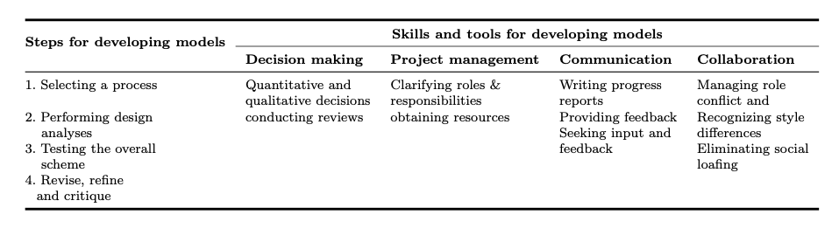
Phase 3: models & experiments

Slide 47
Phase 3: models & experiments
Predictive models: theory leads
Scale models: try a simpler/smaller version
Quick & dirty: proof of principle, with understanding it must be redone if successful
Simulation: e.g., finite element

Slide 48
Phase 3: models & experiments
Design analysis: driven by preliminary data
What happened? Did it match expectations?
  If not, do you know why?
  If you don’t know why, what to test/check?
  Is a redesign necessary?
Was it good enough?
  Where are improvements needed or desired?
In all stages: prioritize!

Slide 49
Phase 3: models & experiments
Clarifying roles & responsibilities
  Do you know who is doing what?
  Is it better to have 1 or multiple people on a task?
  Who works well together?
  Which skills are needed and who has them?
    If the answer is “no one” who are you gonna call?

Slide 50
Phase 3: models & experiments
Obtaining resources:
  I control or negotiate the resources, mostly
  Make a good case for what you need
  Justify logically, cost effectiveness, utility … ROI
Progress reports:
  Keep the above in mind
  If you want more stuff, indicate you use current stuff well.

Slide 51
Phase 3: models & experiments
Role conflict: stress of several different obligations at the same time
  Examine timelines for different concerns & compare
  Ask for reassignments
  We all get busy at certain times
  Redefine your role so it fits schedule better
  Don’t spend half the time on the last 10%

Slide 52
Phase 3: models & experiments
Role ambiguity: people aren’t sure of roles
  Verify everyone understands
  At end of each meeting, have everyone state what they are expected to do and by when
  Create sub-teams if needed to ensure skills needed are present
  Use timelines/Gantt charts and planning tools
  Use concrete examples to make what contributions should be clear to all

Slide 53
Phase 3: models & experiments
Style differences: you already get this part
Dominant? Influential? Conscientious? Steady?
Try to match tasks and styles when you can
Learn to adapt when you cannot
Social loafing: address it right away
  Be calm and focus on working as a team
  Can you re-align roles or timelines to help?

Slide 54
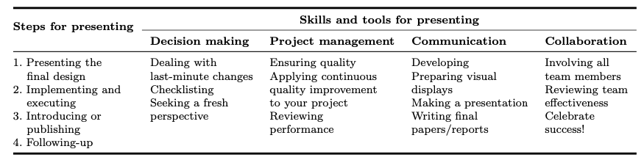
Phase 4: implementing & presenting
Your experiment only has value if people know about it
Wrong-turns were failures if you keep them to yourself
Organize and lay out your problem & solution
Find the best presentation, possibly at expense of historical narrative

Slide 55
Phase 4: implementing & presenting
Visualization and writing: coming soon!
Involving everyone in the final product
Writing the report: as above, define roles
Last-minute shenanigans and Remaining Calm
Defining success criteria – when are you done?
Follow-up: sensible to go further?
  Is this a team that should get together again?

Slide 56
Interlude
Your experience with this varies wildly
The engineers cover this stuff much better than we do tbh
But CERN groups and similar large collaborations are clearly very good at this stuff.
Anyway: this may seem ‘trivial,’ but it is no fun to learn the hard way

Slide 57
The Promised Panglossian Problem
“It is demonstrable," said he, "that things cannot be otherwise than as they are; for as all things have been created for some end, they must necessarily be created for the best end. Observe, for instance, the nose is formed for spectacles, therefore we wear spectacles. The legs are visibly designed for stockings; accordingly, we wear stockings.” – Voltaire, Candide
What’s the problem here?

Slide 58
The Promised Panglossian Problem
Don’t confuse cause & effect or model & reality.
  Awfully convenient you found what you wanted …
  Amazing nature decided to follow your model!
  Don’t get too excited solving a problem you created
  Don’t confuse an analogue for the real thing.
Sometimes there is no moral. Sometimes it's just a bunch of stuff that happened. That’s fine, just tell the story. (h/t The Simpsons 7F22)
  E.g., materials discovery
  Sometimes there just isn’t an obvious model

Slide 59
Inverse Occam’s razor
Discuss! What did you get from this?
Keep this in mind when you write your reports.

Slide 60
Next assignment: mock project outline
An experiment you’ve already done
  Suggest: PH255, but another class/research is OK
Go through the four stages of of design
At a high level – think outline
Charts/sketches a plus but not required
Example and rubric given

Slide 61
References
“Tools and Tactics of Design”
  Dominick et al (ISBN-13: 978-0471386483) – used heavily for this presentation
“Measurement Systems: application and design”
  Ernest O. Doebelin (ISBN-13: 978-0072922011)
“Engineering Design: A Systematic Approach”
  Pahl & Beitz (ISBN-13: 978-1846283185)
“Inverse Occam’s razor”,
  Igor Mazin. Nat. Phys. 18, 367–368 (2022)
  https://doi.org/10.1038/s41567-022-01575-2

Slide 62
Extra sides on formulating solutions
When your group is having problems …

Slide 63
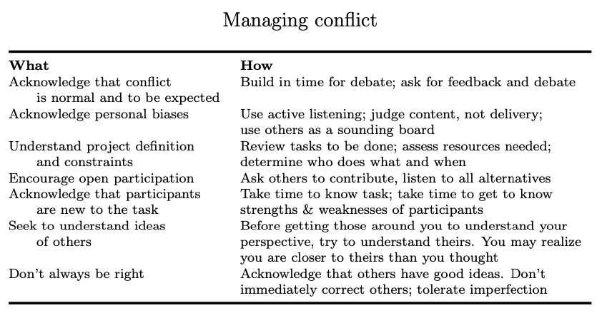
Phase 2: formulating solutions (FOR LATER)

Slide 64
Phase 2: formulating solutions (FOR LATER)
Steps if your team is avoiding conflict
  Decide to explore fully pros & cons of each issue that comes up, even if it means a longer meeting or extra stress for a while
  Before meeting closes, have everyone summarize next steps they are responsible for & the reason for them
  Start meetings on time
  Create an agenda of issues for the meeting
  Appoint someone as discussion lead to keep on track

Slide 65
Phase 2: formulating solutions (FOR LATER)
Steps if your team is avoiding too accommodating
  Have team members who argue for or against fully explain their rationale and defend it against counterarguments
  Start discussions about pros/cons of an issue by having each write down their argument, then read aloud & discuss
  Appoint a different person for each meeting to act as facilitator, they should ask for everyone’s input
  Evaluate each idea against the criteria for a good decision and not just because it was suggested

Slide 66
Phase 2: formulating solutions (FOR LATER)
Steps if your team is fighting
  Refrain from passing judgement or assessing blame if things don’t go right.
  It doesn’t matter who broke it, just figure out how to fix it.
  Divide cliques and meet in different subgroups
  Ask members to defend an idea they disagree with to get them to see positive sides of an alternative they didn’t consider
  Spend 1 meeting reviewing principles of active listening
  Remind team that each idea needs to be evaluated against criteria of best solution & not origin of the idea

Slide 67
Phase 2: formulating solutions (FOR LATER)
Steps if your team is too quick to compromise
  Refrain from taking a vote to decide an issue, even if it prolongs discussion time
  Appoint someone as the results checker – after decision is made, they walk the team through the evaluation criteria and compares decision to criteria
  Encourage debate – have each member state pros & cons of one alternative, have rest respond

Slide 68
Phase 2: formulating solutions (FOR LATER)
Signs your team is collaborating
  Members feel free to communicate openly with each other
  Members listen actively
  Criteria for a good solution are what drive discussion, not frustration or anger and blame
  Everyone understands that the best solution is best for the group regardless of where the ideas came from
  All alternatives are explored, and alternatives are combined to create even better solutions
  Everyone understands the steps in the process and agrees about what is the best next step

Slide 69
Phase 2: formulating solutions (FOR LATER)
Avoid groupthink
  not disagreeing out of fear of being ostracized
There are outside pressures
Watch for dominating behavior. Resist the urge to interrupt

