Slide 1
Visualization of Data
P. LeClair
PH 4/591 Fall 2022

Slide 2
Next assignment
Data visualization exercise
Show me don’t tell me
I tried to make the source data as irrelevant as possible, there is no deep meaning
Your argument is not all that critical, supporting it with visualization(s) is
Obviously: don’t screw up technical details like axis labels and units.

Slide 3
Thursday
You have options.
Continue with last mini-experiment
Do another mini-experiment
Machine shop tour and demonstration
Sign up on your way out

Slide 4
Data analysis
I assume you remember uncertainty propagation and the like
I have reading material if you want it
Data analysis we’ll learn as we go with real examples. You will also learn this in practice.
Data visualization is something else, and you are far less likely to see this elsewhere

Slide 5
Main source material
Franconeri, S. L., Padilla, L. M., Shah, P., Zacks, J. M., & Hullman, J. (2021). The science of visual data communication: What works. Psychological Science in the Public Interest, 22(3), 110–161.
Figures used are from this unless noted.
https://doi.org/10.1177%2F15291006211051956

Slide 6
Why
Effective visualization aids understanding
‘picture is worth 1000 words’
Poor visualization can cause confusion, misunderstanding, and distrust
How to do it right?
What are some good and bad practices?
This is an entire field of study

Slide 7
Importance
Evidence-based policy communication often done with heavy reliance on visualizations
Any data-driven field relies on visualization to reduce data and find patterns
Low graphical literacy and poor design lead to a struggle to understand
Easy to mislead, intentionally or not

Slide 8
Fuzzy aspects
Psychology – color has connotation. Red is alarming!
Working memory limits the complexity you can use
If you make it hard for the reader, they move on
Translating visual to underlying concept
Why do some visualizations seem more trustworthy?
How to properly communicate uncertainty?
Misleading charts for fun and profit, how is it done?

Slide 9
Looking beyond summary statistics
Stats are the same,
including linear trendline
That’s good, right?
Let’s have a look.

Slide 10
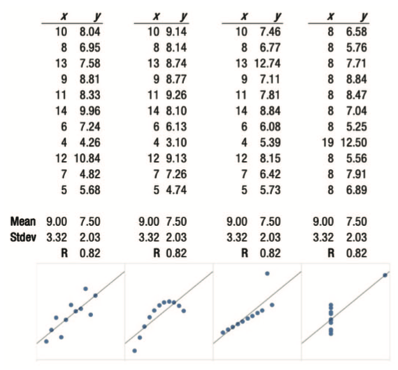
Oops we over-reduced the data
https://dl.acm.org/doi/10.1145/3025453.3025912

Slide 11
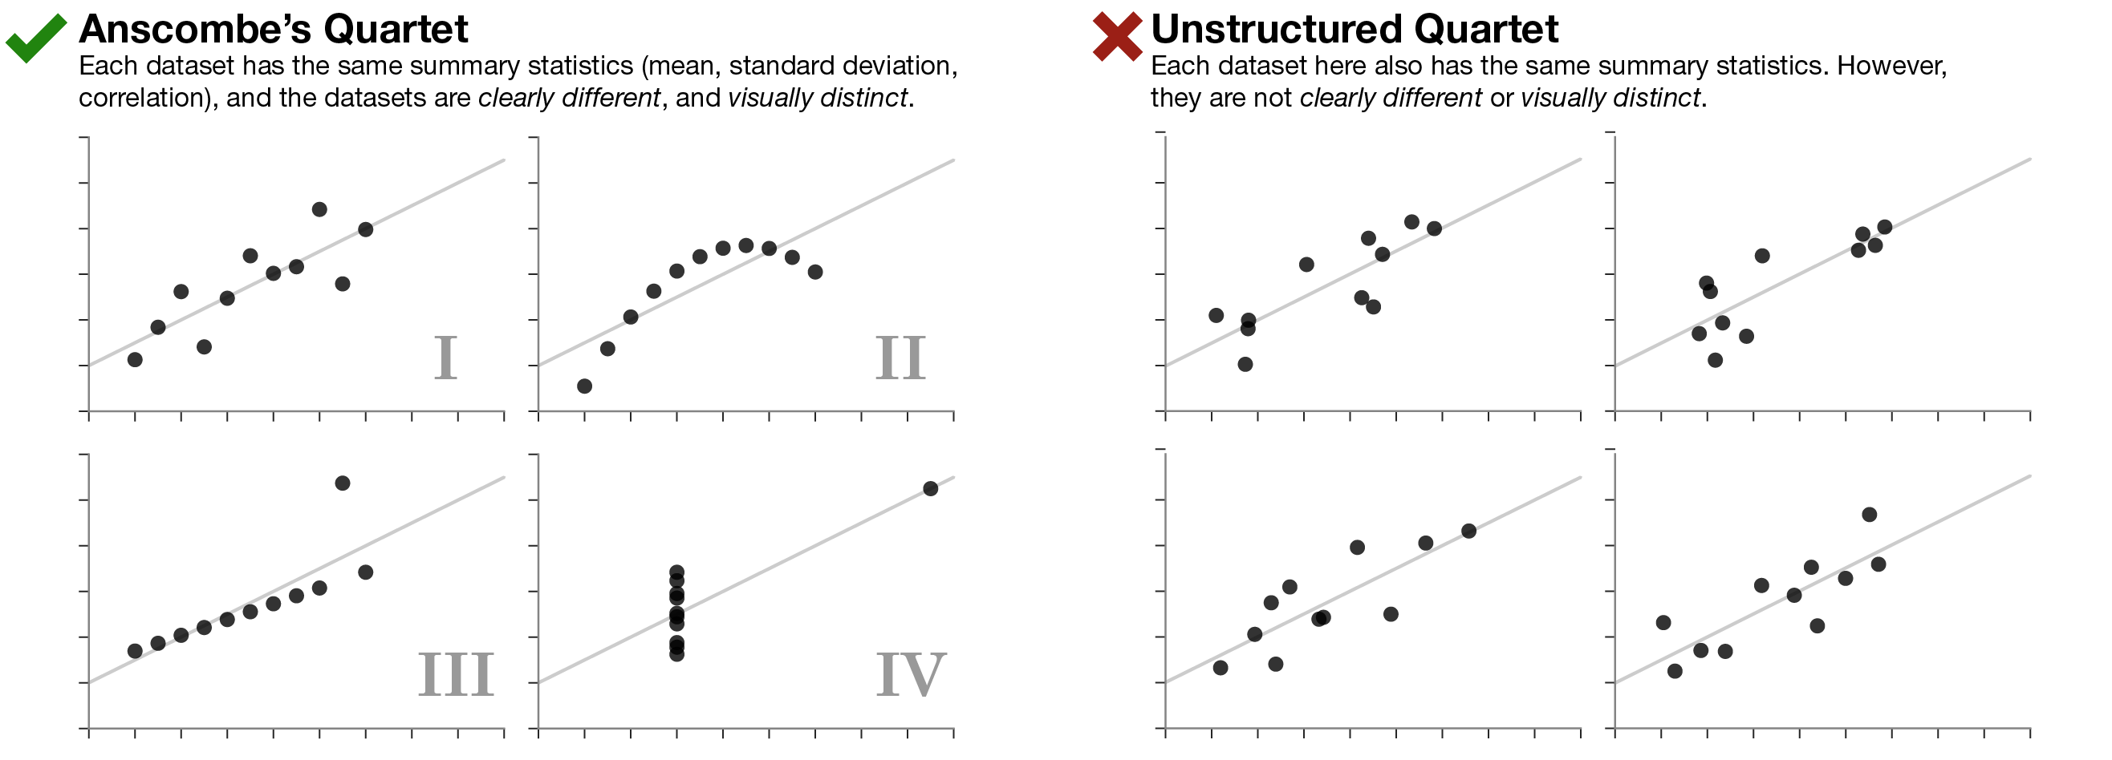
More subtle than it looks

Slide 12
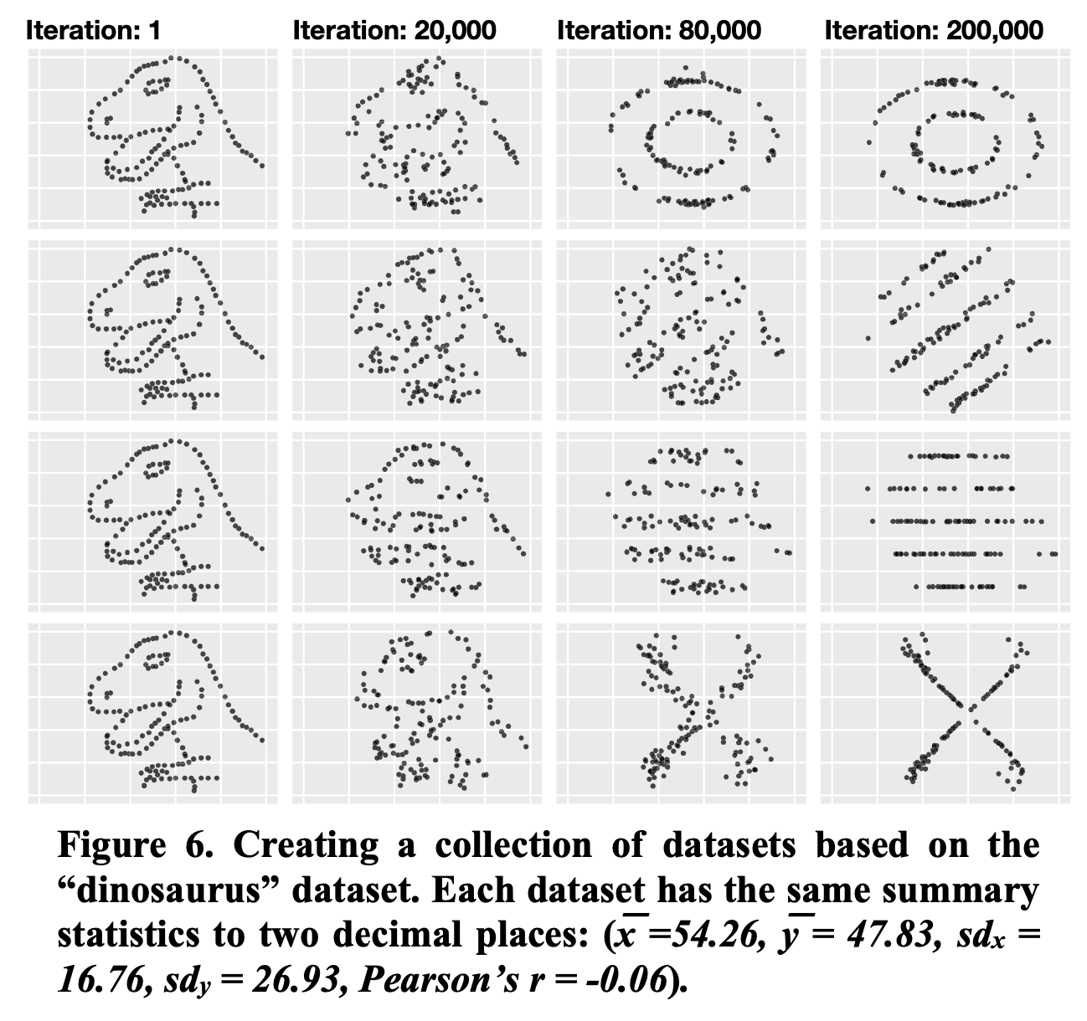
Something has gone terribly wrong
See reference for how to do this.
Stats do not tell you everything about the data.
https://dl.acm.org/doi/10.1145/3025453.3025912

Slide 13
(video 1)
https://dl.acm.org/doi/10.1145/3025453.3025912

Slide 14
(video 2)
https://dl.acm.org/doi/10.1145/3025453.3025912

Slide 15
How to design accurate visualizations
How to precisely convey numeric values?
E.g., 1:7 ratio between two numbers
state numbers: no problem, but does not scale
Position is ok – lines
Area is hard – mix up linear dimension & area
slope is hard to map mentally to a number
Intensity is basically useless here

Slide 16
Position wins for precision
Leads to prioritization of 2D space
If you have a list of numbers vertically, what to do with horizontal space?
E.g., run data vertically, use horizontal position to group by categories
Plenty of ways to mislead …

Slide 17
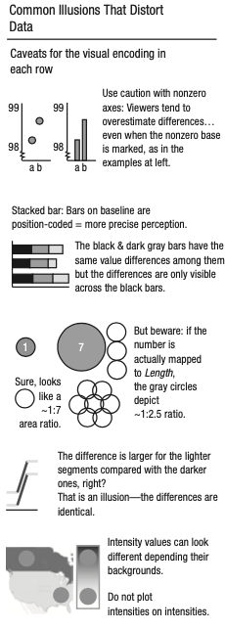
Common distortions
Broken axes are a no-no
Stacked bar graphs: highlighting differences or totals?
Mapping to length or area?
Vertical shifts
Intensity is background-dependent

Slide 18
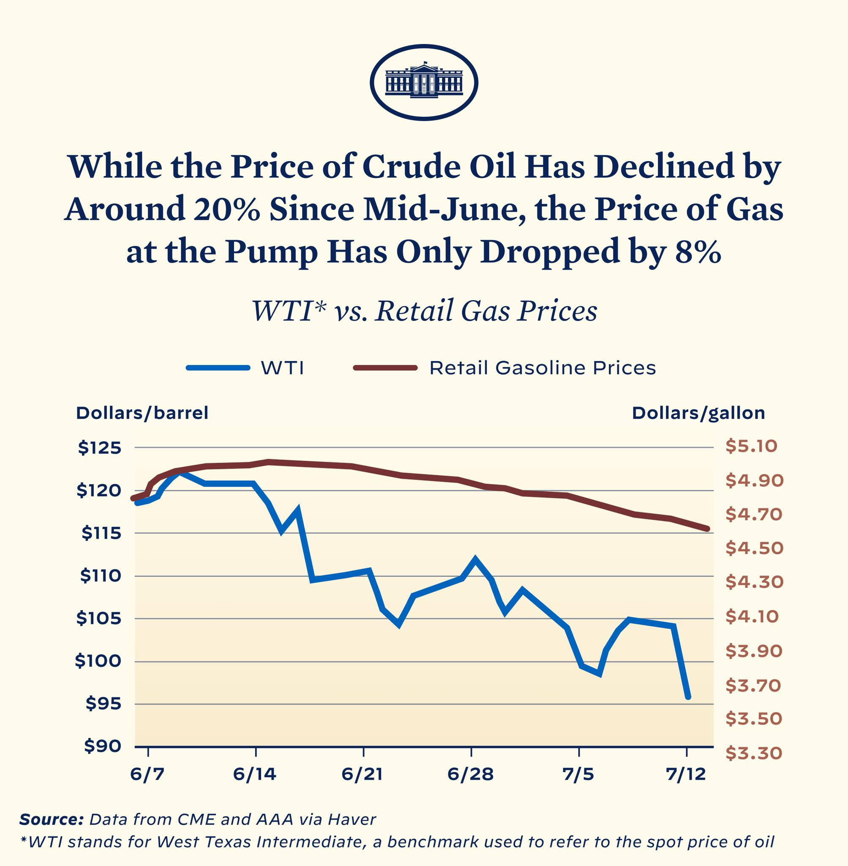
Timely example
Not debating conclusion
What is wrong with the figure?
If both mostly decrease, you can always rescale them to match.
Look what happens when we normalize scales:
1.33
1.48
1.0
1.0

Slide 19
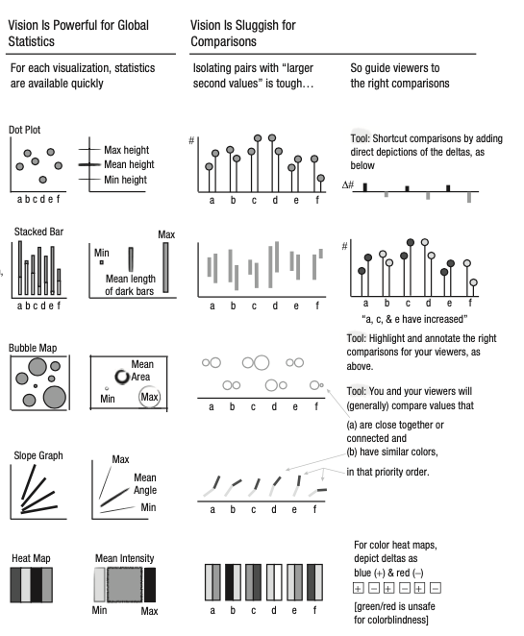
And more

Slide 20
Mapping to visual and back again
Perceptual illusions can cause visual data to be misinterpreted
Misinterpretation maps back to quantitative picture for viewer incorrectly
If two plotted values have a 1:7 ratio, then the visualization should cause a typical viewer to see that 1:7 ratio vertically.

Slide 21
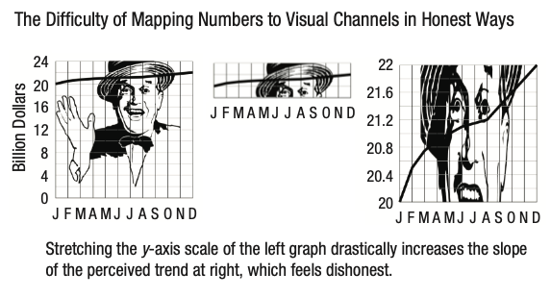
Scaling

Slide 22
This happens a lot.
Especially with bar graphs …

Slide 23
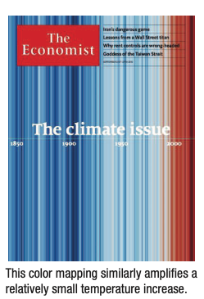
And again

Slide 24
Length vs area
Values may be encoded by 1D length, producing a 1:2 ratio
However, you might find that your estimate of the depicted values is determined instead by the area taken up
This leads to something closer to a 1:4 ratio (or even a 1:16 ratio, if the icons suggest 3D)

Slide 25
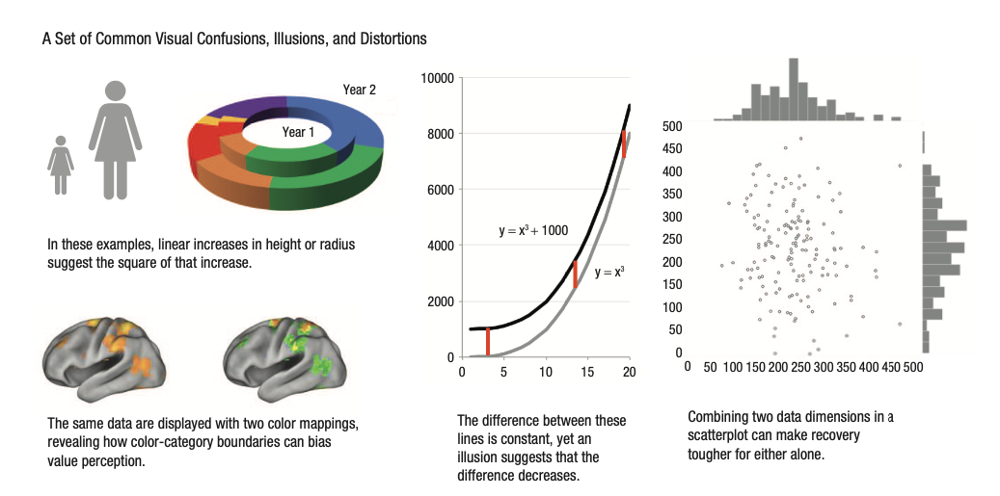

Slide 26
The use of color
Can someone who is color blind still get the message?
How about someone printing in black & white?
Did you use color strategically, or because you could?
Differentiating is easier if encoded colors are farther apart in color space.
Easier to tell red from blue than from orange-red
Accessible palettes have been developed
https://davidmathlogic.com/colorblind for example

Slide 27
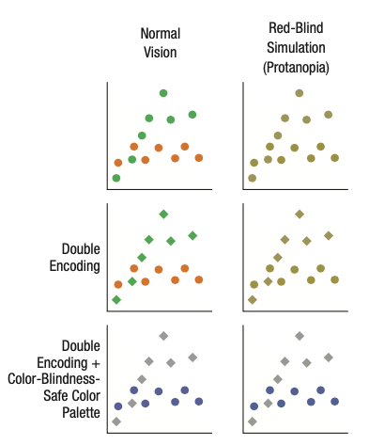
What it looks like
Double encoding can help
But careful!
Clever palette will make it a (partly) moot point
Safe palette is not easy with a lot of lines, to be fair

Slide 28
Double encoding
The shapes you use matter
Redundant encoding does necessarily not improve efficiency for those without color vision impairment
May inadvertently use shape to signal additional variable
Subtle is good – e.g., filled vs open symbols

Slide 29
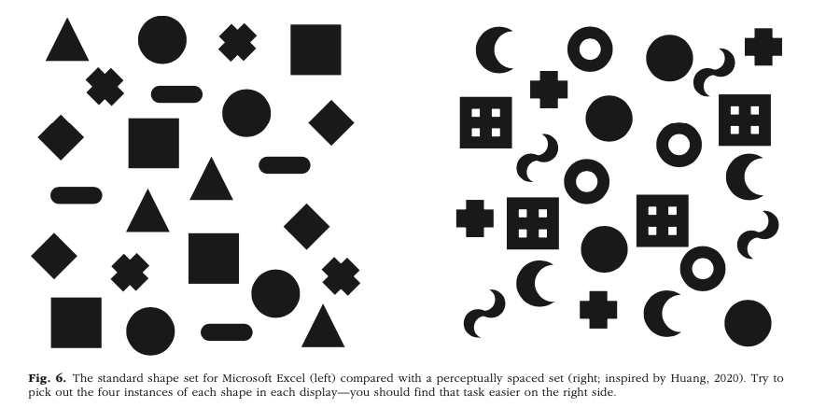
Shape encoding

Slide 30
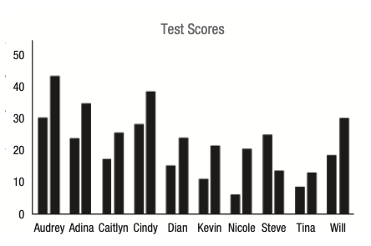
What are you trying to see?
Which student has a second bar that is lower than the first?
To find the answer, need to process each set of bars individually, rather than all at once.
Slow to process!
Basically you’re running a sorting algorithm …

Slide 31
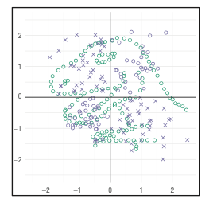
Look at the blue dots!
If you ask people to complete a task comparing blue dots, many will fail to see the dinosaur

Slide 32
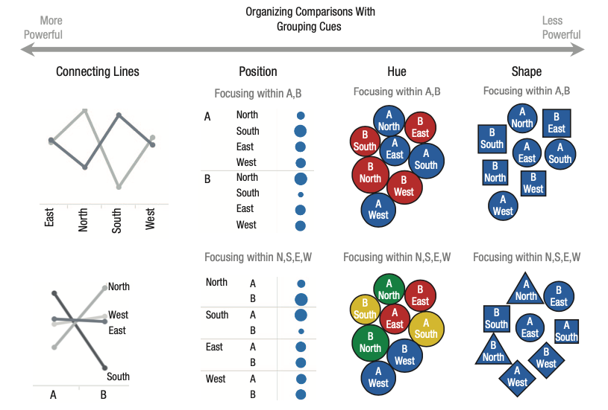
Adding visual cues for grouping
We live over here
most of the time

Slide 33
Guide to the most useful comparison
Top: color and proximity lead you to different comparisons
Same data, different emphasis
Bottom: word cloud grouping is weakly controlled by color at left, more strongly by proximity on right

Slide 34
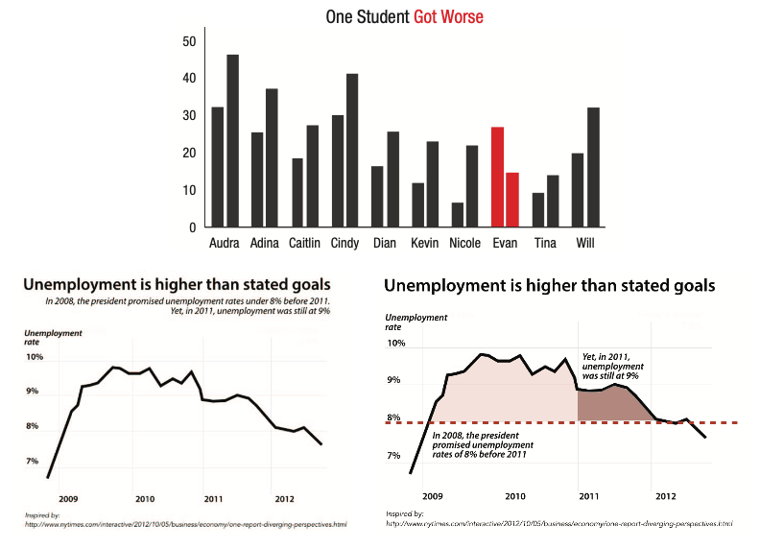
Color highlighting
Bar graph clearer
Line graph given better context
Relevant for next assignment?

Slide 35
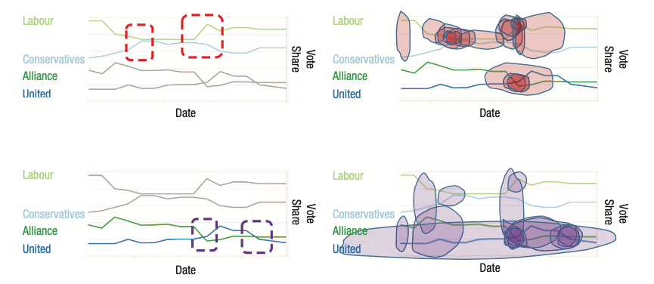
Viewer may lack relevant experience
Trends a story highlighted (left) vs what untrained viewers highlighted as important

Slide 36
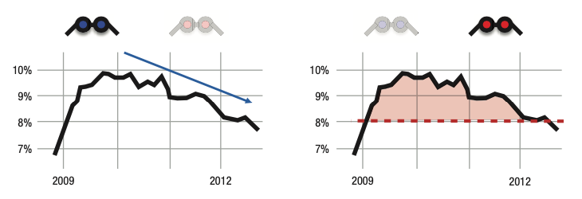
Can be set to good or evil

Slide 37
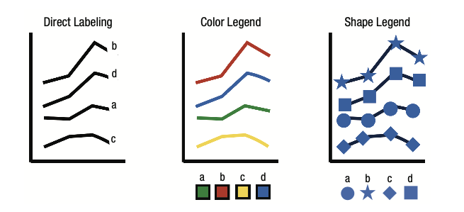
Direct labeling beats legends
Don’t tax working memory
Gets harder from L to R

Slide 38
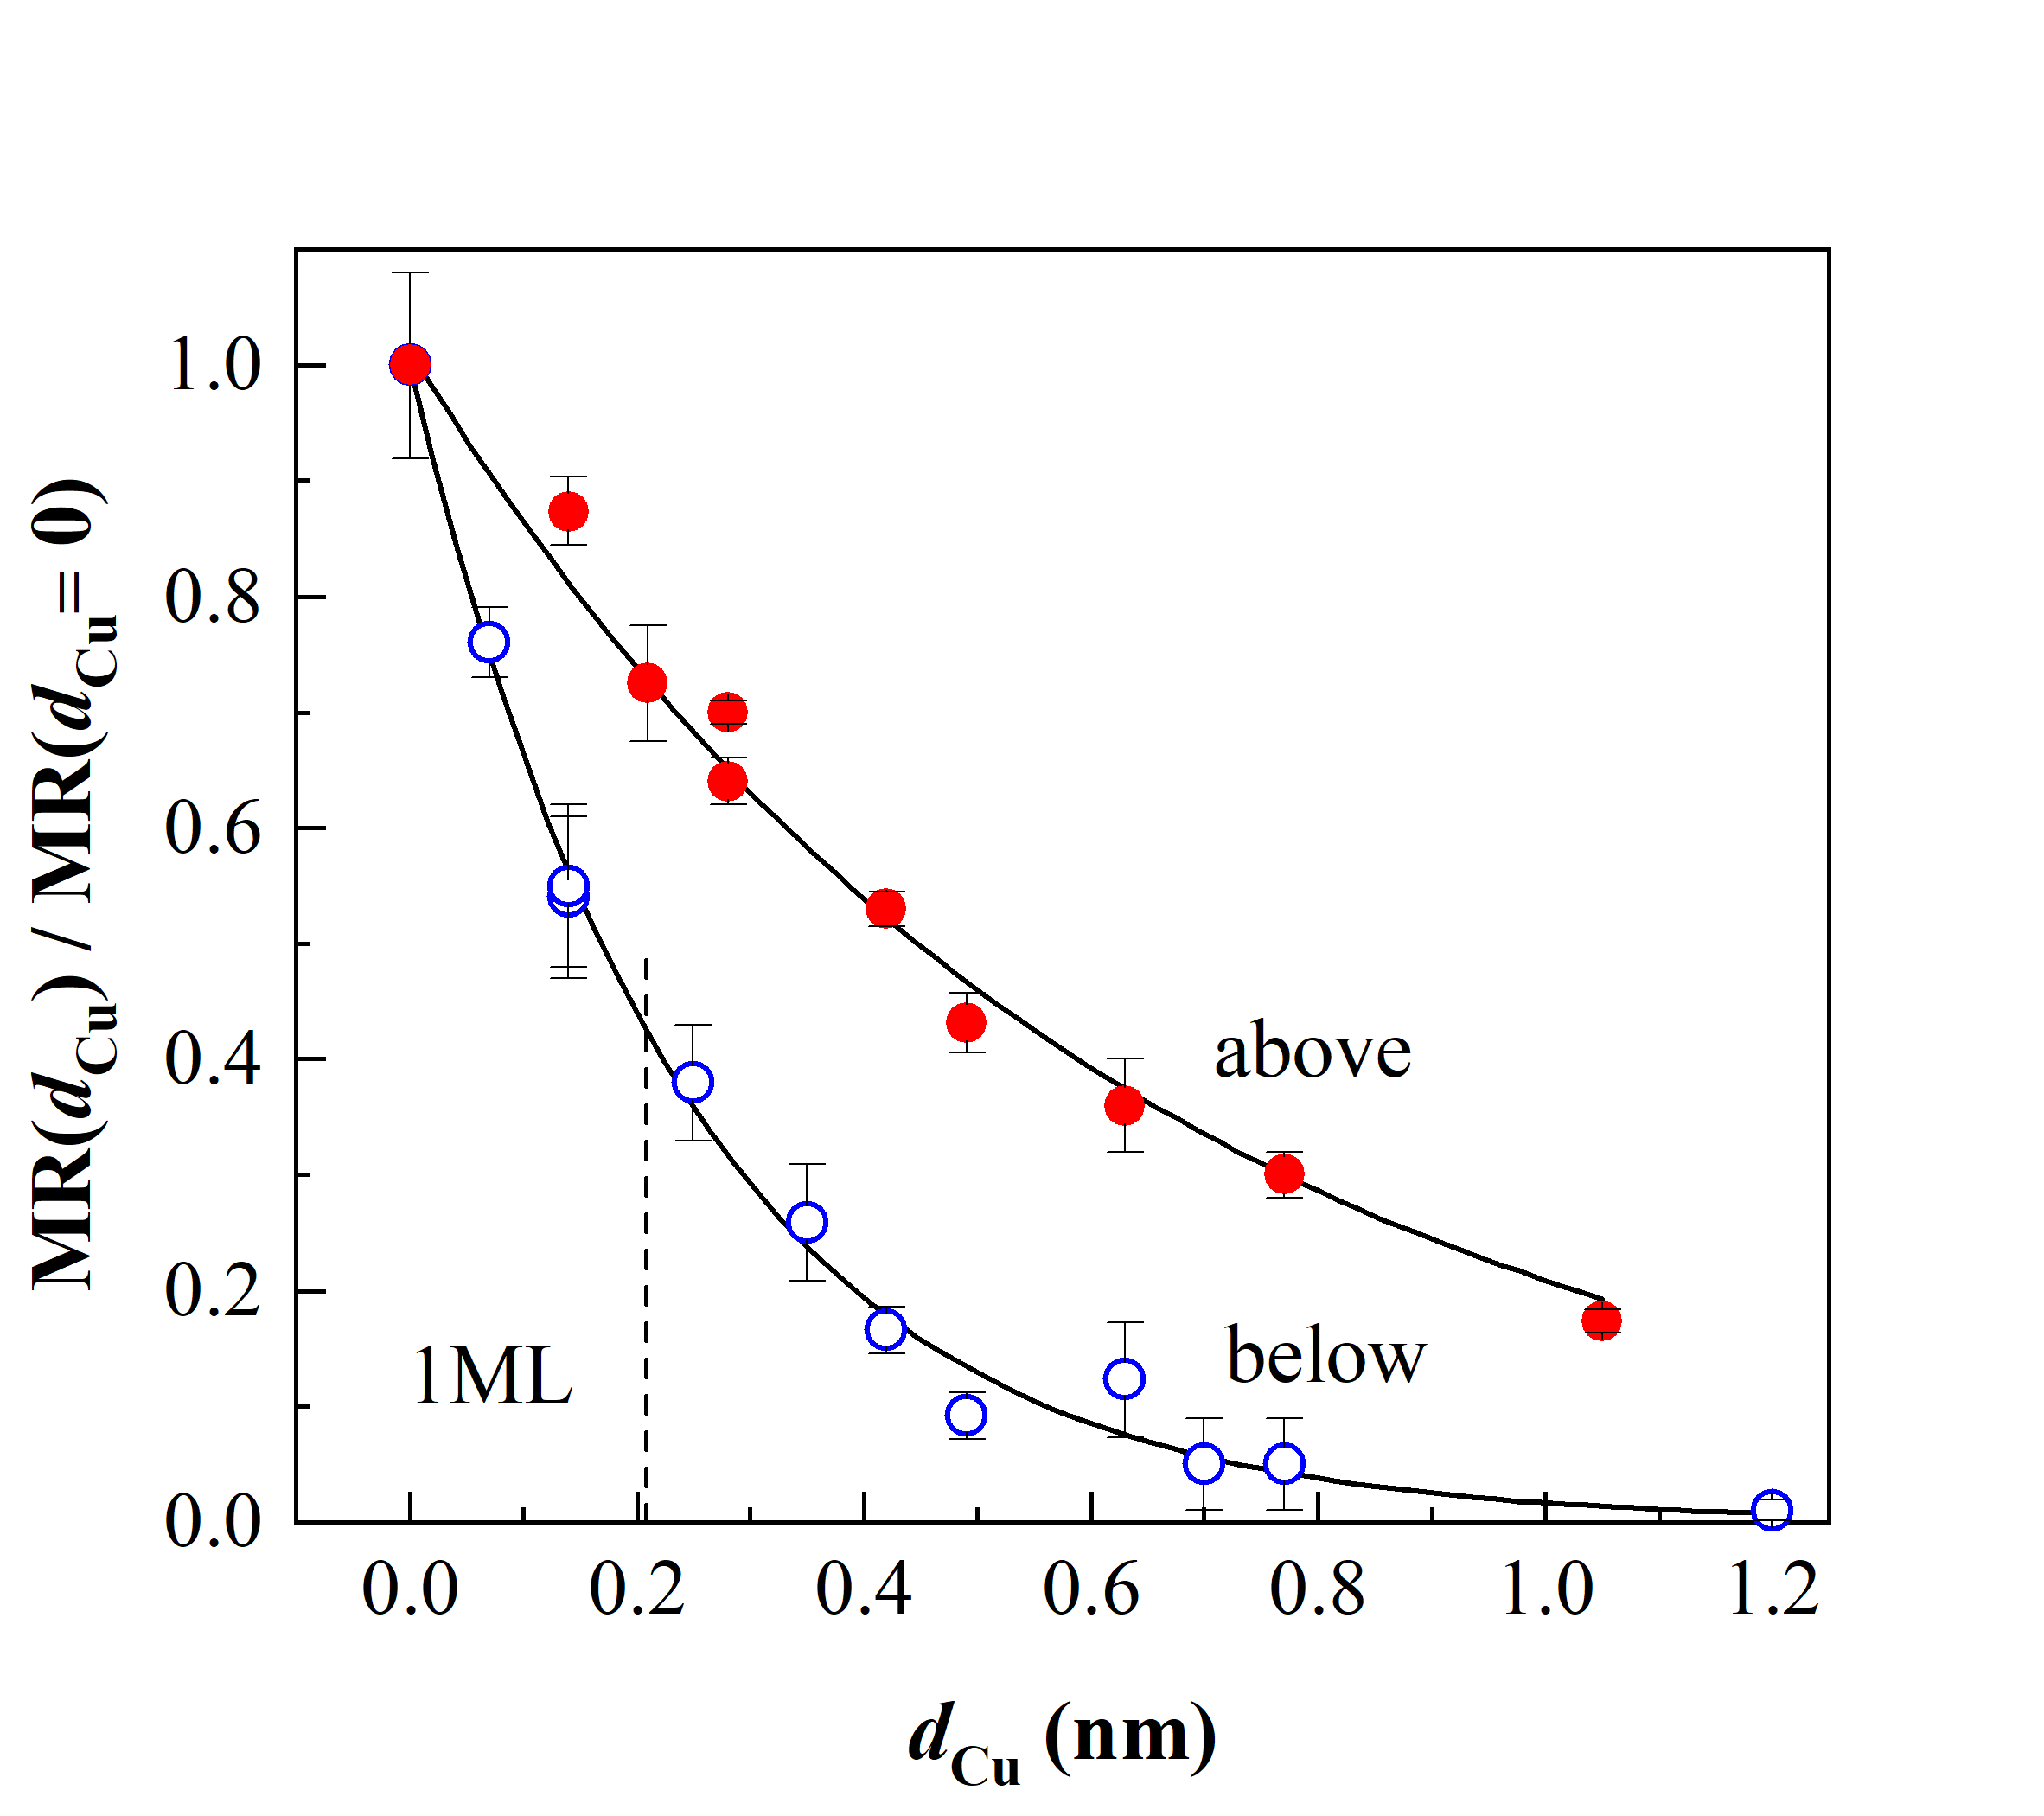
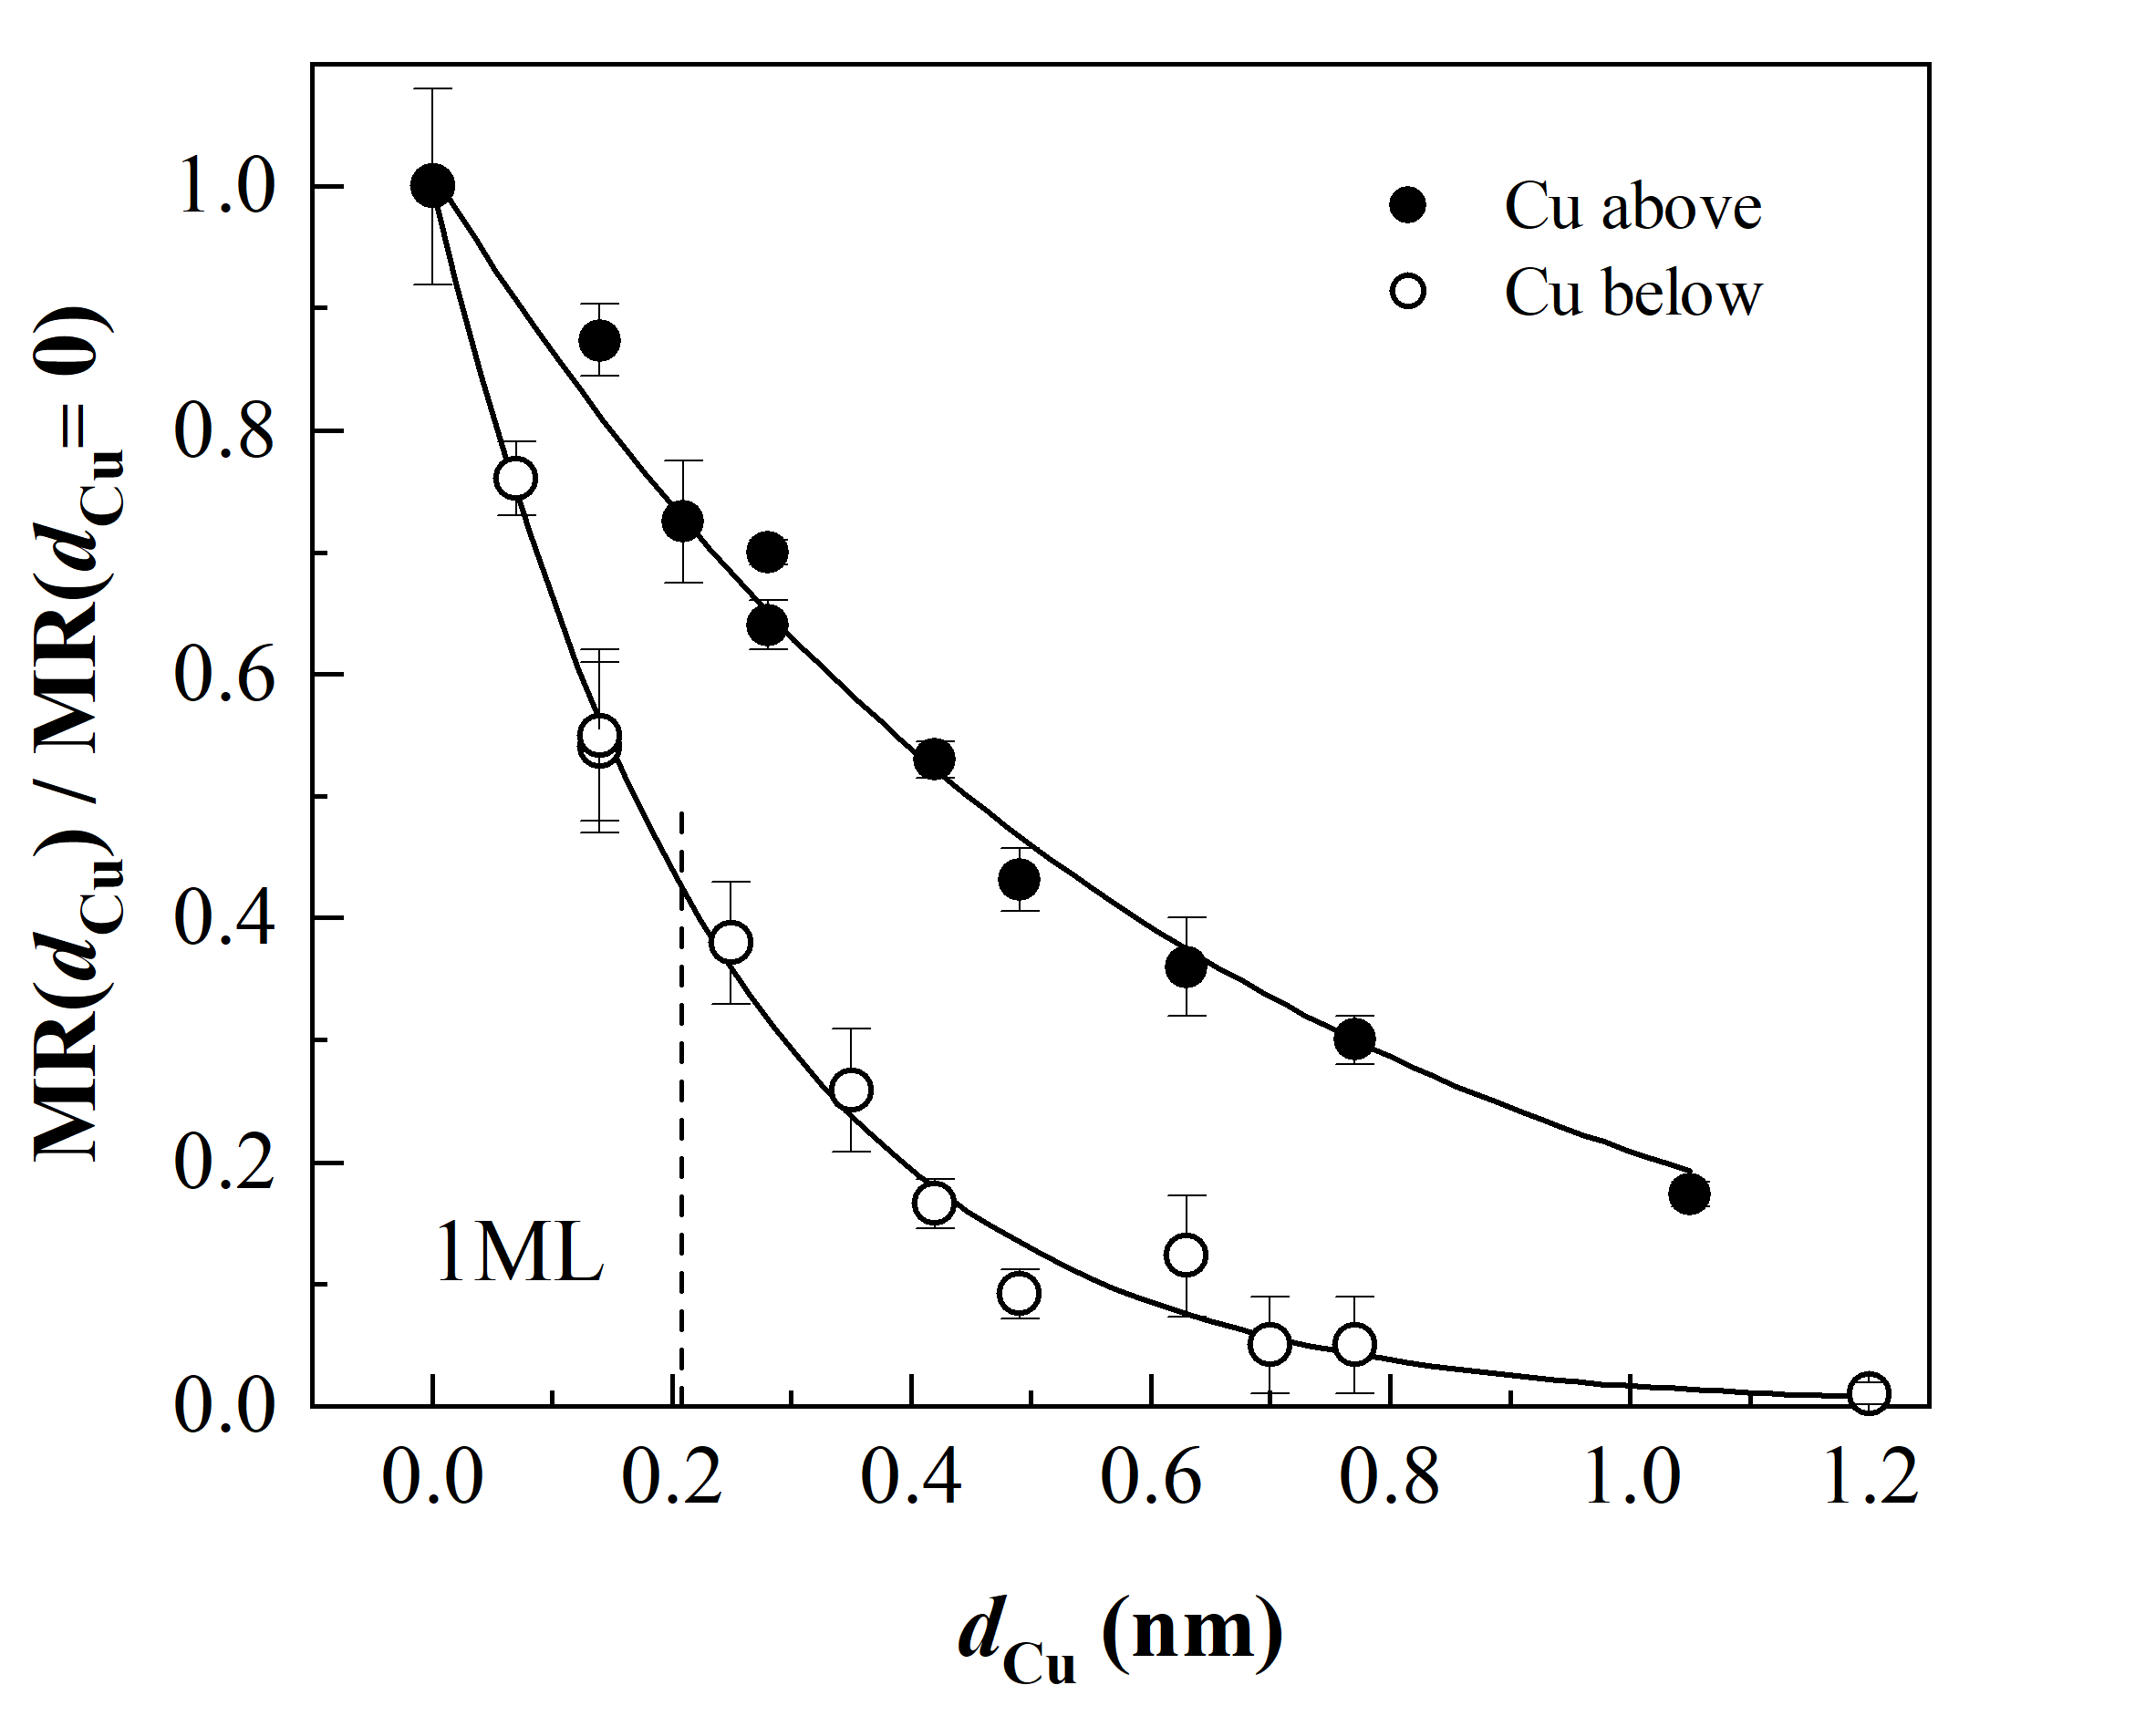
What I did (1999) vs what I would do now
Not bad, but the legend was pointless
Subtle dual encoding was OK

Slide 39
Stupid things might help memory
Same data. Which one are you going to remember? (The journal will probably only take the middle one.)
Cluttered, minimalist, pictorial
Having a $5.00 graph won’t help if you have $0.50 data

Slide 40
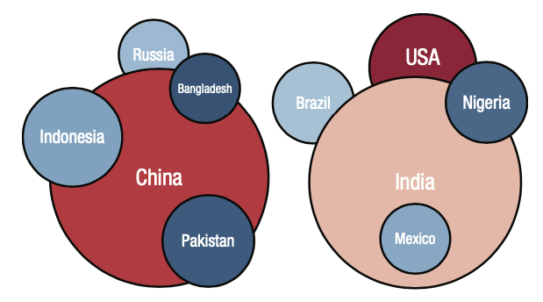
Think about your scheme
Color, shape, etc. all encode information
intentionally or not.
This has an unclear schema

Slide 41
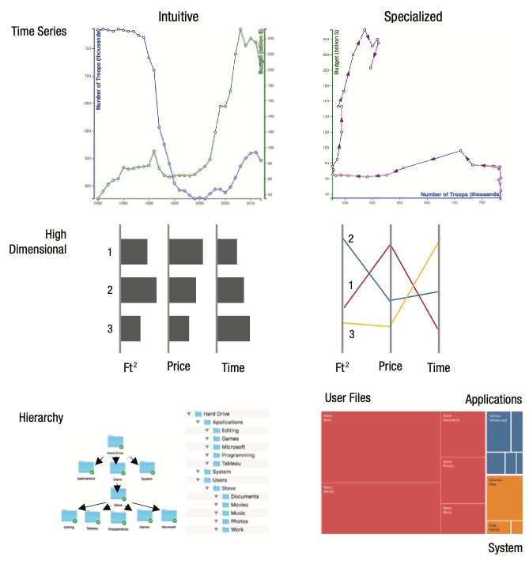
Does your field do something special?

Slide 42
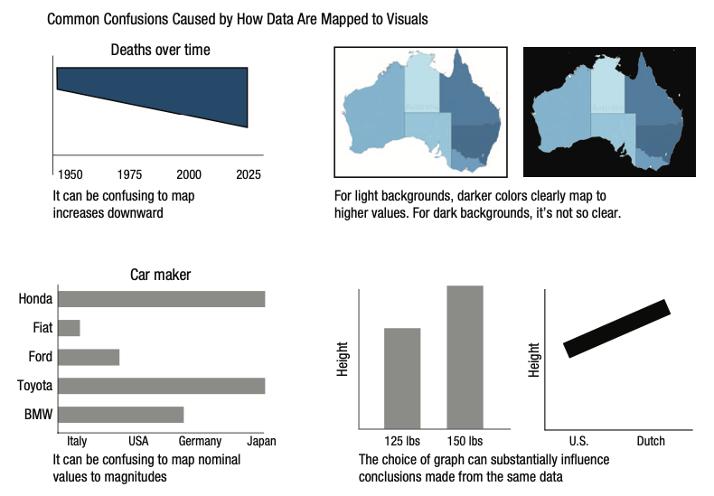
Common confusions mapping to visuals

Slide 43
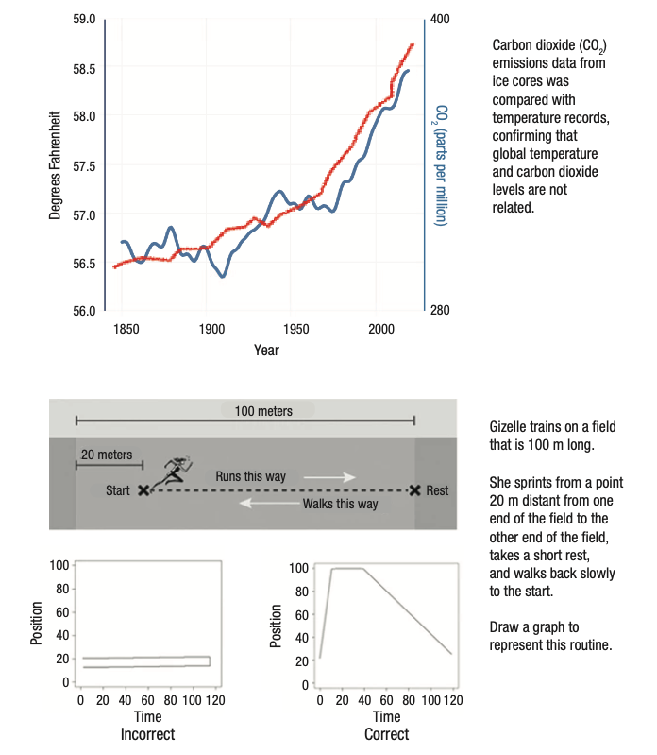
Graphical reasoning
Top: we’ve seen this!
Bottom: only 1% of middle school students drew correct graph – mixing t and x

Slide 44
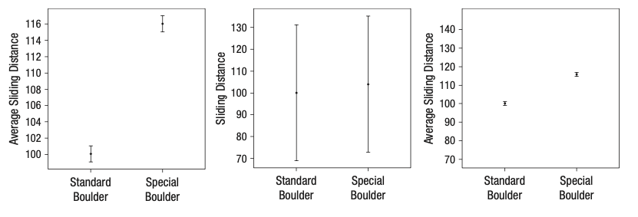
Uncertainty is hard
Left: 1.96 standard errors
Middle: 1.96 standard deviations
Right: as left but scale of middle

Slide 45
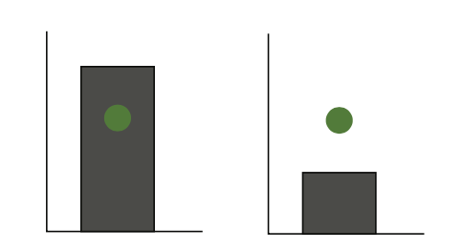
Uncertainty is hard
Dot is same distance from edge of bar in each case
Most say point inside bar as being more likely to belong to distribution

Slide 46
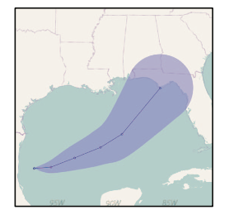
Cone of uncertainty
This is not a cone of danger, but a cone containing most predicted outcomes.
Areas outside are not necessarily safe
Resisting super obvious joke

Slide 47
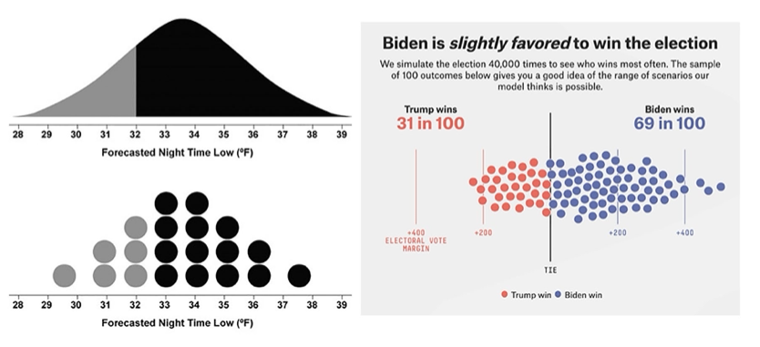
If it is a distribution, maybe just show the distribution
Bar & error bar chart probably misleading here
Really need to see a representation of the distribution

Slide 48
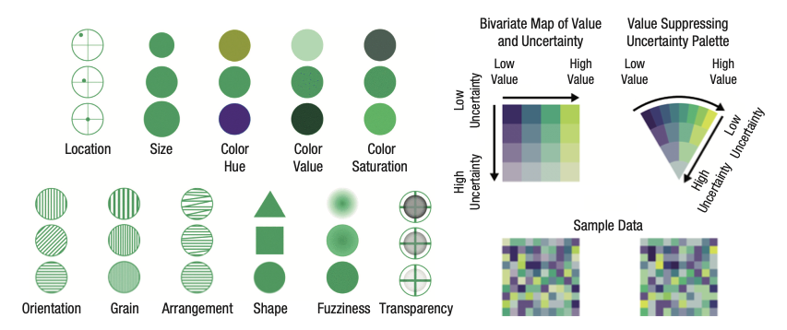
Ways of encoding uncertainty

Slide 49
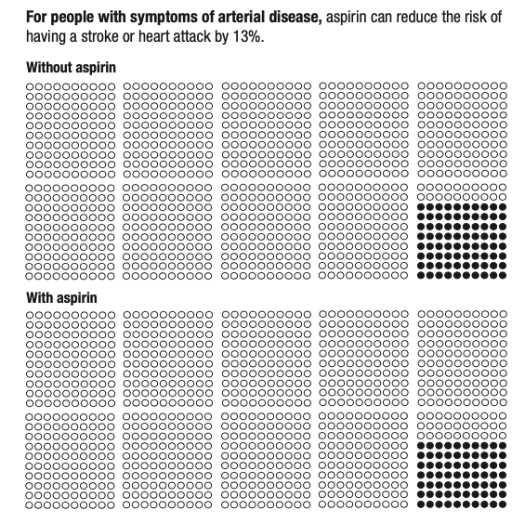
Reduced by X%
Better way to frame frequency
Especially when “reduced by 13%” fails to convey that it was already unlikely to start with
WOW 13% SEEMS LIKE A LOT will be all people hear if you’re not careful

Slide 50
Tables
Back to this when we get to writing
Never use vertical rules (or grid)
Forget double rules too
Put units in the column heading, not table body
Redundant repetition and waste of valuable space
Table defaults are typically hideous.

Slide 51
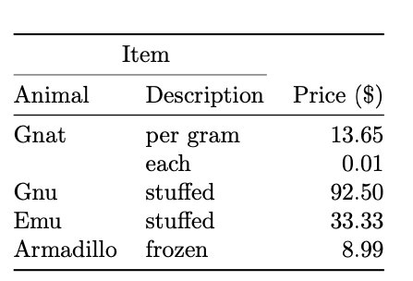
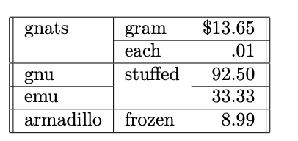
Good and bad
Left example: hard to parse, vertical lines add nothing
Right example: much cleaner, lower cognitive load
Publication quality tables in LATEX, Simon Fear

Slide 52
Good and bad
Tufte, “Envisioning Information”

Slide 53
Guidelines
Viewers can visually extract broad statistics about data in a display, e.g. mean and extrema, almost instantly
Visualize your data (histograms, scatterplots, etc) before trusting stats
Watch out for common visual illusions and confusions (not starting axes at zero, 1D vs 2D, color perception issues)

Slide 54
Guidelines
Extracting global stats is fast, comparing subsets is slow – use grouping cues
Do it anyway, even if it seems obvious – you have a ‘curse of knowledge’ and know what to look for already
Don’t tax working memory with legends, label directly if you can and avoid animations

Slide 55
Guidelines
Know your audience and use forms they are used to
(e.g., one admin who loves cumulative distributions and uses them well, but many in the audience don’t parse them at all)
Beware common associations, like “up=more”
Use a format that works with the message you have
With a lay-audience: avoid error bars that can be misinterpreted as a data range. Show discrete outcomes

Slide 56
Guidelines
For lay audiences especially (but also in general) rely on absolute instead of relative rates, or at least include both
Similarly – for low N frequencies (3 out of 10) may be better than percentages (30%)
Think really hard about that 2D plot with a color map, does it convey quantitative information or just look cool?

Slide 57
Remaining time
Visualization and analysis exercises overview
I’m not going to rehash propagation of uncertainty and stats unless you suggest I need to

Slide 58
Resources
https://doi.org/10.1177%2F15291006211051956
https://dl.acm.org/doi/pdf/10.1145/3025453.3025912
https://www.autodesk.com/research/publications/same-stats-different-graphs
https://flowingdata.com

