Slide 1
Constructing and writing a scientific paper
P. LeClair
PH 4/591 Fall 2022

Slide 2
This is a “W” class
As such, we require 2 papers
One with feedback around midterm
One at the end
In both cases, you will be able to revise & resubmit if you like, based on my feedback
First one due 29 Sept – basic design of your experiment and progress report

Slide 3
What we’ll do (and won’t)
We will discuss:
What is particular to writing a scientific paper
What are some good and bad practices
Look at and critique specific examples
We will not discuss
Language, grammar, etc.
Details about specific programs

Slide 4
To write you need to read
“Scientific English” is not well-defined
but people know it when they see it
Read papers in your area, get a feel for style
But don’t take what you see as gospel – pay attention to what you don’t like too
Also - necessary to contextualize your work
Will use my own examples, good and bad

Slide 5
Basic content guidelines
Well-organized, clear argument start → finish
Know your audience …
Know the destination requirements
e.g., https://journals.aps.org/prl/authors
Don’t make up new terms unless you must
Set off equations rather than inline
Put work in context, make clear what is new/different

Slide 6
Basic format of a journal article
Obviously varies. Example for expt + theory
Title, abstract
Introduction – background, what has been done, what did you do
Methods
Results & Discussion
Conclusions
Acknowledgements
References
First a short tour of each section
Then do’s and don’t’s
Then how to go about it

Slide 7
Title and abstract
Title: catchy but true.
Concise and informative. Avoid hyperbole
If your title doesn’t catch someone’s eye, they will never read the rest.
Must give an idea of what the paper is about
Abstract:
the second, and possibly last thing anyone reads
Succinct, self-contained.
Summarize the whole work, key points
I usually finish title last, abstract second to last!

Slide 8
Material and what we found clear
(maybe not ‘catchy’ …)
Summarize key points of whole work
First and last sentences key.

Slide 9
Introduction
Probably third to last … because it informs the rest of the paper (and therefore relies on it existing)
What is the basic motivation?
What has been done before?
What issues remain?
What did you do?
https://doi.org/10.1016/j.jallcom.2018.07.298

Slide 10
Methods
This part is simple enough.
List the stuff you used and how you used it
But add the details – enough to reproduce
Which tool did you use?
Which algorithm?
What conditions?
Most journals now have “supplementary info” docs you can add so length is no worry

Slide 11
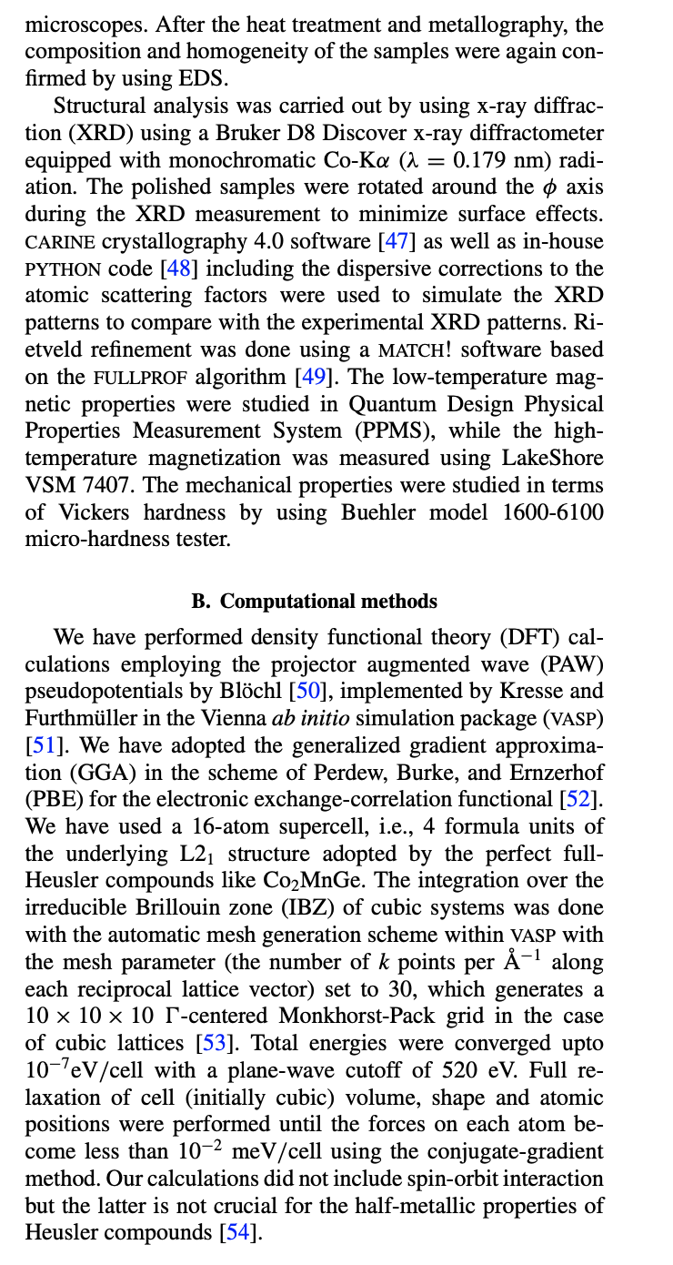
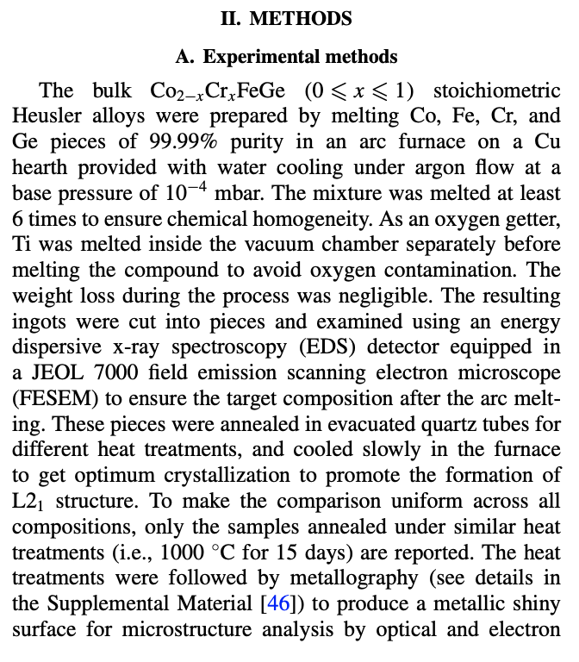
Example

Slide 12
Results and discussion
This is what it sounds like
Break into sub-sections if necessary
Proceed logically rather than historically
Include negative results that are relevant
First describe, then analyze
OK to speculate, but be clear when you are
https://doi.org/10.1103/PhysRevMaterials.3.114406

Slide 13
Conclusions/acknowledgements
Like the abstract, but with the benefit of having read the paper
What were the most important things?
Entirely possible someone reads
Title → abstract → figures → conclusion
Acknowledgements:
Funding, facilities used, helpful discussions, etc.

Slide 14
References
Follow the style of the journal/publication
Enough detail to actually find it
Actually read the papers you cite at least briefly
Cite useful papers
Often obliged to cite first paper, but also add the ones you found useful
Look at references and citations of papers you cite. Did you miss anything?

Slide 15
How do I write a paper
Figure out the story first – rough outline
Tell the story in pictures (figures)!
Visual outline of your work
Describe each picture – the results section
Discuss what they meant – discussion section
Describe how you did each thing – methods
This is already the bulk of your paper

Slide 16
How do I write a paper
Can you summarize the whole thing succinctly?
This is your conclusion
Can you explain why you did it and put it in context?
This is your introduction
Can you write a 300-word sales pitch that summarizes everything? The Abstract.

Slide 17
How do I write a paper
Throughout: what can I cite to justify what I just wrote? References.
Especially in the introduction
Now you need a catchy title
This presupposes you settled questions of formatting and style before starting.

Slide 18
Figures
We talked about visualization
Consistency and attention to detail
Same axis format, font sizes, units, etc.
Careful with color – reading B&W printout? R/G colorblind? Use color strategically
They can get too busy very easily

Slide 19
Tables
Going back to visualization …
Never use vertical rules (or grid)
Forget double rules too
Put units in the column heading, not table body
Redundant repetition and waste of valuable space
Publication quality tables in LATEX, Simon Fear

Slide 20
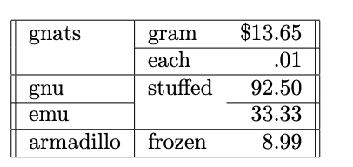
LaTeX examples
Hodge-podge of information.
Publication quality tables in LATEX, Simon Fear

Slide 21
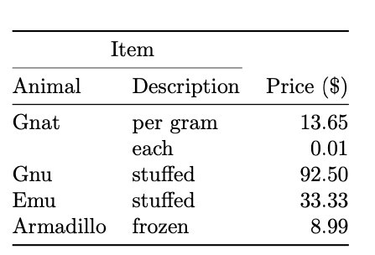
LaTeX examples
Better, and easier to lay out
Publication quality tables in LATEX, Simon Fear

Slide 22
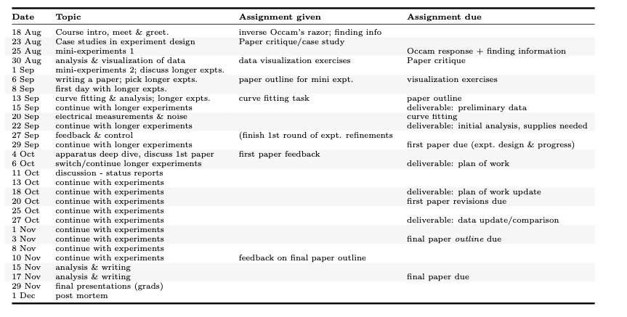
Your schedule
Very light grey to denote weeks and guide the eye – easy to get lost reading across
Still too much text tbh

Slide 23
Bad example
Prominent top position has least important information
Tufte, “Envisioning Information”

Slide 24
Fixed
Calmer without grid, most important at top
De-emphasize less important data
Adds new info, leader dots & shading gently guide
Tufte, “Envisioning Information”

Slide 25
Some things not to do
It isn’t a story, exactly. “and then, and then …”
It doesn’t have to be boring though!
Be honest even though it is hard to write about what didn’t work or what you don’t understand
Don’t feel pressured to mimic the style you read in every detail!
Don’t dance around what you recognized but didn’t understand!

Slide 26
Some things not to do
There are a lot of boring or pretentious-sounding papers.
Tedium and opacity do not make it scientific
Using $5 words for $1 ideas – that first article we read
Avoid exclusionary jargon and acronyms
We don’t print stuff anymore; do you really need to save characters?
Clearly define each acronym on first use
E.g., Co₂FeO₄ and Co₂MnSi --> CFO and CMS.
Why? What would Co₂MnSn be then?

Slide 27
Some things to do
Read target journal to see if they have a particular style
Make a good outline so your argument is crisp
Get someone else to read it
Proofread, proofread, proofread
Look at every section and sentence, is there anything you don’t need?

Slide 28
Some things to do
Are you writing the same introduction everyone else does? If so, maybe don’t.
It is easy to shorten a good draft, it is hard to add length meaningfully – write a good draft and worry about length later
Make up your story and outline before you decide the destination – don’t add artificial constraints (e.g., page limit)

Slide 29
A few examples to look over
Recent one, liked the intro:
https://www.sciencedirect.com/science/article/pii/S1359645422004931?via%3Dihub
An older one, tried to cram too much into a page limit and it shows
https://journals.aps.org/prl/abstract/10.1103/PhysRevLett.94.037006
Concise, decent figures; rare case of color contour/scale I didn’t hate
http://dx.doi.org/10.1063/1.3654121
A 1.5-pager that got a Nobel
https://journals.aps.org/prl/abstract/10.1103/PhysRevLett.5.147

Slide 30
Collaborative editing
Overleaf (LaTeX)
Box notes
Box + office
Don’t email drafts back and forth like its 1998
Set standards before you start
E.g., fonts, figure details, citations …
Communicate – who’s going to do what?

Slide 31
A good approach to group editing
https://hbr.org/2021/07/a-better-approach-to-group-editing
Limit participation
Give enough time, but specific deadline
Clarify roles – manager/writer/reviewer/approver
Start with a clean draft – one expert, one writer
Keep people in their lanes (writer vs subject expert)
Share clean versions, maintain version control
Explain why changes were made
Indicate intention with each version

Slide 32
What about talks?
A whole new ballgame
Visualization stuff is crucial
Some aspects translate, but now performance is also key
A good start from our associate dean:
http://pages.astronomy.ua.edu/white/webtalks/raysrules.html

Slide 33
Paper pseudocode/outline
For one of the mini-experiments
I’ll provide some data/figures/analysis
Focus on writing not visualization here
Make detailed outline of the paper you would write
Like pseudocode – outline + sketch of specific paragraphs

Slide 34
Rest of class
Discuss longer experiments
Pick groups (mostly done I guess)
Pick your experiment to start with
Next time we get started on them!
I’ll have some reading for you

