Slide 1
Noise floor example?
Curve fitting
P. LeClair
PH 4/591 Fall 2022
based on material from A. Piepke

Slide 2
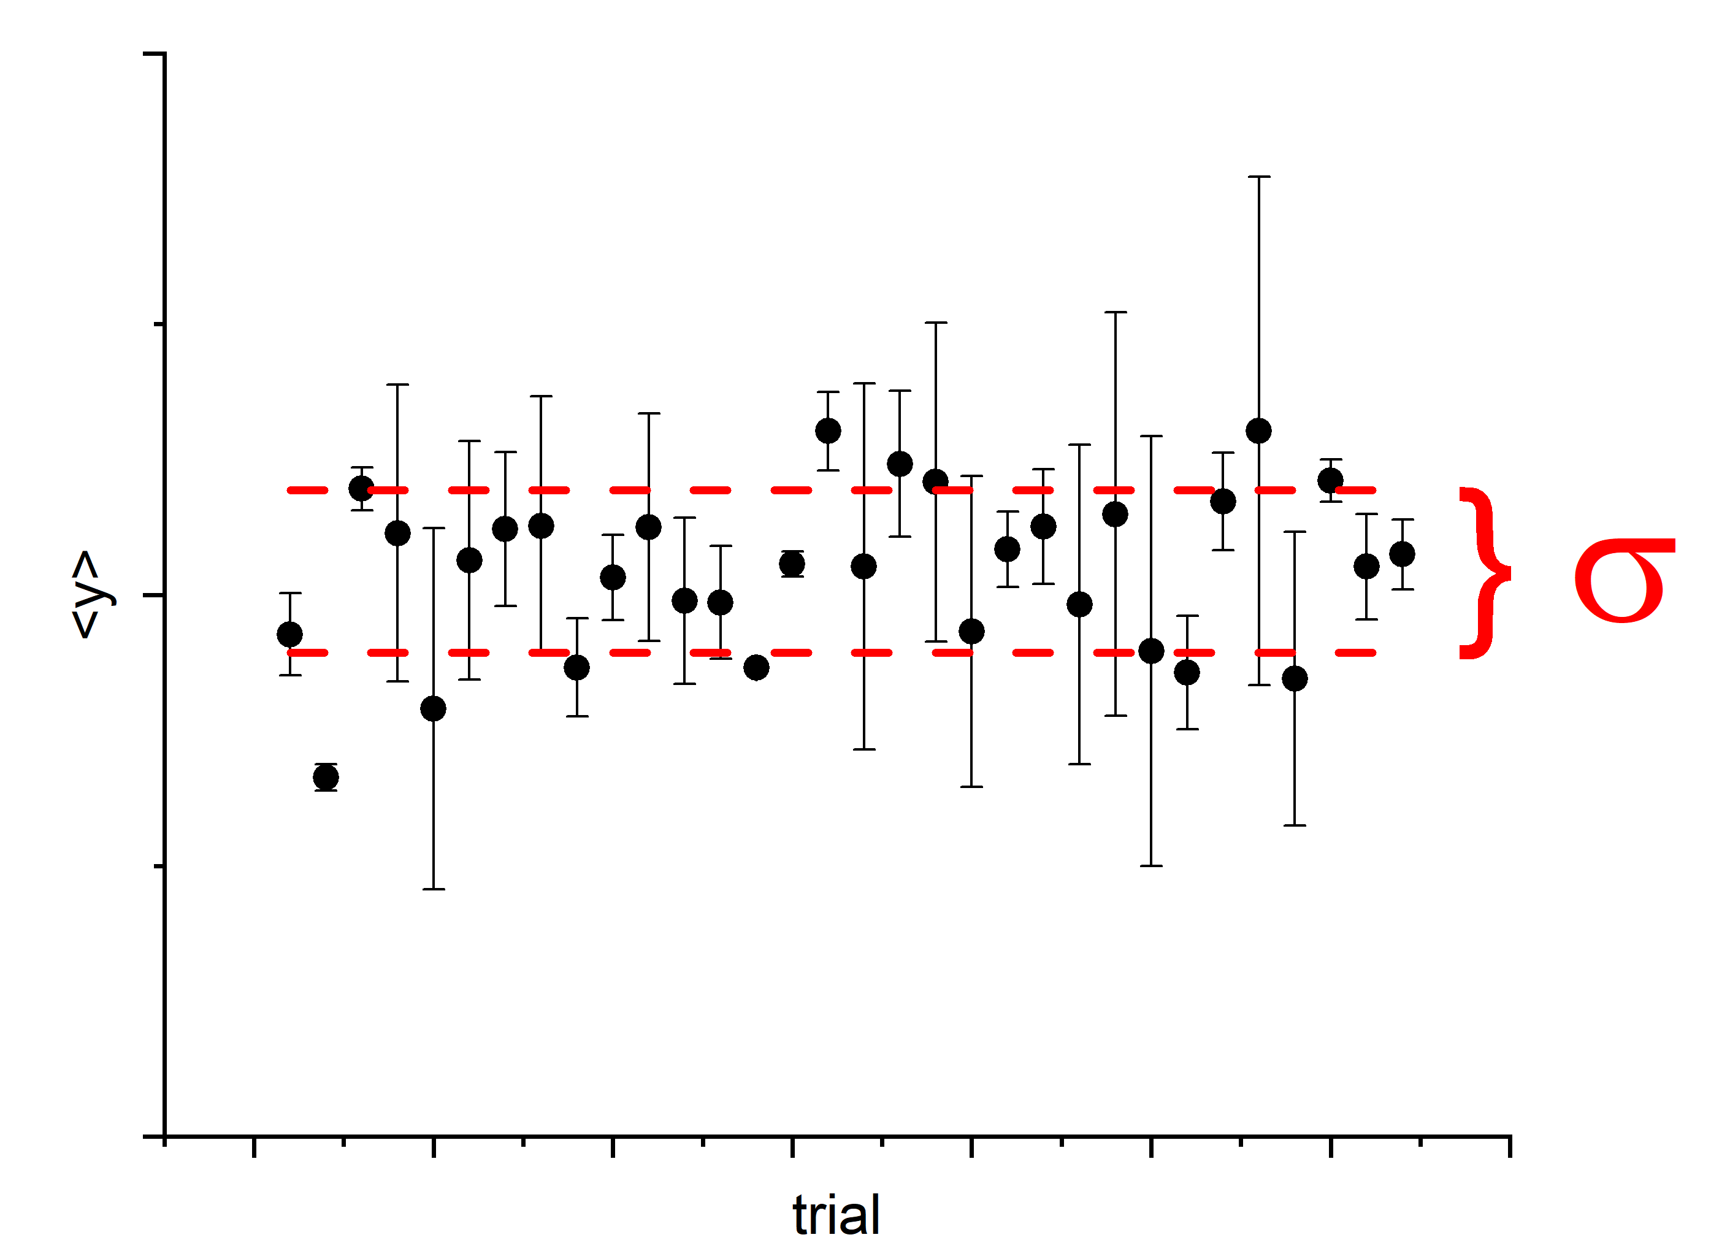
Summary statistics
We have studied how to summarize a data set $y_{i}$ of $i=1,…,N$ independent measurements with a mean and standard deviation:
Mean:
$$\left\langle y\right\rangle =\frac{1}{N}∙\sum_{i=1}^{N}{y_{i}}$$
Standard deviation:
$$s^{2}=\frac{1}{N−1}∙\sum_{i=1}^{N}{{\left(y_{i}−\left\langle y\right\rangle \right)}^{2}}$$
What do we do if the data exhibits a linear correlation? Assume the variation in $i$ goes along with changing some observable $x$ not plotted here.

Slide 3
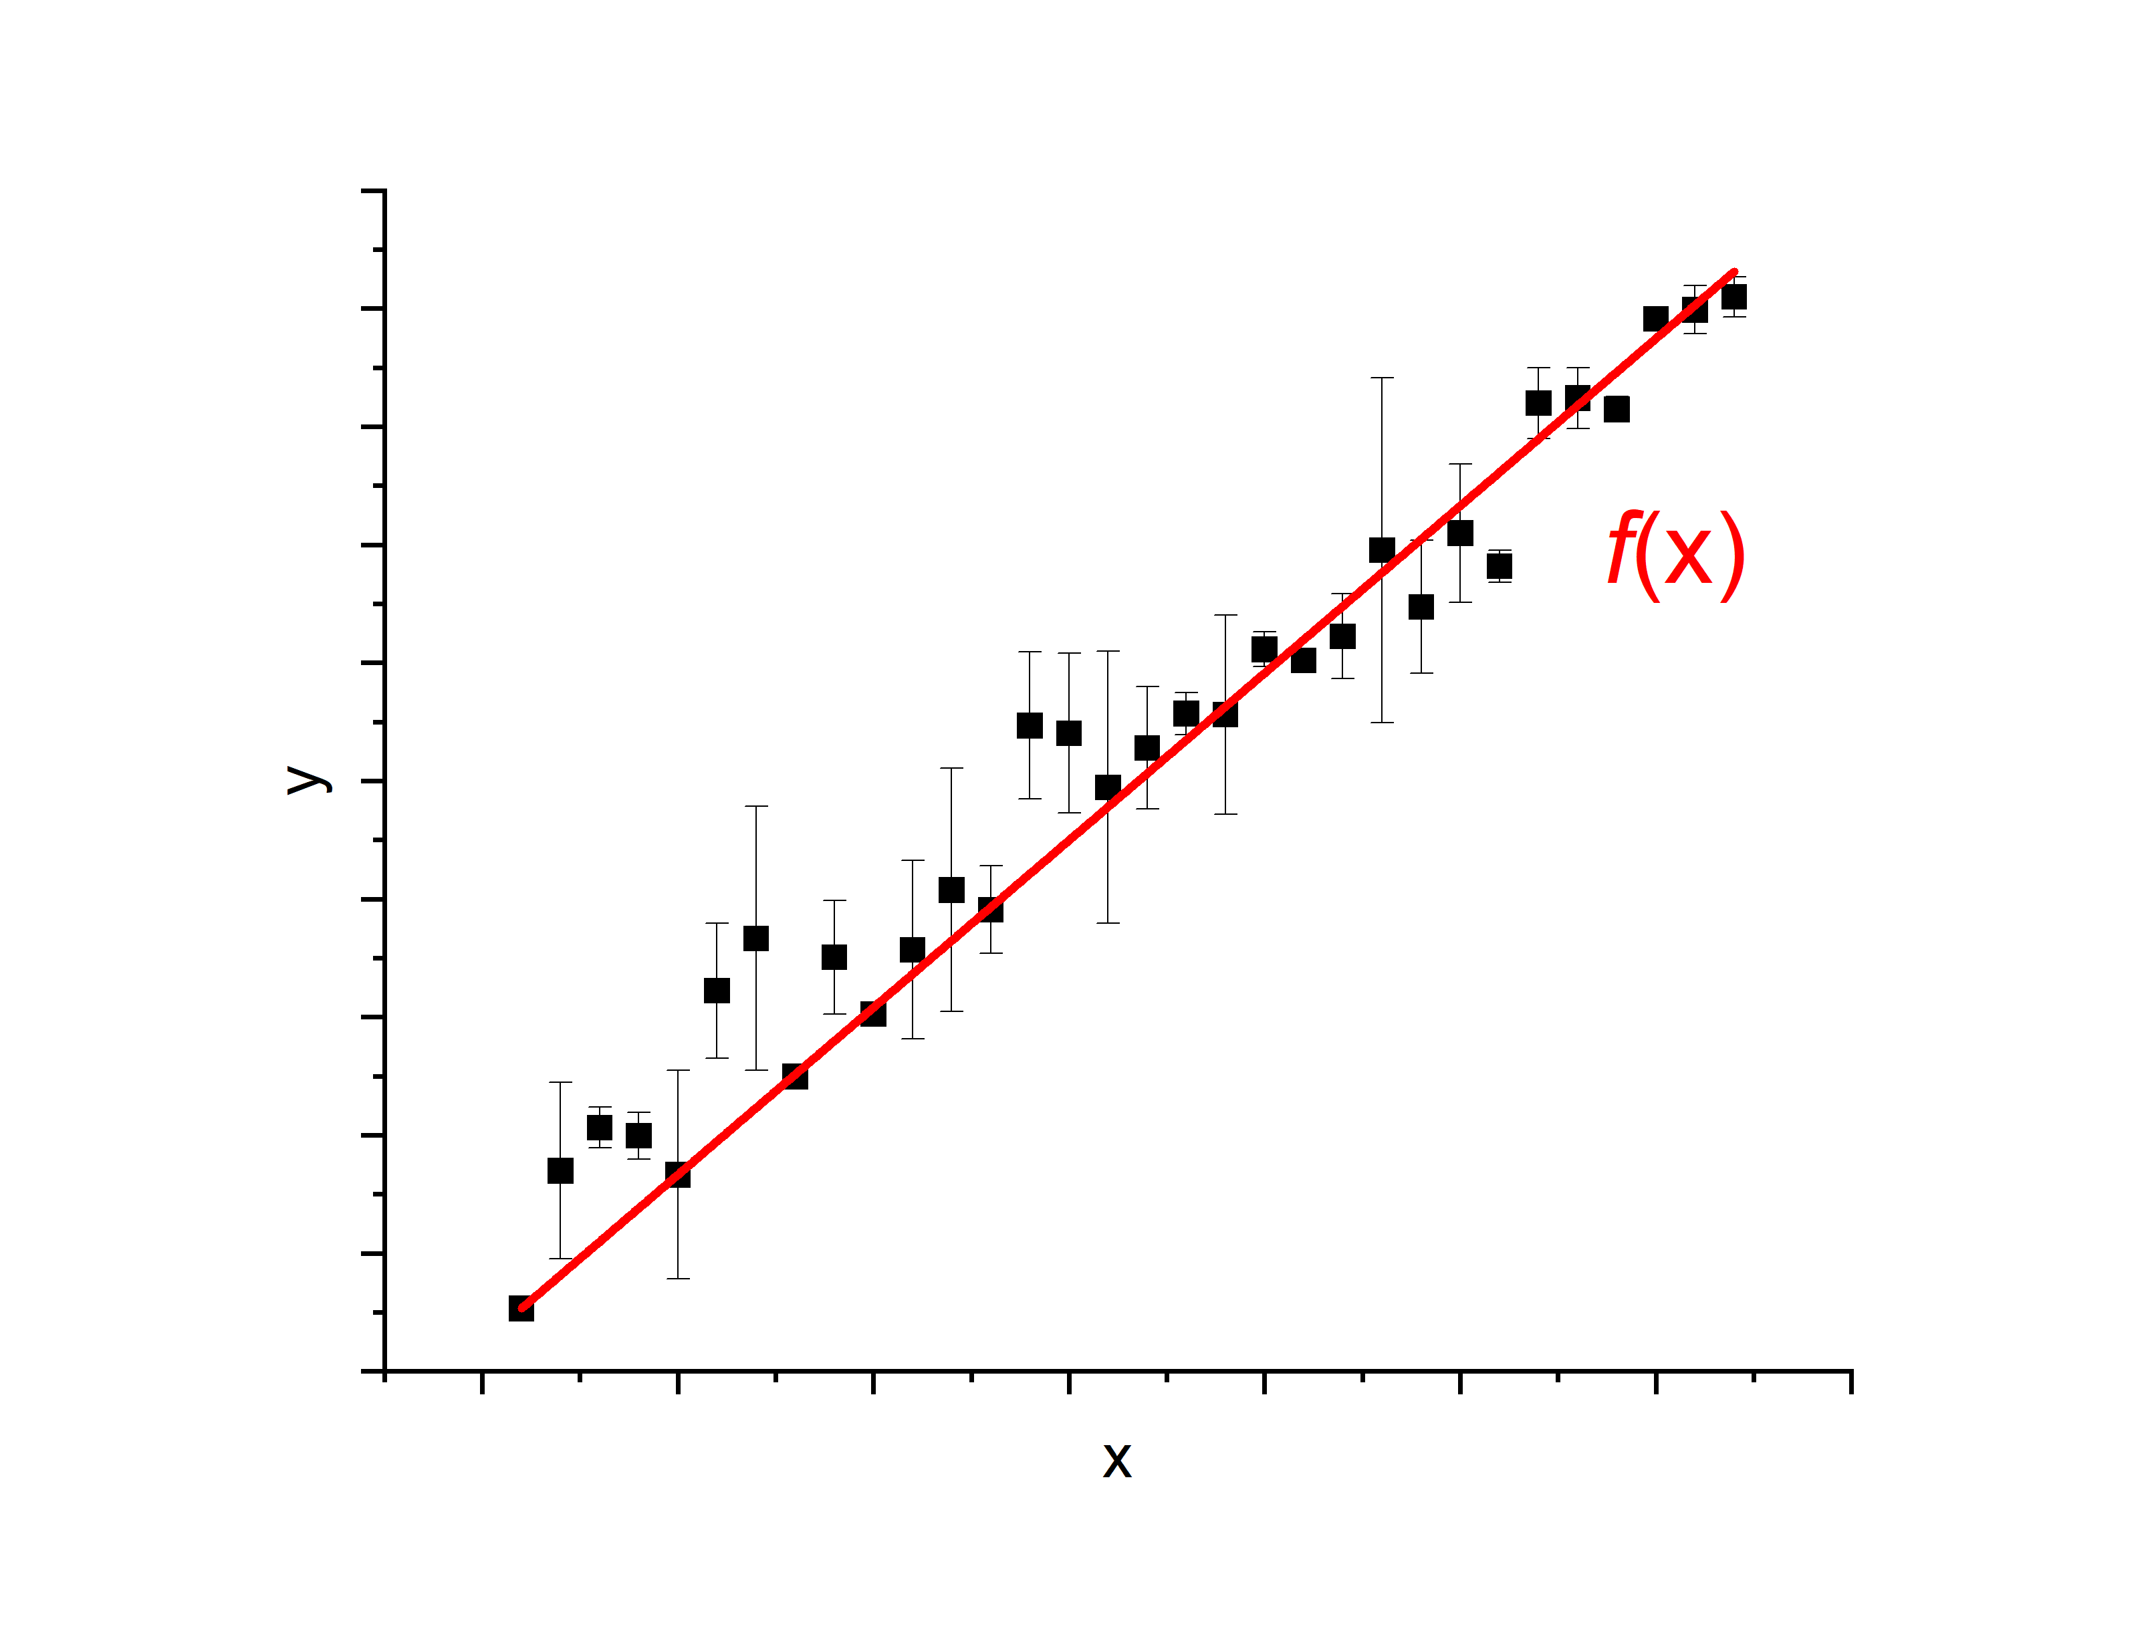
Linear relationships
This data better described by line
$$y=f\left(x\right)=p_{2}∙x+p_{1}$$
How do we find the optimal $p_{1}$ and $p_{2}$?
Assume fluctuations are random (Gaussian), errors symmetric.
Assume the data represents the most likely outcome of the measurement.
Then: principle of maximum likelihood allows parameter estimation.

Slide 4
Model functions
$N$ data pairs $\left(x_{i}, y_{i}\right)$.
Want $f\left(x_{i}\right)$ that describes $y_{i}$ so $f\left(x_{i}\right)≈y_{i}$.
The function f is our fit model. What is reasonable form for f ?
Justified by how well $f$ fits the data and physical plausibility
Often starts by eyeballing it!
f needs M tunable parameters $p_{1},…,p_{M}$, therefore:
$y_{i}≈f\left(x_{i};p_{1},…, p_{M}\right)$.
Once a functional form has been chosen, game is to determine the numerical values of $p_{i}$ (and their errors) that best fit the data.
Assume the statistical fluctuations of the data are Gaussian

Slide 5
Likelihood
Probability $P$ for observing $y_{i}$ for an independent variable $x_{i}$ is given by:
Our description of the “mean”
$$P\left(x_{i};p_{1},…, p_{M}\right) dx=\frac{1}{\sqrt{2∙π}}∙\frac{1}{s_{i}}∙exp\left(−\frac{{\left[y_{i}−f\left(x_{i},p_{1},…, p_{M}\right)\right]}^{2}}{2∙s_{i}^{2}}\right)dx$$
A$ssume each y_{i}$ subject to fluctuations of known standard dev $s_{i}$ (but $x_{i}$ free of fluctuations)
$f$ plays the role of the underlying true value o$f y$
Want $p_{1},…,p_{M}$ that maximize the likelihood of observing the union of all $N$ pairs $\left(x_{i}, y_{i}\right)$.

Slide 6
Likelihood
Maximize product of individual data-pair wise probs:
$$P_{s}=\prod_{i=1}^{N}{P\left(x_{i};y_{i}, p_{1},…, p_{M}\right)}$$
Easier to find the max of $\ln{P_{s}}$ … ln(x) is monotonic
$$ln\left(P_{s}\right)=\sum_{i=1}^{N}{ln\left[P\left(x_{i};y_{i}, p_{1},…, p_{M}\right)\right]}$$
$$=\sum_{i=1}^{N}{ln\left[\frac{1}{\sqrt{2∙π}}∙\frac{1}{s_{i}}∙exp\left(−\frac{{\left[y_{i}−f\left(x_{i}, p_{1},…, p_{M}\right)\right]}^{2}}{2∙s_{i}^{2}}\right)\right]}$$

Slide 7
Likelihood
$$ln\left(P_{s}\right)=\sum_{j=1}^{N}{ln\left[\frac{1}{\sqrt{2∙π}}∙\frac{1}{s_{i}}∙exp\left(−\frac{{\left[y_{i}−f\left(x_{i}, p_{1},…, p_{M}\right)\right]}^{2}}{2∙s_{i}^{2}}\right)\right]}$$
$$ln\left(P_{s}\right)=\sum_{i=1}^{N}{ln\left(\frac{1}{\sqrt{2∙π}}∙\frac{1}{s_{i}}\right)−\frac{1}{2}∙\sum_{i=1}^{N}{\frac{{\left[y_{i}−f\left(x_{i}, p_{1},…, p_{M}\right)\right]}^{2}}{s_{i}^{2}}}}$$
S$et of p_{j}$ that maximizes the likelihood are the best fit parameters.
$$\frac{∂P_{s}\left(x_{i};y_{i}, p_{1},…, p_{M}\right)}{∂p_{j}}=0$$

Slide 8
Likelihood
$$\frac{∂}{∂p_{j}}\left[\sum_{i=1}^{N}{ln\left(\frac{1}{\sqrt{2∙π}}∙\frac{1}{s_{i}}\right)−\frac{1}{2}∙\sum_{i=1}^{N}{\frac{{\left[y_{i}−f\left(x_{i};p_{1},…, p_{M}\right)\right]}^{2}}{s_{i}^{2}}}}\right]=0$$
for $j=1,…,M$
does not depend on $p_{j}$, all derivatives are 0
minus sign: likelihood is maximal when this expression is minimal
$$χ^{2}=\sum_{i=1}^{N}{\frac{{\left[y_{i}−f\left(x_{i};p_{1},…, p_{M}\right)\right]}^{2}}{s_{i}^{2}}}$$
This is the chi-square statistic.
Measures the deviation of our data from the fit function $f$.
Choose $p_{j}$ t$o minimize χ^{2}$ and thus maximize likelihood

Slide 9
Chi square
$$χ^{2}\left(N,x_{i};y_{i},s_{i},p_{1},…,p_{M}\right)=\frac{1}{N−M}∙\sum_{i=1}^{N}{\frac{{\left[y_{i}−f\left(x_{i},;p_{1},…, p_{M}\right)\right]}^{2}}{s_{i}^{2}}}$$
This method of finding the best-fit $f$ is called chi-square minimization. It works for just about any function.
Obtain the unknown parameters $p_{i}$ by simultaneously solving the $M$ equations:
$$\frac{∂}{∂p_{j}}χ^{2}=\frac{∂}{∂p_{j}}\sum_{i=1}^{N}{\frac{{\left[y_{i}−f\left(x_{i};p_{1},…, p_{M}\right)\right]}^{2}}{s_{i}^{2}}=0 for j=1,…,M}$$
Usually leads to a system of $M$ non-linear equations that can’t be solved analytically … numerical methods required

Slide 10
Numerical methods
T$he linear case$ is analytically solvable
$y_{i}=f\left(x_{i}\right)=p_{2}∙x_{i}+p_{1}$
Every decent analysis program does this
Excel does the absolute bare minimum
Some will do much more – matlab, mathematica, originlab, python … many options, learn one of these.

Slide 11
Linear case
$$χ^{2}=\frac{1}{N−M}∙\sum_{i=1}^{N}{\frac{{\left(y_{i}−{p_{2}∙x}_{i}−p_{1}\right)}^{2}}{s_{i}^{2}}}$$
Describe data with linear function:
(each measurement has own $s_{i}$)
Find the values of $p_{1}$ and $p_{2}$ which minimize $χ^{2}$
2 eqns 2 unknowns
Need at least two data pairs to solve this problem; more improve precision.
$$\frac{∂χ^{2}}{∂p_{2}}=0$$
$$\frac{∂χ^{2}}{∂p_{1}}=0$$
and
$$\frac{∂χ^{2}}{∂p_{2}}=−2∙\sum_{i=1}^{N}{\frac{\left(y_{i}−p_{2}{∙x}_{i}−p_{1}\right){∙x}_{i}}{s_{i}^{2}}}=0$$
Simultaneously solve two inhomogeneous linear equations.
$$\frac{∂χ^{2}}{∂p_{1}}=−2∙\sum_{i=1}^{N}{\frac{\left(y_{i}−p_{2}∙x_{i}−p_{1}\right)}{s_{i}^{2}}}=0$$

Slide 12
Linear case
$$−\sum_{i=1}^{N}{\frac{y_{i}{∙x}_{i}}{s_{i}^{2}}}+p_{2}∙\sum_{i=1}^{N}{\frac{x_{i}^{2}}{s_{i}^{2}}}+p_{1}∙\sum_{i=1}^{N}{\frac{x_{i}}{s_{i}^{2}}}=0$$
Solve for $p_{1}$ and $p_{2}$.
Tedious; details in appendix
$$−\sum_{i=1}^{N}{\frac{y_{i}}{s_{i}^{2}}}+p_{2}∙\sum_{i=1}^{N}{\frac{x_{i}}{s_{i}^{2}}}+p_{1}∙\sum_{i=1}^{N}{\frac{1}{s_{i}^{2}}}=0$$
Algebra ensues …
$$p_{1}=\frac{1}{Δ}∙\left(\sum_{i=1}^{N}{\frac{x_{i}^{2}}{s_{i}^{2}}∙\sum_{i=1}^{N}{\frac{y_{i}}{s_{i}^{2}}}−\sum_{i=1}^{N}{\frac{x_{i}}{s_{i}^{2}}}}∙\sum_{i=1}^{N}{\frac{{x_{i}∙y}_{i}}{s_{i}^{2}}}\right)$$
where
$$Δ=\left[\sum_{i}{\frac{1}{s_{i}^{2}}∙\sum_{i}{\frac{x_{i}^{2}}{s_{i}^{2}}−}}{\left(\sum_{i}{\frac{x_{i}}{s_{i}^{2}}}\right)}^{2}\right]$$
$$p_{2}=\frac{1}{Δ}∙\left(\sum_{i=1}^{N}{\frac{1}{s_{i}^{2}}}∙\sum_{i=1}^{N}{\frac{{x_{i}∙y}_{i}}{s_{i}^{2}}}−\sum_{i=1}^{N}{\frac{x_{i}}{s_{i}^{2}}}∙\sum_{i=1}^{N}{\frac{y_{i}}{s_{i}^{2}}}\right)$$

Slide 13
Linear result
Slope $p_{2}$ of the fit line:
$$p_{2}=\frac{1}{Δ}∙\left(\sum_{i=1}^{N}{\frac{1}{s_{i}^{2}}}∙\sum_{i=1}^{N}{\frac{{x_{i}∙y}_{i}}{s_{i}^{2}}}−\sum_{i=1}^{N}{\frac{x_{i}}{s_{i}^{2}}}∙\sum_{i=1}^{N}{\frac{y_{i}}{s_{i}^{2}}}\right)$$
i: number of measurements,
i=1, 2,…, N
x_{i}: independent variable
y_{i}: dependent variable
s_{i}: standard deviation of y_{i}
s_{p2}: standard deviation of p₂
s_{p1}: standard deviation of p₁
Intercept $p_{1}$ of the fit line:
$$p_{1}=\frac{1}{Δ}∙\left(\sum_{i=1}^{N}{\frac{x_{i}^{2}}{s_{i}^{2}}∙\sum_{i=1}^{N}{\frac{y_{i}}{s_{i}^{2}}}−\sum_{i=1}^{N}{\frac{x_{i}}{s_{i}^{2}}}}∙\sum_{i=1}^{N}{\frac{{x_{i}∙y}_{i}}{s_{i}^{2}}}\right)$$
$$Δ=\sum_{i=1}^{N}{\frac{1}{s_{i}^{2}}}∙\sum_{i=1}^{N}{\frac{x_{i}^{2}}{s_{i}^{2}}}−{\left(\sum_{i=1}^{N}{\frac{x_{i}}{s_{i}^{2}}}\right)}^{2}$$

Slide 14
Linear result (equal s_{i})
If all uncertainties are equal $\left(s=s_{i}\right)$, simple enough Excel can do it:
Slope $p_{2}$ of the fit line:
$$p_{2}=\frac{1}{Δ′}∙\left(N∙\sum_{i=1}^{N}{{x_{i}∙y}_{i}}−\sum_{i=1}^{N}{x_{i}}∙\sum_{i=1}^{N}{y_{i}}\right)$$
$$Δ′=N∙\sum_{i=1}^{N}{x_{i}^{2}}−{\left(\sum_{i=1}^{N}{x_{i}}\right)}^{2}$$
Intercept $p_{1}$ of the fit line:
$$p_{1}=\frac{1}{Δ′}∙\left(\sum_{i=1}^{N}{x_{i}^{2}∙\sum_{i=1}^{N}{y_{i}}−\sum_{i=1}^{N}{x_{i}}}∙\sum_{i=1}^{N}{{x_{i}∙y}_{i}}\right)$$

Slide 15
Linear result - uncertainty
If all uncertainties can be assumed to be equal $\left(s=s_{i}\right)$, you can determine this common uncertainty from the data.
e.g. uncertainties are instrumental and you’ve used the same instrument for all
$$s^{2}=\frac{1}{N−2}∙\sum_{i=1}^{N}{{\left(y_{i}−{p_{2}∙x}_{i}−p_{1}\right)}^{2}}$$

Slide 16
Linear result - uncertainty
What about the error on the fitted slope $p_{2}$ and intercept $p_{1}$?
(general case of unequal s_{i} again)
$$\frac{∂χ^{2}}{∂p_{2}}=p_{1}∙\sum_{i}{\frac{x_{i}}{s_{i}^{2}}+p_{2}∙}\sum_{i}{\frac{x_{i}^{2}}{s_{i}^{2}}−\sum_{i}{\frac{x_{i}{∙y}_{i}}{s_{i}^{2}}}=0}$$
Solve for slope $p_{2}$…
The slope $p_{2}$ and intercept $p_{1}$ are dependent on each other (correlated).
Must be taken into account when calculating the error of interpolated or extrapolated values $y=p_{2}∙x+p_{1}$
$$p_{2}=\frac{\sum{\frac{x_{i}{∙y}_{i}}{s_{i}^{2}}}−p_{1}∙\sum{\frac{x_{i}}{s_{i}^{2}}}}{\sum{\frac{x_{i}^{2}}{s_{i}^{2}}}}$$

Slide 17
Linear result - uncertainty
We use error propagation to find the errors on $p_{1}$ and $p_{2}$, assuming the errors $s_{j}$ of the individual measurements $y_{j}$ are uncorrelated.
$$s_{p_{2}}^{2}=\sum_{i=1}^{N}{{\left(\frac{∂p_{2}}{∂y_{i}}\right)}^{2}{∙s}_{i}^{2}}$$
$$s_{p_{1}}^{2}=\sum_{i=1}^{N}{{\left(\frac{∂p_{1}}{∂y_{i}}\right)}^{2}{∙s}_{i}^{2}}$$
After some manipulation:
$$s_{p_{2}}^{2}=\frac{1}{Δ}∙\sum_{i=1}^{N}{\frac{1}{s_{i}^{2}}}$$
$$s_{p_{1}}^{2}=\frac{1}{Δ}∙\sum_{i=1}^{N}{\frac{x_{i}^{2}}{s_{i}^{2}}}$$
$$Δ=\sum_{i=1}^{N}{\frac{1}{s_{i}^{2}}}∙\sum_{i=1}^{N}{\frac{x_{i}^{2}}{s_{i}^{2}}}−{\left(\sum_{i=1}^{N}{\frac{x_{i}}{s_{i}^{2}}}\right)}^{2}$$
Where, as before:

Slide 18
Linear result - uncertainty
For the special case of equal uncertainties $s=s_{i}$ for all $y_{i}$-values the uncertainties $s_{p_{1}}$ and $s_{p_{2}}$ of the fitted intercept $p_{1}$ and slope $p_{2}$ are:
$$s_{p_{1}}^{2}=\frac{s^{2}}{Δ′}∙\sum_{i=1}^{N}{x_{i}^{2}}$$
$$s_{p_{2}}^{2}=N∙\frac{s^{2}}{Δ′}$$
$$Δ′=N∙\sum_{i=1}^{N}{x_{i}^{2}}−{\left(\sum_{i=1}^{N}{x_{i}}\right)}^{2}$$
$$s^{2}=\frac{1}{N−2}∙\sum_{i=1}^{N}{{\left(y_{i}−{p_{2}∙x}_{i}−p_{1}\right)}^{2}}$$

Slide 19
Linear result - uncertainty
In Excel - use the function LINEST. Syntax:
=LINEST(y-array,x-array,TRUE,TRUE)
You’ll need to look up the details.
This routine is what EXCEL calls an “array formula”, it needs to be declared as such.
Array formulas typically require some output to be spread over multiple cells, you need to define which cells.
Again, look up how to do this.

Slide 20
Summary
$$f\left(x\right)=p_{2}∙x+p_{1}$$
N correlated pairs x_{i} and y_{i}
N correlated pairs x_{i} and y_{i} with individual y-errors s_{i}
$$p_{1}=\frac{1}{Δ′}∙\left(\sum_{i=1}^{N}{x_{i}^{2}∙\sum_{i=1}^{N}{y_{i}}−\sum_{i=1}^{N}{x_{i}}}∙\sum_{i=1}^{N}{{x_{i}∙y}_{i}}\right)$$
$$p_{1}=\frac{1}{Δ}∙\left(\sum_{i=1}^{N}{\frac{x_{i}^{2}}{s_{i}^{2}}∙\sum_{i=1}^{N}{\frac{y_{i}}{s_{i}^{2}}}−\sum_{i=1}^{N}{\frac{x_{i}}{s_{i}^{2}}}}∙\sum_{i=1}^{N}{\frac{{x_{i}∙y}_{i}}{s_{i}^{2}}}\right)$$
Intercept:
Intercept:
$$s_{p_{1}}=\sqrt{\frac{\sum_{i=1}^{N}{x_{i}^{2}}}{Δ′}}∙s$$
$$s_{p_{1}}=\sqrt{\frac{1}{Δ}∙\sum_{i=1}^{N}{\frac{x_{i}^{2}}{s_{i}^{2}}}}$$
Error in intercept:
Error in intercept:
$$p_{2}=\frac{1}{Δ′}∙\left(N∙\sum_{i=1}^{N}{{x_{i}∙y}_{i}}−\sum_{i=1}^{N}{x_{i}}∙\sum_{i=1}^{N}{y_{i}}\right)$$
$$p_{2}=\frac{1}{Δ}∙\left(\sum_{i=1}^{N}{\frac{1}{s_{i}^{2}}}∙\sum_{i=1}^{N}{\frac{{x_{i}∙y}_{i}}{s_{i}^{2}}}−\sum_{i=1}^{N}{\frac{x_{i}}{s_{i}^{2}}}∙\sum_{i=1}^{N}{\frac{y_{i}}{s_{i}^{2}}}\right)$$
Slope:
Slope:
$$s_{p_{2}}=\sqrt{\frac{N}{Δ′}}∙s$$
$$s_{p_{2}} =\sqrt{\frac{1}{Δ}∙\sum_{i=1}^{N}{\frac{1}{s_{i}^{2}}}}$$
Error in slope:
Error in slope:
$$Δ′=N∙\sum_{i=1}^{N}{x_{i}^{2}}−{\left(\sum_{i=1}^{N}{x_{i}}\right)}^{2}$$
$$s^{2}=\frac{1}{N−2}∙\sum_{i=1}^{N}{{\left(y_{i}−{p_{2}∙x}_{i}−p_{1}\right)}^{2}}$$
$$Δ=\sum_{i=1}^{N}{\frac{1}{s_{i}^{2}}}∙\sum_{i=1}^{N}{\frac{x_{i}^{2}}{s_{i}^{2}}}−{\left(\sum_{i=1}^{N}{\frac{x_{i}}{s_{i}^{2}}}\right)}^{2}$$

Slide 21
Going further - linearization
Both the slope and intercept are determined by simple sums; no complicated iterative process is needed to get the fit results
In many cases, experimental problems can be linearized by redefining experimental variables
Then, linear regression offers a simple means to find a description of the data.

Slide 22
Example: Rydberg constant
Atomic spectra - wavelengths of transitions in the hydrogen atom (Balmer series).
Measure the Rydberg constant, R_{H}, in Balmer formula
Rydberg formula:$\frac{1}{λ}=R_{H}∙\left(\frac{1}{n_{1}^{2}}−\frac{1}{n_{2}^{2}}\right)$
Balmer series: ${n_{1}=2 \text{and} n}_{2}=3,…,∞$.
Given $n$, $λ$ data, how to extract R_{H}?

Slide 23
Example: Rydberg constant
Data from a hydrogen lamp via the Ocean Optics spectrometer.
First attempt: plot the raw data, wavelength versus main quantum number of final state.
n₂ | λ (nm) | s_{λ} (nm)
4 | 484 | 4.0
5 | 433 | 3.0
6 | 408 | 2.5
7 | 395 | 3.0
8 | 387 | 1.0
Doesn’t help, the problem is obviously non-linear.

Slide 24
Example: Rydberg constant
Now linearize the problem with: $\frac{1}{λ}=−R_{H}∙\left(\frac{1}{n_{2}^{2}}\right)+\frac{R_{H}}{n_{1}^{2}}$.
n₂ | 1/n₂² | λ (nm) | s_{λ} (nm) | 1/λ (nm⁻¹) | s_{1/λ} (nm⁻¹)
4 | 0.063 | 484 | 4.0 | 2.066E-03 | 1.71E-05
5 | 0.040 | 433 | 3.0 | 2.309E-03 | 1.60E-05
6 | 0.028 | 408 | 2.5 | 2.451E-03 | 1.50E-05
7 | 0.020 | 395 | 3.0 | 2.532E-03 | 1.92E-05
8 | 0.016 | 387 | 1.0 | 2.584E-03 | 6.68E-06
Translate errors of y-values, from λ to 1/λ. Error propagation ftw:
$$\frac{d\left(\frac{1}{λ}\right)}{dλ}=−\frac{1}{λ^{2}}$$
$$s_{1/λ}=\frac{s_{λ}}{λ^{2}}$$
Now apply linear regression to find the slope & Rydberg constant.

Slide 25
Details.
n₂ | x ≡ 1/n₂² | λ (nm) | s_{λ} (nm) | y ≡ 1/λ (nm⁻¹) | s_{1/λ} (nm⁻¹) | x_{i}²/s_{i}² | y_{i}/s_{i}² | x_{i}/s_{i}² | x_{i}·y_{i}/s_{i}² | 1/s_{i}²
4 | 0.0625 | 484 | 4 | 2.066E-03 | 1.71E-05 | 1.34E+07 | 7.086E+06 | 2.14E+08 | 4.429E+05 | 3.43E+09
5 | 0.0400 | 433 | 3 | 2.309E-03 | 1.60E-05 | 6.25E+06 | 9.020E+06 | 1.56E+08 | 3.608E+05 | 3.91E+09
6 | 0.0278 | 408 | 2.5 | 2.451E-03 | 1.50E-05 | 3.42E+06 | 1.087E+07 | 1.23E+08 | 3.019E+05 | 4.43E+09
7 | 0.0204 | 395 | 3 | 2.532E-03 | 1.92E-05 | 1.13E+06 | 6.848E+06 | 5.52E+07 | 1.398E+05 | 2.70E+09
8 | 0.0156 | 387 | 1 | 2.584E-03 | 6.68E-06 | 5.48E+06 | 5.796E+07 | 3.50E+08 | 9.056E+05 | 2.24E+10
Sum |  |  |  |  |  | 2.97E+07 | 9.18E+07 | 8.99E+08 | 2.15E+06 | 3.69E+10
Perform all multiplications and products of the sums to get $p_{1}$, $p_{2} →n_{1},R_{H}$…
$p_{2}=−R_{H}=\left(1.109±0.036\right)∙{10}^{−7} m$ (y-axis is in nm, I converted to m).
$n_{1}$ from intercept: $n_{1}=\sqrt{\frac{R_{H}}{p_{1}}}=2.005$ but what’s the error of $n_{1}$?
Tabulated value: $R_{H}=1.097∙{10}^{−7} m$
In practice: don’t have to do manually with sums, could use LINEST in Excel

Slide 26
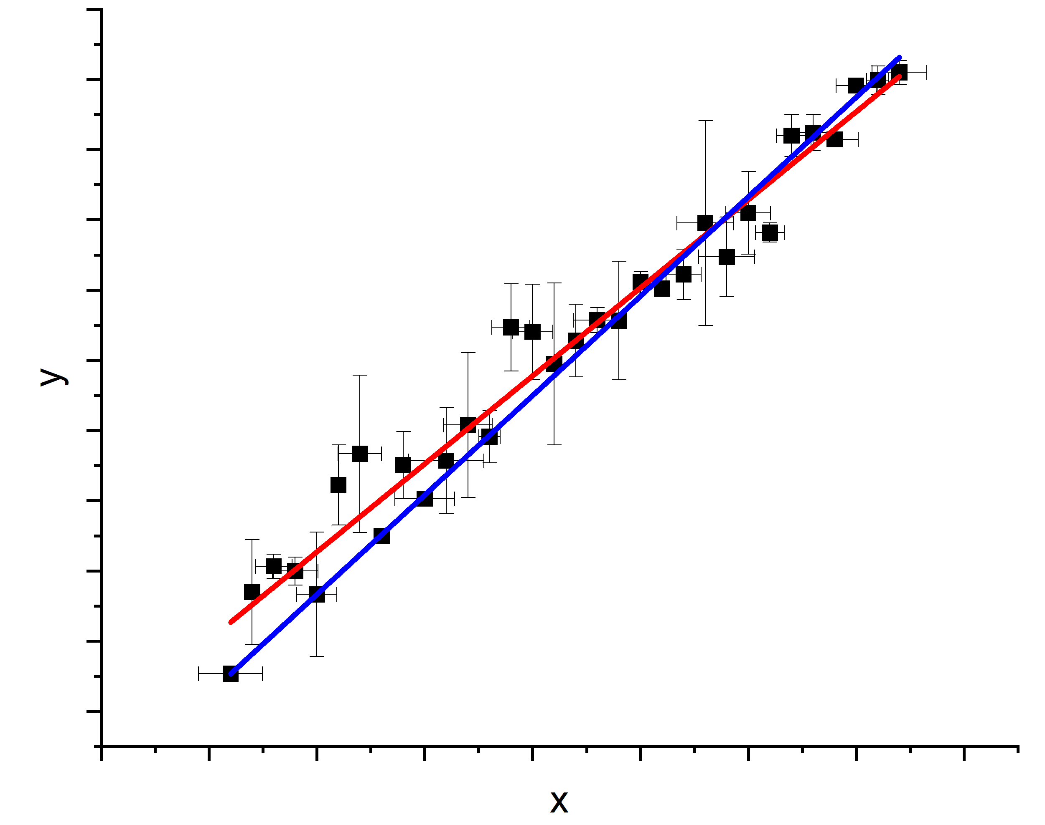
Linear fit with uncertainties
Red: neglect
Blue: include
Huge for intercept
Non-negligible for slope
(curves with or without x error same on this scale)
Mode | Slope (err) | Intercept (err)
Ignore both | 5.02 ± 0.17 | 0.32 ± 3.21
Include y error | 5.67 ± 0.08 | -15.1 ± 1.5
Include y and x errors | 5.48 ± 0.12 | -12.5 ± 1.8

Slide 27
Power laws
“I know, let’s plot it on a log scale and the power is the slope”
“I know, we can use different power laws in different regimes”
Uncertainty and noise floor … propagate/subtract
Nothing is really a power law except in a narrow range
Don’t piece together models without (logical) glue

Slide 28
A better way
If the model is
Then
It is true the slope of a ln y – ln x plot has slope n, but it is easy to fool yourself
Better: logarithmic derivative
Much easier to judge if plot is just a constant

Slide 29
Exercise
From here you learn by doing
I’ll give you data – resistivity vs temperature.
You come up with a model and fit
If possible – reason for model? Physics?
Not including uncertainty for now
Report fit parameters with uncertainty and (chi-square)/DOF (and a plot obviously)

Slide 30
Data and plausible models
Will give csv file of data
Plausible models? Many!
Material – VO₂

Slide 31
Appendices
Further details on uncertainties of extrapolated and interpolated data
Some derivations

Slide 32
Uncertainties on Extrapolated and Interpolated Values
After performing linear regression on $x−y$-data pairs, the fit line’s utility is often to use it to determine the $y$ -values for $x$-values you haven’t directly observed during your “calibration”. If these $x$-values are bracket by $x_{min}$ and $x_{max}$ such as $x_{min}≤x≤x_{max}$ you call this interpolation. If $x$-lies outside the “calibrated” range you call this process extrapolation. The question is: how do we determine the uncertainty on interpolated and extrapolated $y$-values?

Slide 33
We now know how to fit this data with the equation $y=f\left(x\right)=m∙x+b$. We get the values of m and b and their uncertainties $s_{m}$ and $s_{b}$ through linear regression.
Suppose we want to calculate the value of ŷ at some value of x, where we did not make a measurement, using the linear regression equation. What is the uncertainty on s_{ŷ} on ŷ?
My apology: there is a terminology change here. Before: $f\left(x\right)=p_{2}∙x+p_{1}$. For the rest of this section I use: $f\left(x\right)=m∙x+b$. I didn’t feel like changing 50+ equations…

Slide 34
Another reminder: $m$ and $b$ are correlated because
$$m=\frac{\sum_{i}{\frac{x_{i}{∙y}_{i}}{s_{i}^{2}}}−b∙\sum_{i}{\frac{x_{i}}{s_{i}^{2}}}}{\sum_{i}{\frac{x_{i}^{2}}{s_{i}^{2}}}}$$
Note: the sums all go over $i=1,…, N$. From here on the summation index will be dropped from the equations to reduce the number of symbols.
Therefore to calculate the error on $f\left(x\right)$ we need to propagate the errors on $m$ and $b$, including the covariant term.
$$s_{\hat{y}}^{2}={\left(\frac{∂f\left(x\right)}{∂m}\right)}^{2}{∙s}_{m}^{2}+{\left(\frac{∂f\left(x\right)}{∂b}\right)}^{2}{∙s}_{b}^{2}+2∙s_{mb}∙\left(\frac{∂f\left(x\right)}{∂m}\right)∙\left(\frac{∂f\left(x\right)}{∂b}\right)$$

Slide 35
$$s_{\hat{y}}^{2}={\left(\frac{∂f\left(x\right)}{∂m}\right)}^{2}{∙s}_{m}^{2}+{\left(\frac{∂f\left(x\right)}{∂b}\right)}^{2}{∙s}_{b}^{2}+2∙s_{mb}∙\left(\frac{∂f\left(x\right)}{∂m}\right)∙\left(\frac{∂f\left(x\right)}{∂b}\right)$$
Since $f\left(x\right)=m∙x+b$ :
$$\frac{∂f\left(x\right)}{∂m}=x$$
$$\frac{∂f\left(x\right)}{∂b}=1$$
and
$$s_{\hat{y}}^{2}=x^{2}∙s_{m}^{2}+s_{b}^{2}+2{∙s}_{mb}∙x$$

Slide 36
The covariance in this case is
I won’t show where this comes from. However, you can find this treatment in L. Lyons, Statistics for Nuclear and Particle Physicists, Cambridge University Press, p127f.
$$s_{mb}=\sum_{i=1}^{N}{\left(\frac{∂m}{∂y_{i}}\right)∙\left(\frac{∂b}{∂y_{i}}\right)∙s_{i}^{2}}$$
From before, we showed that (sums go over $i=1,…N$)
$$m=\frac{\sum{\frac{x_{i}∙y_{i}}{s_{i}^{2}}}−b∙\sum{\frac{x_{i}}{s_{i}^{2}}}}{\sum{\frac{x_{i}^{2}}{s_{i}^{2}}}}$$
$$b=\frac{\sum{\frac{x_{i}{∙y}_{i}}{s_{i}^{2}}}−m∙\sum{\frac{x_{i}^{2}}{s_{i}^{2}}}}{\sum{\frac{x_{i}}{s_{i}^{2}}}}$$
and

Slide 37
Start with the equations for $m$ and $b$ from linear regression
$$m=\frac{1}{Δ}∙\left(\sum_{i}{\frac{x_{i}{∙y}_{i}}{s_{i}^{2}}}∙\sum_{i}{\frac{1}{s_{i}^{2}}}−\sum_{i}{\frac{x_{i}}{s_{i}^{2}}}∙\sum_{i}{\frac{y_{i}}{s_{i}^{2}}}\right)$$
This is how slope and intercept depend on the primary data (x_{i}, y_{i}, and s_{i}). The change of the results under a variation of the data (derivatives), weighted by the amount of variability (uncertainties of individual data points) determines the variability of the result.
$$b=\frac{1}{Δ}∙\left(\sum_{i}{\frac{x_{i}^{2}}{s_{i}^{2}}}∙\sum_{i}{\frac{y_{i}}{s_{i}^{2}}}−\sum_{i}{\frac{x_{i}}{s_{i}^{2}}}∙\sum_{i}{\frac{x_{i}{∙y}_{i}}{s_{i}^{2}}}\right)$$
Now take the partial derivatives of $m$ and $b$ with respect to $y_{i}$ or jump to result.

Slide 38
$$\frac{∂m}{∂y_{i}}=\frac{1}{∆}∙\left(\left[\sum_{j}{\frac{1}{s_{j}^{2}}}\right]∙\frac{x_{i}}{s_{i}^{2}}−\left[\sum_{j}{\frac{x_{j}}{s_{j}^{2}}}\right]∙\frac{1}{s_{i}^{2}}\right)$$
Remember: Δ does not depend on the y_{i}-values, only on the x_{i} and s_{i}-values. This means it acts as a parameter, you don’t need to evaluate a complicated derivative of a ratio of functions.
$$\frac{∂b}{∂y_{i}}=\frac{1}{∆}∙\left(\left[\sum_{j}{\frac{x_{j}^{2}}{s_{j}^{2}}}\right]∙\frac{1}{s_{i}^{2}}−\left[\sum_{j}{\frac{x_{j}}{s_{j}^{2}}}\right]∙\frac{x_{i}}{s_{i}^{2}}\right)$$
Substitute this into the expression for covariance s_{mb}
$$s_{mb}=\sum_{i}{s_{i}^{2}∙\left(\frac{∂m}{∂y_{i}}\right)∙\left(\frac{∂b}{∂y_{i}}\right)}=\frac{1}{∆^{2}}∙\sum_{i}{s_{i}^{2}}\left(\left[\sum_{j}{\frac{1}{s_{j}^{2}}}\right]∙\frac{x_{i}}{s_{i}^{2}}−\left[\sum_{j}{\frac{x_{j}}{s_{j}^{2}}}\right]∙\frac{1}{s_{i}^{2}}\right)∙\left(\left[\sum_{j}{\frac{x_{j}^{2}}{s_{j}^{2}}}\right]∙\frac{1}{s_{i}^{2}}−\left[\sum_{j}{\frac{x_{j}}{s_{j}^{2}}}\right]∙\frac{x_{i}}{s_{i}^{2}}\right)$$

Slide 39
$$s_{mb}=\frac{1}{∆^{2}}∙\sum_{i}{s_{i}^{2}}\left(\left[\sum_{j}{\frac{1}{s_{j}^{2}}}\right]∙\frac{x_{i}}{s_{i}^{2}}−\left[\sum_{j}{\frac{x_{j}}{s_{j}^{2}}}\right]∙\frac{1}{s_{i}^{2}}\right)∙\left(\left[\sum_{j}{\frac{x_{j}^{2}}{s_{j}^{2}}}\right]∙\frac{1}{s_{i}^{2}}−\left[\sum_{j}{\frac{x_{j}}{s_{j}^{2}}}\right]∙\frac{x_{i}}{s_{i}^{2}}\right)$$
$$s_{mb}=\frac{1}{∆^{2}}∙\sum_{i}{s_{i}^{2}}\left[\left(\sum_{j}{\frac{1}{s_{j}^{2}}}\right)∙\left(\sum_{j}{\frac{x_{j}^{2}}{s_{j}^{2}}}\right)∙\frac{x_{i}}{s_{i}^{4}}−\left(\sum_{j}{\frac{x_{j}}{s_{j}^{2}}}\right)∙\left(\sum_{j}{\frac{x_{j}^{2}}{s_{j}^{2}}}\right)∙\frac{1}{s_{i}^{4}}\right]$$
$$+\frac{1}{∆^{2}}∙\sum_{i}{s_{i}^{2}}\left[−\left(\sum_{j}{\frac{1}{s_{j}^{2}}}\right)∙\left(\sum_{j}{\frac{x_{j}}{s_{j}^{2}}}\right)∙\frac{x_{i}^{2}}{s_{i}^{4}}+\left(\sum_{j}{\frac{x_{j}}{s_{j}^{2}}}\right)∙\left(\sum_{j}{\frac{x_{j}}{s_{j}^{2}}}\right)∙\frac{x_{i}}{s_{i}^{4}}\right]$$
Now write this out as 4 separate sums.

Slide 40
$$s_{mb}=\frac{1}{∆^{2}}∙\left[\left(\sum_{j}{\frac{1}{s_{j}^{2}}}\right)\left(\sum_{j}{\frac{x_{j}^{2}}{s_{j}^{2}}}\right)\sum_{i}{\frac{x_{i}}{s_{i}^{2}}−\left(\sum_{j}{\frac{x_{j}}{s_{j}^{2}}}\right)\left(\sum_{j}{\frac{x_{j}^{2}}{s_{j}^{2}}}\right)\sum_{i}{\frac{1}{s_{i}^{2}}}}\right]$$
$$+\frac{1}{∆^{2}}∙\sum_{i}{\frac{x_{i}}{s_{i}^{2}}}\left[−\left(\sum_{j}{\frac{1}{s_{j}^{2}}}\right)\left(\sum_{j}{\frac{x_{j}^{2}}{s_{j}^{2}}}\right)+{\left(\sum_{j}{\frac{x_{j}}{s_{j}^{2}}}\right)}^{2}\right]$$
Δ
$$s_{mb}=−\frac{1}{∆}∙\sum_{i}{\frac{x_{i}}{s_{i}^{2}}}$$
Finally,

Slide 41
$$s_{mb}=−\frac{1}{∆}∙\sum_{i}{\frac{x_{i}}{s_{i}^{2}}}$$
$$s_{m}^{2}=\frac{1}{Δ}∙\sum_{i}{\frac{1}{s_{i}^{2}}}$$
$$s_{b}^{2}=\frac{1}{Δ}∙\sum_{i}{\frac{x_{i}^{2}}{s_{i}^{2}}}$$
$$s_{\hat{y}}^{2}=x^{2}∙s_{m}^{2}+s_{b}^{2}+2{∙s}_{mb}∙x$$
All sums are performed over all measured values, $i=1,…,N$.
$$s_{\hat{y}}^{2}=\frac{1}{Δ}∙\left[\sum_{i}{\frac{x_{i}^{2}}{s_{i}^{2}}}+x^{2}∙\sum_{i}{\frac{1}{s_{i}^{2}}}−2∙x∙\sum_{i}{\frac{x_{i}}{s_{i}^{2}}}\right]$$
$$Δ=\sum_{i=1}^{N}{\frac{1}{s_{i}^{2}}}∙\sum_{i=1}^{N}{\frac{x_{i}^{2}}{s_{i}^{2}}}−{\left(\sum_{i=1}^{N}{\frac{x_{i}}{s_{i}^{2}}}\right)}^{2}$$
Note that the error in $\hat{y}$ depends on $x$. The further you extrapolate from measured values, the larger the uncertainty on the extrapolation becomes.

Slide 42
Check what happens in the special case that $x=0$:
$$s_{\hat{y}}^{2}=\frac{1}{Δ}∙\left[\sum_{i}{\frac{x_{i}^{2}}{s_{i}^{2}}}+x^{2}∙\sum_{i}{\frac{1}{s_{i}^{2}}}−2∙x∙\sum_{i}{\frac{x_{i}}{s_{i}^{2}}}\right]=\frac{1}{Δ}∙\sum_{i}{\frac{x_{i}}{s_{i}^{2}}}$$
$$s_{b}^{2}=\frac{1}{Δ}\sum_{i}{\frac{x_{i}^{2}}{s_{i}^{2}}}$$
This is simply the uncertainty on the $y$-intercept:
For the unweighted case, $s_{i}=s$ for all $i=1,…,N$
$$s_{\hat{y}}^{2}=\frac{s^{2}}{Δ′}∙\left[\sum_{i}{x_{i}^{2}}+{N∙x}^{2}−2∙x∙\sum_{i}{x_{i}}\right]$$
$$Δ′=N∙\sum_{i=1}^{N}{x_{i}^{2}}−{\left(\sum_{i=1}^{N}{x_{i}}\right)}^{2}$$

Slide 43
Example:
You have measured 7 linearly correlated $x−y$-data pairs $\left(x_{i}, y_{i}\right)$ and have knowledge of their individual standard deviation $s_{y_{i}}$. What straight line fit $f\left(x\right)=m∙x+b$ do you obtain and what do you know about the uncertainties of the fit and its parameters $m$ and $b$?
x [arbitrary units] | y [arbitrary units] | s_{y} [arbitrary units]
1.0 | 4.07 | 0.20
2.0 | 4.76 | 0.30
3.0 | 7.00 | 0.50
4.0 | 6.97 | 1.50
5.0 | 8.3 | 1.10
6.0 | 7.01 | 2.50
7.0 | 9.90 | 2.10
EXCEL’s answer (ignoring individual point-wise uncertainties):
$$m=0.83±0.17$$
$$b=3.53±0.77$$
$${χ^{2}}/{NDF}={8.65}/5$$

Slide 44
Now perform linear regression we learned last class, taking into account the individual uncertainties.
EXCEL’s answer (ignoring individual point-wise uncertainties):
$$m=0.83±0.17$$
$$b=3.53±0.77$$
$${χ^{2}}/{NDF}={8.65}/5$$
$$m=1.06±0.16$$
$$b=2.97±0.30$$
$${χ^{2}}/{NDF}={5.04}/5$$
The analyzed data was created with a random number generator (using the normal distribution). The “truth information” was:
$$m=1.0$$
$$b=3.0$$

Slide 45
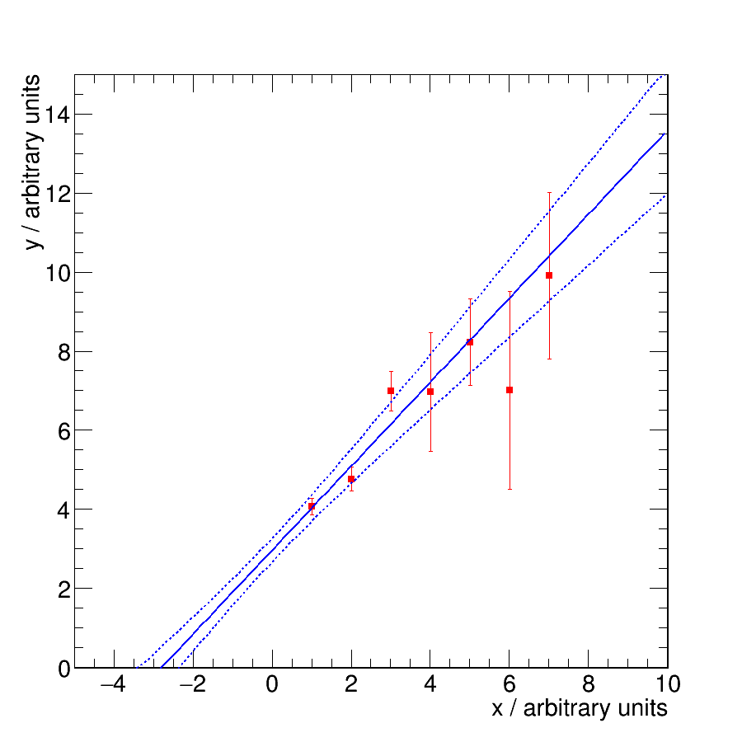
How well do we estimate interpolated and extrapolated y-values?
In this example I just ignored the covariant error term. This model is simple but wrong.

Slide 46
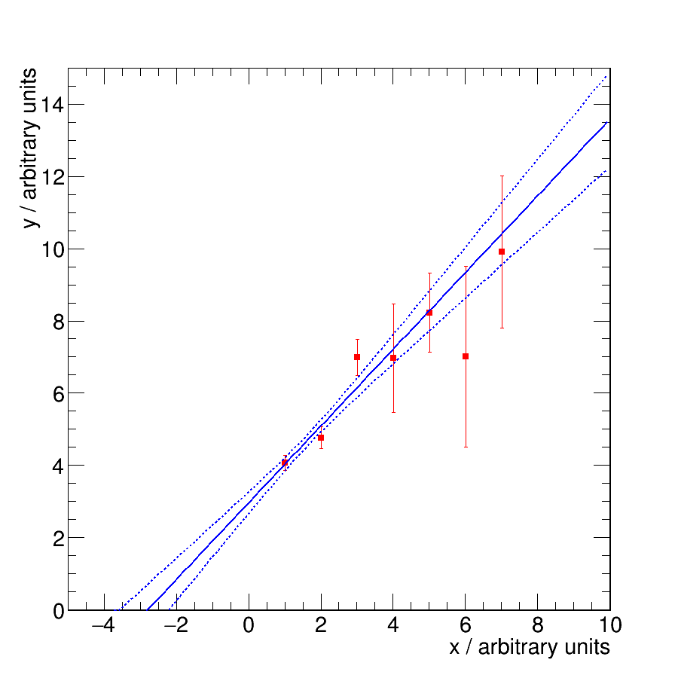
In this calculation I utilized the covariant error term. This model is more complicated but correct.
The error boundaries are a little tighter as before, the point with minimal error corresponds to a different x-value.
The uncertainty is smallest where you have data (interpolation). It is smaller than the individual error bars. The uncertainty quickly grows where you have no supporting data (extrapolation).

Slide 47
I hope some of the material I presented sticks. These basic concepts of data treatment and estimation of certainty are essential tools for anybody in the sciences, engineering etc. who has to deal with data. In practical situations: if you can’t know how sure to be about something, you need to base decisions on “feelings”, “convictions”, “common sense” instead of rational thought and quantifiable arguments.
There are certain situations where you have no choice because you simply don’t know the quantifiable details. If one has a choice ratio (Latin for reason) is usually a good guide to decision making.

Slide 48
Appendix 2: derivation of the linear regression relations

Slide 49
Backup: derivation of linear regression formulas for slope and y-intercept
$$χ^{2}=\sum_{i}{\frac{{\left(y_{i}−y_{fi}\right)}^{2}}{s_{i}^{2}}=}\sum_{i}{\frac{{\left(y_{i}−{m∙x}_{i}−b\right)}^{2}}{s_{i}^{2}}}$$
$$\frac{∂χ^{2}}{∂m}=−2\sum_{i}{\frac{\left(y_{i}−m{∙x}_{i}−b\right)x_{i}}{s_{i}^{2}}}=0$$
Note: in this appendix the straight line is parametrized as f(x)=m·x+b. Therefore, m≡p₂ and b≡p₁.
$$\frac{∂χ^{2}}{∂b}=−2\sum_{i}{\frac{\left(y_{i}−m{∙x}_{i}−b\right)}{s_{i}^{2}}}=0$$

Slide 50
$$−\sum_{i}{\frac{y_{i}x_{i}}{s_{i}^{2}}}+m\sum_{i}{\frac{x_{i}^{2}}{s_{i}^{2}}}+b\sum_{i}{\frac{x_{i}}{s_{i}^{2}}}=0$$
$$m\sum_{i}{\frac{x_{i}^{2}}{s_{i}^{2}}}+b\sum_{i}{\frac{x_{i}}{s_{i}^{2}}}=\sum_{i}{\frac{y_{i}x_{i}}{s_{i}^{2}}}$$
(I)
$$−\sum_{i}{\frac{y_{i}}{s_{i}^{2}}}+m\sum_{i}{\frac{x_{i}}{s_{i}^{2}}}+b\sum_{i}{\frac{1}{s_{i}^{2}}}=0$$
$$−m\sum_{i}{\frac{x_{i}}{s_{i}^{2}}}−b\sum_{i}{\frac{1}{s_{i}^{2}}}=−\sum_{i}{\frac{y_{i}}{s_{i}^{2}}}$$
(II)
Multiply (I) by$\sum_{i}{\frac{x_{i}}{s^{2}}} and \left(II\right) by\sum_{i}{\frac{x_{i}^{2}}{s^{2}}}$
$$m\sum_{i}{\frac{x_{i}^{2}}{s_{i}^{2}}}\sum_{i}{\frac{x_{i}}{s_{i}^{2}}}+b\sum_{i}{\frac{x_{i}}{s_{i}^{2}}}\sum_{i}{\frac{x_{i}}{s_{i}^{2}}}=\sum_{i}{\frac{y_{i}x_{i}}{s_{i}^{2}}\sum_{i}{\frac{x_{i}}{s_{i}^{2}}}}$$
(I)
$$−m\sum_{i}{\frac{x_{i}}{s_{i}^{2}}}\sum_{i}{\frac{x_{i}^{2}}{s_{i}^{2}}}−b\sum_{i}{\frac{1}{s_{i}^{2}}}\sum_{i}{\frac{x_{i}^{2}}{s_{i}^{2}}}=−\sum_{i}{\frac{y_{i}}{s_{i}^{2}}}\sum_{i}{\frac{x_{i}^{2}}{s_{i}^{2}}}$$
(II)

Slide 51
Now add (I) and (II) and define $Δ=\left[\sum_{i}{\frac{1}{s_{i}^{2}}\sum_{i}{\frac{x_{i}^{2}}{s_{i}^{2}}−}}{\left(\sum_{i}{\frac{x_{i}}{s_{i}^{2}}}\right)}^{2}\right]$
$$b=\frac{1}{∆}\left(\sum_{i}{\frac{y_{i}}{s_{i}^{2}}}\sum_{i}{\frac{x_{i}^{2}}{s_{i}^{2}}}−\sum_{i}{\frac{y_{i}x_{i}}{s_{i}^{2}}\sum_{i}{\frac{x_{i}}{s_{i}^{2}}}}\right)$$
y-intercept
Now modify the calculation from the previous slide to get the slope.

Slide 52
$$−\sum_{i}{\frac{y_{i}x_{i}}{s_{i}^{2}}}+m\sum_{i}{\frac{x_{i}^{2}}{s_{i}^{2}}}+b\sum_{i}{\frac{x_{i}}{s_{i}^{2}}}=0$$
$$m\sum_{i}{\frac{x_{i}^{2}}{s_{i}^{2}}}+b\sum_{i}{\frac{x_{i}}{s_{i}^{2}}}=\sum_{i}{\frac{y_{i}x_{i}}{s_{i}^{2}}}$$
(I)
$$−\sum_{i}{\frac{y_{i}}{s_{i}^{2}}}+m\sum_{i}{\frac{x_{i}}{s_{i}^{2}}}+b\sum_{i}{\frac{1}{s_{i}^{2}}}=0$$
$$−m\sum_{i}{\frac{x_{i}}{s_{i}^{2}}}−b\sum_{i}{\frac{1}{s_{i}^{2}}}=−\sum_{i}{\frac{y_{i}}{s_{i}^{2}}}$$
(II)
Multiply (I) by$\sum_{i}{\frac{1}{σ^{2}}} and \left(II\right) by\sum_{i}{\frac{x_{i}}{σ^{2}}}$
$$m\sum_{i}{\frac{x_{i}^{2}}{s_{i}^{2}}}\sum_{i}{\frac{1}{s_{i}^{2}}}+b\sum_{i}{\frac{x_{i}}{s_{i}^{2}}}\sum_{i}{\frac{1}{s_{i}^{2}}}=\sum_{i}{\frac{y_{i}x_{i}}{s_{i}^{2}}\sum_{i}{\frac{1}{s_{i}^{2}}}}$$
(I)
$$−m\sum_{i}{\frac{x_{i}}{s_{i}^{2}}}\sum_{i}{\frac{x_{i}}{s_{i}^{2}}}−b\sum_{i}{\frac{1}{s_{i}^{2}}}\sum_{i}{\frac{x_{i}}{s_{i}^{2}}}=−\sum_{i}{\frac{y_{i}}{s_{i}^{2}}}\sum_{i}{\frac{x_{i}}{s_{i}^{2}}}$$
(II)

Slide 53
Now add (I) and (II) and define $Δ=\left[\sum_{i}{\frac{1}{s_{i}^{2}}\sum_{i}{\frac{x_{i}^{2}}{s_{i}^{2}}−}}{\left(\sum_{i}{\frac{x_{i}}{s_{i}^{2}}}\right)}^{2}\right]$
$$m=\frac{1}{∆}\left(\sum_{i}{\frac{y_{i}x_{i}}{s_{i}^{2}}\sum_{i}{\frac{1}{s_{i}^{2}}}}−\sum_{i}{\frac{y_{i}}{s_{i}^{2}}}\sum_{i}{\frac{x_{i}}{s_{i}^{2}}}\right)$$
slope

Slide 54
Backup: derivation of error on y-intercept from linear regression fit
$$b=\frac{1}{∆}\left(\sum_{i}{\frac{y_{i}}{σ_{i}^{2}}}\sum_{i}{\frac{x_{i}^{2}}{σ_{i}^{2}}}−\sum_{i}{\frac{y_{i}x_{i}}{σ_{i}^{2}}\sum_{i}{\frac{x_{i}}{σ_{i}^{2}}}}\right)$$
$$σ_{b}^{2}=\sum_{j}{\left(\frac{∂b}{∂y_{j}}\right)σ_{j}^{2}}$$
$$\frac{∂b}{∂y_{j}}=\frac{1}{∆}\left(\frac{1}{σ_{j}^{2}}\sum_{i}{\frac{x_{i}^{2}}{σ_{i}^{2}}}−\frac{x_{j}}{σ_{j}^{2}}\sum_{i}{\frac{x_{i}}{σ_{i}^{2}}}\right)$$

Slide 55
$$σ_{b}^{2}=\sum_{j}{\frac{1}{Δ^{2}}{\left(\frac{1}{σ_{j}^{2}}\sum_{i}{\frac{x_{i}^{2}}{σ_{i}^{2}}}−\frac{x_{j}}{σ_{j}^{2}}\sum_{i}{\frac{x_{i}}{σ_{i}^{2}}}\right)}^{2}σ_{j}^{2}}$$
$$σ_{b}^{2}=\sum_{j}{\frac{σ_{j}^{2}}{Δ^{2}}\left[\frac{1}{σ_{j}^{4}}{\left(\sum_{i}{\frac{x_{i}^{2}}{σ_{i}^{2}}}\right)}^{2}−2\frac{x_{j}}{σ_{j}^{4}}\left(\sum_{i}{\frac{x_{i}^{2}}{σ_{i}^{2}}}\right)\left(\sum_{i}{\frac{x_{i}}{σ_{i}^{2}}}\right)+\frac{x_{j}^{2}}{σ_{j}^{4}}{\left(\sum_{i}{\frac{x_{i}}{σ_{i}}}\right)}^{2}\right]}$$
$$σ_{b}^{2}=\frac{1}{Δ^{2}}\sum_{j}{\frac{1}{σ_{j}^{2}}{\left(\sum_{i}{\frac{x_{i}^{2}}{σ_{i}^{2}}}\right)}^{2}}−2\sum_{j}{\frac{x_{j}}{σ_{j}^{2}}}\left(\sum_{i}{\frac{x_{i}^{2}}{σ_{i}^{2}}}\right)\left(\sum_{i}{\frac{x_{i}}{σ_{i}^{2}}}\right)+\sum_{j}{\frac{x_{j}^{2}}{σ_{j}^{2}}}{\left(\sum_{i}{\frac{x_{i}}{σ_{i}^{2}}}\right)}^{2}$$
$$σ_{b}^{2}=\frac{1}{Δ^{2}}\sum_{j}{\frac{x_{j}^{2}}{σ_{j}^{2}}}∙\left[\sum_{j}{\frac{1}{σ_{j}^{2}}}\sum_{i}{\frac{x_{i}^{2}}{σ_{i}^{2}}}−{\left(\sum_{i}{\frac{x_{i}}{σ_{i}^{2}}}\right)}^{2}\right]$$
The term in square brackets is Δ

Slide 56
$$σ_{b}^{2}=\frac{1}{Δ}\sum_{j}{\frac{x_{j}^{2}}{σ_{j}^{2}}}$$
Error on y-intercept
After a similar calculation
$$σ_{m}^{2}=\frac{1}{Δ}\sum_{j}{\frac{1}{σ_{j}^{2}}}$$
Error on slope

