Slide 1

Electrical measurements and signals
P. LeClair
PH 4/591 Fall 2022

Slide 2
why?
Just about every measurement ends up being electrical at some point
General aspects and circuits
Signal processing
  Modulation techniques: improve S/N
  Grounding and other nefarious problems

Slide 3
series resistors
R1
R2
Req
a
b
c
a
c
I
I
+
-
+
-
∆V
∆V

Slide 4
voltage divider
R1
signal
in
Vin
Vout
R1
signal
out
R2
volume
R2
R2
Vout =
Vin
R1+R2

Slide 5
parallel resistors
∆V1=∆V2=∆V
1
1
1
R2
=
+
Req R1 R2
Req
I1
R1
a
b
I
I2
+
-
+
-
∆V
∆V
current divider

Slide 6
more complex arrangements

Slide 7
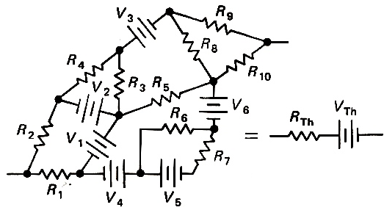
Thévenin equivalents
Vth = V (open circuit)
V (open circuit)
Rth =
I (closed circuit)
any weird combinations of R’s and V’s
is equivalent
to a
SINGLE R and V
(or a single I source
in parallel with R)

Slide 8
so what?
E
I
R
V
R
real sources =
ideal sources + R
real meter =
ideal meter with R

Slide 9
V source loading
∆Vload = V - Ir
for r ≪ Rload,
∆Vload ≈ V
V
Rload
r
I
V source wants R high
one easy solution:
large resistor in parallel with load
source
like a battery

Slide 10
I source loading
r
Iload = I
r+R
r
Rload
for Rload ≪ r,
Iload ≈ I
I
Ip
Iload
source
I source wants R low
sourcing currents at high Rload is hard

Slide 11
measuring the meter
I
I
r
Rload
V
Req
V
real
meter
ideal
meter
∆Vload = IReq =
R
I
Rload ≪ r, ∆Vload ≈ IR
1+R/r

Slide 12
summary
voltmeter wants R low!
  can use a buffer/follower
I source wants R low
  transformer pre-amp if ac
  consider sourcing V
V source wants R high
  large series + parallel resistors
  present large R

Slide 13
Sourcing current
This is what a hand meter does.
Why is it not great?
V_{meter} = I(R_{thing} + 2R_{wires})
R_{wires}
I
V
R_{thing}
R_{wires}
Meters: check your inputs
Check for “R=0” by shorting leads
Keep after the batteries …

Slide 14
Sourcing current, “properly”
R_{wires}
I
R_{thing}
V
R_{thing} ≪ Rinternal
or add buffer
R_{wires}
No problem.
You just need four wires.
What is still potentially wrong?

Slide 15
source/meter impedance
voltmeter wants R low
  Buffer/amp to increase input R of meter?
  can easily provide ~10¹⁰ Ohm
I source wants R low
  can we stay in compliance? What does that mean?
  is it better to source V?
  pre-amp?
  High resistances are a problem
  But so are low resistances if V is too small!

Slide 16
Sourcing voltage
R_{wires}
Vs
R_{thing}
V
R_{wires}
Still have to measure voltage on device
the wires have a V drop
What about current?

Slide 17
Sourcing voltage II
Vs
R_{wires}
V
R_{thing}
Rs
Rpar
Ι
R_{wires}
Ι
R = ∆V / I
Note we need 4 wires again
current meter - not hard
still problems?
=
R_{precise}
V

Slide 18
source/meter resistances
voltmeter wants R low
but V source wants R high
need buffer/amp on V meter
resistor in parallel with source
if V source is problem, R is too low
  consider sourcing I

Slide 19
what if I want to measure a small change in R?
R1
R3
Vs
V
Adjust R₂ to balance to V=0
Detect small changes in V
R2
Rx+dR
At balance,
Allows very accurate difference measurement
(measure only the change not change + bkgd)

Slide 20
what about a real sample with a weird shape? Van der Pauw technique
make four fairly arbitrary contacts
source I on 2 adjacent contacts
measure V on the other two
rotate the configuration 90º
solve a little equation …
get sheet resistance (resistivity/thickness)
<works for Hall effect too>

Slide 21
What? Why?
get sheet resistance
    (+ resistivity with known thickness)
get doping type (i.e. if it is a p-type or n-type) material.
get sheet carrier density of the majority carrier
    (+ doping level with known thickness)
get mobility of the majority carrier.
no patterning!
  - we are lazy
  - separates material properties from processing

Slide 22
rc circuits
C
E
R
V
S
V ∝ e^{-τ/RC}
Do it on purpose: ramp/time delay
Time domain analysis …

Slide 23
differentiator
C
Vin (t)
V (t)
R
Voltage across C is V_{in}-V
Same current in C and R
}
for small RC,

Slide 24
integrator
R
Vin (t)
Vout (t)
C
}
for large RC (V ≪ Vin)

Slide 25
so what?
On purpose: filtering of signals
Not on purpose:
                unintentional capacitive coupling
                see from waveform shape
                debugging tool …
more later

Slide 26
ac circuits & impedance
generalization of resistance to time-varying signals
using ac, everything lets current through a little
Z = impedance ~ resistance
  frequency dependent
  can include phase shift! (time lag of V or I)
ZR = R
ZC = -i/ωX
ΖL = iωL
}
+/- 90º phase shift

Slide 27
resistive circuits
nothing earth-shattering happens
except P is lower than you expect

Slide 28
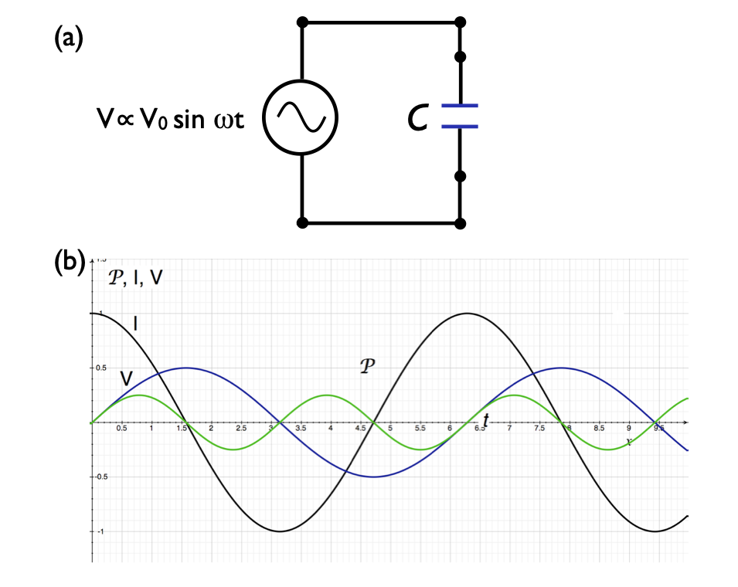
capacitive circuits
I and V 90º out of phase
average power is ZERO
frequency response?
  insulating at dc
  conducting at high f
voltage “lags” current

Slide 29
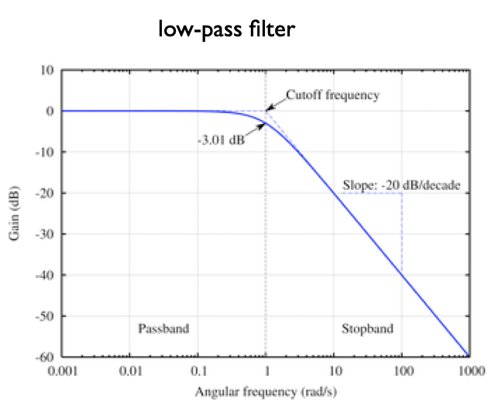
our filters in frequency domain
low-pass
high-pass
R
C
Vin
Vout
Vin
Vout
C
R

Slide 30
familiar?
R
C
Vin
Vout
Vin
Vout
C
R
low-pass filter
high-pass filter
frequency domain
⇕
time domain
integrator
differentiator

Slide 31
familiar?
R
C
Vin
Vout
Vin
Vout
C
R
low-pass filter
high-pass filter
frequency domain
⇕
time domain
integrator
differentiator
Eliminate slow variations
Magnify changes
Peaks become zero crossing
Cut out high frequency noise
Smooths (but slows response)

Slide 32
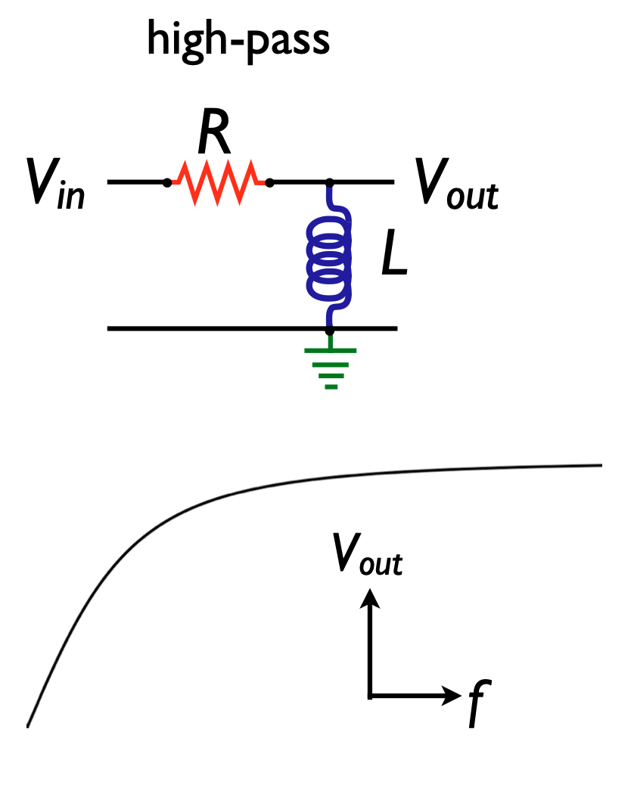

Slide 33
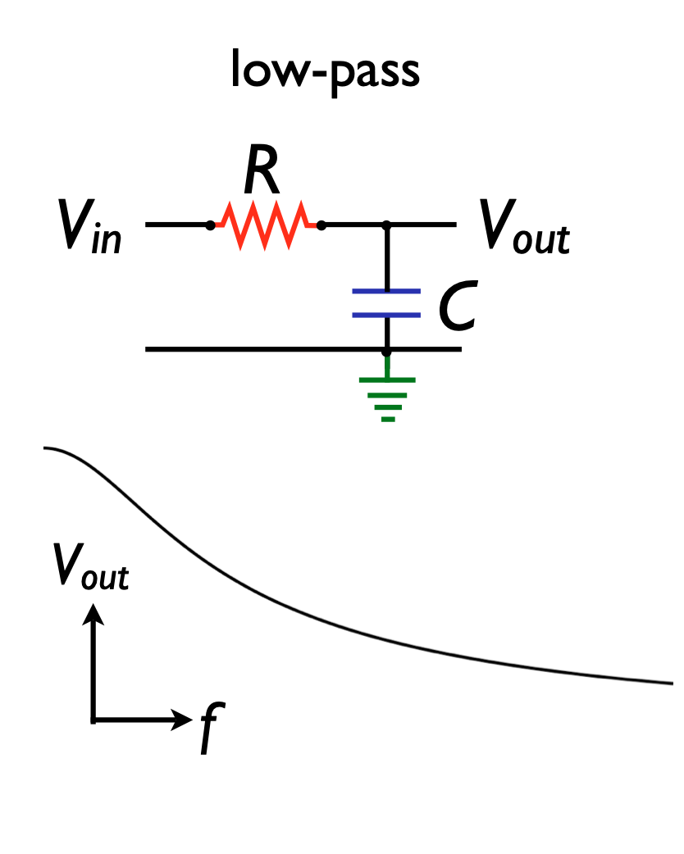

Slide 34
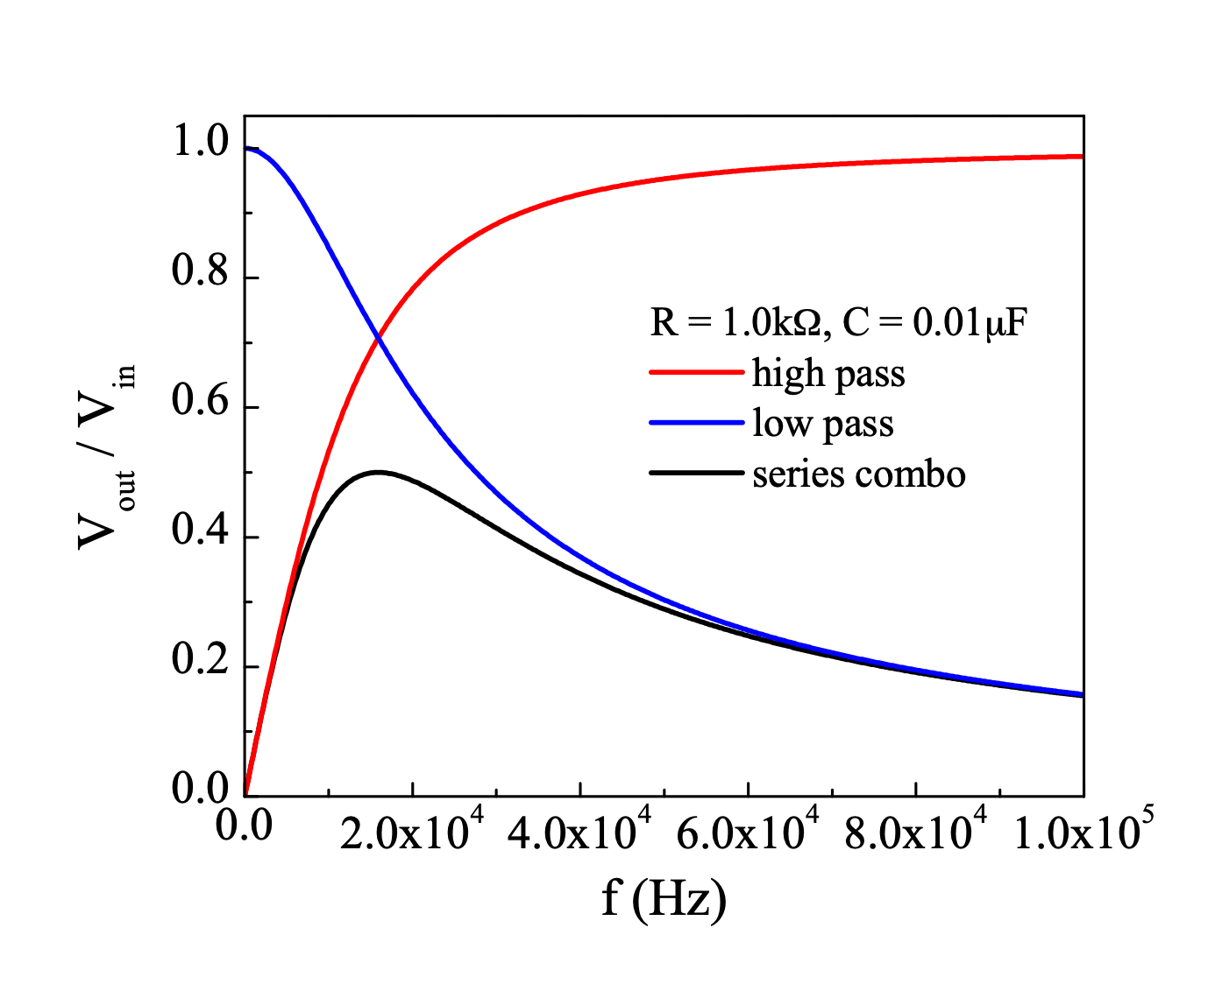

Slide 35
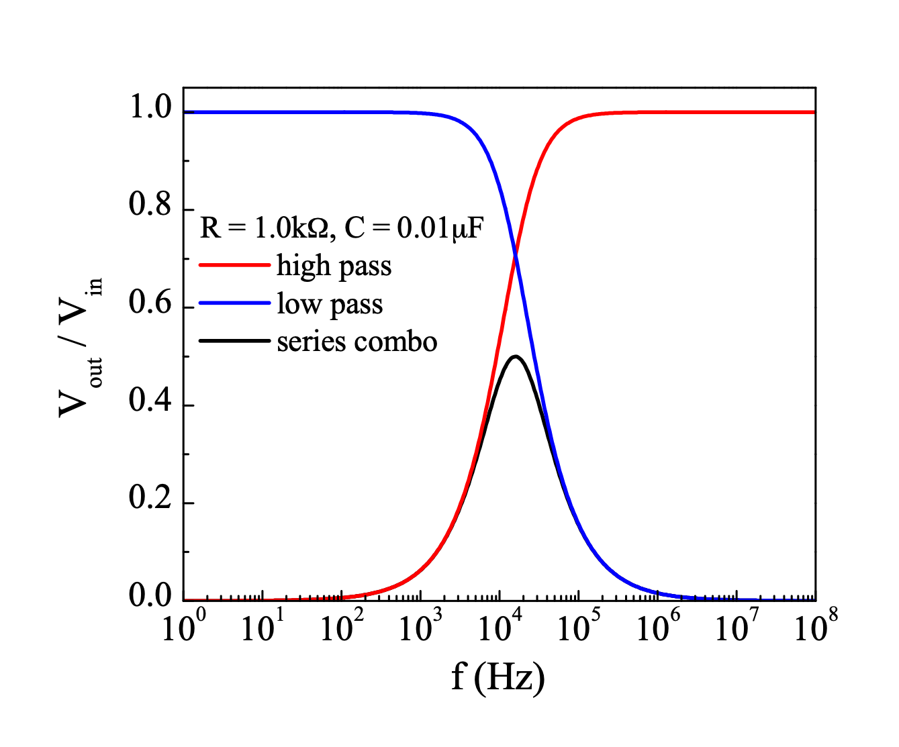

Slide 36
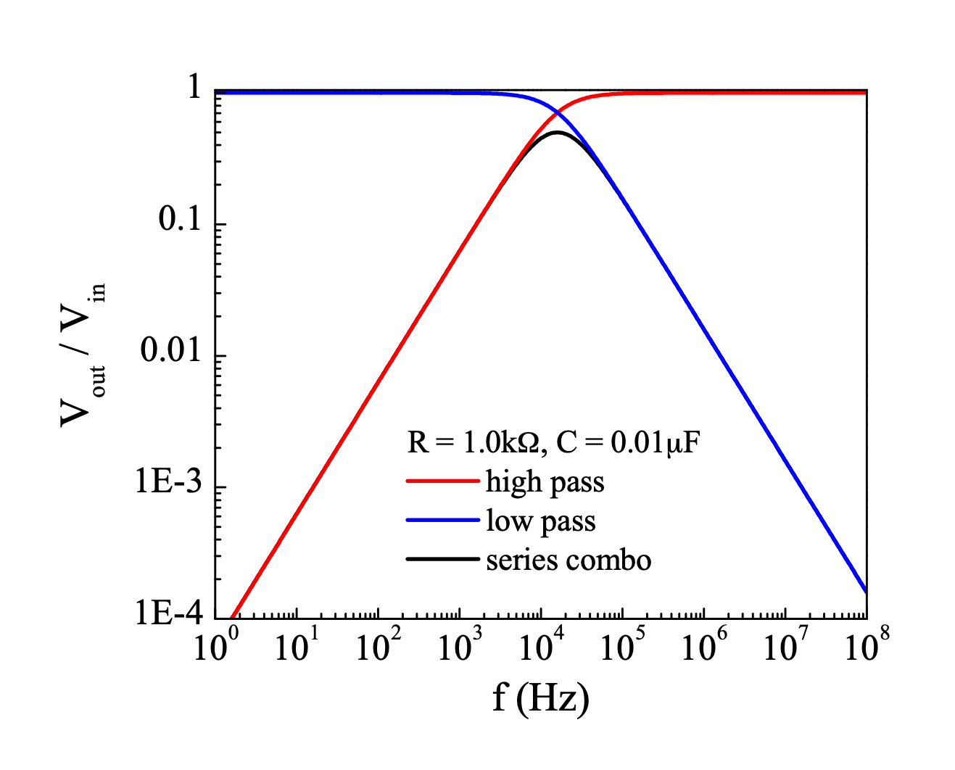
dB/decade ...

Slide 37
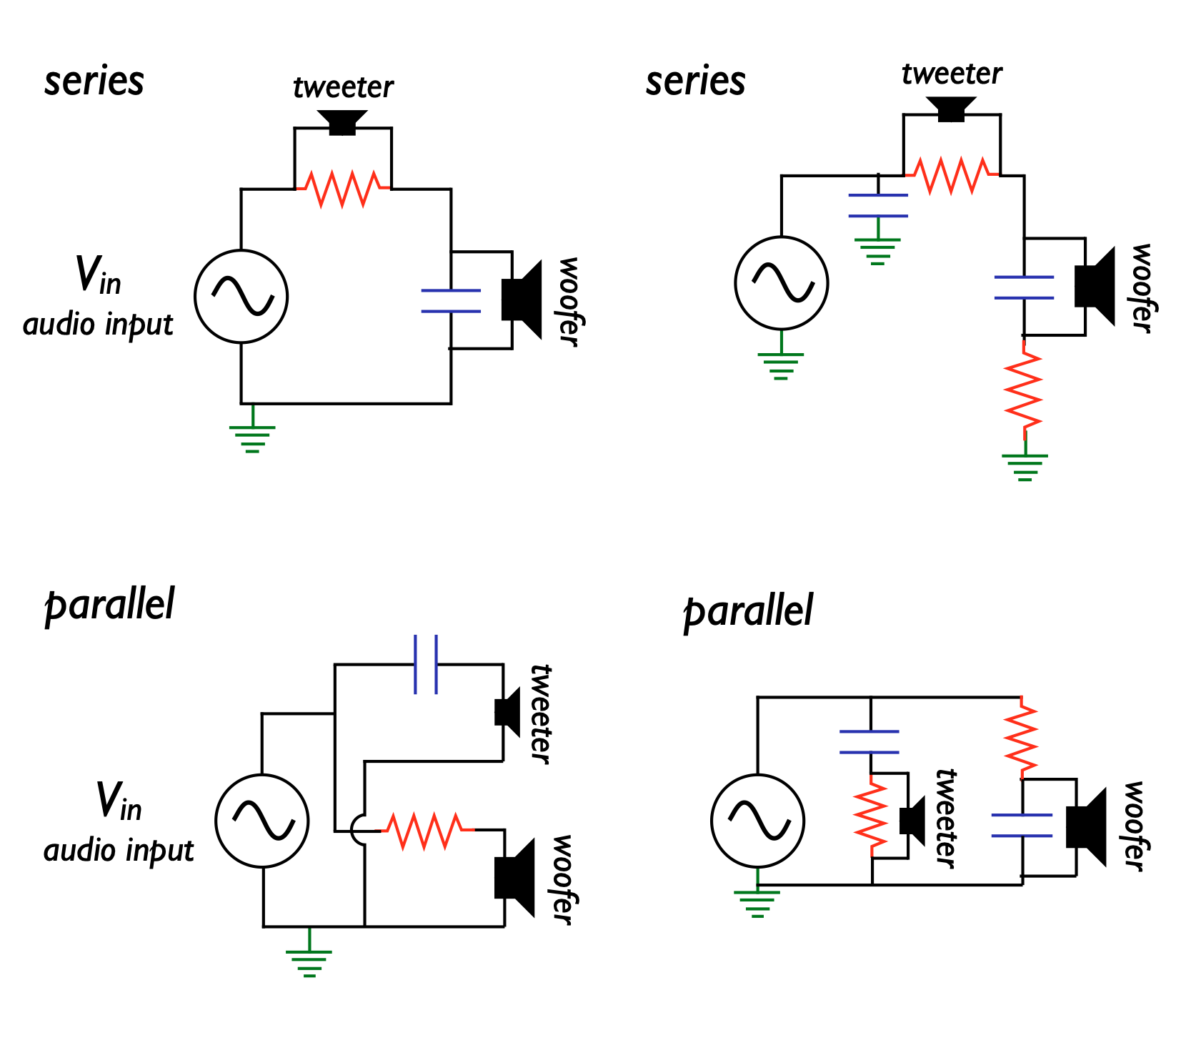
audio crossovers

Slide 38
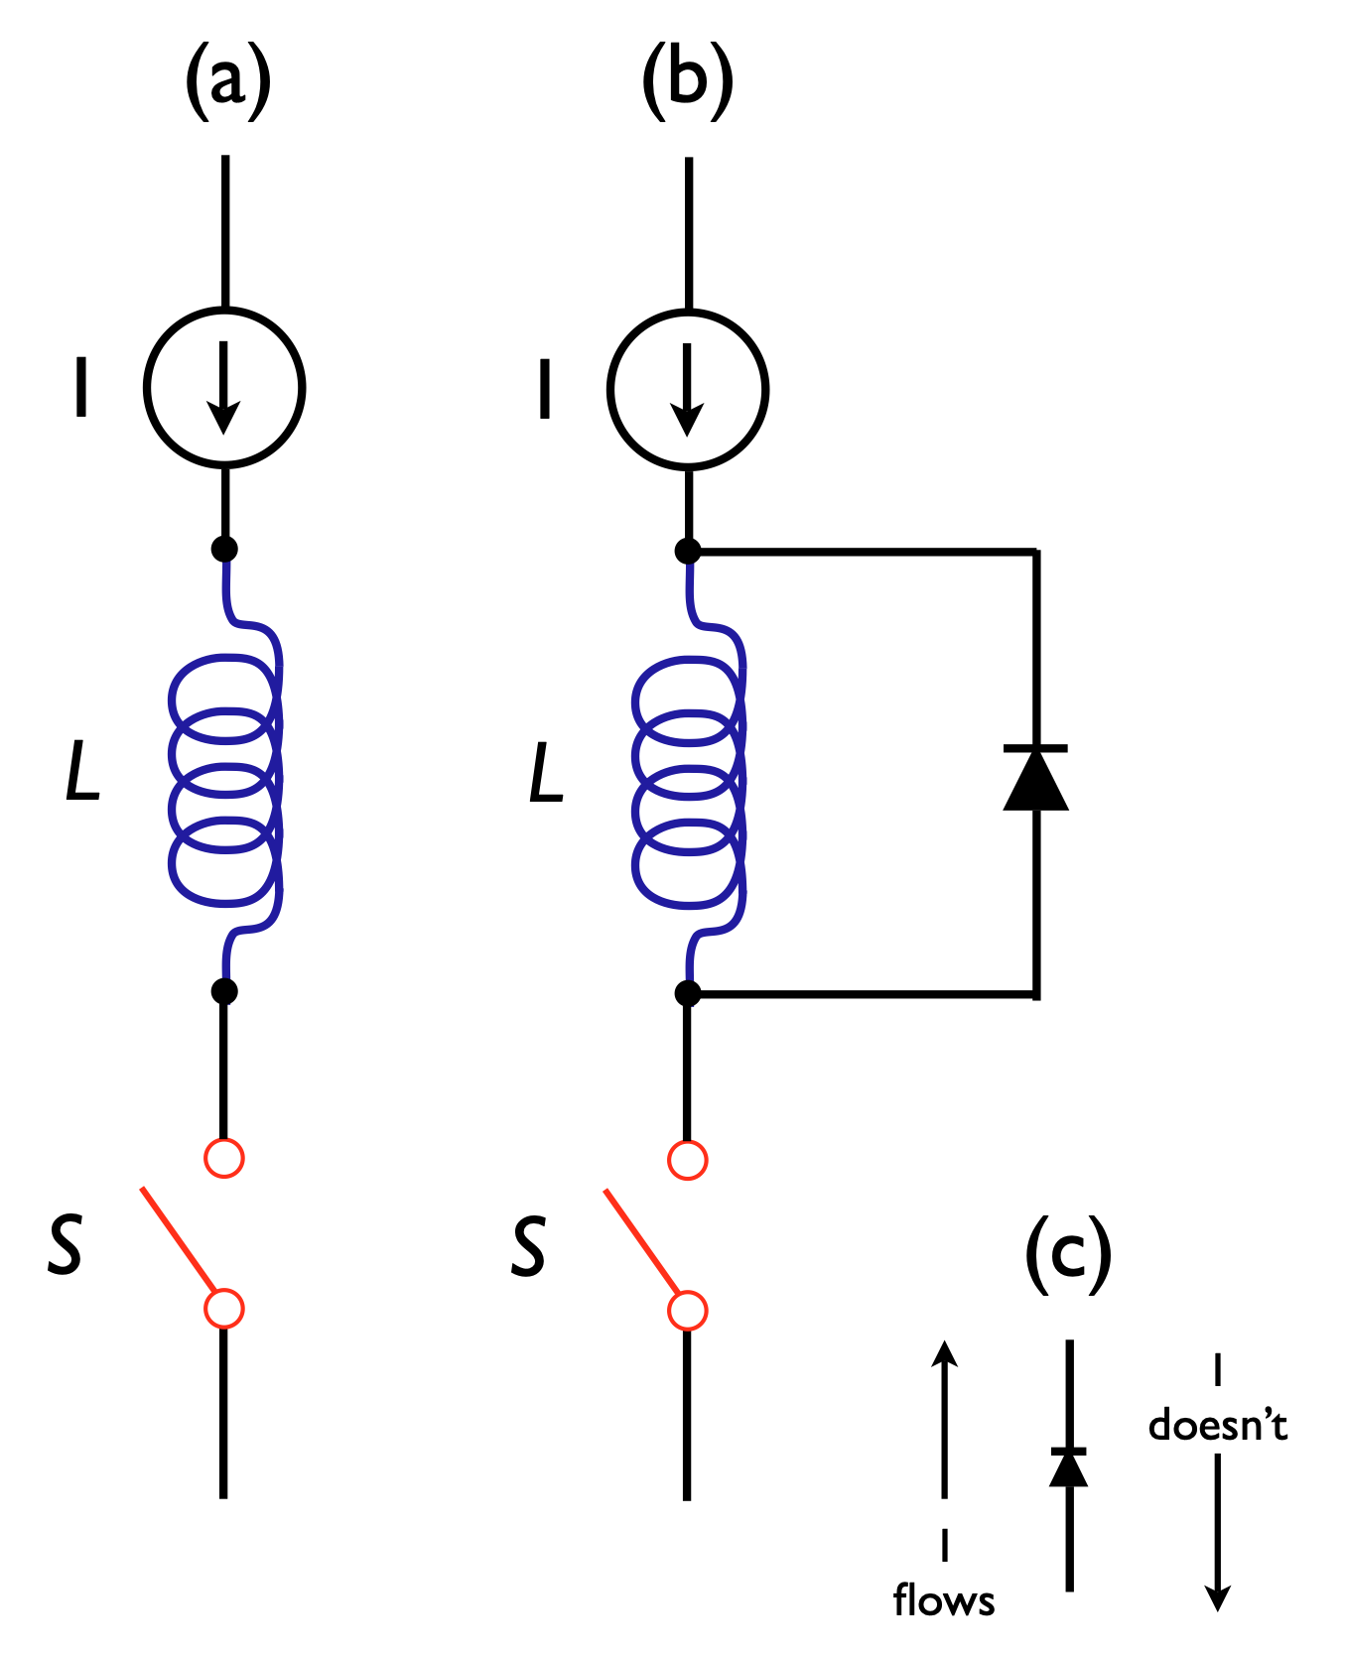
inductive “kick” …
aka the Angry Current

Slide 39
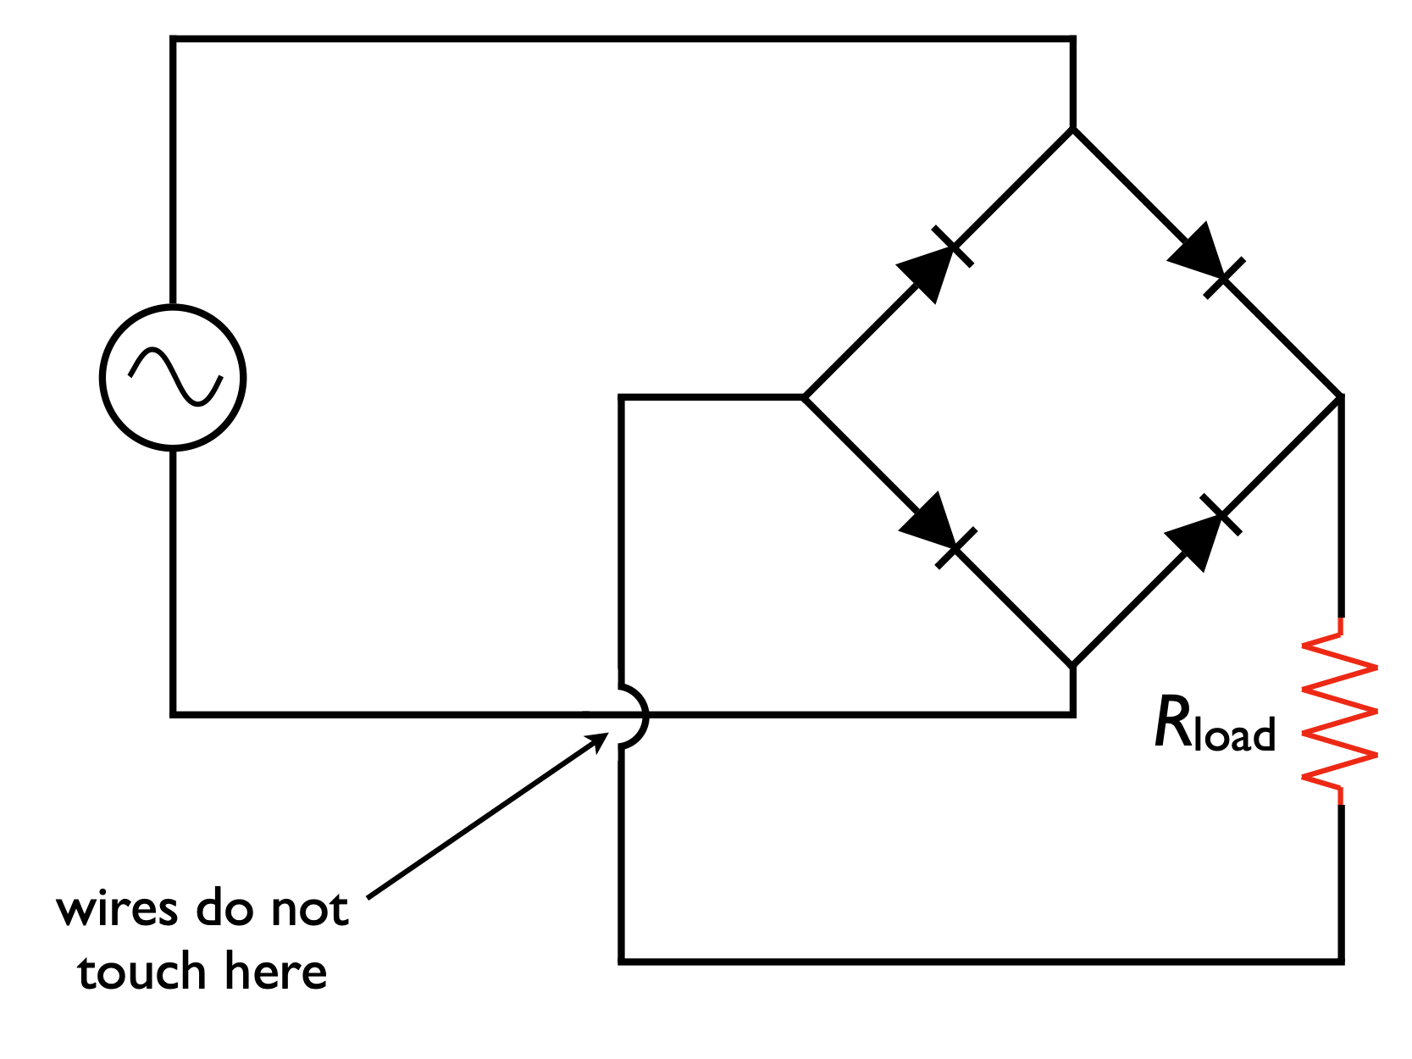

Slide 40
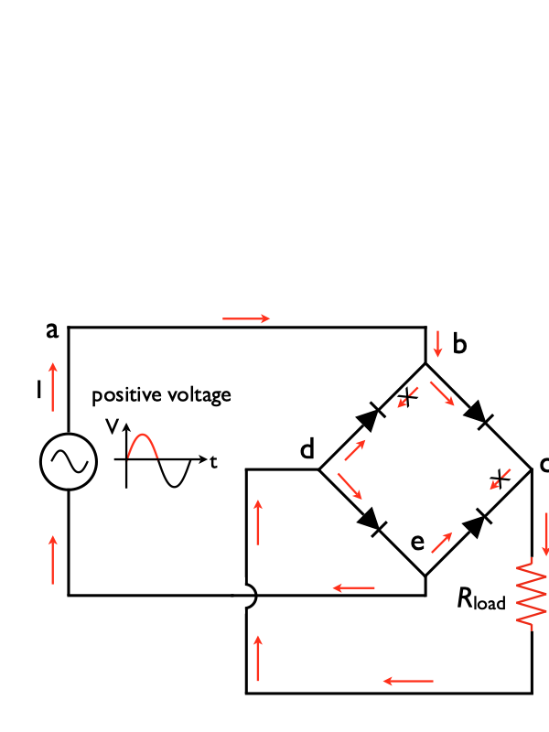

Slide 41
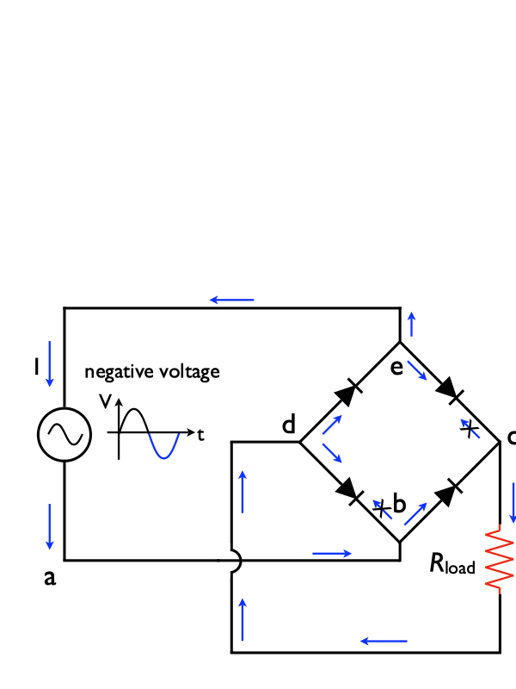

Slide 42
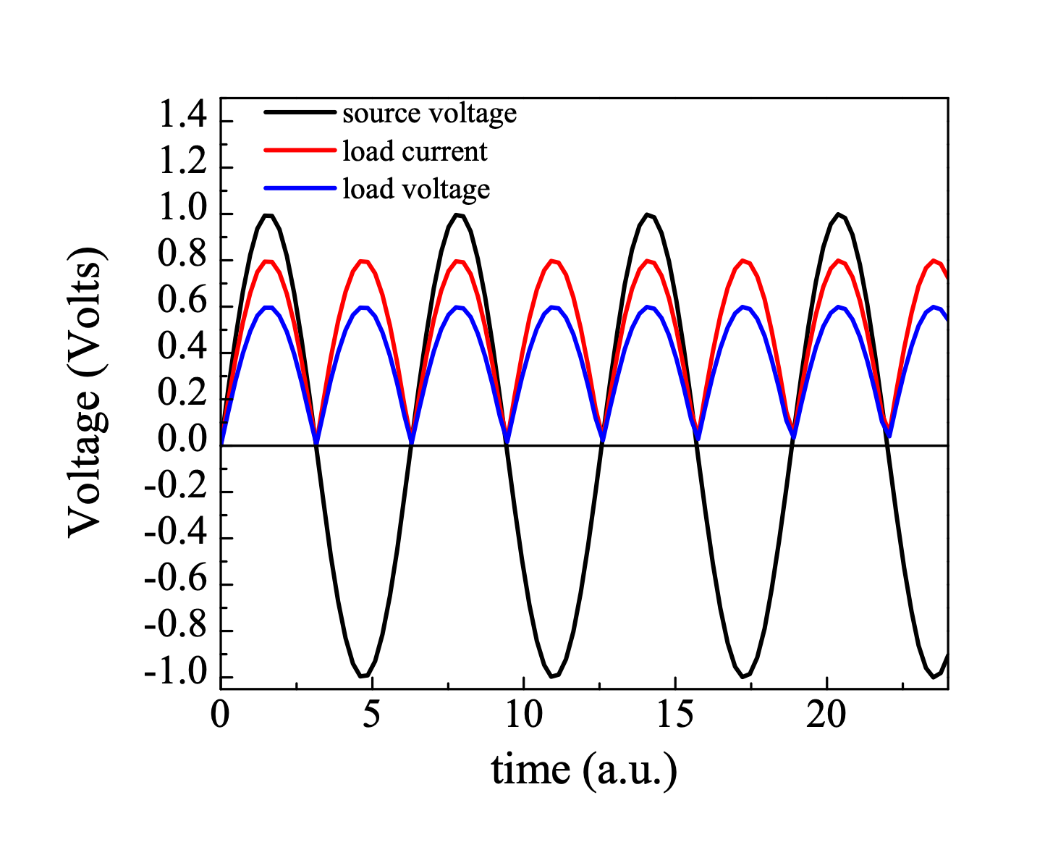

Slide 43
noise
Frequency dependence of noise
Low frequency ~ 1 / f
  example: temperature (0.1 Hz) , pressure (1 Hz), acoustics (10 -- 100 Hz)
High frequency ~ constant = white noise
  example: shot noise, Johnson (thermal) noise, spontaneous emission noise
Total noise depends strongly on freq.; worst at DC, best in “white” region
Problem -- most signals at DC
  (Bandwidth? Measurement time)
log(V_{noise})
Noise amplitude
1/f noise
White noise
0
0.1 1 10 100 1k
log( f )

Slide 44
what’s your bandwidth?
Total noise in 10 Hz bandwidth
if we could just measure only one frequency in a narrow bandwidth ...
Signal at DC
1/f noise
log(V_{noise})
10 Hz
White noise
0
0.1 1 10 100 1kHz
log( f )
Signal at 1 kHz
1/f noise
and shift our measurement to higher frequency ...
log(V_{noise})
White noise
10 Hz
0
0.1 1 10 100 1kHz
log( f )

Slide 45
No, what is bandwidth?
2 key frequencies:
- inverse of measurement time T sets low f
- sampling frequency is high limit
Shannon-Nyquist theorem: bandwidth is ½ sampling frequency. Measure at 1kHz sampling, BW=0.5kHz.
“If a function x(t) contains frequencies no higher than f_{max}, it can be completely determined by sampling a series of points spaced T=1/2 f_{max} seconds apart, i.e., by sampling at a rate of 2f_{max} samples per second.”

Slide 46
how do we make a signal periodic?
Modulate signal, but not noise ... far from 1/f
  no universal technique
  optical chopper wheel, freq modulation
  small modulation voltage on dc ramp
  Freq low compared to phenomena of interest,
  outside known noisy bands
Shifts signal out to higher frequencies
Detect only at modulation frequency
  Noise at all other frequencies averages to zero
  odds that stray signals are at this f?
  controlled perturbation ... linear response

Slide 47
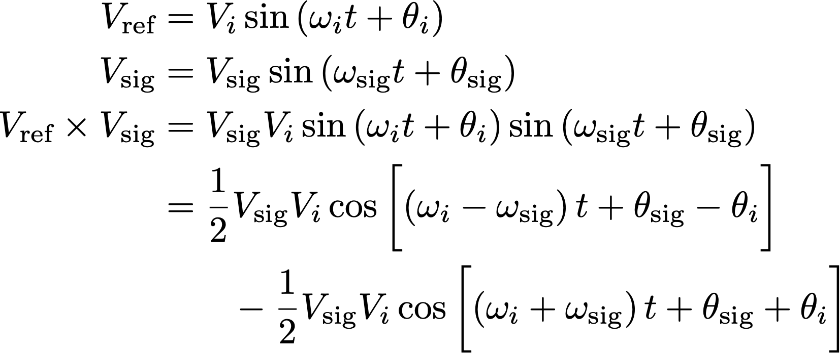
then what?
dc + reference f drives system
multiply response by reference
(can add phase adjust so one is zero)

Slide 48
Demodulation / Mixing
Sum and difference freq generated
Interference, basically
If signal frequency is close to reference frequency:
  low frequency “beating”
  product is DC if signal & ref. have same frequency
  take product, filter, integrate over time
  magnitude depends on relative phase

Slide 49
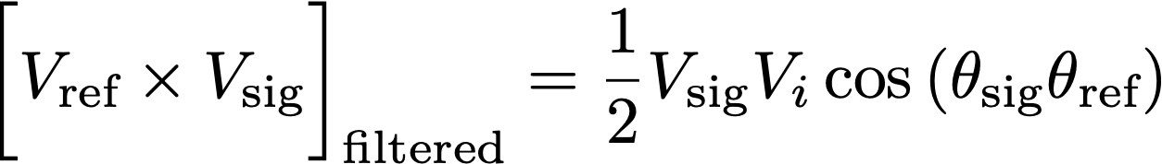
so what?
pass signal through a low pass filter – all ac signals gone
In general, nothing is left …
but if input and signal frequencies match, first term is dc!
Demodulated signal
After multiplying
Voltage
plus low pass
Can set ref phase to zero
Very narrow bandwidth (~0.1Hz)
time

Slide 50
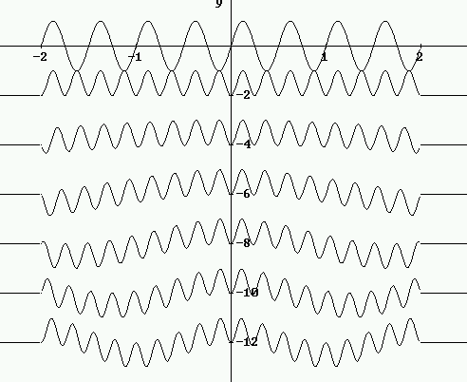
Signal freq approaches ref freq
Beat frequency approaches DC as signal freq approaches ref freq
Reference
Signal freq
vs ref freq
1
1.05
1.1
1.15
1.2
1.25
}
Mixer outputs
caught by filter
+
integrate to zero!

Slide 51
block diagram
Key: sin waves are orthogonal unless f’s match
product of ref + modulated response = dc if f’s match
low-pass = averaging (integrating) + remove harmonics
can set time constant to vary degree of rejection/bandwidth
bandwidth tiny ... ~mHz ... very low noise!
add phase shifter to reference ... tune to max output
Demodulated signal
Mixer
Low pass
filter
After mixer
Output
Input
Buffer
After mixer & low pass
Voltage
Ref
Phase
shift φ
time

Slide 52
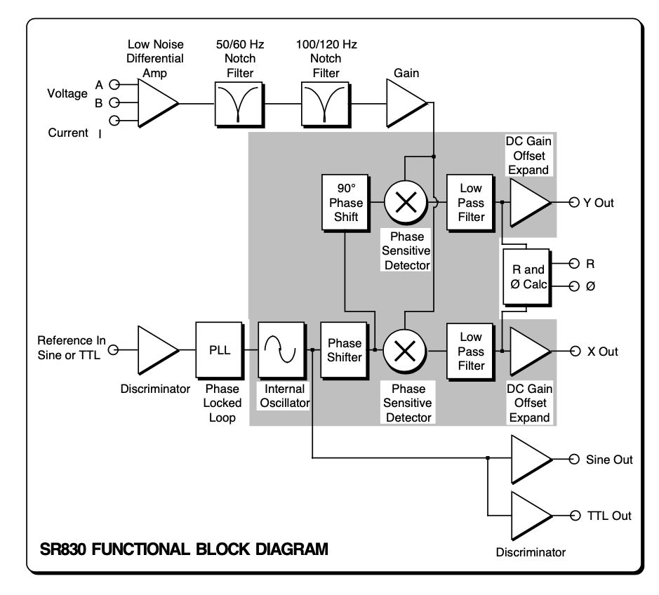
Slightly more realistic

Slide 53
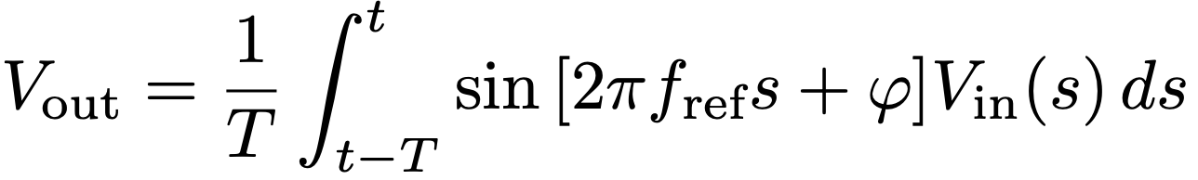
another description
what we really do is multiply sig & ref and integrate
  low-pass = integrator
  T = “time constant”
orthogonality of sin waves:
  sin wave input, integral non-zero only if freq’s match
  practically zero for T ~ 5/f (wait ~5 time constants)
  Non-linear response: Fourier series, etc.

Slide 54
math is useful
resulting signal is essentially DC
contribution from any signal not at fref is nearly 0
out-of-phase component at fref also nearly zero
    sin and cos are also orthogonal
“phase sensitive detector”

Slide 55
example: measuring dI/dV
‘blow up’ small changes in current/conduction
numerical differentiation of I(V) ?
  discretization noise
  RC integrator too restricted
drive system with dc ramp + ac modulation
measure response at modulation frequency
we need a frequency / phase sensitive technique

Slide 56
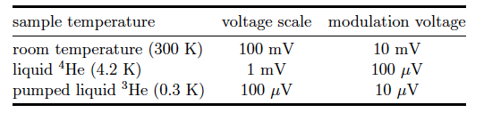
How big should δV be?
ac modulation gives average dI/dV
  over [V - δV, V + δV]
  features smaller than 2δV not resolved
thermal broadening of Fermi-Dirac
  “smearing” over E window ~ 3.5k_{B}T wide
choose δV < 3.5k_{B}T (when you can)

Slide 57
What should the frequency be?
many devices ~ capacitor || resistor
    want to neglect Z_{C} … not too high
    capacitance gives “parasitic” modulation
    want reasonable measure times … R*C
    nowhere near 60Hz (or harmonics)
In practice: ~Hz – kHz
    (very, very slow for electrons)

Slide 58
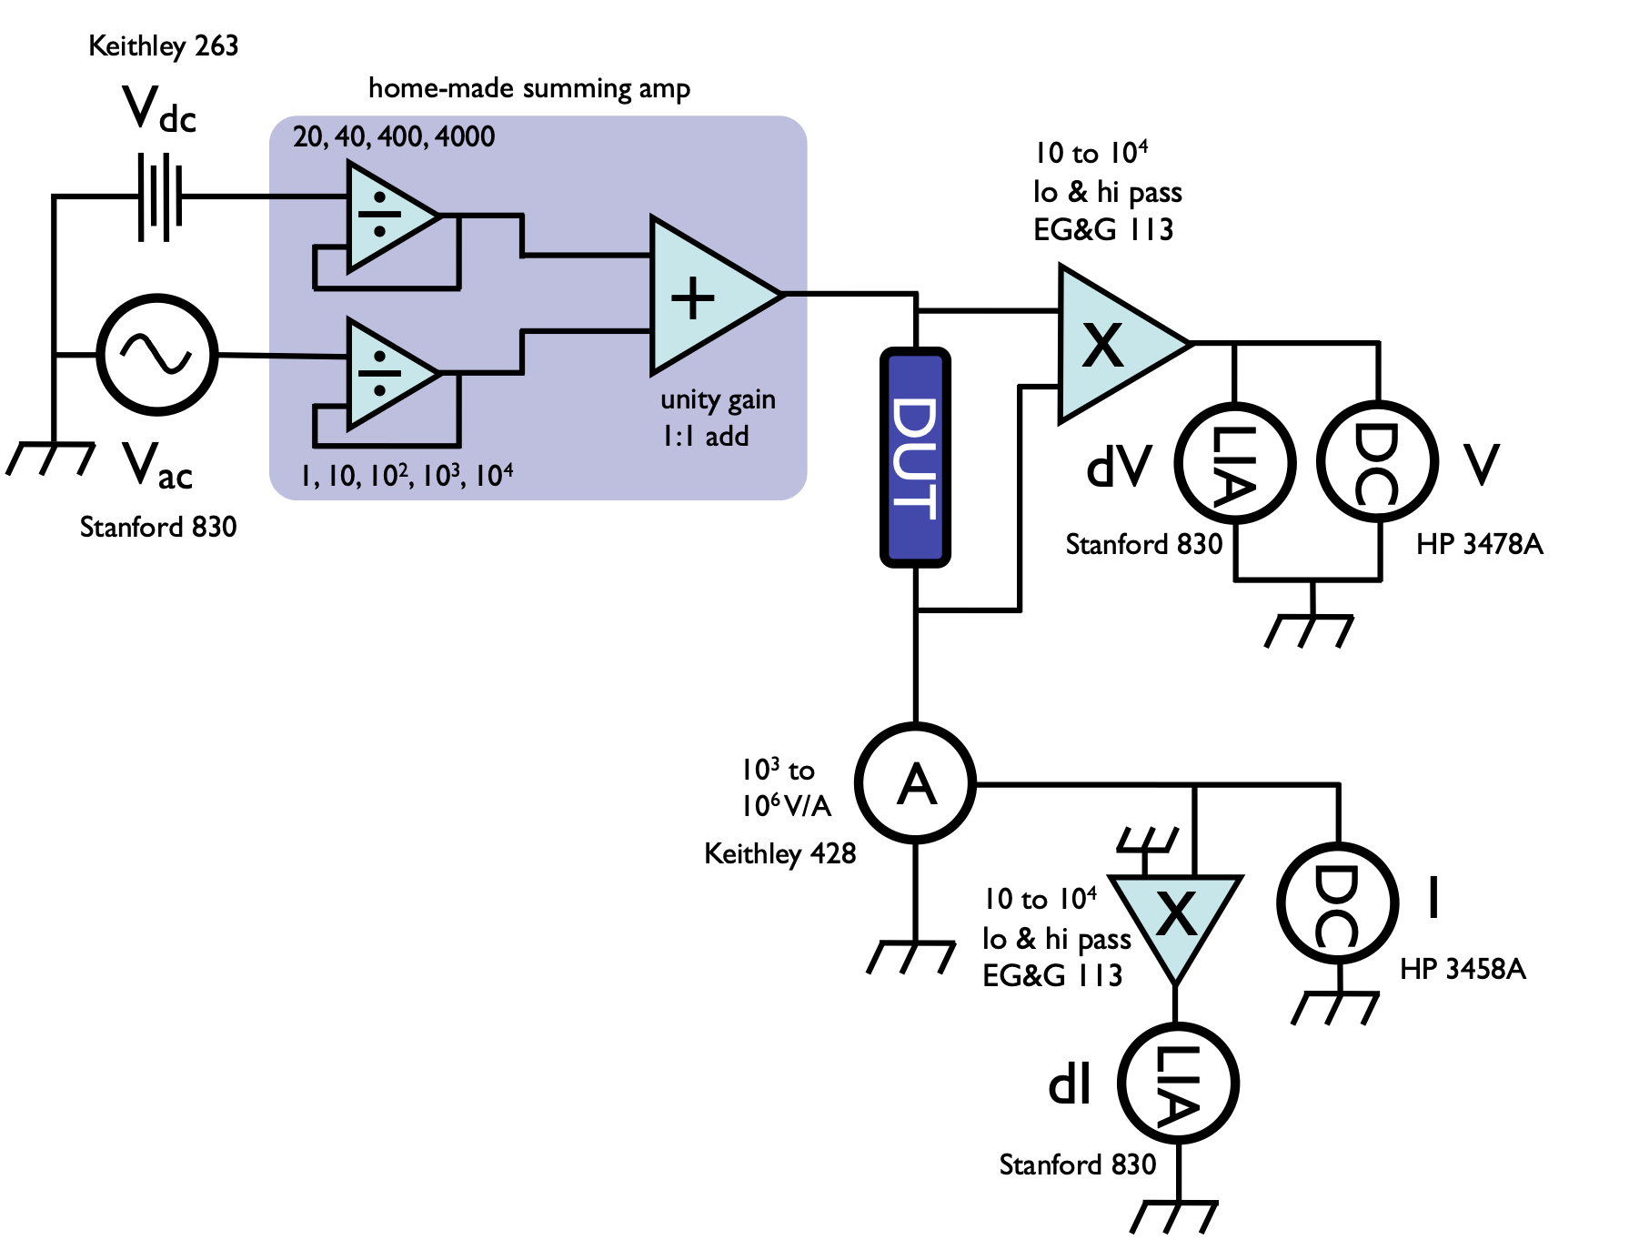
realistic circuit

Slide 59
grounding and other problems

Slide 60
other problems I: imperfect equipment
Finite input impedance
Finite output impedance
A/D converter (resolution)
discretize signal
12 bit = 2¹² = 4096 +/- 5V ⇒ 2.4mV res.
16 bit = 2¹⁶ = 65536 +/- 5V ⇒ 0.15mV res.
    ⇒ pre-amps, offset techniques (e.g., bridge)
Time constants
~ several time constants between points
compare to frequency used
consider instrument and device response (RC)
    ⇒ averaging of some sort - point, sweep/ensemble, multichannel

Slide 61
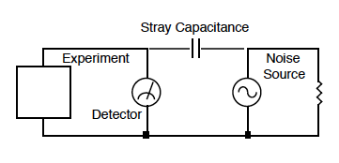
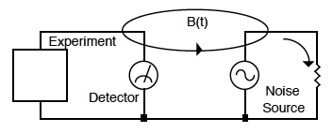
other problems II: ‘pickup’
Capacitive coupling
Sources?
you touching cables
proximity of cables
cables having the audacity to exist
Avoiding?
coax (partly)
be very, very still …
Inductive coupling
Sources of B(t) ???
Light bulbs …
CRT …
everything that plugs in
Avoiding?
Twisted pair wiring

Slide 62
So this means?
Coax is terrible.
    Inductive pickup. B(t) only attenuated
    Helpful: high permeability (magnet sticks to it) shielding
Twisted pairs are terrible
    Capacitive pickup. E(t) is not shielded
    Helpful: conductive shielding
Triax? Why not?
Twisted pairs in a coax = OK*
  *cheaper: you can just twist two coax cables
  the electrons don’t know the difference

Slide 63
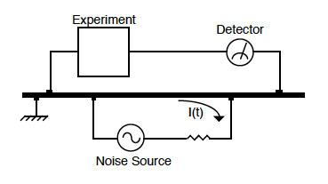
… and then there are ground loops (resistive coupling)
ground everything to the same SINGLE point
“V=0 at ground” is an electrostatics statement, it is not dynamically true
shielding ≠ ground
trial and error
don’t forget: 60Hz is *everywhere*
This is the
HARDEST
problem
Note that instruments are often poorly spec’d. Is the outer part of the BNC ground or not?
anything

Slide 64
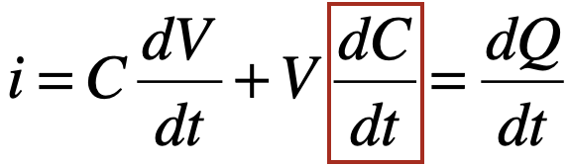
“other”
Microphonics
  touch nothing.
  deformation of coax ⇒ change C
  Yes, you can see this effect
Thermocouple effects
  choose your wire carefully
  Light ballasts put out weird frequencies.
  Switching mode power supplies are ghastly

