Slide 1
Process and measurement control
P. LeClair
PH 4/591 Fall 2022

Slide 2
General scheme
Monitoring of processes and operations
Control of processes and operations
Experimental engineering analysis

Slide 3
Monitoring
Sometimes we’re just watching
  Thermometer, barometer for weather
  Just indicate condition, no control function
Maybe you can’t control it
Maybe you aren’t sure you need to
  Recording just in case

Slide 4
Control
Measuring instrument serves as part of control system – e.g., sweep x and measure y
Clearly: to regulate a variable, must measure it
Feedback is at the heart. e.g., thermostat
Endless variety.
Distinction not always clear:
  Monitoring for one may be control for another
  Weather: we monitor, farmers use as control

Slide 5
Control (closed loop)
Disturbances
Input energy and/or material
Controlled
variable
Process
Final control element
Measuring instrument
Controller
Desired value of controlled variable

Slide 6
Experimental engineering analysis
“engineering” = “actually doing the thing”
Point is to solve a problem
Both theoretical and experimental problem-solving methods used in concert
Some general points follow

Slide 7
Theoretical methods
Results often for general rather than restricted case
Necessarily require simplifying assumptions: modeling is always different from reality
Math may be complicated ... numerical only
May require extensive computing but not lab space …
Smaller time delay associated compared to experiment
  (no setup/acquisition/etc)

Slide 8
Experimental models
Often specific to system under study (generalization possible but limited)
No simplifying assumptions needed – can run on actual system
Require accurate measurements – can be expensive or complicated …
Actual system or scale model required
Considerable time required to design/build/debug

Slide 9
Types of experimental-analysis problems
Test validity of a theoretical prediction
Formulate generalized empirical relationship where good theory does not exist (e.g. fluids)
Determination of parameters for material, component, or system (e.g., efficiency)
Study of phenomena to help develop theory
Solution of equations by analogy (e.g., solid state gravitation analogues)

Slide 10
Description of Instruments
Describe generally the operation and performance without reference to specific hardware
Operation in terms of functional elements
Performance in terms of static & dynamic characteristics
Recurring themes → generalization
No single way to do it

Slide 11
Possible arrangement of elements
Possible arrangement of functional elements in an instrument
Includes all necessary for basic function
Data storage & playback
Presented data
Measured medium
Observer
Primary sensing
Variable-conversion
Variable manipulation
Data transmission
Data presentation
Measured
quantity

Slide 12
Primary sensing element
1st to receive energy from measured medium
Output depending in some way on measured quantity
Always extracts energy from medium
  Ideal measurement not possible
Data storage & playback
Presented data
Measured medium
Observer
Primary sensing
Variable-conversion
Variable manipulation
Data transmission
Data presentation
Measured
quantity

Slide 13
Variable conversion element
May need to convert output of primary sensor
E.g., I to V, V to f, x to V
This is an abstraction – a physical instrument or module might have multiple functions in one
Data storage & playback
Presented data
Measured medium
Observer
Primary sensing
Variable-conversion
Variable manipulation
Data transmission
Data presentation
Measured
quantity

Slide 14
Variable manipulation element
May need manipulation of output, e.g., size
For example: amplifier
May go before or after conversion element (or both)
Data storage & playback
Presented data
Measured medium
Observer
Primary sensing
Variable-conversion
Variable manipulation
Data transmission
Data presentation
Measured
quantity

Slide 15
Data transmission/ storage / presentation
Transmission: functional elements may be physically separated
Anything from a rotating shaft to satellite telemetry
Presentation: make human readable
Data storage & playback
Presented data
Measured medium
Observer
Primary sensing
Variable-conversion
Variable manipulation
Data transmission
Data presentation
Measured
quantity

Slide 16
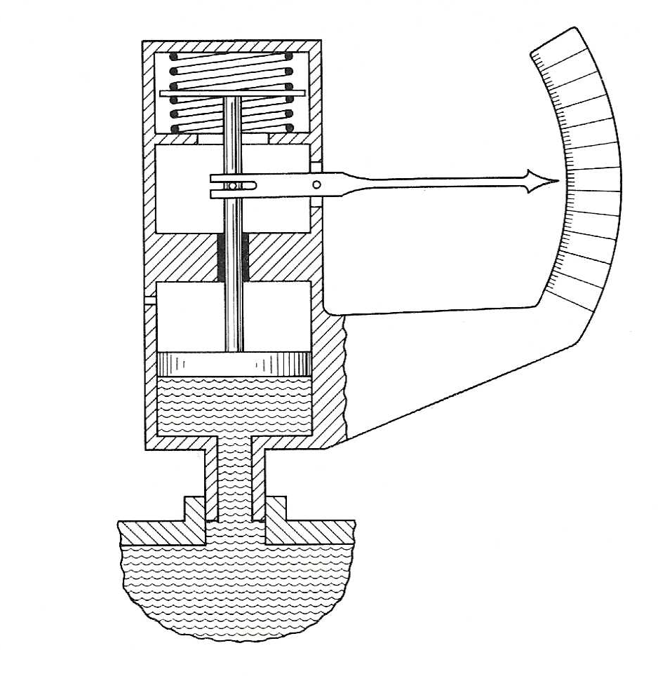
Example: spring pressure gauge
Could transmit pressure with a small tube
Fluid
Piston
Piston
rod
Pointer and scale
Spring
Linkage
Measured medium
Observer
Primary sensing
Variable-conversion
Data transmission
Variable manipulation
Variable manipulation
Data presentation
Measured
quantity
force
force
motion
motion
Presented data
Schematic: Doebelin

Slide 17
Methods for correcting interfering & modifying inputs
Output component due to
interfering input and i_{M}
Interfering input
F_{I}
i_{I}
+
Modifying input
F_{M,I}
o
i_{M}
F_{M,D}
+
Output
Desired input
i_{D}
F_{D}
Output component due to
desired input and i_{M}

Slide 18
Inputs
Desired inputs – quantities instrument is intended to measure
Interfering inputs – quantities it is unintentionally sensitive to
F = function that maps input to output
  Could just be a constant gain multiplier K
  Could be statistical. Could be complicated!
Modifying inputs – cause a change of input/output relationship. E.g., F_{M,I} = how i_{M} affects F_{I}
Add all contributions to create actual output

Slide 19
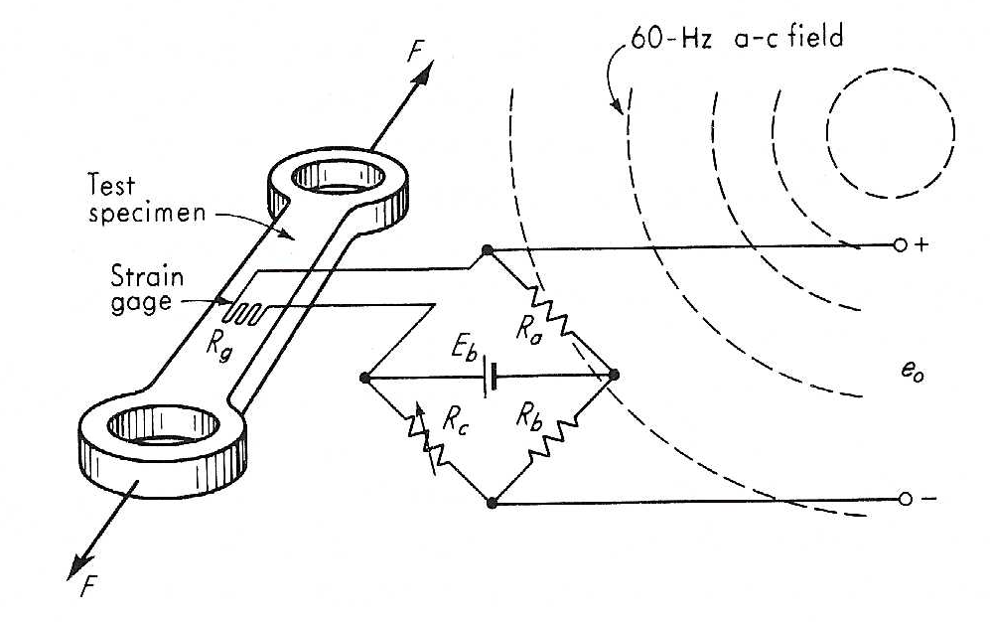

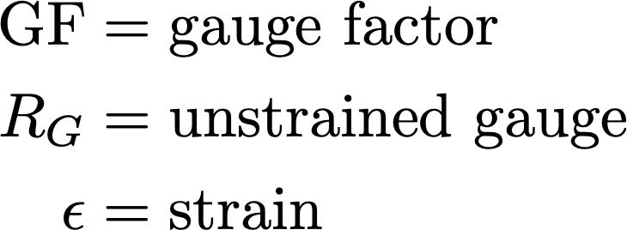
Strain gauge
Ideal gauge characteristic: change in R prop to strain
Image: Doebelin

Slide 20
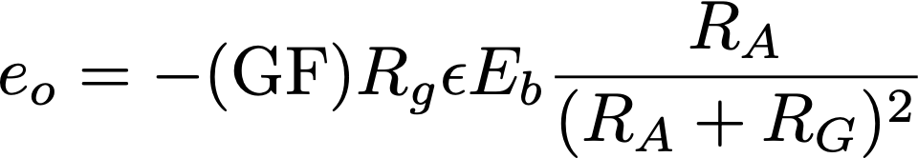
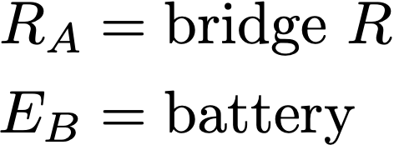
Strain gauge
Put in bridge configuration
Image: Doebelin

Slide 21
Issues
Interference: 60Hz field – pickup in loops!
Gauge temperature modifies R_{G}
Differential thermal expansion of gauge and specimen
Battery voltage changes and fluctuations
How to correct for or minimize these things?
  General idea leads us to feedback and control schemes

Slide 22
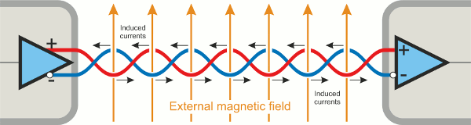
Inherent sensitivity method
Duh: make the measurement only sensitive to what you want and not other things
Make F_{I} and/or F_{M,D} as near zero as possible
  So even if i_{I} and i_{M} exist they don’t affect output
Low thermal coefficient of R for gauge
Small thermal expansion coefficient
Twisted pair wiring / shielding to nullify 60Hz pickup
https://www.guralp.com/howtos/differential-v-single-ended.shtml

Slide 23
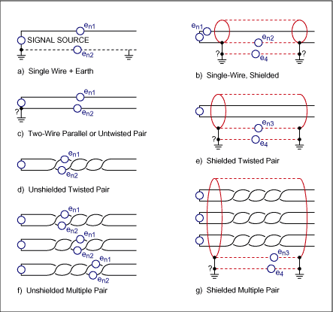
Common mode signals – shielding is also key
Individual pairs can also have common pickup
Common mode signals hard to get rid of
https://www.maximintegrated.com/en/design/technical-documents/tutorials/2/2045.html

Slide 24
Method of high-gain feedback
Measure voltage e_{i} by feeding it to a motor whose torque is applied to a spring -> displacement x_{o}.
Open-loop system (don’t monitor output, just run)
  This is what we generally seek to avoid.
All modifying inputs (i_{M}’s) seen in output
Errors in direct proportion to gain of each element

Slide 25

Open-loop system
Voltage to measure – applied to motor, torque causes spring to compress, which moves an indicator
i_{M,1}
i_{M,2}
F_{M,D,1}
F_{M,D,2}
Voltage
Torque
Displacement
K_{Mo}
K_{Sp}
e_{i}
x_{o}
Motor
Spring
Think about error propagation …

Slide 26

Closed-loop system
Amplify original signal – draw less from medium
Feed part of output back to input as a difference
Output swings push back on themselves!
i_{M,3}
i_{M,1}
i_{M,2}
F_{M,D,3}
F_{M,D,1}
F_{M,D,2}
e_{i}
+
x_{o}
K_{Am}
K_{Mo}
K_{Sp}
-
Amplifier
Motor
Spring
e_{o}
Constant gain on feedback:
Feedback Device
K_{FB}
F_{M,D,4}
i_{M,4}

Slide 27
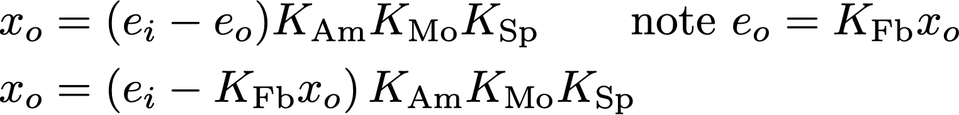
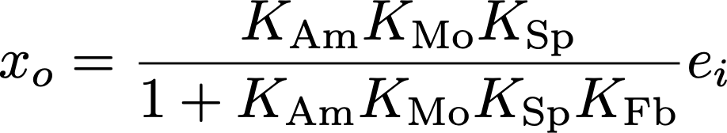
Closed-loop system
Check the math … what is different?
Output depends on itself … rearrange
So what? Output still linear in input signal at least …

Slide 28
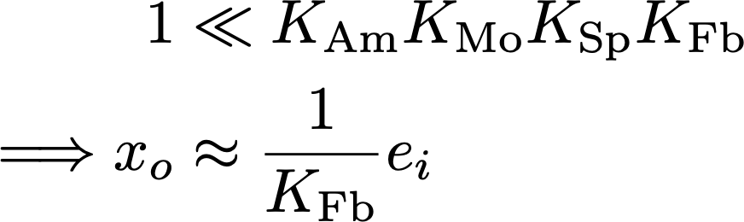
Method of high-gain feedback
Make K_{Am} very large, such that
Now only feedback shows up – only it needs to be constant and unaffected by i_{M4}. Easier!
Feedback is key, not the gain being especially large

Slide 29
Method of high-gain feedback
Amp supplies most of the power, so feedback can work with low power
  Better accuracy and linearity, easier
Feedback can use tiny signals so influence on medium is much less than open-loop
Open loop is susceptible to all spurious inputs for all blocks, but all can be negated at once with high amplification and stable, accurate feedback
Familiar if you’ve used op-amps or transistors

Slide 30
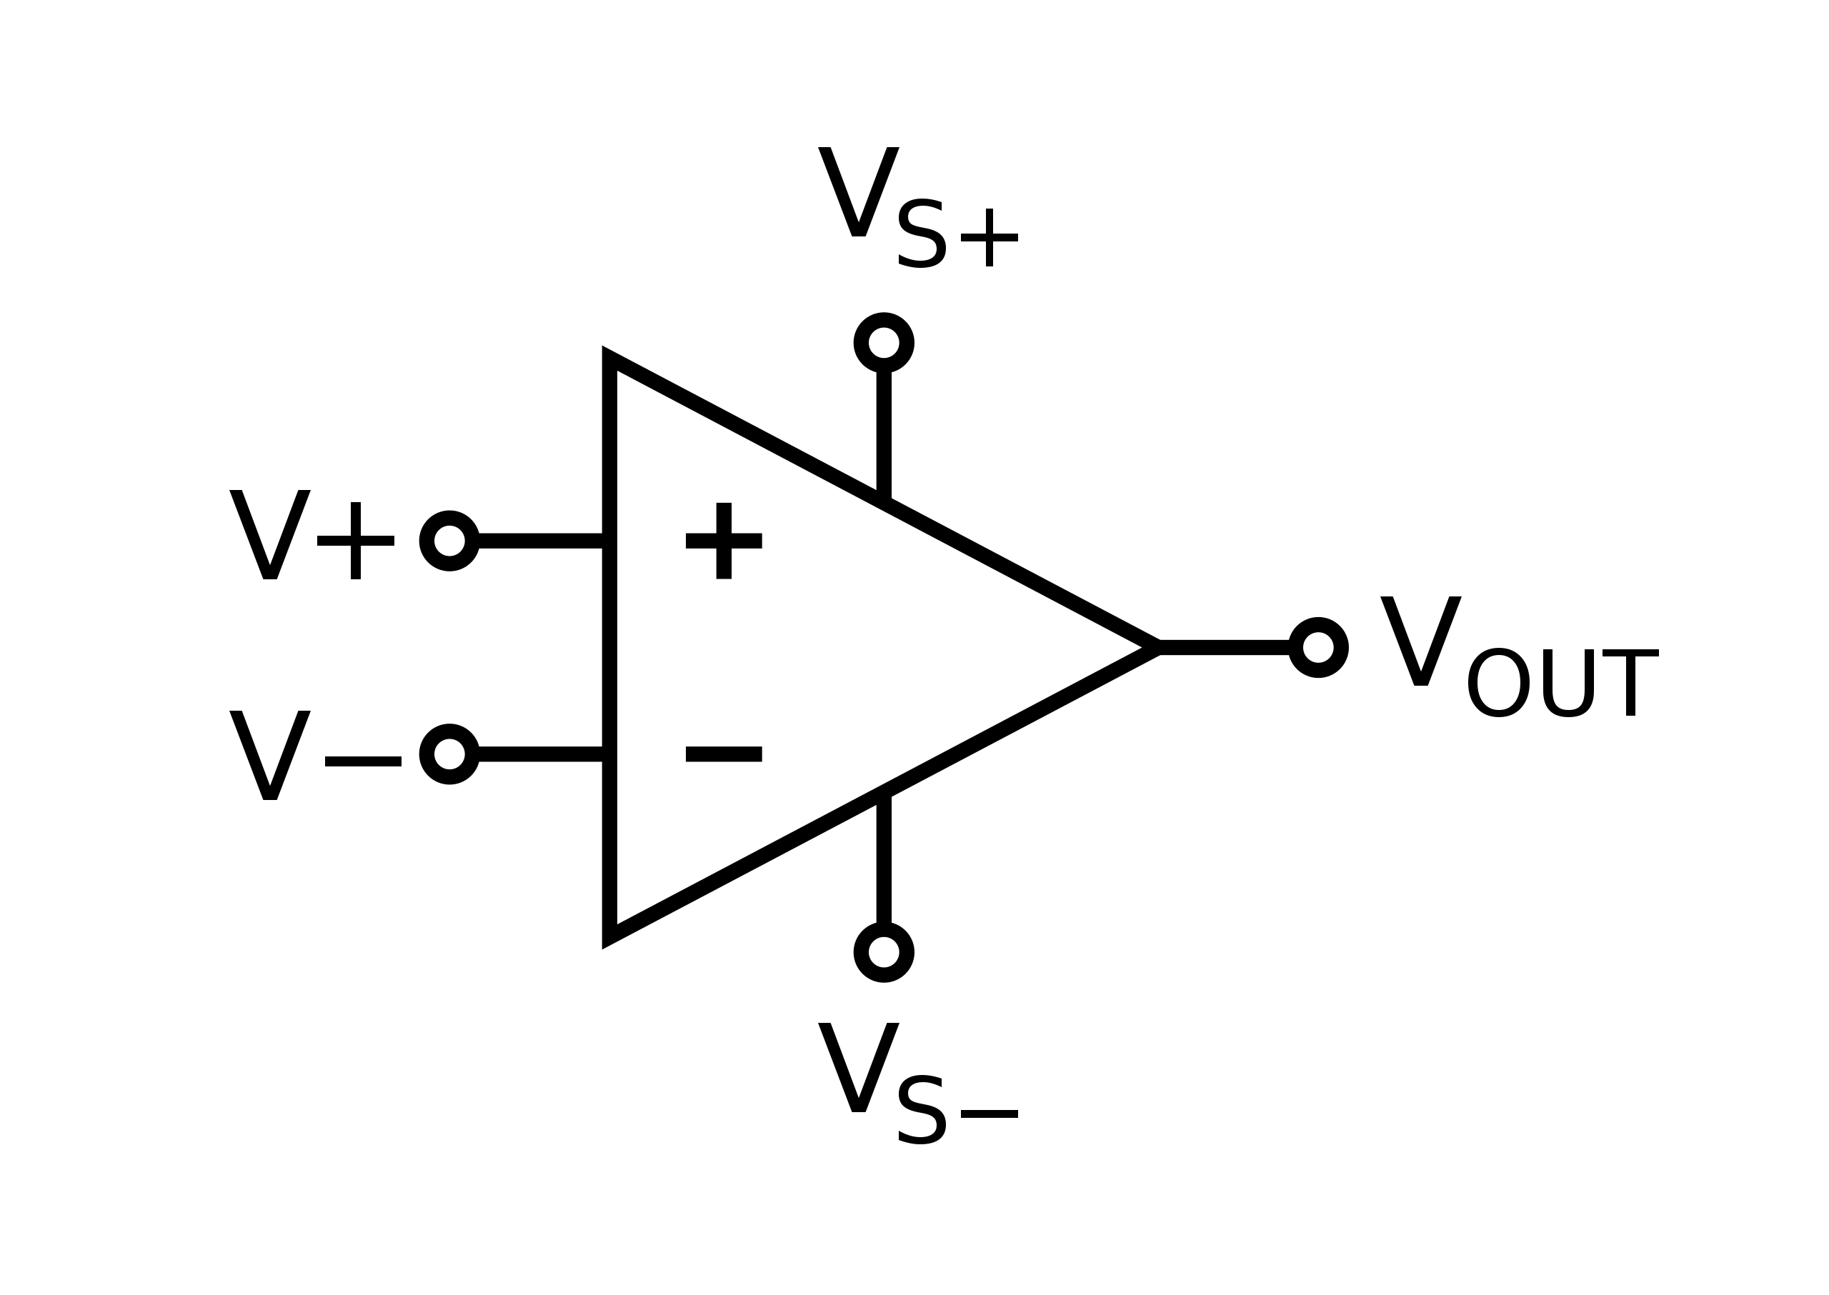

Feedback example
Operational amplifier (“op amp”)
Rules:
  Does what it must to keep V₊=V₋
  V₊ and V₋ inputs draw no current
  Output limited by V_{s}+/-
  Open loop gain A_{OL} huge (> 10⁵)
  Too large to be useful (or stable)
  Would just swing between +/- V_{s}
https://commons.wikimedia.org/wiki/File:Op-amp_symbol.svg#/media/File:Op-amp_symbol.svg

Slide 31
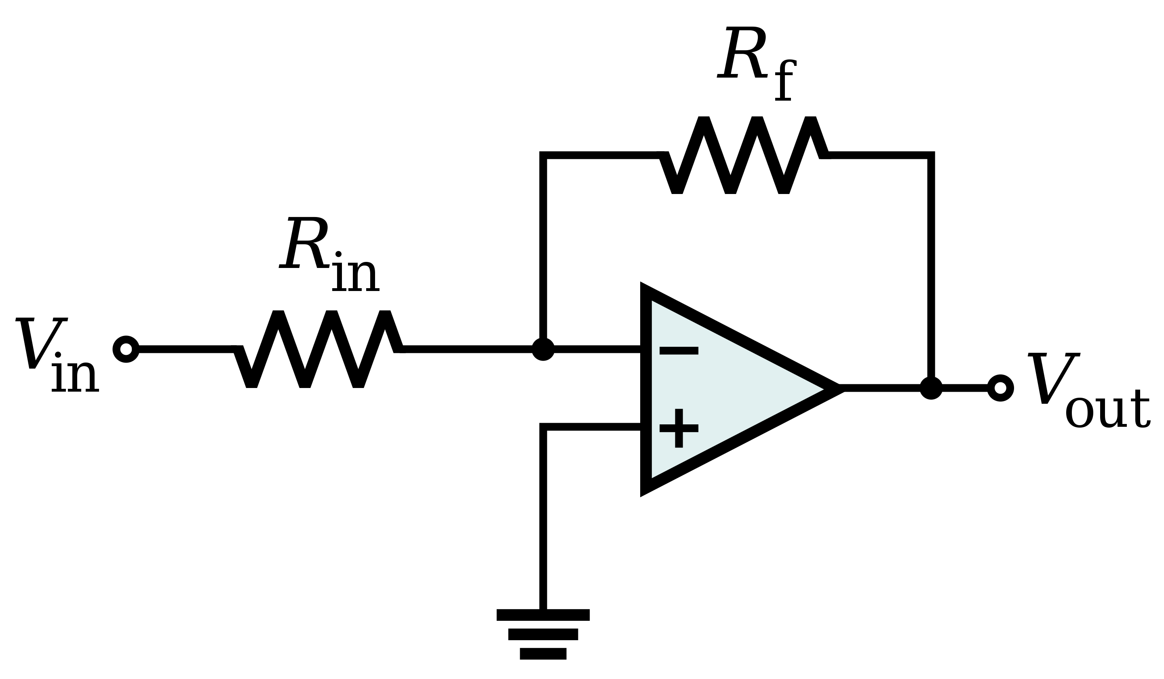
Feedback example
Op amp – inverting amp
Add feedback and close loop
Lowers gain but predictable and stable
V₊ is at ground, so must be V₋
- input draws no current
Current due to V_{in} across R_{in} must be same as current due to V_{out} across R_{f}, but in opposite direction!
https://commons.wikimedia.org/wiki/File:Op-Amp_Inverting_Amplifier.svg#/media/File:Op-Amp_Inverting_Amplifier.svg

Slide 32
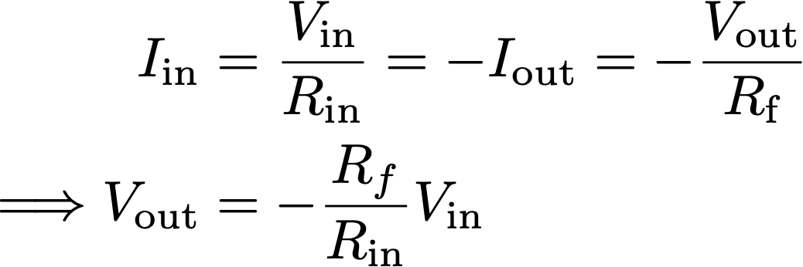
Feedback example
Output is inverted, with gain of R_{f}/R_{in}!
Open-loop gain of op-amp is irrelevant
Amp is easily swapped with another, not sensitive to gain fluctuations
https://commons.wikimedia.org/wiki/File:Op-Amp_Inverting_Amplifier.svg#/media/File:Op-Amp_Inverting_Amplifier.svg

Slide 33
Noise
Noise source
N_{s}
e_{i}
e_{o}
G
Open loop: e_{o} = G(e_{i}+N_{s})
Noise alone: set e_{i}=0, N_{o} = N_{s}G
Noise is amplified, as expected
Signal to noise ratio in = SNR_{i} = e_{i}/N_{s}
Signal to noise ratio out = SNR_{o} = e_{o}/N_{o} = 1 + e_{i}/N_{s}
SNR improved; use a low noise amp!
But … large power gain & low noise are not often compatible.
Two stage solution: low noise preamp, then high power amp
  Low noise and very high amplification not always possible either

Slide 34
Noise: dual amp - low gain low noise stage 1
Still open loop: e_{o} = G_{a}G_{b}e_{i} presume amp a has minimal noise
Noise alone: set e_{i}=0, N_{o} = N_{s}G_{b}
Noise is amplified by 2nd stage, as expected
Signal to noise ratio out = SNR_{o} = e_{o}/N_{o} = G_{a}e_{i}/N_{o} =G_{a} SNR_{i}
Better SNR, as expected – just need 2 amps
Noise source
N_{s}
e_{i}
e_{o}
Ga
Gb
amp a
Low noise
amp b
High power
High gain

Slide 35
Noise in feedback systems
Closed loop:
Noise alone:
Again, amp a helps
G_{f}G_{a}G_{b} >>1 ?
N_{o} ~ N_{s}/G_{f}G_{a} !
very strong noise reduction!
Better SNR and retain benefits of feedback
Low-noise amp should be first and ASAP in signal chain
Noise source
N_{s}
e_{i}
+
e_{o}
G_{a}
G_{b}
e_{o}
-
amp a
amp b
e_{o}
Feedback Device
G_{f}

Slide 36
Filtering
What it sounds like. On input or output (or both)
Consider signal as having many frequency components, squash the ones you don’t want
E.g., equalizer -> tweeter/woofer
Filter
i_{I}
i_{I}’
Zero
F_{I}
On input or output
Input filtering shown
Filter
+
i_{M}
i_{M}’
F_{M,I}
Zero
F_{M,D}
+
Output
i_{D}
F_{D}

Slide 37
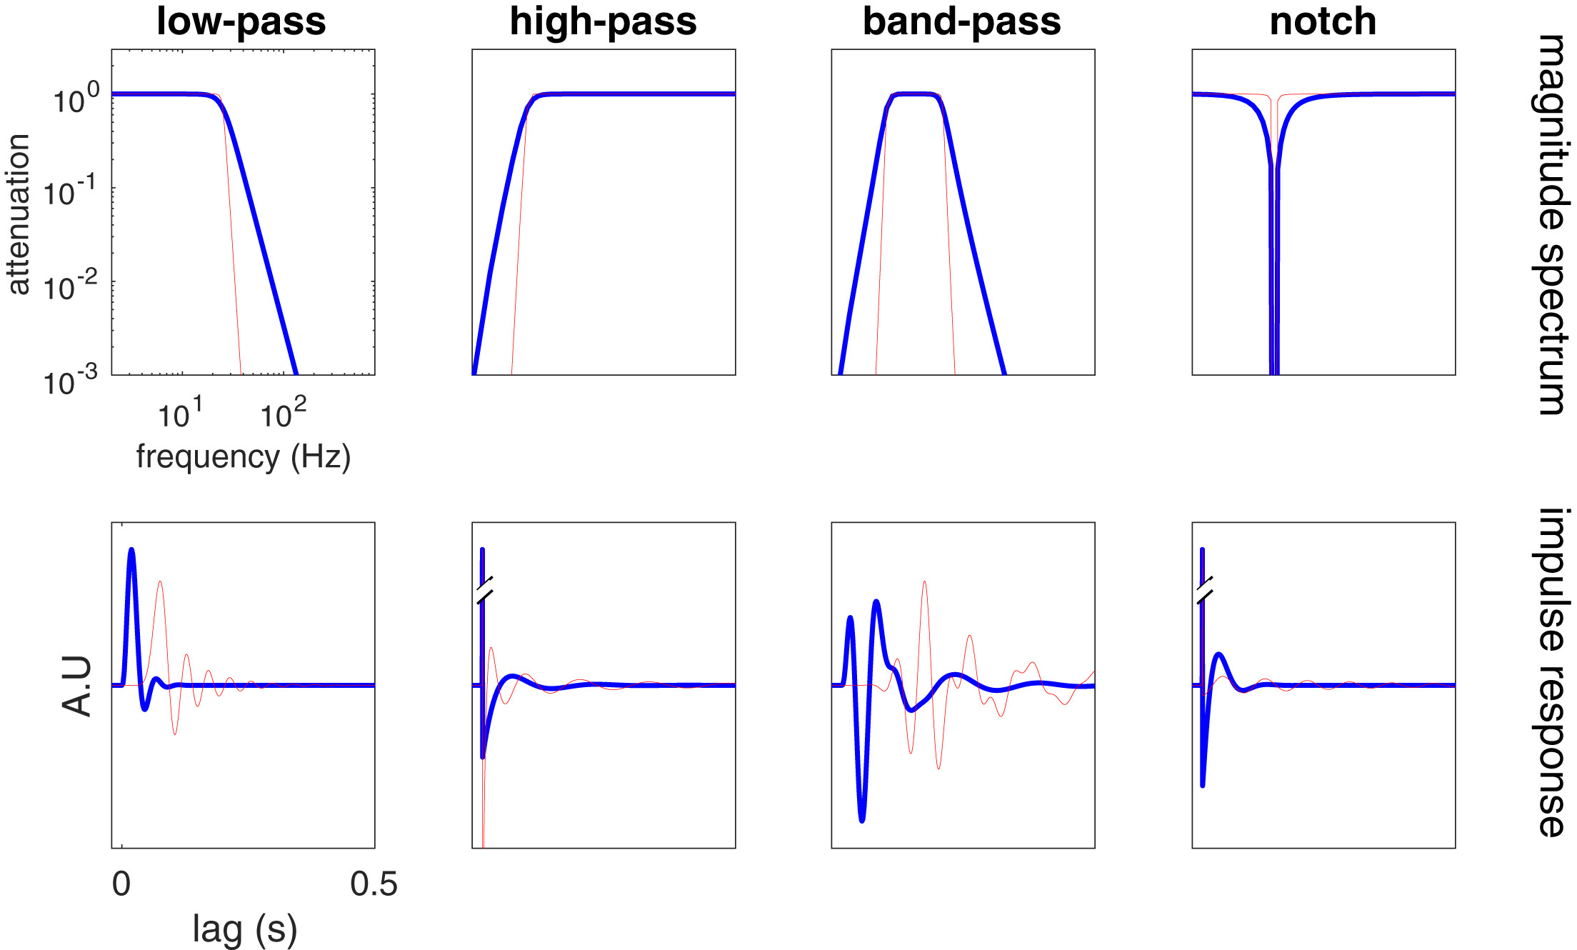
Filtering
Can be electrical, mechanical, optical, etc.
Image: https://doi.org/10.1016/j.neuron.2019.02.039

Slide 38
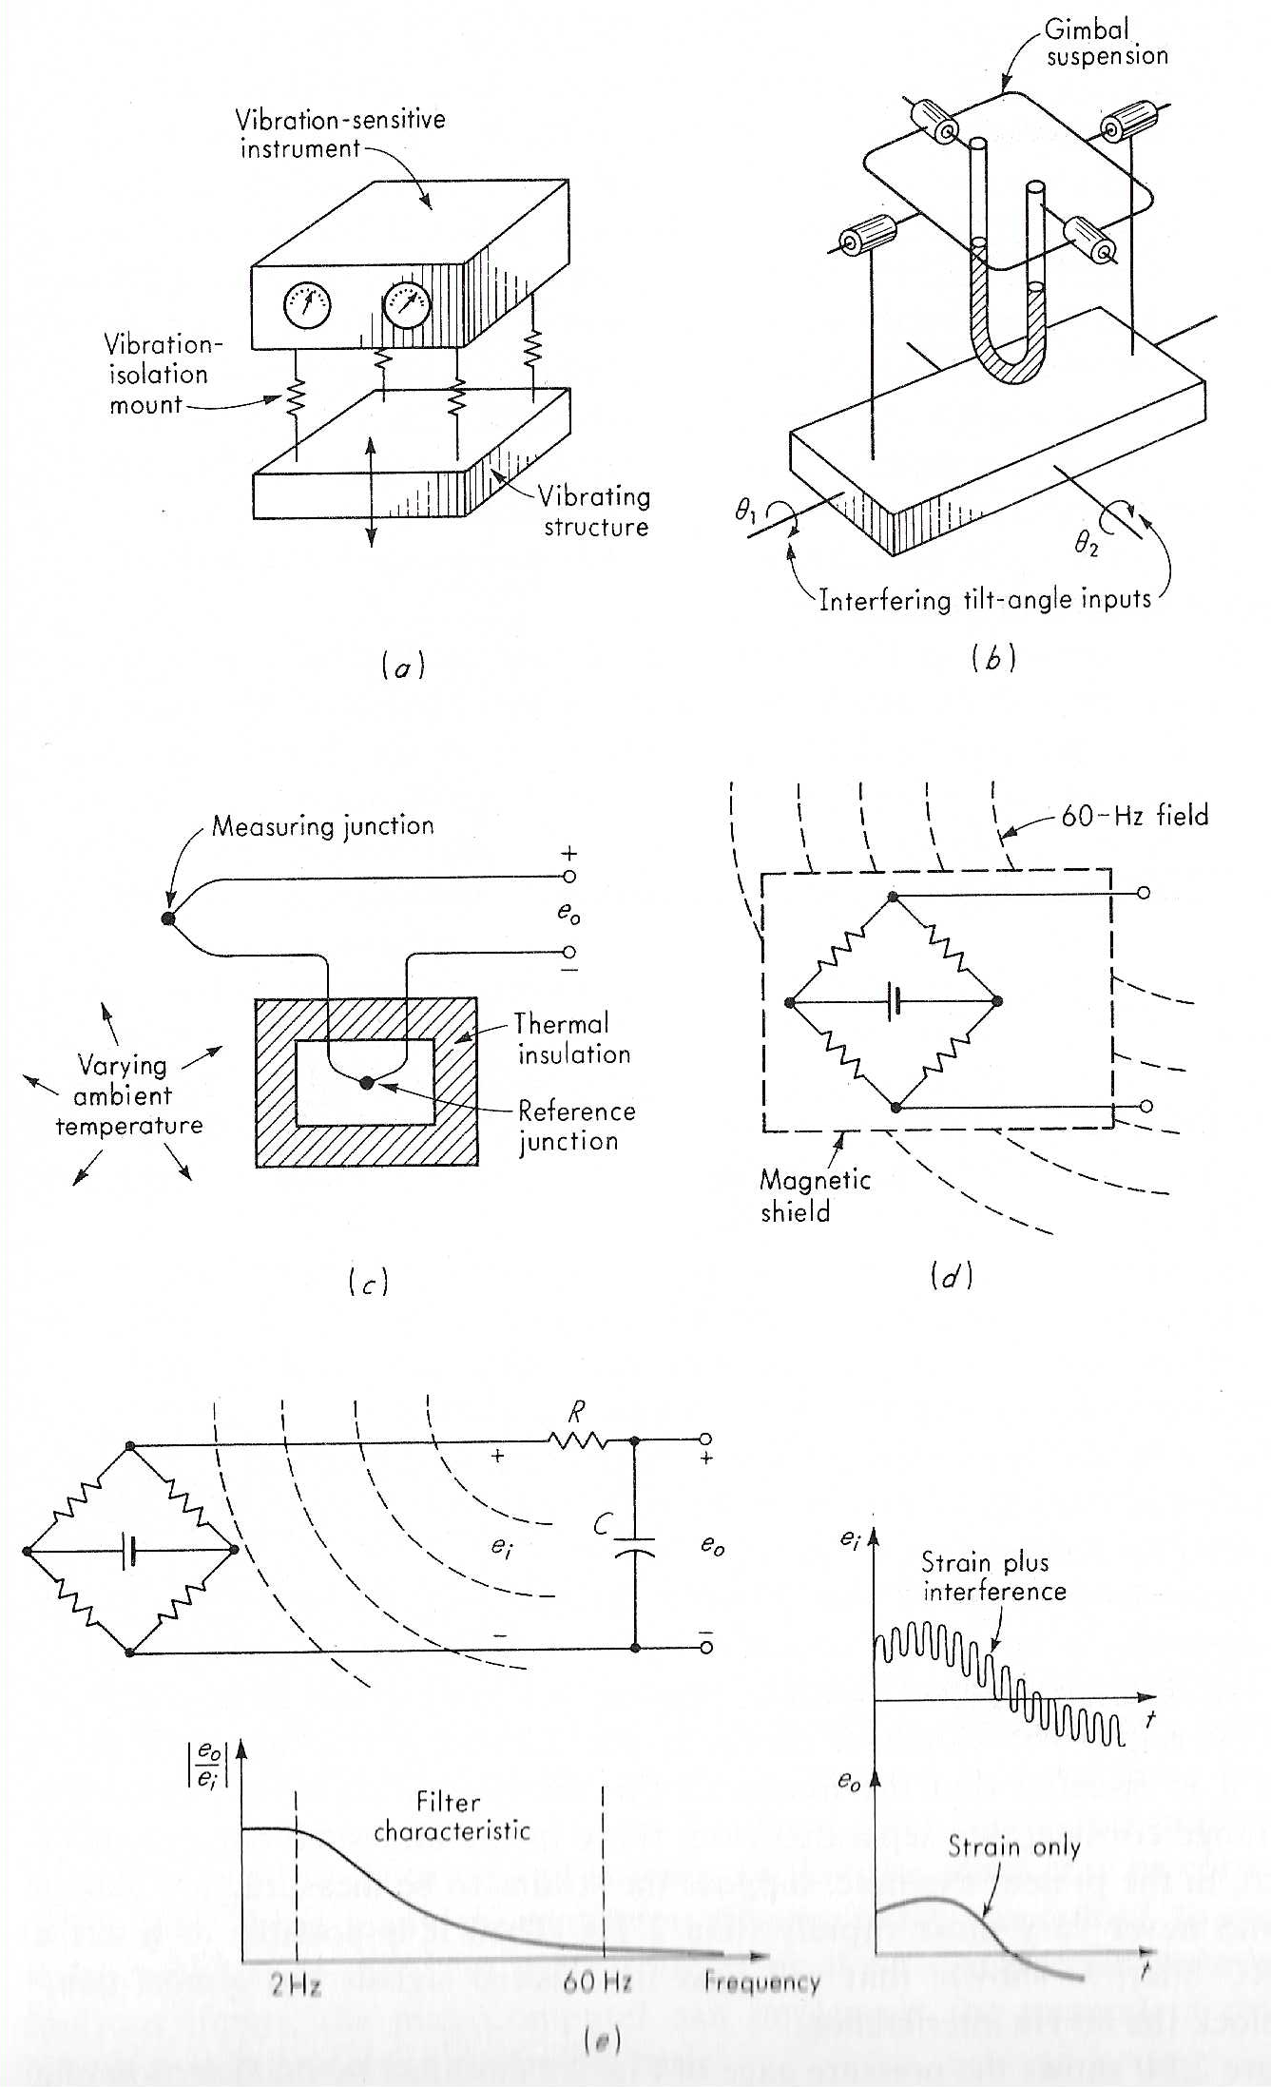
Examples
Mechanical: spring only couples a portion of vibration
Tilt angle filter: gimbal so tube always hangs vertical
Thermal isolation: nullify changes not due to T
Magnetic shield – no pickup
Image: Doebelin

Slide 39
Passive RC output filter
Low-pass filter to attenuate 60 Hz pickup
Would want this before amplifier most of the time
  (why?)
Image: Doebelin

Slide 40
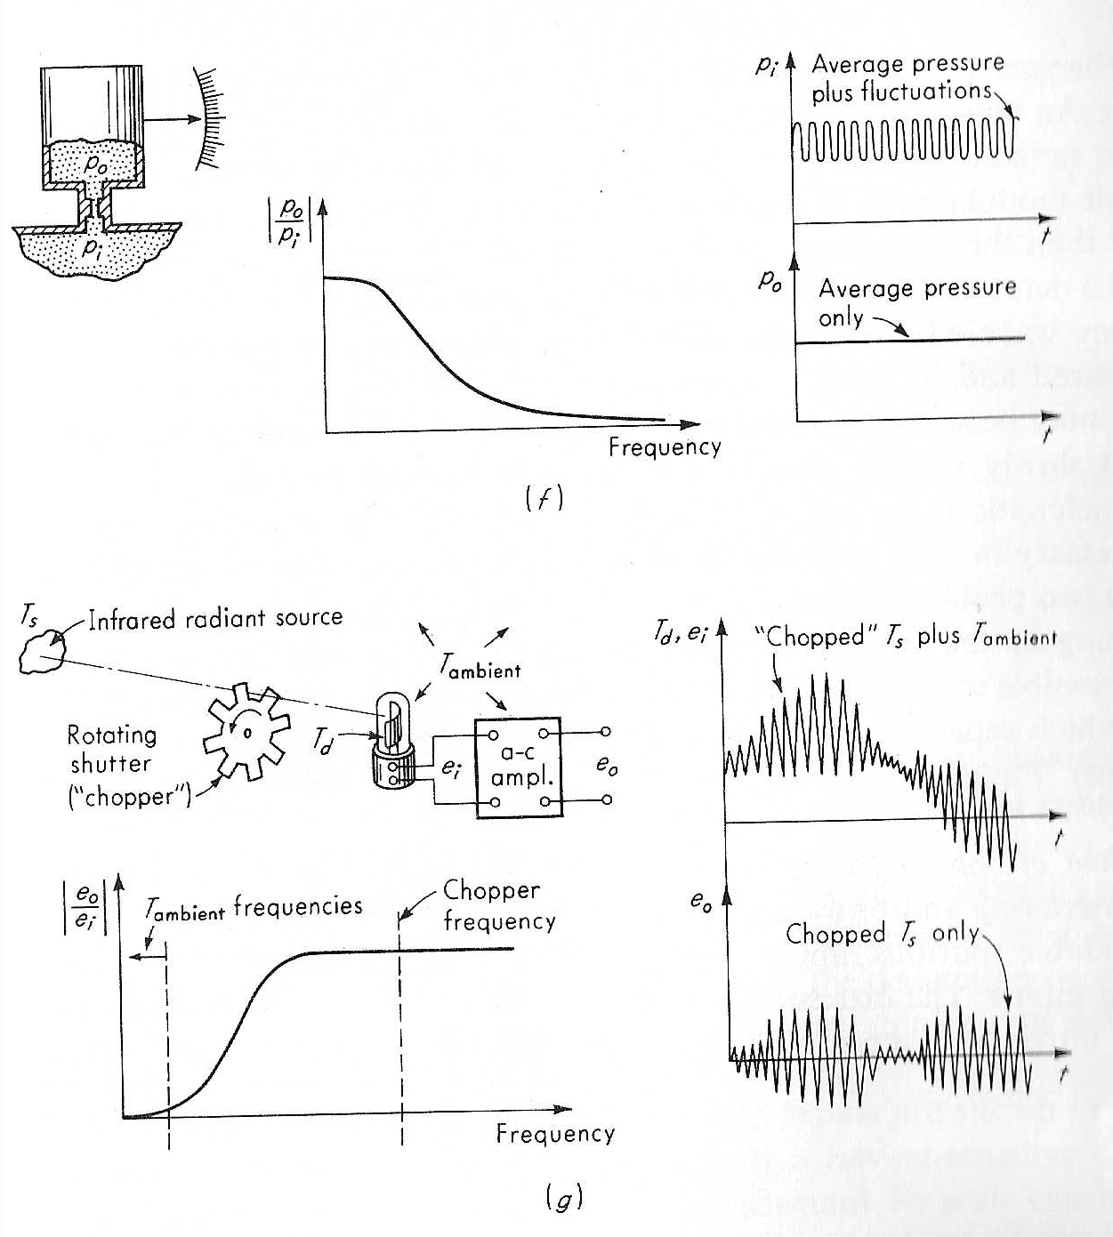
Pneumatic filter
Restriction = pneumatic filter (low pass)
  Like RC filter in previous; only low freq. couple
Image: Doebelin

Slide 41
Chopper
Modulate to shift measurement to less noisy frequency range and reduce bandwidth (LED blinking expt.)
Modulate faster than drift.
What are the odds anything moves at this frequency?
Basis for lock-in amplifier - later
Image: Doebelin

Slide 42
Method of opposing inputs
Like active noise cancellation: if you can’t avoid the modifying input, sample it and add back out of phase
Unavoidably interfering input
Essentially
zero
o_{I1}
i_{I1}
F_{I1}
+
Intentionally introduced interfering input
-
o_{I2} - o_{I2}
i_{I2}
F_{I2}
Idea clear for many decades, having signal processing hardware able to do it effectively and cheaply is another thing
Patent 1936. Commercial: 1980s
o_{I2}
+
o
Desired input
o_{D}
+
i_{D}
F_{D}
Output

Slide 43
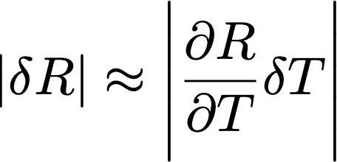
Process control (PID)
Say you want to measure resistance vs temperature
You have a sample heater to control temperature
How do you do it? Closed-loop, but details
  How to ramp power to approach set point?
  Does overshoot matter (hysteresis)?
  Speed vs accuracy tradeoffs
How well you control process variable impacts the measurement of interest ...

Slide 44
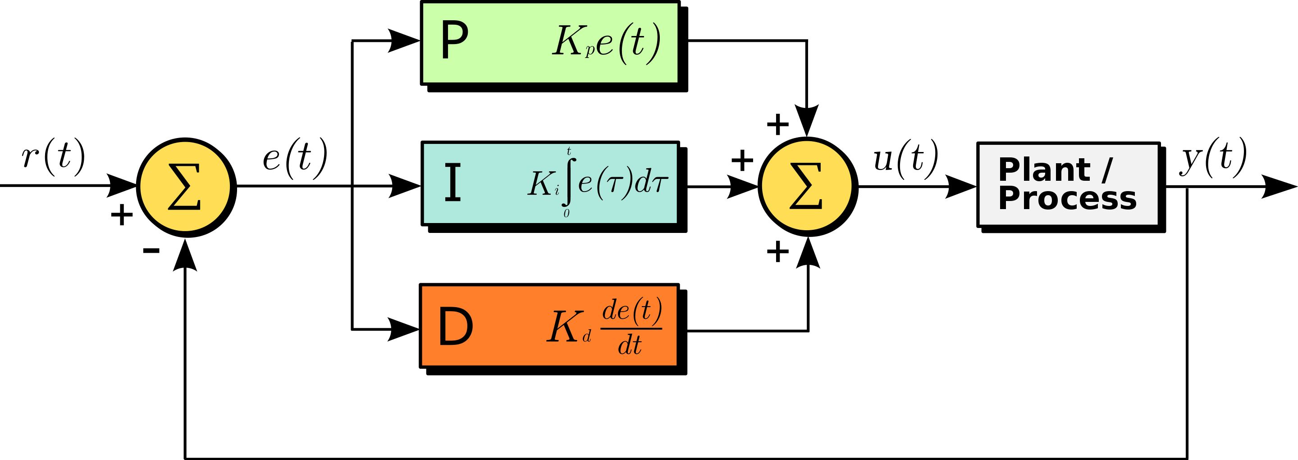
PID
Control process variable (PV) in comparison to setpoint (SP)
Error value e(t) is the difference, used to correct – closed loop
SP = desired = r(t), PV = actual output = y(t)
SP-PV = error = e(t), control function = u(t)
Image: http://commons.wikimedia.org/wiki/File:PID.svg

Slide 45


Proportional
Control signal has 3 terms in response to error
P term = proportional
  Proportional to (SP-PV) via gain factor K_{P}
  Like closed-loop example earlier
  Large (+) error => large (+) output
  Using P alone generally results in an error, because it requires an error to respond! No error, no response
  Does not account for nature of the deviation
  Sometimes P alone is enough
    (or even less than this: “bang-bang” controller = only on/off)
    (e.g., pulse width modulation)

Slide 46
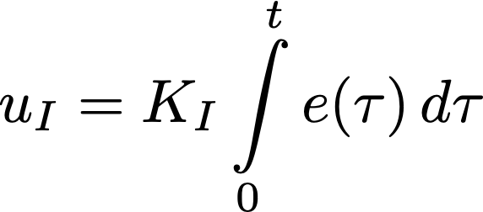
Integral
I term = integral
Integrates difference signal e(t) over time to respond
Eliminate offset / residual error
Historic accumulation matters
As error ↓ P is less effective … but I effect grows
Time scale: oscillations faster than 1/t don’t show up
Too high: overshoot at small e, leading to oscillation
General: feedback too high can lead to instability

Slide 47
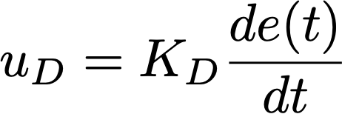
You guessed it, Derivative
Based on current rate of change
“anticipatory” control; damping
Correct for approaching SP too quickly/slowly
Basically, a damping/viscosity term
Purely derivative control cannot bring to SP – not sensitive to actual value of PV

Slide 48
PID control
Tuning: find the K values to optimize response
  Always some trial and error – change SP and observe
  What do you mean by “optimum” …
  Rise vs settling time, overshoot, max dev?
Control action – as shown = “direct action”
  i.e., 100% error => 100% control signal
  Can be reverse action, e.g., valve 100/0% => 0/100%
Some applications need only 1 or 2 terms
  Natural damping/time constant of system
  Not D alone – sensitive to noise
  Need I to settle at longer times

Slide 49
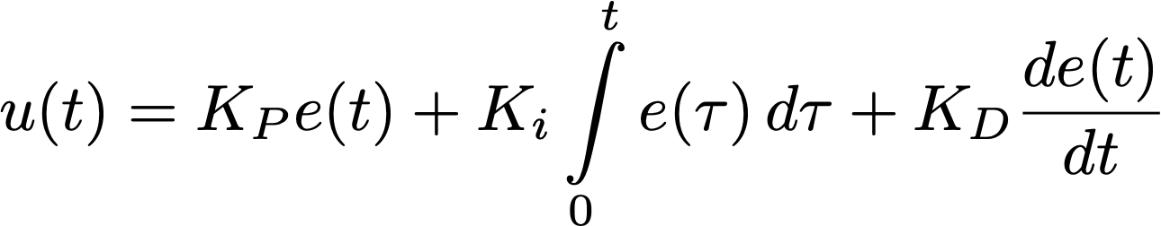
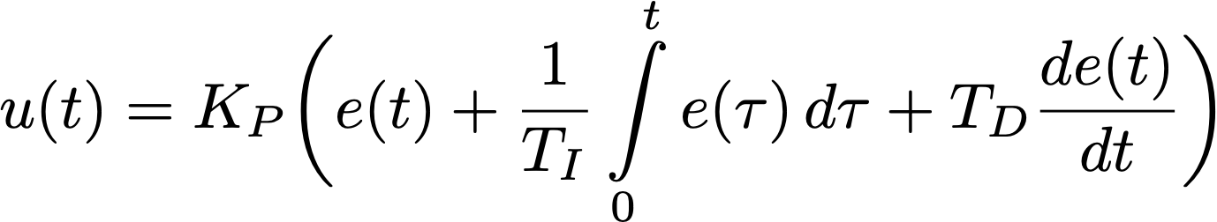
Math
Overall control function:
K’s are all non-negative (but can be zero)
Standard form, making timing explicit:
T_{I} = how long you tolerate begin above/below SP … low-pass
T_{D} = time with which controller attempts to approach SP … high-pass

Slide 50
Control loop example: robotic arm
Can be moved and positioned by a control loop.
An electric motor lifts or lowers it based on power input
But: motor power can’t be a simple function of position due to mass of arm & forces on it (and need to be gentle!)
The sensed position is the process variable (PV).
The desired position is called the setpoint (SP).
The difference between the PV and SP is the error (e) – is the arm too low or too high & by how much.
The input to the process (motor current) is the output from the PID controller. Called manipulated variable (MV) or the control variable (CV).
By measuring the position (PV), and subtracting it from the setpoint (SP), the error (e) is found, and from it the controller calculates how much electric current to supply to the motor (MV).
https://en.wikipedia.org/wiki/PID_controller#Control_loop_example

Slide 51
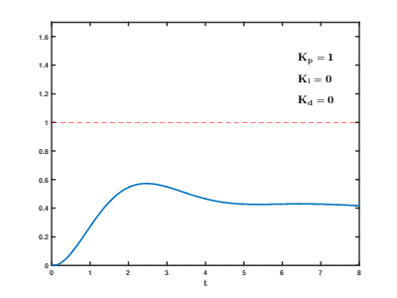
Effect of P,I,D on step response
At t=0, step change of input from 0 to 1
P increases the speed of the system, decreases the residual steady state error but cannot eliminate it
I eliminates the residual error but adds oscillations/overshoot
D “damps out” the undesired oscillations in the transient response.
GIF: https://en.wikipedia.org/wiki/PID_controller#/media/File:PID_Compensation_Animated.gif

Slide 52
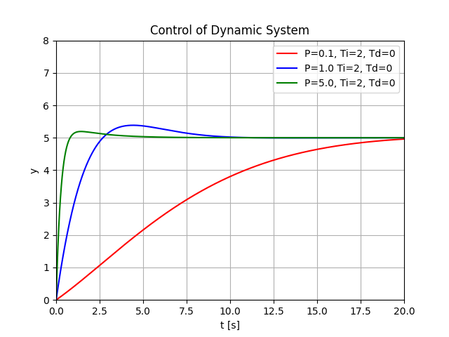
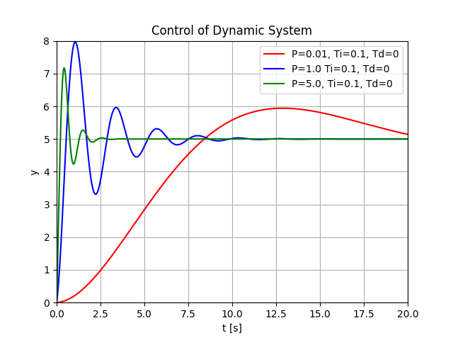
P alone (fix I, D)
Red: near critical damping (but slow)
Blue, green: P too high, overshoot
(but faster settle)
All curves: I too low, system tends to oscillation – always overshoots
(but fast settle if P high enough)
Increase P: rise time less, overshoot more; settling time similar; degrades stability …
Ask about the python code! Based on https://www.halvorsen.blog/documents/programming/python/resources/powerpoints/Python%20for%20Control%20Engineering.pdf

Slide 53
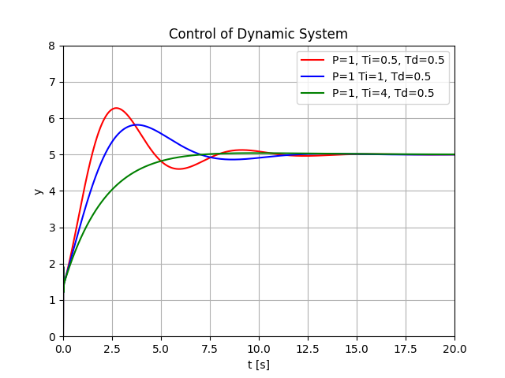
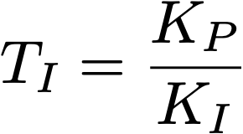
I alone (fix P, D)
Green: near critical damping
Red, green: integral gain too high, oscillates (integration time too low compared to oscillation period)
Increase I / decrease T_{I}: faster rise but more oscillation/overshoot
- like a low-pass filter

Slide 54
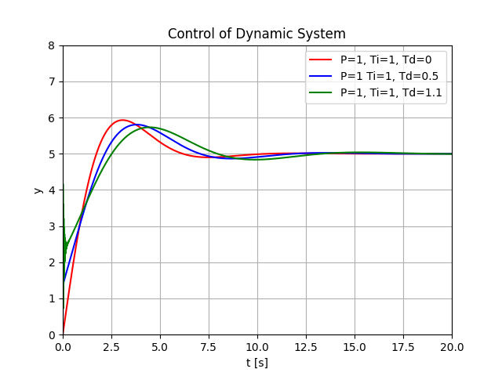
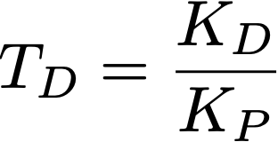
D alone (fix P, I)
Adding derivative helps, but clearly P/I are not tuned well
Increase D / increase T_{D}: damp oscillation, decrease overshoot, similar rise time.
Small Kd can improve stability … but high frequency noise is a problem
https://commons.wikimedia.org/wiki/File:Change_with_Kd.png#/media/File:Change_with_Kd.png

Slide 55
PID
High P gain can lead to instability, but low P can make system unresponsive – action may be too small to respond to a disturbance
Best practice: bulk of response should be P
I can cause overshoot, but gets rid of offset from P alone
D term tries to predict behavior and improve settling time and stability. Often also needs low-pass filtering to limit susceptibility to high frequency noise
D is more seldom in practice – often P or PI alone. Actual behavior tough and impact on stability is tricky.

Slide 56
PID
Doesn’t guarantee optimal control or control stability
  E.g., measurement of PV delayed, action too slow
  May need additional meas. or revise action
May be embedded in measurement loop
  E.g. PID to set T, only proceed when within tolerance
There is an open-loop way to do this – feed forward
  Control changes based on modeling rather than output
Can cascade – inner / outer or fast / slow combos
  E.g., cryogenics – may monitor several temperatures
  Gradient to outside also informs control

Slide 57
Tuning
You want system critically damped – smooth decay to SP with no oscillation
Modern systems have autotuning features
Can do it manually, but not fun
Effects of increasing a parameter independently
Parameter | Rise time | Overshoot | Settling time | Steady-state error | Stability
K_{p} | Decrease | Increase | Small change | Decrease | Degrade
K_{i} | Decrease | Increase | Increase | Eliminate | Degrade
K_{d} | Minor change | Decrease | Decrease | No effect in theory | Improve if Kd small
Table:wikipedia/PID

Slide 58
Tuning
Somewhat more clever: Ziegler–Nichols method
Set K_{I} and K_{D} gains to zero.
Increase K_{P} until it reaches ultimate gain K_{u} and loop output starts to oscillate constantly.
K_{u} and oscillation period T_{u} are used to set the gains:
Control Type | K_{p} | K_{i} | K_{d}
P | 0.50K_{u} | — | —
PI | 0.45K_{u} | 0.54K_{u}/T_{u} | —
PID | 0.60K_{u} | 1.2K_{u}/T_{u} | 3K_{u}T_{u}/40
Table:wikipedia/PID

Slide 59
references
“Measurement Systems: application and design”, Ernest O. Doebelin
https://en.wikipedia.org/wiki/PID_controller
https://en.wikipedia.org/wiki/Operational_amplifier
https://en.wikipedia.org/wiki/Operational_amplifier_applications
http://brettbeauregard.com/blog/2011/04/improving-the-beginners-pid-introduction/
Alain de Cheveigné, Israel Nelken, “Filters: When, Why, and How (Not) to Use Them”, Neuron 102, 280-293 (2019). https://doi.org/10.1016/j.neuron.2019.02.039.
https://www.halvorsen.blog/documents/programming/python/resources/powerpoints/Python%20for%20Control%20Engineering.pdf
https://www.allaboutcircuits.com/technical-articles/negative-feedback-part-3-improving-noise-linearity-and-impedance/

